Slide 1
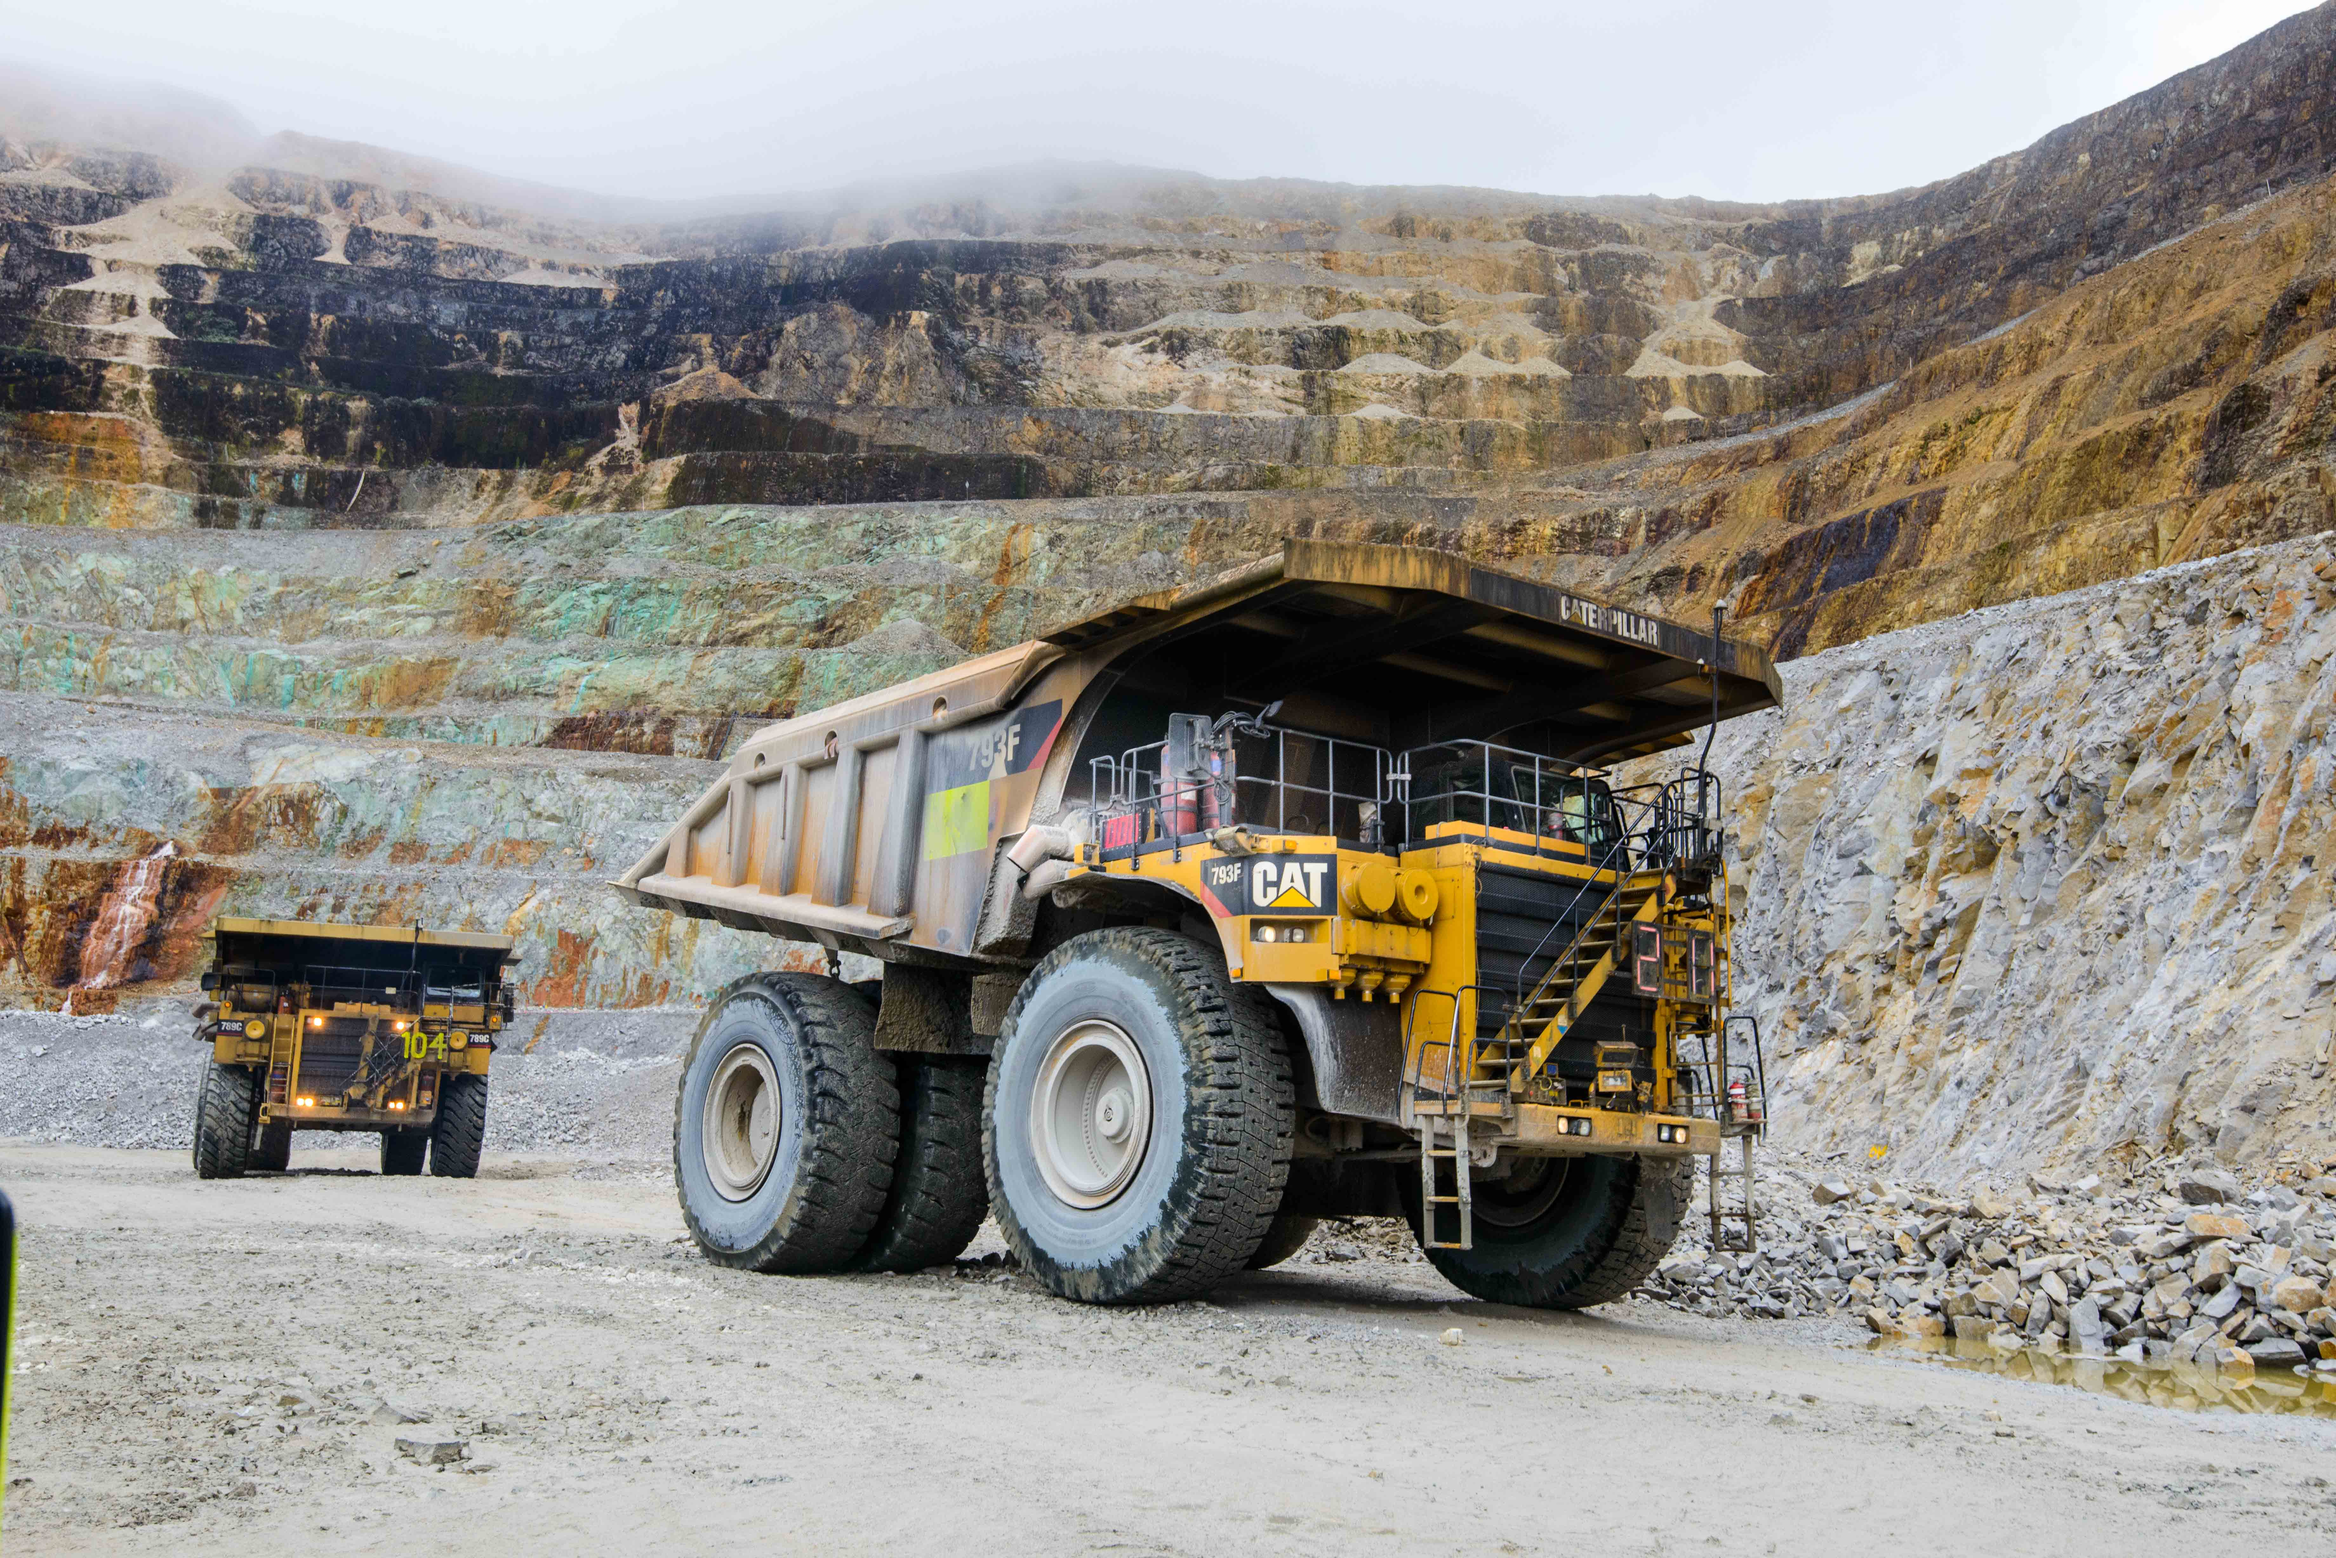
Mining (Safety) Act 1977 & Mining (Safety)
Regulation 1935 Awareness

Slide 2

1. Introduction
Aim:
Provide participants with understanding of the regulatory framework within which OTML operates and the obligations of OTML, and individual employees/contractors – in relation to the PNG Mining (Safety) Act and Regulation
Awareness Outcomes - include the ability to demonstrate an understanding of
The role of the MRA Inspectorate Division
The PNG Mining (Safety) Act and Regulation
The role, obligations, areas of responsibility and names of the Agent and Registered Manager(s)
The role, obligations, areas of responsibility and names of the Registered and Certified personnel
The obligations required of each individual
The types of and timetable for reportable incidents

Slide 3
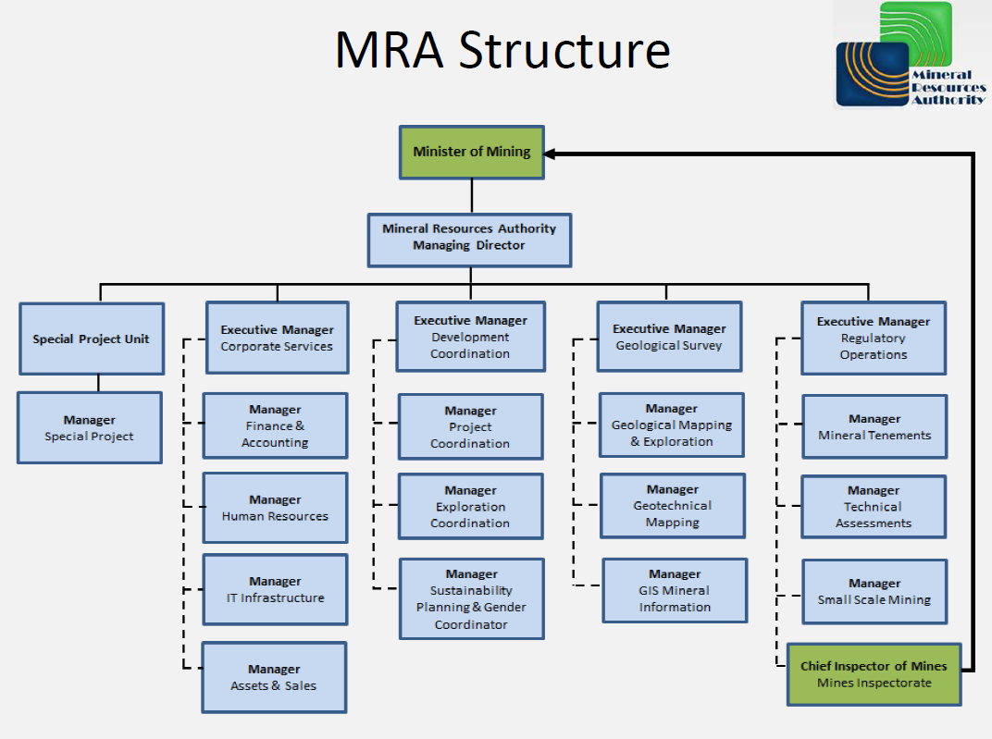
Mineral Resources Authority (MRA) – Structure

Slide 4
MRA – Mines Inspectorate
Core Functions
Undertake inspections and audits.
Undertake accident investigations and inquiries.
Issue Orders and Notices.
Grant approvals for new works or deviations in mine plans.
Monitor health and safety compliance.
Compile reports to the Mining Minister, the MRA Board and MAC .
Mines Inspectorate Personnel
Chief Inspector of Mines, Mr Lave Michael
Inspector of Mines, Mr Philip Kae – assigned to OTML

Slide 5
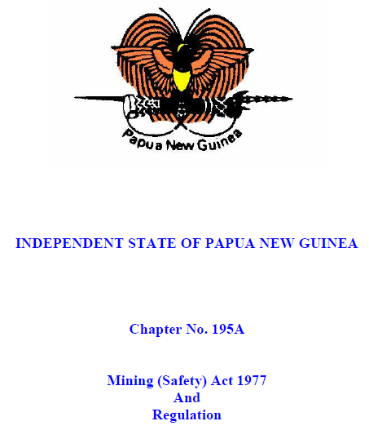
PNG Mining (Safety) Act and Regulation
OTML operates under the jurisdiction of the Independent State of PNG
OTML subject to numerous acts, regulations and constitutional requirements
PNG Mining Act
  Regulates mining and exploration leases
PNG Mining (Safety) Act and Regulation
  Primary Act/Reg regulates health and safety aspects
  Often referred to as Chapter 195A

Slide 6
PNG Mining (Safety) Act and Regulation
Mining (Safety) Act – 80 sections

Slide 7
PNG Mining Safety Act and Régulation
Mining (Safety) Regulation – 371 sections

Slide 8
Statu tory Positions and Permit Holders under Mine Safety Act
The key statutory positions and occupations at the mine (works) where ‘certificate of competency’ and ‘permits’ as prescribed under the Act and Regulation as mandatory;
Chief Inspector (CIM) – person appointed as Chief Inspector of Mines under the Act
Inspector – person appointed as Inspector of Mines under the Act
Owner of the Mine – holder of the mining tenement where a mine is situated, represented by the Chairman,
Agent of the mine – appointed by the Owner as its representative for the management of the Mine and as such superior to a Manager under the Act – CEO/MD
Registered Manager – appointed by the Agent and certified by MRA Board of Examiners;
  Metalliferous Mine Manager – Surface
  Metalliferous Mine Manager – Underground
  Mine Manager Works – Processing plant & ancillary facilities
Mine Electrician – A person certified as electrician at the Mine
Mine Surveyor – A person certified as surveyor at the Mine
Boiler Inspector – A person certified as boiler inspection at the Mine
Dredge Master – A person certified to operator dredge at the Mine
Boiler Operator & Inspector – A person permitted as boiler operator and Inspector at the Mine/Works
Underground Miner – A person permitted to work in underground Mines

Slide 9
PNG Mining (Safety) Act and Regulations
Mining (Safety) Act - Sections 16, 17, 18
Mining (Safety) Regulation – Sections 318, 319
Occupations Requiring Appointment, Certificates of Competency or Permits
Agent/Owner rep
Registered Manager Mining (Works)
Registered Manager Works (Mill)
Registered Manager Works (Tbg)
Registered Manager Works (Bige)
Registered Manager Works (Kiunga)
Mine Surveyor
Mine Electrician
Dredge Master
Kedi Ilimbit
Yagatau Hamena
Alan Bong
Franz Hemetsberger
Naimen Kepan
Maling Ambranga
Steve Aka
Paul Jones
Dredeco Bige - several

Slide 10
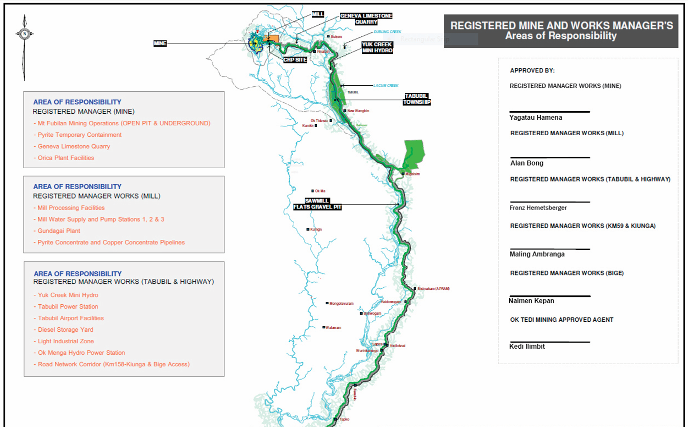
PNG Mining (Safety) Act and Regulations
Registered Manager Mine - Mill - Works (Tabubil) - areas of responsibility

Slide 11
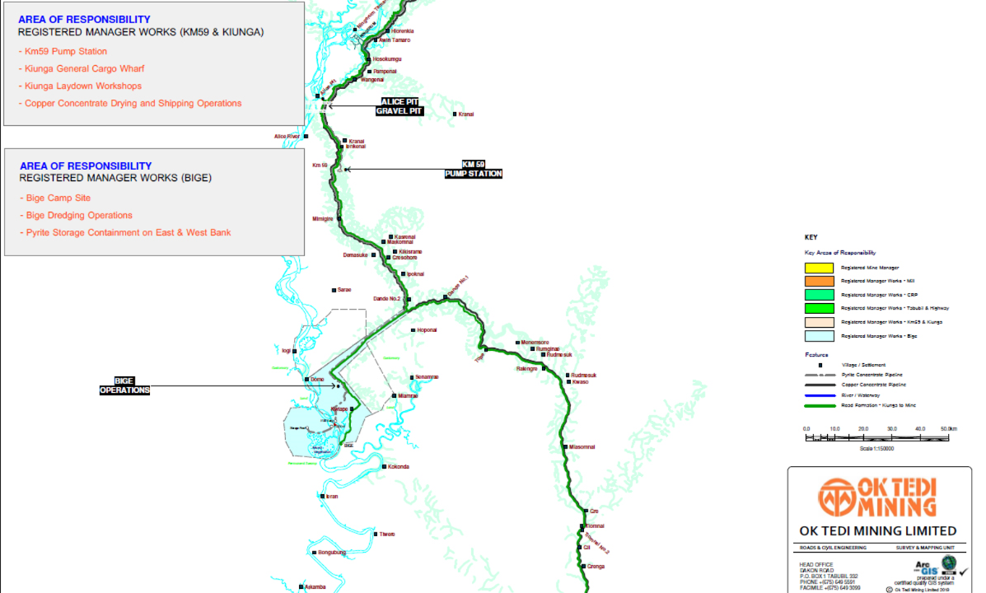
PNG Mining (Safety) Act and Regulations
Registered Manager Works (Bige/Kiunga) - areas of responsibility

Slide 12
PNG Mining (Safety) Act and Regulation
Mining (Safety) Act 1977;
Section 45 - Any unsafe condition in mine or works to be reported
Every person employed in or about a mine or works who becomes aware of anything in or about the mine or works which is likely to cause injury to a person or to the mine or works shall promptly report the fact to a person in authority at the mine or works
Section 46 - Employees to ascertain if appliances are safe
Every person employed in or about a mine or works shall, before commencing and whilst at work, take all reasonable precautions to ascertain whether the tubs, trucks, chains, tackle, windlass, ropes, tools or other appliances used by him and the place in which he works are safe
A person shall not:
(a) use any of the appliances which appear unsafe; or
(b) Remain in any unsafe working place
Section 55 - Accident to be Reported
Duty of every person employed, as soon as he becomes aware to the person in charge of the mine or works.

Slide 13
PNG Mining (Safety) Act and Regulation
Mining (Safety) Act
Section 57 - Notification of Certain Incidents
Loss of life; fracture of the skull or of a limb, or other serious bodily injury; or causes person to be unfit to return to his ordinary work for a period of 14 days; fire; explosion; electric shock; boiler incident, etc
Mining (Safety) Regulation
Section 171 - Accident Affecting Persons
Every accident arising out of the operation of any electrical apparatus and causing bodily injury (including shock or burn) to any person shall be reported promptly to the manager
Section 358 - Reports of Incidents
Form 14 - loss of human life or bodily injury
Form 33 - without bodily injury.
Report shall be made within 24 hours of the occurrence of the accident.

Slide 14
PNG Mining (Safety) Act and Regulation
Mining (Safety) Regulation
Section 274 – Manager to Inform Himself of Condition of Appliances
The manager of every mine, or some other assigned competent person at intervals of not more than one week
Keep himself constantly informed on and carefully examine the condition of the mine and all buildings, machinery, ropes, and other safety appliances, gear, shafts, levels, planes, and other places used in the working of the mine;
Make and sign an entry in the prescribed Mine Register including his opinion of the condition, and of the need for alterations or repairs, having regard to the safety of persons employed in the mine.
Section 281 – Weekly Inspection by Manager
The manager of every mine shall at least once a week make a thorough inspection of every part of the mine; and make and sign an entry in the prescribed Mine Register

Slide 15
PNG Mining (Safety) Act and Regulation
Mining (Safety) Regulation
Section 128 – Unlawful Use or Removal of Machinery Fittings
A person shall not wilfully damage, use, remove, or render useless, any machinery, appliance, gear, fitting, timber, material, or other thing provided in or about any mine.
Section 284 – Wilful Damage
A person shall not wilfully damage or, without proper authority, remove or render useless, any safety appliance, gear, etc in or about any mine.

Slide 16
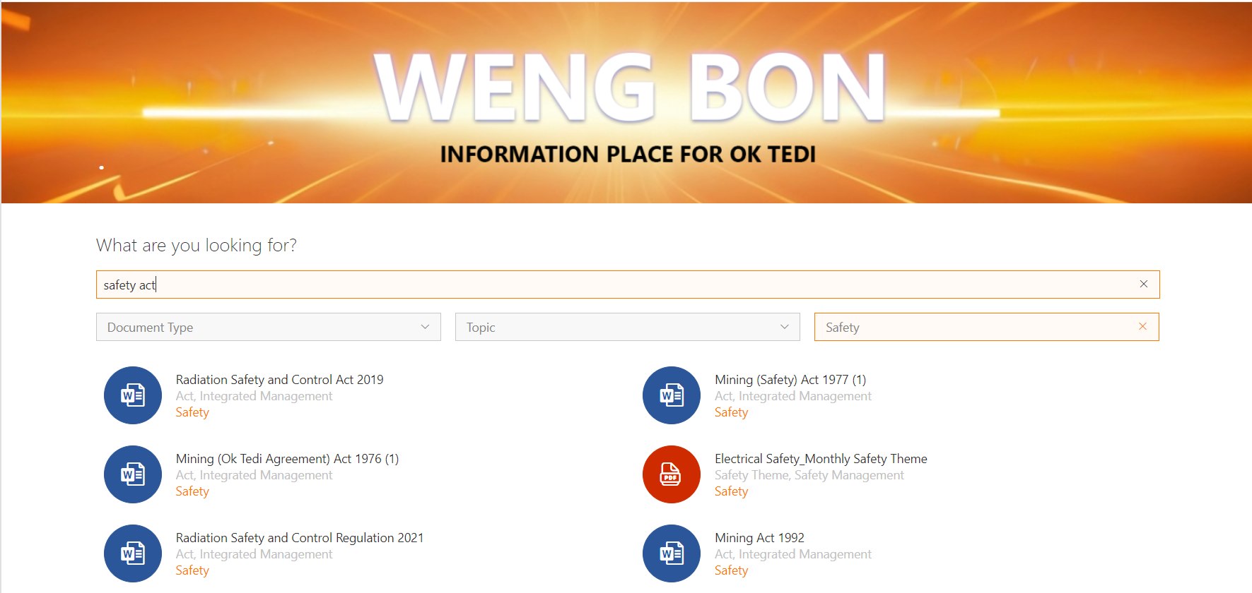
PNG Mining (Safety) Act and Regulation
Mining (Safety) Act & Regulation
Copy available on Weng Bon or ask your department Manager or Registered Manager

Slide 17
PNG Mining (Safety) Act and Regulation
Learning Evaluation Tool – maximum 10 minutes to complete
What is the role of the MRA Inspectorate Division?
What primary Act/Regulation regulates health and safety in the mining industry including for OTML?
How many Registered Managers are there at OTML and what are their areas of responsibility?
Who is responsible for ensuring all equipment is safe before use?
How often are safety inspections required to be undertaken by the Registered Manager or assigned competent person?
Who is responsible for reporting any unsafe conditions or equipment?
Who is responsible for reporting accidents?
What accidents are classified as reportable?
Where can you find a copy of the Act and Regulation?

