Slide 1
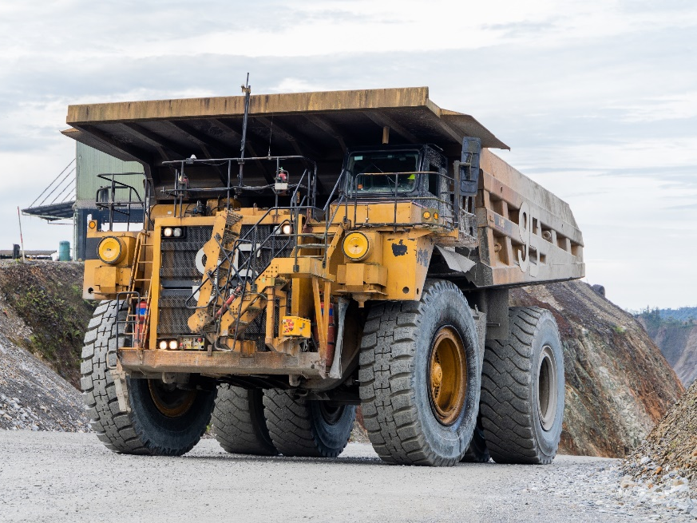

National Mine Safety Week (NMSW) 2023
Safe Roads and Conditions

Slide 2
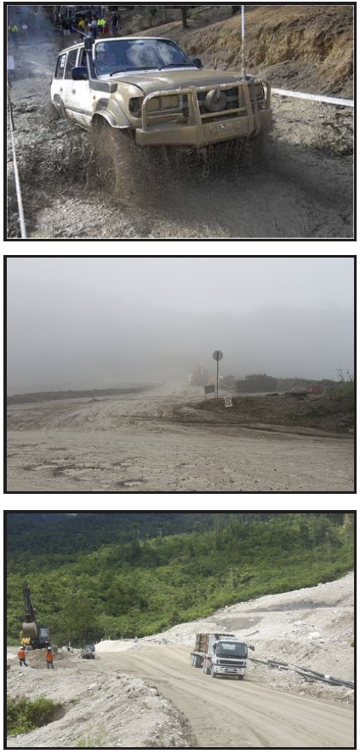
Introduction
  Risky environmental conditions:
  Overhanging trees
  Fog
  Wet weather
  Wind
  Floods
  Landslides
  Risky road conditions:
  Changing mining routes
  Heavy loads
  High wear and tear
  gravel/unsealed roads
  road design
Notes:
Briefly outline the conditions that increase the risk of using vehicles at OTML.

Slide 3
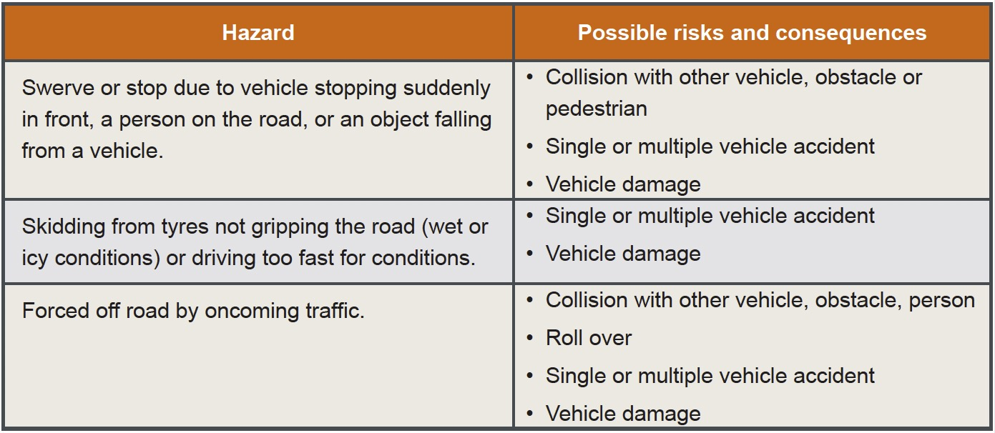
Driving Hazards
Notes:
Discuss driving hazards.

Slide 4
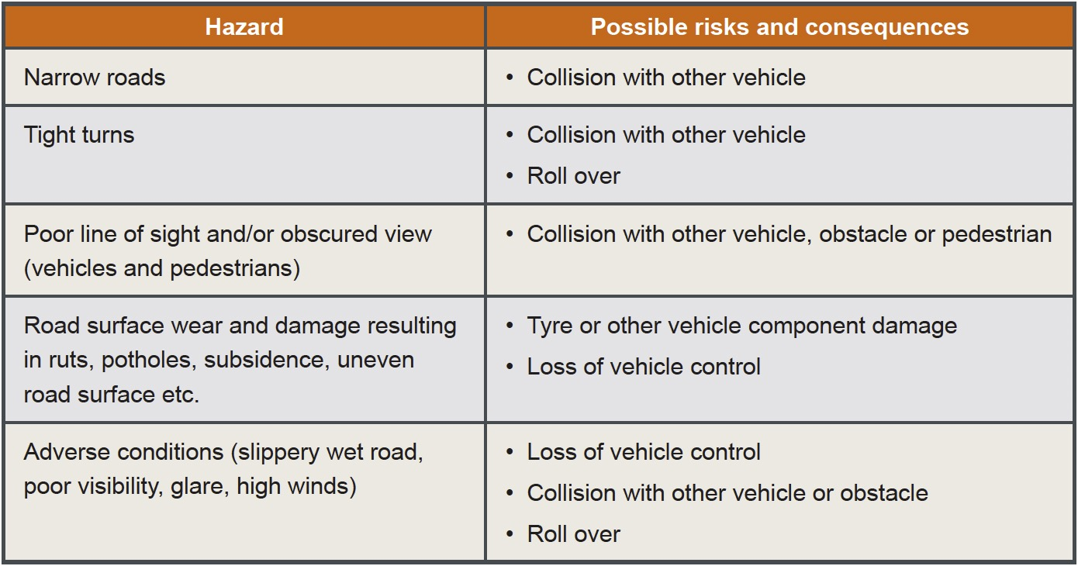
Road Design and Maintenance Hazards
Notes:
Discuss road design and maintenance hazards.

Slide 5
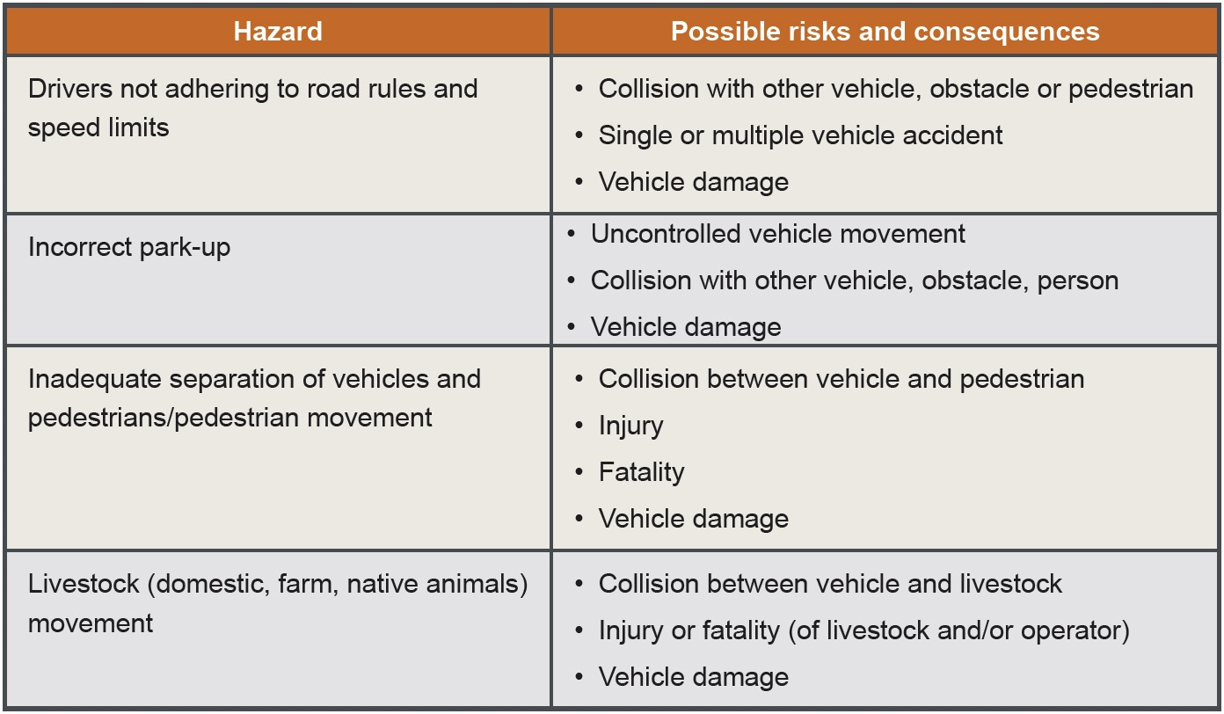
Traffic Management Hazards
Notes:
Discuss traffic management hazards and the special arrangements that may be in place when traffic flow is restricted.

Slide 6
Controls – Road Design
  Competent and authorised
  Site Road Design and Maintenance Plans
  Road designs, signage consistent with site traffic management requirements
  Road design considers site risk assessment
  Road designs and changes approved by responsible General Manager
Notes:
Discuss the road design controls that are in place.

Slide 7
Controls – Site Plan
  Road width, cross fall, crown, camber, curvature
  Clearance to infrastructure
  Line of sight
  Drainage
  Road grade
  Berms / windrows and guarding
  Structural response to applied loads
  Wearing course and materials
  Maintenance requirements according to wearing course selection
  Dust generation
  Minimisation of road surface and associated structures deformation
Notes:
Discuss the information that should be in a site road design, inspection and maintenance plan.

Slide 8
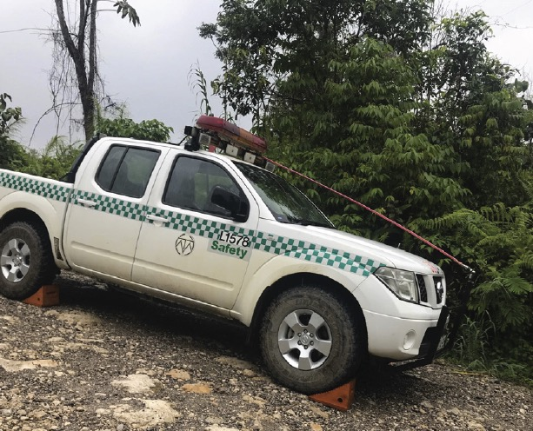
Controls – Drive to Conditions
  Unsealed/Gravel roads
  Dust
  Inclines/declines
  Restricted vision
  Wet weather
  Driving at night
Notes:
Discuss the safe driving techniques that should be employed in each of these adverse conditions.

Slide 9

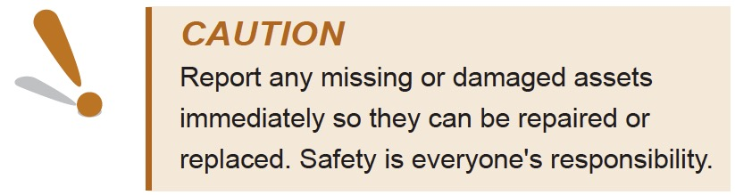
Controls – Separation
  Adhere to designated
  areas
  These should be sign
  posted
  Observe exclusion zones
Notes:
Discuss the separation requirements on site.

