Slide 1
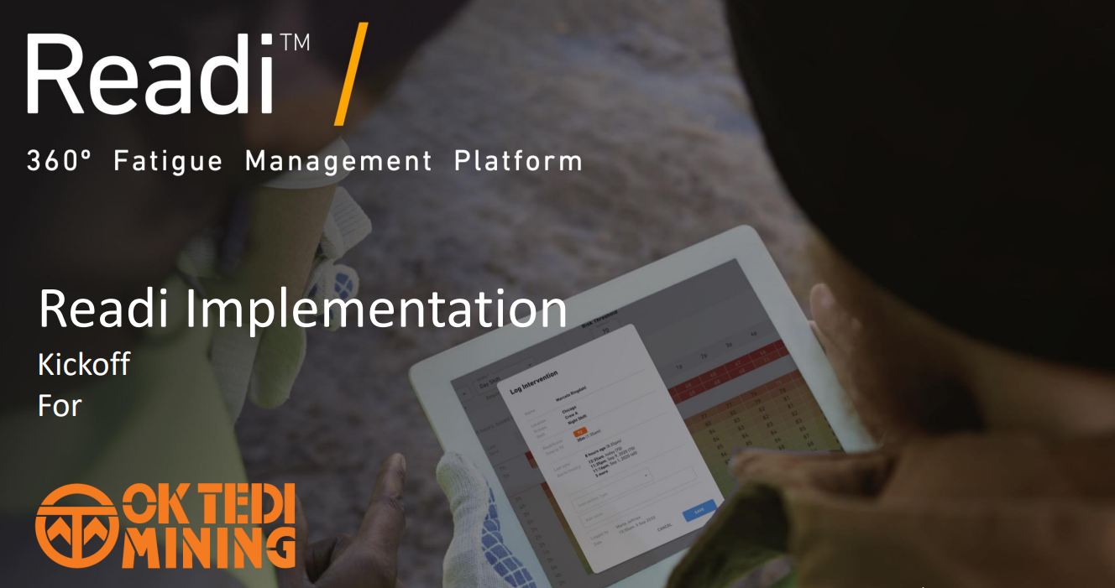


Slide 2
Intro
50% of the significant incidents (SI) and the recent fatal incident this year relating to operation of LV and Mobile Equipment.
Analysis from 2022 LV and Mobile Equipment SI reported that the top 3 contributing factors were
  service and maintenance of LV and Mobile Equipment
  At-risk driving behaviours and,
  Fatigue
39% of top 3 contributing factor related directly to Fatigue.
OK Tedi has in place controls to managing Fatigue at workplace.
However, more reliable effective controls needs to be explored to have a significant impact to continuous trend.

Slide 3
Redi Fatigue Risk Management Process
Fatigue Risk Management Software for predicting, managing and mitigating operator fatigue.
  Worker data and sleep data is collected through the use of wearables (RediWatch) by Operators.
  Data is then processed through a Biometrical Fatigue Model.
  Personalised Fatigue Predication is reported as a RediScore.
Outcome
Reduction in the overall Fatigue related LV and Mobile Equipment incidents, and productivity at workplace.
    Leadership (ELT + Safety) – use insights to reduce fatigue reduction initiatives
    Supervisors responsible – use data to plan and intervene on risks
    Operators – receive on wrist Fatigue Alerts & daily Fatigue forecast

Slide 4
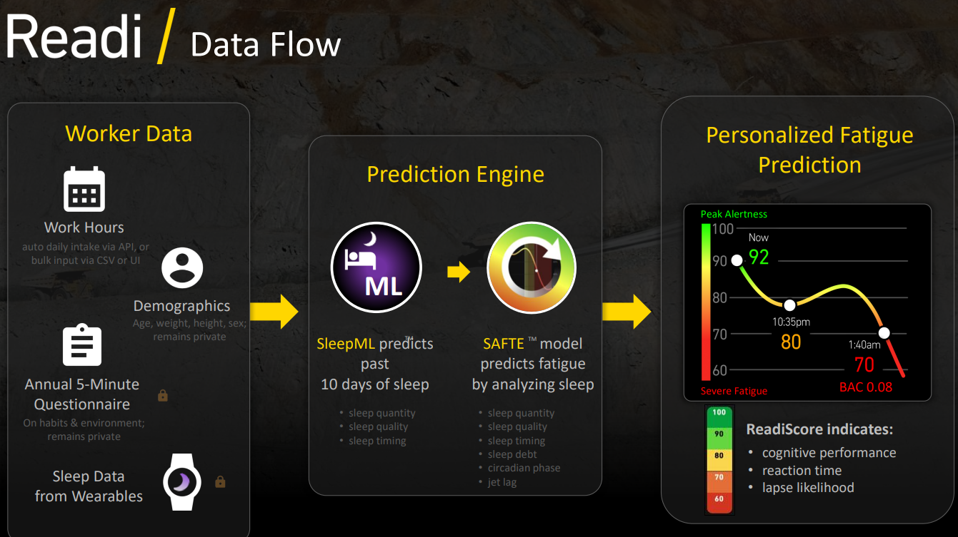
Redi Fatigue Risk Management Process Flow
https://fatiguescience.com/

Slide 5
Redi trial for OK Tedi High Risk Drivers
3 month trial period 01st May – 31st July 2023 (coincide with NMSW theme on “Mobile Equipment Safety”)
Target workgroups
  High Risk Drivers (60)
    Bus Drivers (Logistics),
    Frequent Highway Users (Roads and Engineering and StarWest)
  Mine Mobile Equipment Operators (60)
  86% ($997,595.00) of total associated cost damage of LV and Mobile Equipment from Mine.
  Volunteer - based trial and consent form to be signed prior to participating.
Outcome:
To identify gaps/issues and address as part of change management prior to implementation with rest of the high risk drivers throughout OTML Operations.

Slide 6
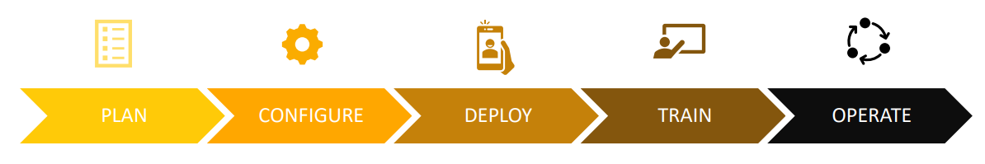
Redi trial plan for OK Tedi
Define objectives and success criteria
Establish Project Team
Define Users / Key stakeholders
Operators
Supervisors
ELT + Safety
ICT
HR
Define roles and responsibilities
Create awareness
Collection of worker data & One time survey
Define and Configure Redi
Define Supervisor workflow
Create awareness
Pair, set up and deploy devices
Define and Configure Redi
Define Supervisor workflow
Onboard Users
Deliver initial training to supervisors
Create awareness
Deliver in dept training with your data
Integrate workflows into existing processes
Create awareness
Track Review and adjust

Slide 7

Redi Benefits for OK Tedi
Monitoring and management of fatigue at workplace.
Accountability and responsibility at all levels.
Reduction in fatigue incidents, increase productivity and profit .
Potential for other existing reactive devices done away with.
Assessment for risk to new or changed rosters can be predicted.
Working or environment conditions can be improved on.
Worker privacy is respected

