Slide 1
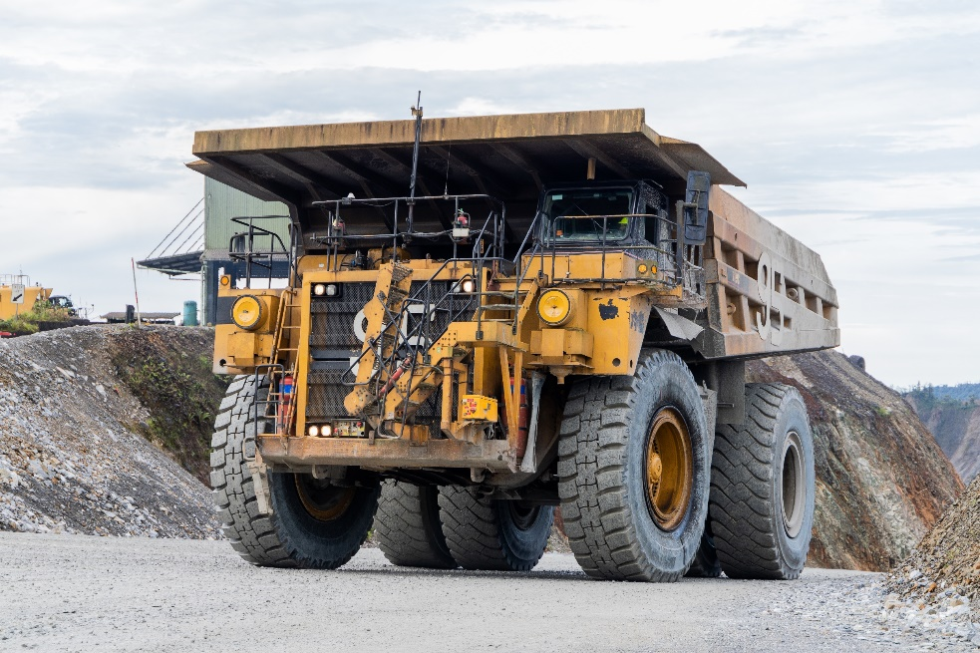

National Mine Safety Week (NMSW) 2023
Safety Theme: “Intro to LV and Mobile Equipment Safety”

Slide 2
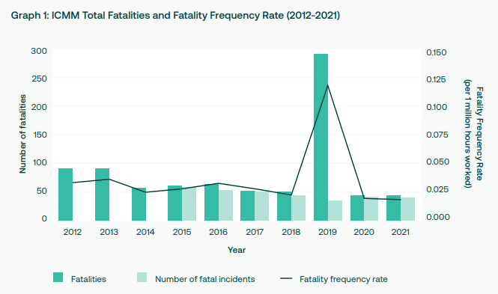
Mining Industry Fatality Frequency Rate (FFR)
Data from the International Council on Mining & Metals (ICMM) indicates that the industry globally is struggling to make a step change improvement in FFR with an average of around 0.04
A similar FFR trend applies to PNG Mines.
To make a difference will require collaborated effort from the industry across PNG and abroad.
ICMM = International Council on Mining & Metals
Average FFR
OTML
PNG
ICMM
ICMM excluding 2019

Slide 3
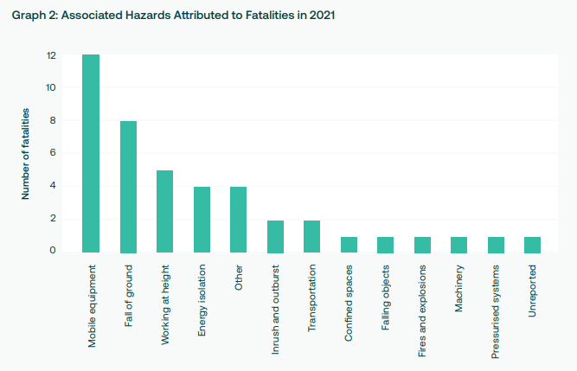
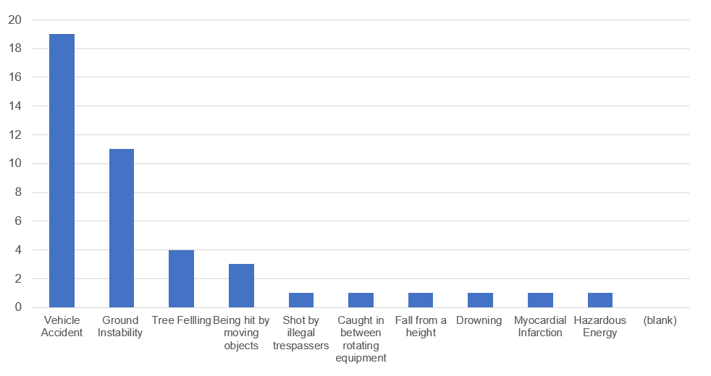
Major Hazards Contributing to Fatalities
The ICMM reports the main associated Major Hazard attributed to Fatalities in 2021 was “Mobile Equipment”.
MRA data tells the same story with “Vehicle Accident” as the main hazard 2008 to 2021.
Ok Tedi’s data indicates the same for the period 1989 to 2022.
ICMM Associated Hazards attributed to Fatalities in 2021
OTML Associated Hazards attributed to Fatalities in 1989 – 2022
PNG Associated Hazards attributed to Fatalities in 2008 – 2021

Slide 4
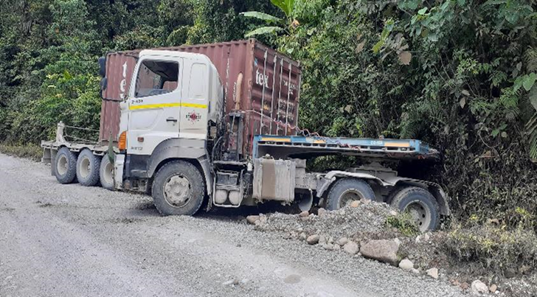
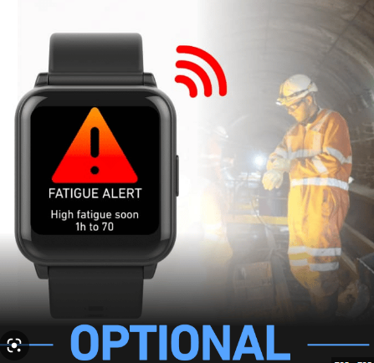
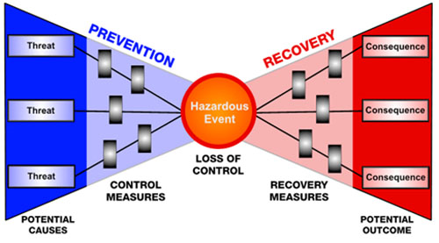
Mobile Equipment Safety in Focus
Some key activities or critical controls to address the Equipment, People and Workplace aspect of this Major Hazards
Equipment
  Light Vehicle & Mobile Equipment Standards
  QA/QC of Maintenance of Mobile Equipment
  Effective defective reporting systems
People (Drivers)
  Behavioural Safety Programs for Drivers.
  Fatigue Management (eg Use of predictive fatigue technology)
  Simulator Training to increase driver skills and knowledge
Workplace/Environment
  Bow Tie Studies on Mobile Equipment Operations to identify complete risk assessment and controls
  Inspections or Audit on Road design, Safety Road Signage etc
  Journey Management Plans and associated risks

Slide 5

Summary
Fatalities and potential fatalities continue to occur in the industry globally.
Fatal major hazard risks around “Mobile Equipment” are currently the leading cause of fatalities.
We must recognise this fatal major hazard risks and the need to eliminate them through reliable critical controls.
In collaboration with MRA and PNG Mines, the focus on the theme “Mobile Equipment Safety” for NMSW for 2023 can make an impact in reducing the FFR trend and support the industry towards achieving zero fatalities.

