Slide 1
LMS – Journey Management Plan On-Line User Guide

Slide 2
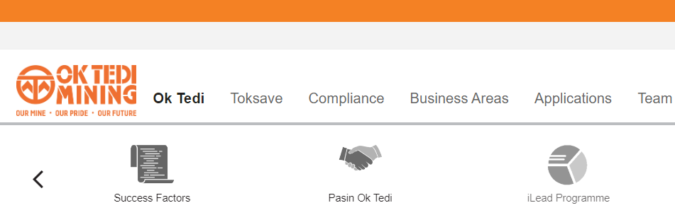
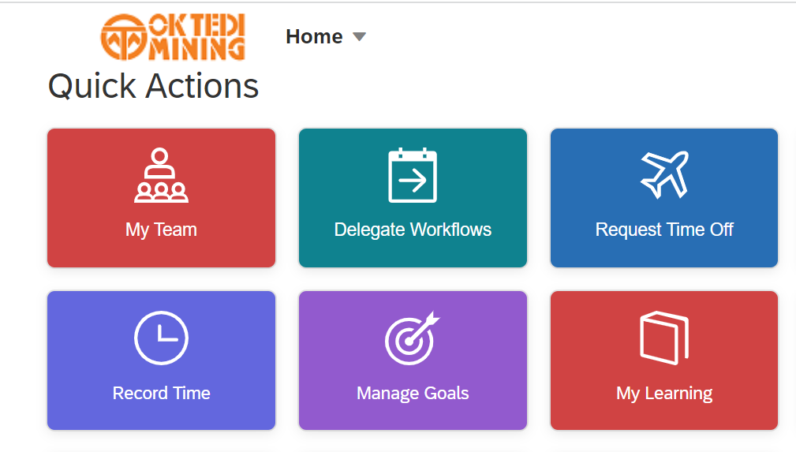
Go to the Learning Management System
STEPS
1 Log onto the Ok Tedi Intranet and click on the SuccessFactors icon.
2 Click on “My Learning” or on the icon which will take you to the training courses assigned to you
1
2

Slide 3
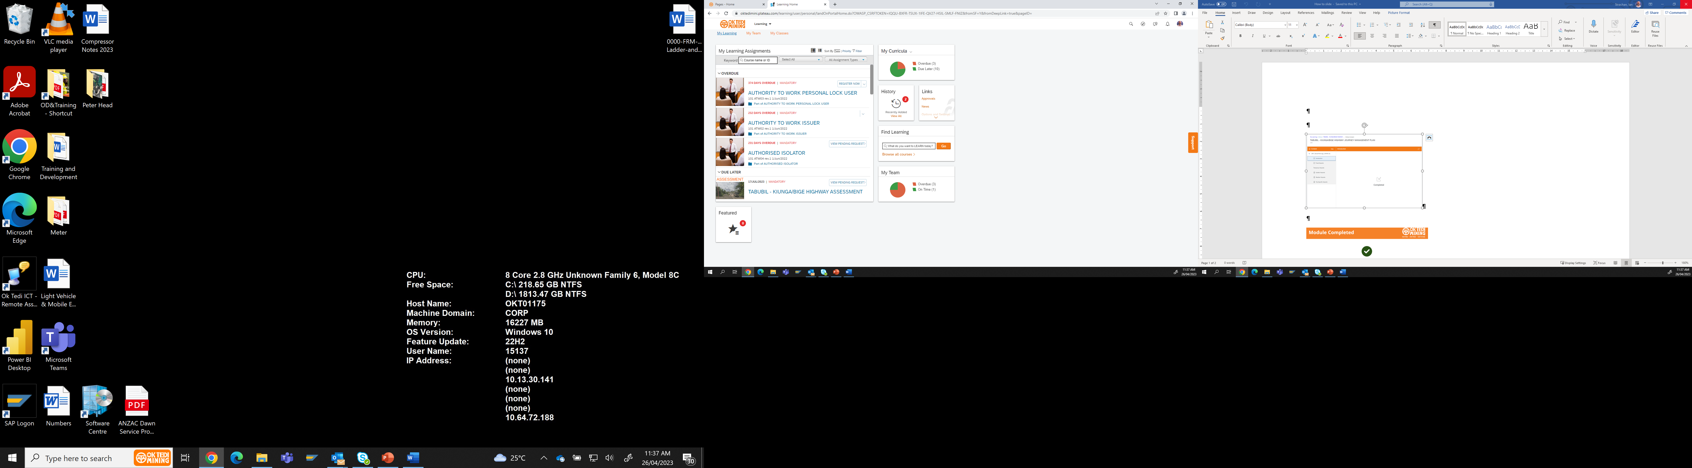
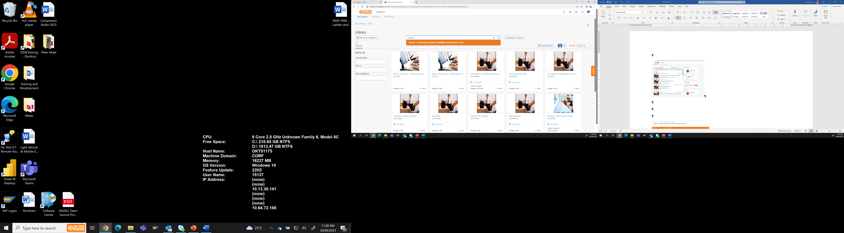
Your “My Learning Page to Launch the JMP Training
STEPS
Click on Find Learning “Browse all Courses”
2. Type in “Journey” in the Search Field and Click in the Looking Glass. (Search)
1
Note:
Confirm that you have access to Success Factors.
2

Slide 4
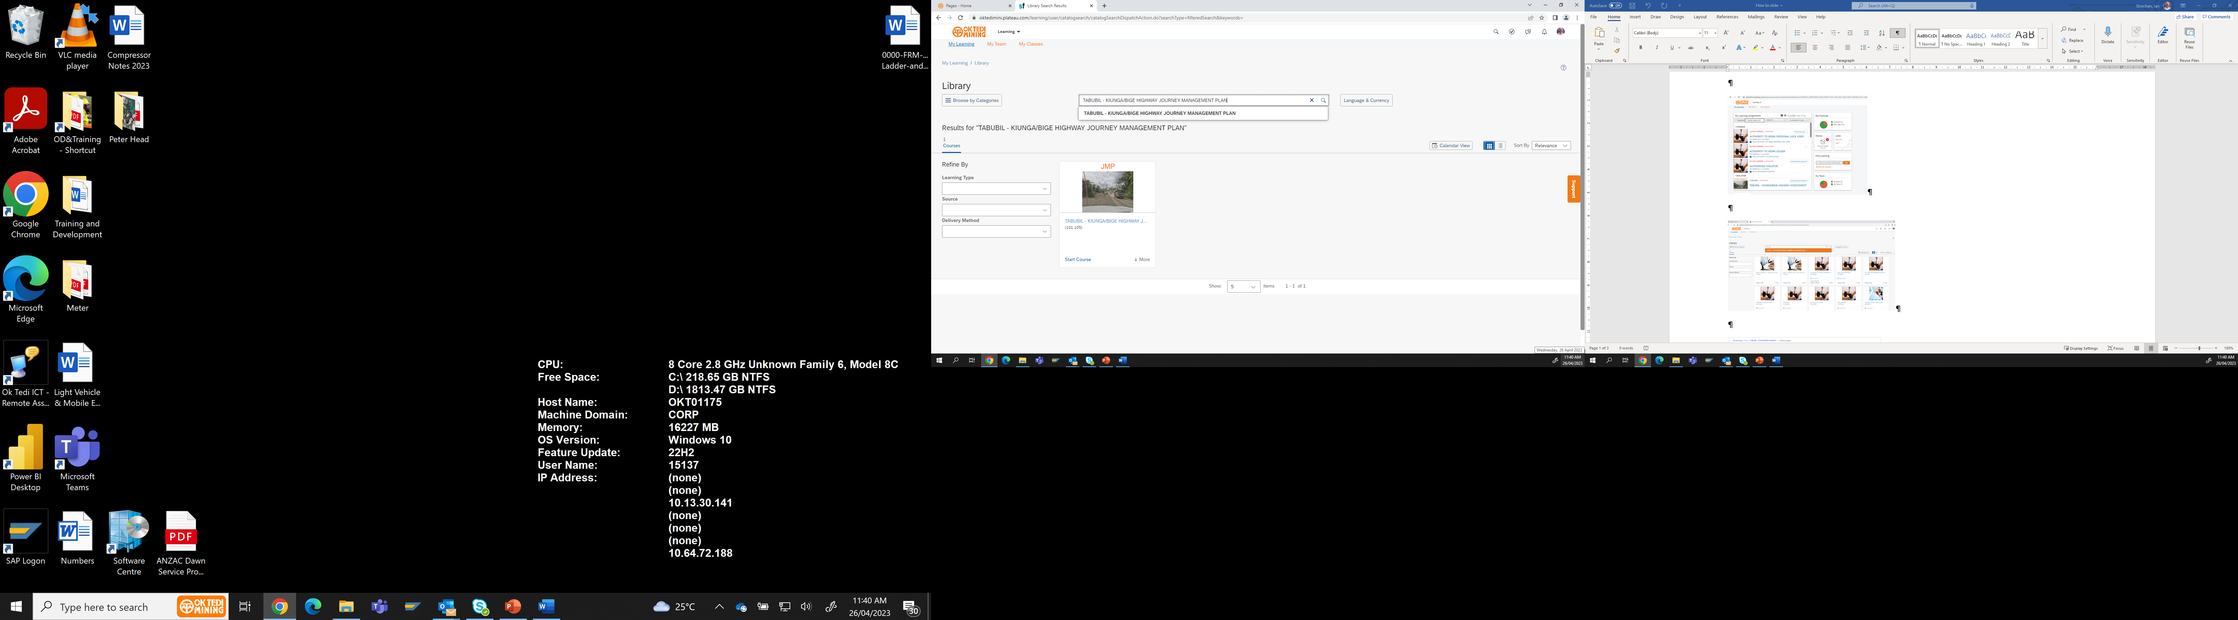
Locate the Tabubil, Kiunga , Bige Highway Journey Management Plan
STEPS
Click on “Start Course”.
1
Note: You will need to concentrate as you will be asked questions during the presentation.

Slide 5
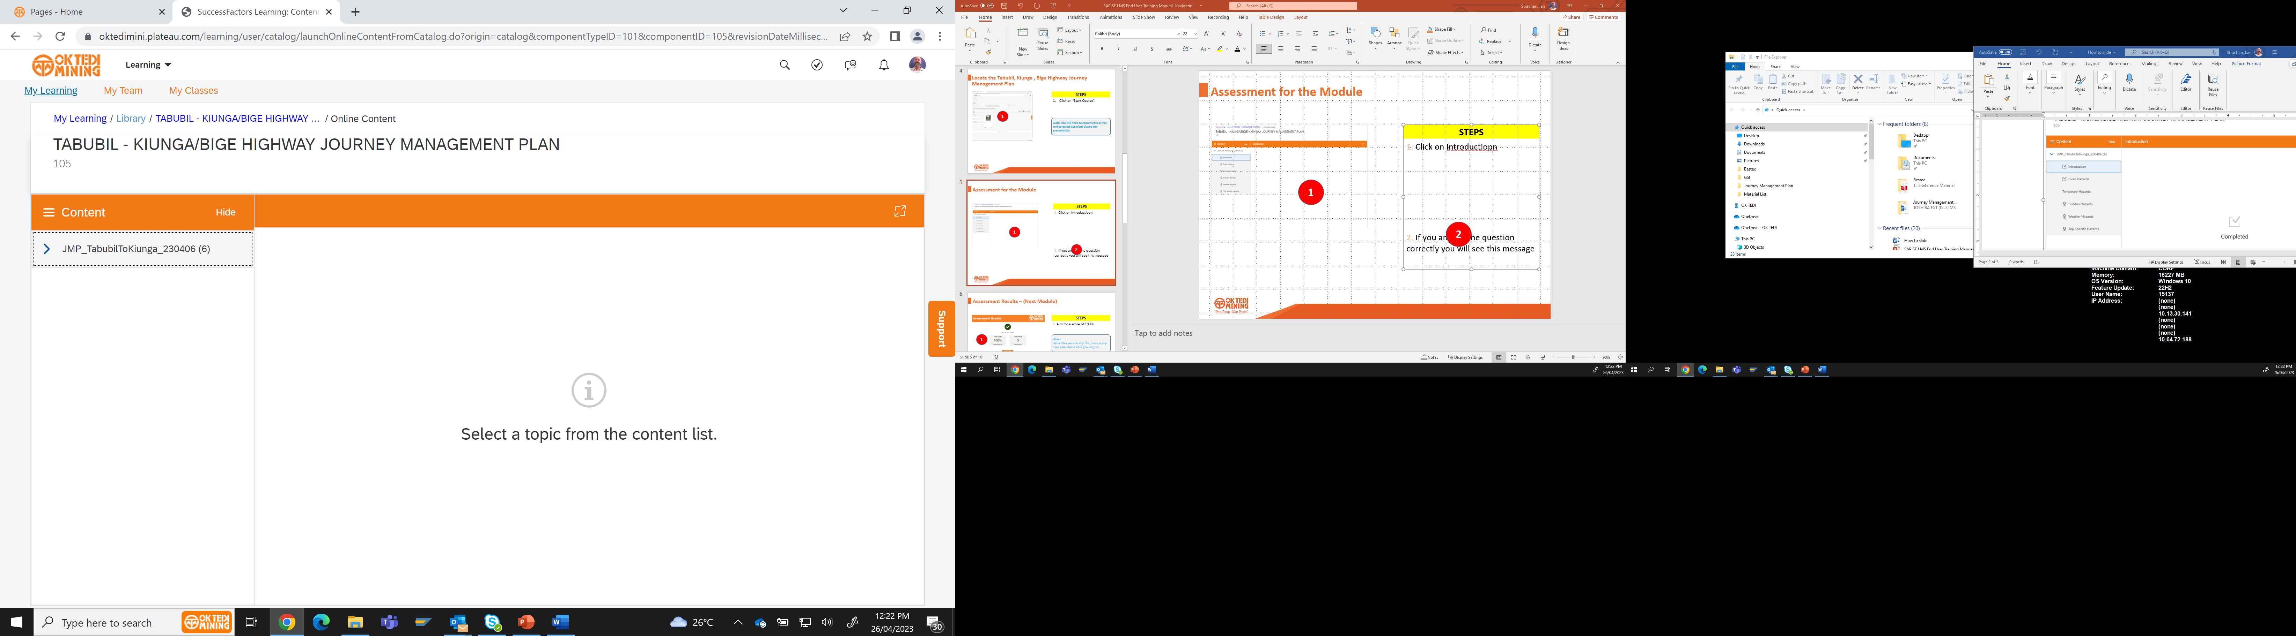
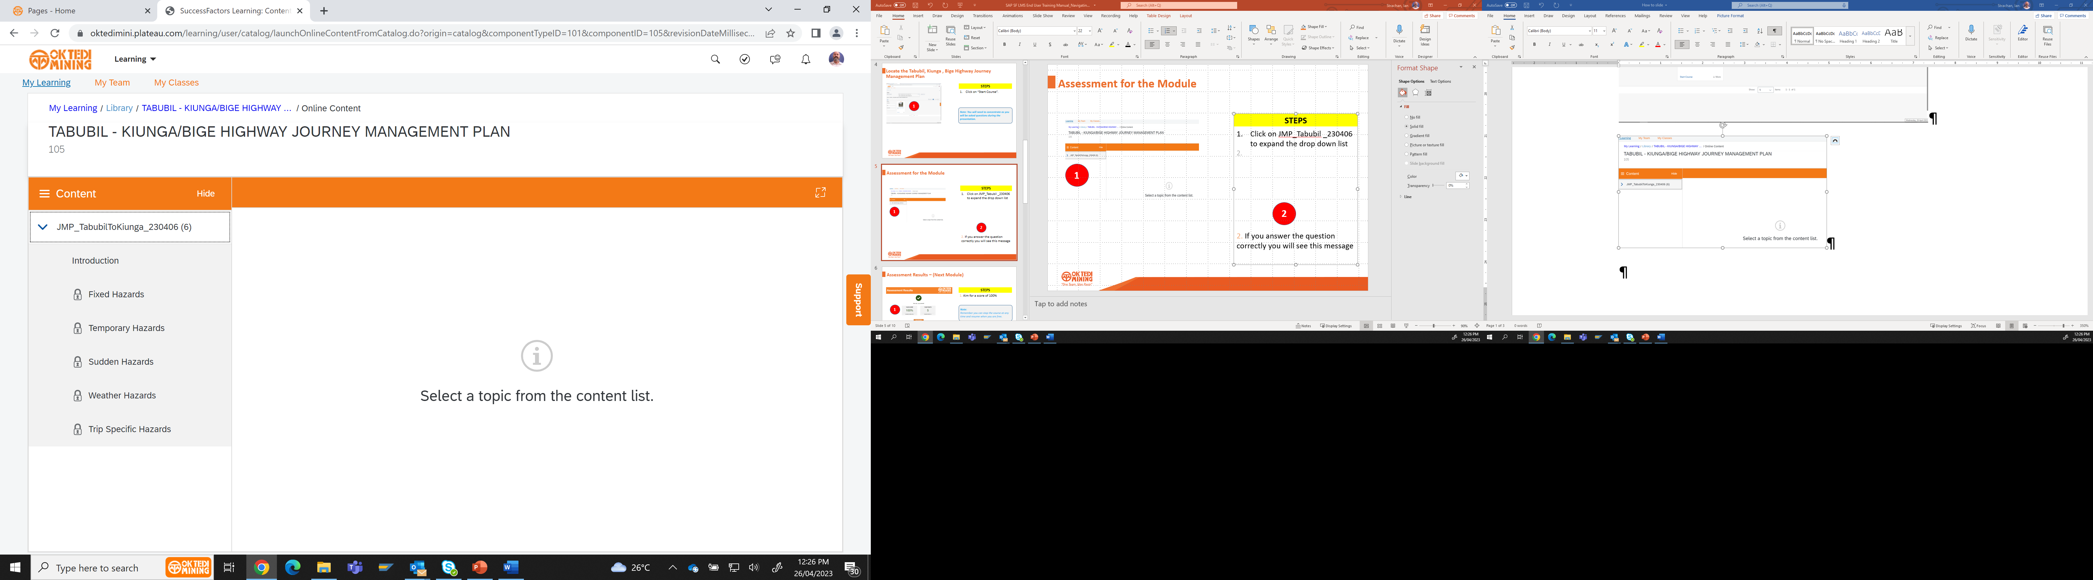
Select a Module Topic from the JMP.
STEPS
Click on “JMP_Tabubil _230406” to expand the drop down list 2. Click on the introduction to start the course.
1
Note: You MUST complete all Topics of the JMP and answer all the questions correctly to be marked as competent in the course.
2

Slide 6
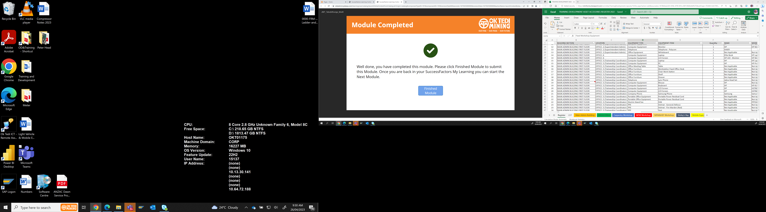
Complete the Module Topic from the JMP.
STEPS
There are SIX Module Topics you must complete, Fixed Hazards, Temporary Hazards, Sudden Hazards, Weather Hazards, Trip Specific Hazards. Work through them one by one. 2. Once you have completed the Topic Module Click on Finish Module.
1
Note: You MUST complete all Topics of the JMP and answer all the questions correctly to be marked as competent in the course.
2

Slide 7
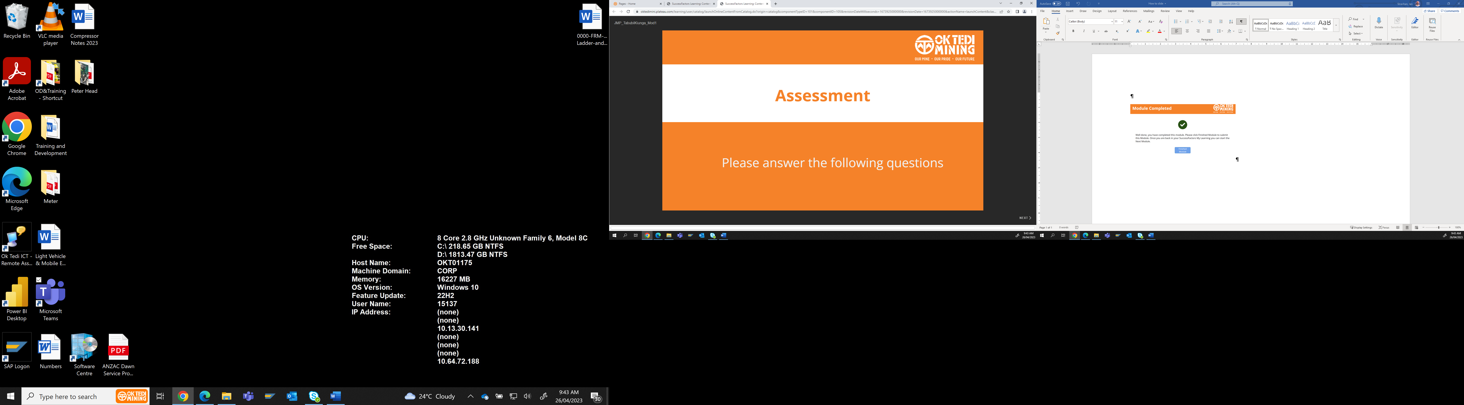
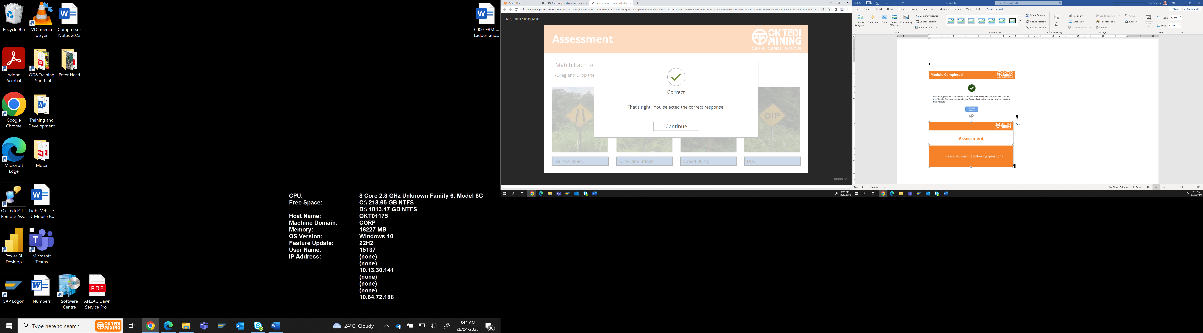
Complete the Module Topic Assessment.
STEPS
Open up and complete the Topic Assessment that has been set for each of the completed Module Topics. 2. Once you have answered the Module questions correctly click on “Continue”
1
Note: You MUST complete all Topics of the JMP and answer all the questions correctly to be marked as competent in the course.
2

Slide 8
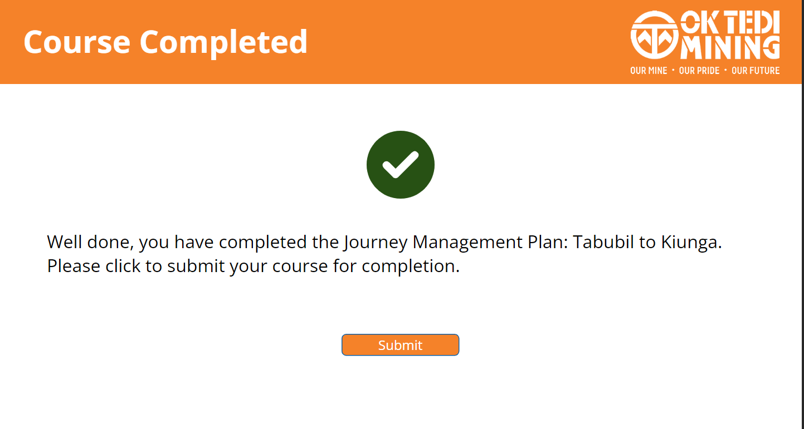
Assessment Results – (Retry Module)
STEPS
1. Well done you have complete the Journey Management Plan
Note:
REMEMBER to take your time.
You will you will need to go back to the beginning of the Module and start the section again by pressing Retry Module if you get incorrect answers.
1

Slide 9
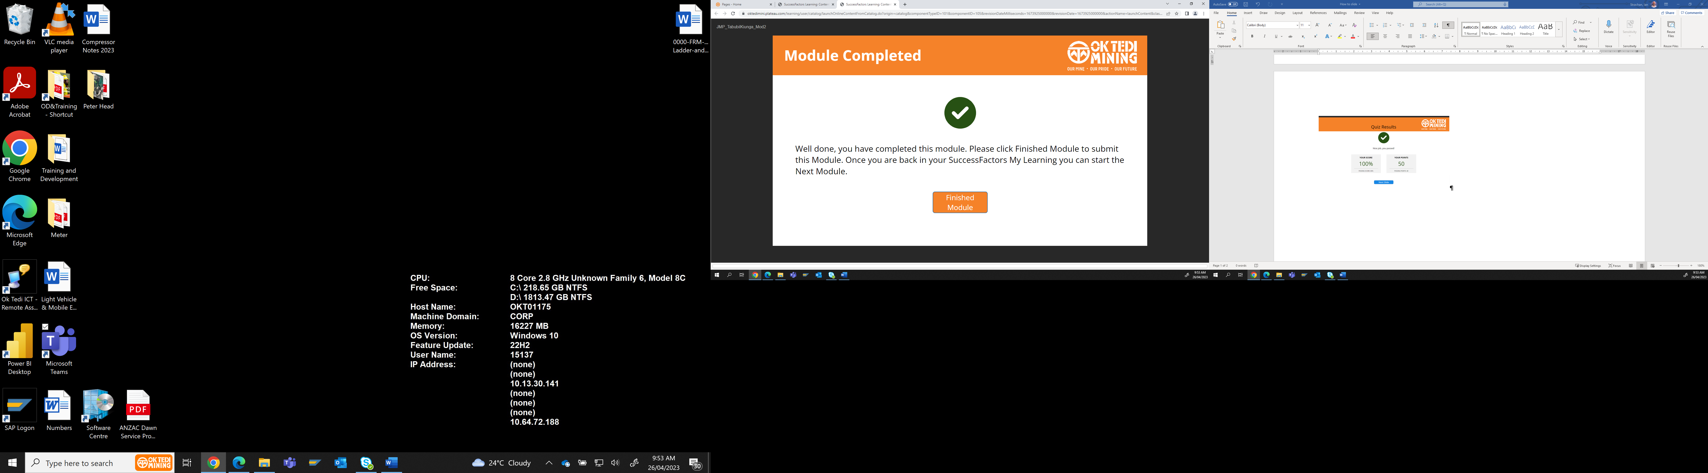
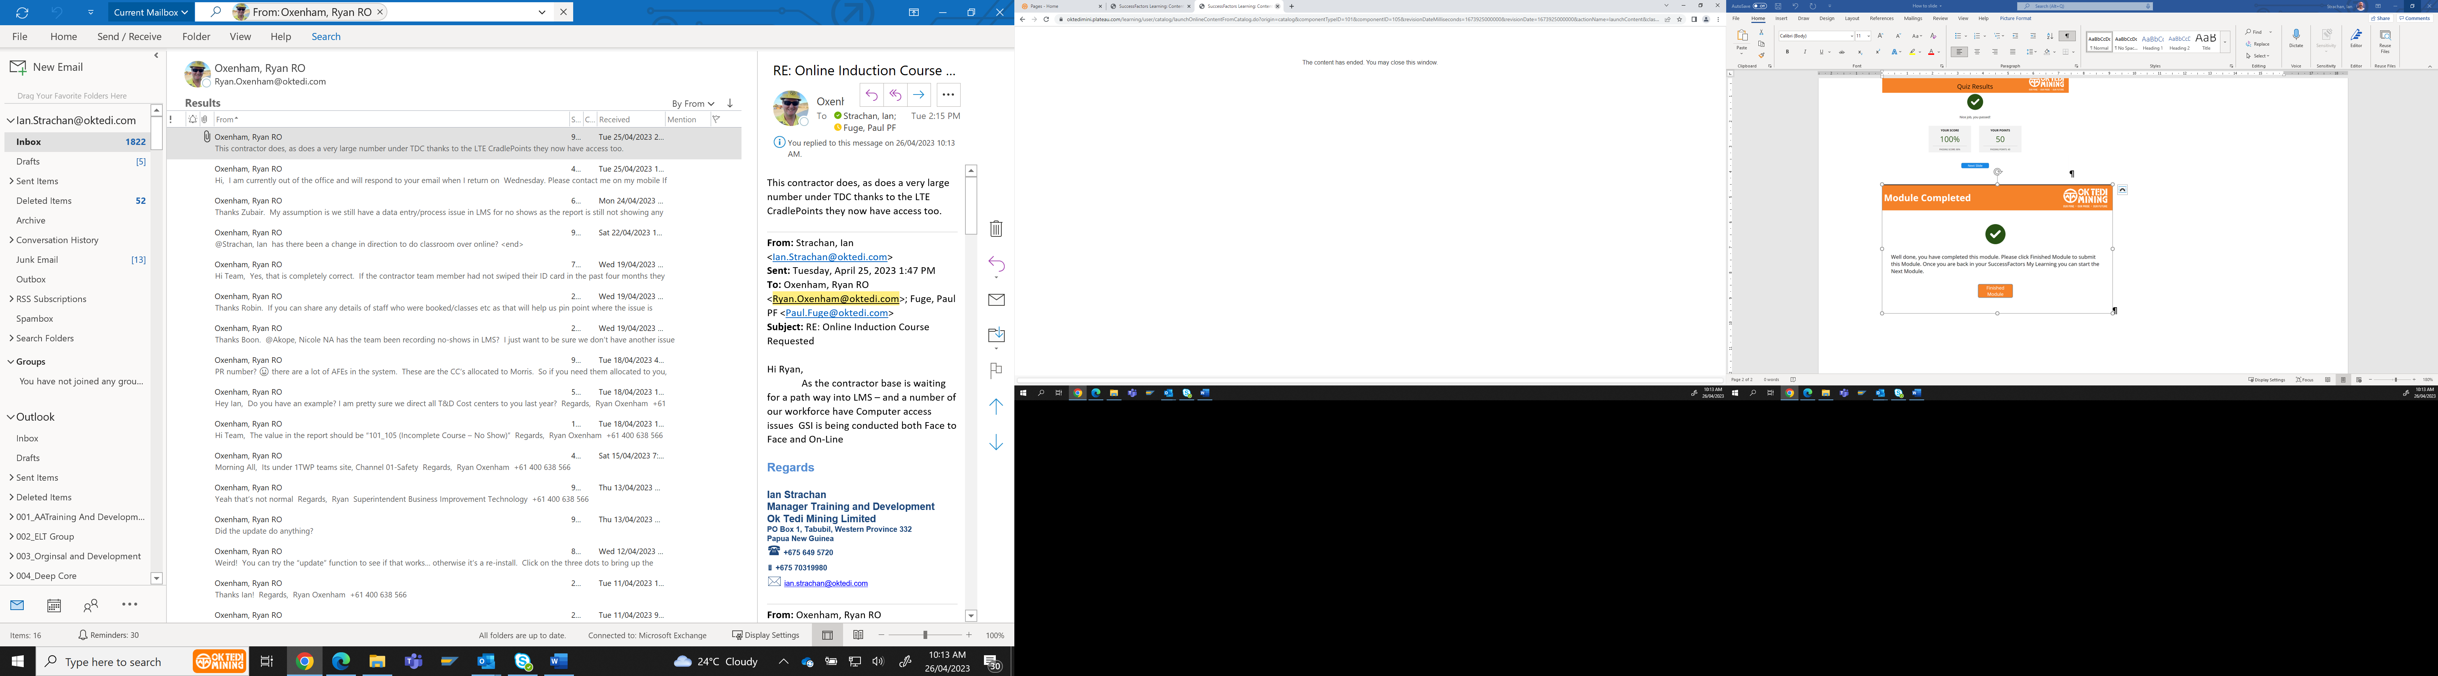
Assessment Results – (Next Module)
STEPS
1. Click on “Finish Module” to submit each completed Module 2. Click on the “X” to close the window to select the next Module.
1
2

Slide 10
Assessment Results – (Course Completed)
STEPS
1. Well Done you have completed the On-Line Journey Management Plan On Line Course 2. You MUST Click on Submit Button for the GSI Permit to be recorded against your employee Profile
1
2

