Slide 1


National Mine Safety Week (NMSW) 2023
Fitness for Work

Slide 2
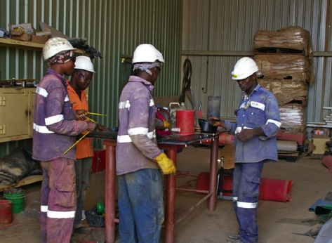
What is Fitness for Work
Being in a physical, mental and emotional state
that allows you to perform your work to the
standards set by Ok Tedi, and in a manner
that will not put yourself or others at risk
Ok Tedi recognises that an individual’s
fitness for work can be affected by :
  Fatigue
  Emotional issues and stress
  Inappropriate use of alcohol
  Use of illicit drugs
  Taking some types of prescribed medications
  Physical difficulties
It is important to identify when an individual is not fit for work at an early stage and to provide support and assistance when it is required
Final determination of being fit for work is based on the opinion of the principal Employer, Manager, Superintendent and the individual
Notes:
Explain that mining work is physically demanding and requires mobility, strength, good posture, reach, fine motor skills and an aerobic capacity to perform the relevant tasks.
Being ‘fit for work’ means that, as an individual, you must be in a physical, mental and emotional state that allows you to perform your work to the standards set by Ok Tedi, and in a manner that will not put yourself or others’ safety or health at risk.
Discuss the factors that can affect a person’s fitness for work.
Emphasise the importance of identifying if someone is not fit for work at an early stage.

Slide 3
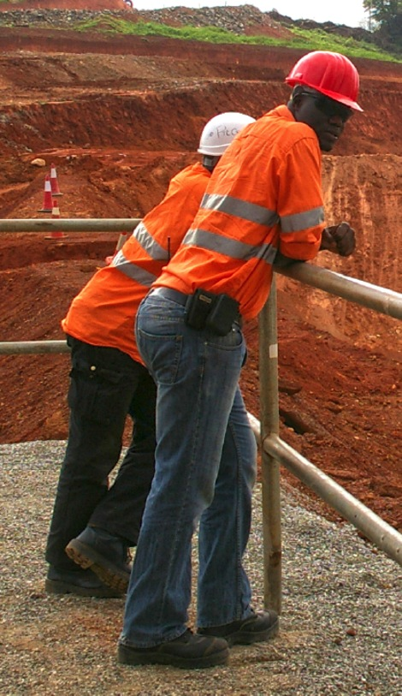
Your Obligations
  Come to work in a condition to perform duties without risk to yourself or others
  Notify your Supervisor if you:
  Believe that you are unfit for work
  Believe that someone else is not fit for work
  Know of someone who has unauthorised possession of alcohol, consumes alcohol, or takes illicit drugs at the workplace or during the work period
  Use medication as directed by a medical practitioner or the manufacturer
  Cooperate in alcohol and drug testing
  Assess your own fitness for work at the end of shift to ensure you are okay to commute home
Notes:
Discuss the obligations that workers, contractors and visitors to site have to Ok Tedi.

Slide 4
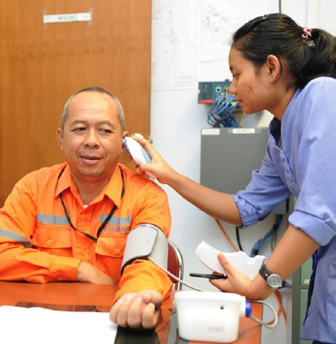
Fitness for Work Assessments
Assessments are conducted:
Following an accident or any reportable incident
If a Supervisor has reasonable grounds to
suspect that you could be unfit for work
  On a random basis while at work
  As part of a pre-employment medical examination
Assessment methods include:
  Face-to-face discussion
  Observation of work performance
  Medical assessment
  Alcohol and drug testing
  Employee self-testing for alcohol and other drugs
Notes:
Explain that Ok Tedi has an obligation under Workplace Health and Safety Legislation to ensure that everyone on a Ok Tedi site is fit for work. One method for meeting this obligation is to conduct fitness for work assessments.

Slide 5
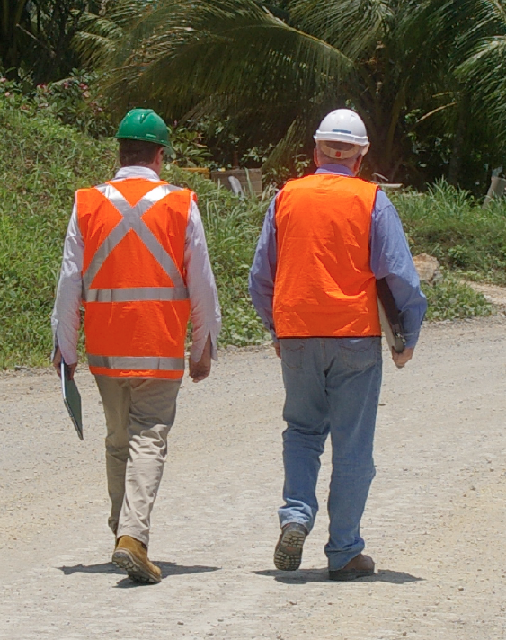
What Happens if I am Unfit for Work
  You will be:
  Removed from the workplace
  Prohibited from driving a vehicle or operating machinery
  Transported back to your home or accommodation
  Provided with a letter stating why your are in breach of the fitness for work and wellbeing procedure and a copy of any positive test results
  NOTE: All information relating to an individual’s condition is confidential
Notes:
Explain that:
Managers and Supervisors take the actions when an individual is deemed unfit for work for any reason.
Accommodation is the camp in a remote location or to their home in a residential location.
Information is subject to legal and legislative requirements and is available on a strictly ‘need-to-know’ basis. Failure of any individual to maintain confidentiality will result in disciplinary action.

Slide 6
Return to Work
  Before Ok Tedi employees are permitted to return to work, they:
  Must meet with their Manager or Supervisor and demonstrate that they are fit for work
  Produce a negative drug and alcohol result
  Demonstrate that the cause of the problem has been addressed
  Employees can access sick leave and then accrued annual leave during the period that they are unable to demonstrate that they are fit for work – they can also access the EAP
  On return to work, employees must demonstrate a clear and consistent improvement in their job performance
  If an immediate danger exists as a result of an individual’s state (e.g. drug overdose or potential for suicide), the Manager or Supervisor will take appropriate action which may include getting external assistance
Notes:
Explain that employees who have breached Standard HE ST-04 Fitness for Work can access the Employee Assistance Program (EAP) to address work and personal problems. If you are a Ok Tedi employee, this service is available to your immediate family members.
If an immediate danger exists (e.g. drug overdose or potential for suicide), the Manager or Supervisor will take appropriate action which may include gaining external assistance.

Slide 7
Refusing to be Tested
If you refuse to be tested the matter will be treated as if the test result was positive
Notes:
Explain what happens if a person refuses to be tested.
Emphasise that the primary reason for instigating a fitness for work test is to ensure safety and wellbeing.

Slide 8

Impact of Fatigue on Fitness for Work
Fatigue can significantly affect your capacity to function
Side effects include:
  Decreased performance and productivity
  Increased potential for injuries
Fatigue can occur following:
  Physical exertion
  Emotional exertion
  Inadequate or disturbed sleep
  Illness
Notes:
Discuss the impact and causes of fatigue.

Slide 9
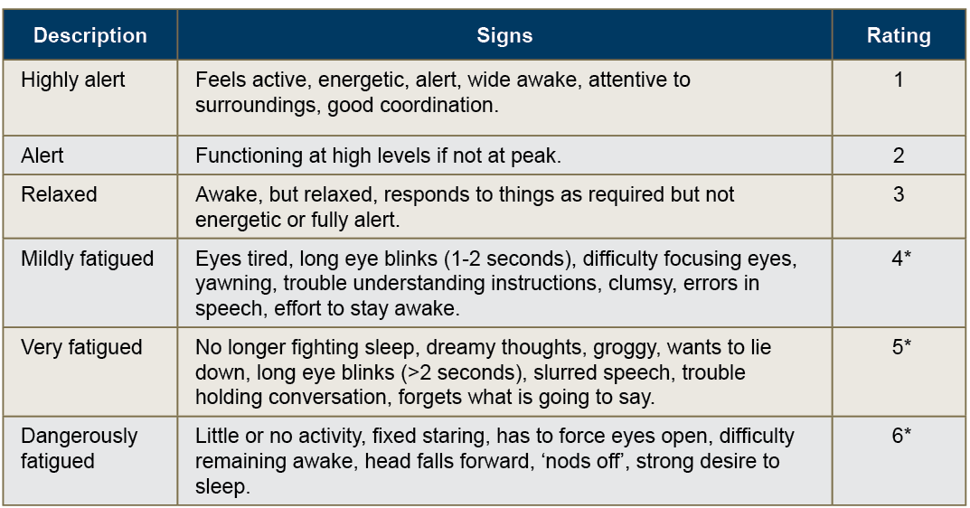
Signs of Fatigue (Ratings 4, 5, and 6)
* Individuals with ratings 4, 5, and 6 should not operate plant and equipment
Notes:
Discuss the signs of fatigue.

Slide 10
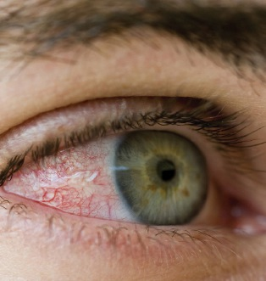
Controlling Fatigue
Lack of sleep is the number 1 cause of fatigue
Inform your Supervisor if you consider that you present a risk to yourself or others
Take steps to ensure that you do not present to work in a fatigued state
Identify and address the factors that are contributing to the fatigue
Seek professional help if necessary
Notes:
Explain that lack of sleep is the number 1 cause of fatigue.
If you are fatigued then getting more than 7-8 hours of sleep a night is critical.
Discuss the measures that you can take to control fatigue.

Slide 11
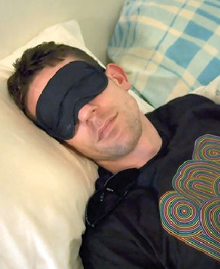
Controlling Fatigue (Cont.)
Organise good routine sleep habits
Have an afternoon nap the before the first night shift
Avoid heavy meals, alcohol, tea or coffee before going to bed
NOTE: Being awake for 17 hours is equivalent to a blood alcohol level of 0.05
Being awake for 20 hours is equivalent to a blood alcohol level of 0.1
Notes:
Discuss the importance of getting enough sleep.

Slide 12
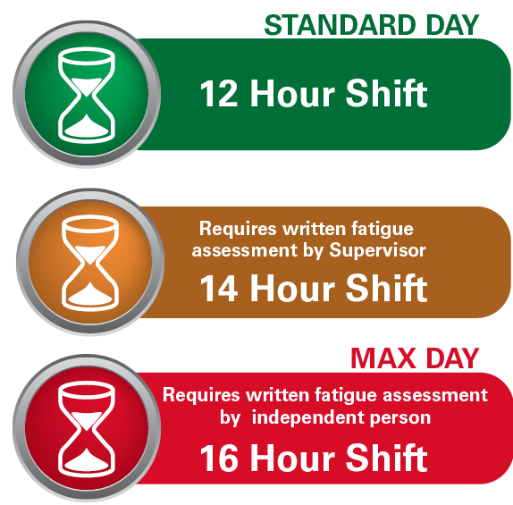
Ok Tedi Fatigue Management Guidelines
Shifts must be less than 16 hours in a 24 hour period
If a 12 hour shift is extended up to 14 hours, the Supervisor completes a written fatigue assessment before the extended work period
If a shift is extended beyond 14 hours the Supervisor and an independent must complete the written fatigue assessment
Where the maximum 16 hours on site is worked, alternative transport home is a MANDATORY requirement
  The minimum break following an extended work period is 10 hours
  Broken shifts must not be more than 12 hours in a 24 hour period
Notes:
Explain that:
Ok Tedi has the guidelines to control the risk of individuals becoming fatigued through working additional hours or shift work.
No shift is to be greater than 16 hours total in a 24 hour period.
Where a 12 hour shift is extended up to 14 hours (2 hour extension) a written fatigue assessment is completed by the supervisor of the person proposed to work the extended shift before commencing the extended work period.
Where a shift is extended beyond 14 hours (>2 hour extension) a written fatigue assessment is completed with the assistance of an independent person (such as the shift Emergency Response Officer) before commencing the 15th hour of work.
A person working any shift of 16 hours or more is offered alternative transport to their place of residence. For example, taxi or other travel provided by another person not suffering from, nor considered to be at risk from fatigue.
The minimum break following an extended work period must not be less than 10 hours.
Personnel working broken shifts should not work more than12 hours in a 24 hour period.
Regardless of the length of shift, if a worker, Superintendent, or Supervisor assesses a worker as suffering fatigue, or being at risk from fatigue, the Superintendent or Supervisor will arrange a means of alternative travel.

Slide 13

Emotional Issues and Stress
Anxiety
Clinical depression
General stress
Post traumatic stress disorder (PTSD
Eating disorders
Notes:
Explain that:
An individual’s fitness for work may be compromised by an altered emotional state (e.g. stress, depression, anxiety, eating disorder) which can pose a risk to themselves or others.
Your emotional state impacts on how you think, behave and interact with others.
Discuss the effects of stress, mental illnesses, and emotional issues on a person’s ability to work.

Slide 14
Emotional Issues and Stress (Cont.)
If someone tells you that they intend to commit suicide, you have an obligation to stay with that person and seek help from your Supervisor, or EAP personnel
Some warning signs of suicide are:
  Talking, writing or joking about death
  Talking about people who have committed suicide
  Withdrawing or avoiding contact with other people
  Giving away personal possessions
  Saying good-bye in a meaningful way
  Making arrangements for their funeral
  Risk-taking behaviour
  Deliberate self-harm or a suicide attempt
  Recent discharge from a psychiatric unit
  Evidence of depression
  Sudden calmness
Notes:
Discuss some of the warning signs of suicide.

Slide 15
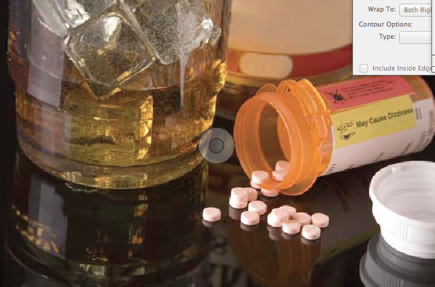
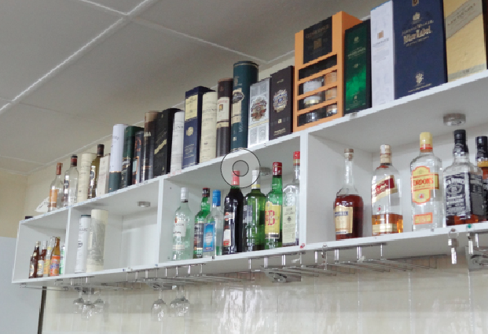
Alcohol, Illicit Drugs, Prescribed Medications
Zero tolerance policy for alcohol and illicit drug use in the workplace
All employees, contractors and visitors must have a 0.00 breath alcohol concentration and a confirmed negative drug test result
Alcohol and drugs include:
  All substances containing alcohol
  Drugs such as amphetamines, barbiturates, benzodiazepines, cannabinoids, cocaine, LSD, methadone, and opiates including over-the-counter and prescription medication
Notes:
Explain that individuals who present to work and have a positive reading will be sent back to the camp or their home and further action will be taken.

Slide 16
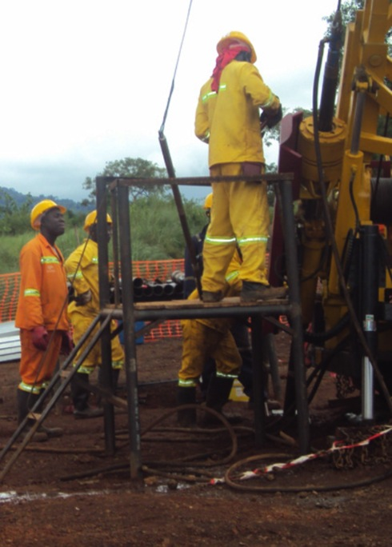
Alcohol, Illicit Drugs, Prescribed Medications
Side effects of alcohol, illicit drugs and some medications impact your ability to:
  Remain awake
  Remain alert
  React in a timely manner
  Make good judgement calls
  Function normally physically
Symptoms are similar to fatigue:
  Erratic, abnormal or unusual behaviour
  Increased rate of near misses or incidents
  Deteriorating work performance
Notes:
Discuss the side effects of alcohol, illicit drugs and some prescription and over-the-counter medications, including:
erratic, abnormal or unusual behaviour
increased rate of near misses or incidents
deteriorating work performance.

Slide 17
Alcohol and Drug Testing
Persons working or visiting a Ok Tedi site may tested at any time and without notice
Drug and alcohol testing is carried out:
  As part of the pre-employment health assessment
  When there is reasonable grounds to suspect a problem consistent with the use of drugs or alcohol
  Following a reportable accident or incident
  On a random basis in accordance with Ok Tedi procedures
Notes:
Ok Tedi employs suitably trained and authorised personnel to collect breath specimens for alcohol screening, and saliva and urine samples for drug screening.
Any person working or visiting a Ok Tedi site may be requested to provide a sample of urine or saliva and/or undertake a breath analysis test at any time and without notice.

Slide 18
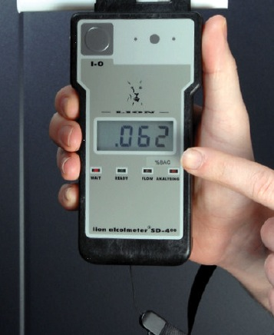
Alcohol and Drug Testing (Cont.)
Breath test for alcohol:
If a positive result is obtained from a breath test, a confirmatory test is performed after a 20 minute interval
If the second test is positive, both tests are recorded and treated as a positive result
If the second test is negative, the individual is cleared for work
Saliva test for drugs:
If a positive result is obtained from a saliva test then a confirmatory test is performed using a urine sample
Tampering:
If you tamper with test samples or results you will be summarily dismissed
Notes:
Explain that if a positive alcohol reading is obtained from a breath test, a confirmatory test is performed after a 20 minute interval. If the second test is positive, then both tests are recorded and treated as a positive result. If the second test is negative, the individual is cleared for work.
If a positive drug result is obtained from a saliva test then a confirmatory test is performed using a urine sample.
Explain that at Ok Tedi, tampering with test samples or results is a serious matter and is dealt with quickly by dismissing the employee or banning contractors and visitors from Ok Tedi sites.

Slide 19
Self-test Kits
Alcohol
Breath analysis self-testing equipment is accessible
If a positive reading results from the self-test, advise your supervisor immediately that you cannot commence work
The test will not result in disciplinary action provided that the self-test was undertaken before entering the main gates and starting work
If you self-test after starting work and a positive reading is obtained then disciplinary action may be taken
Drugs
Self-test drug kits can be purchased at the employee’s own expense
Notes:
Explain that anyone can access the breath analysis self-testing equipment.
If the reading is positive, advise your supervisor immediately that you cannot commence work.
The test will not result in disciplinary action provided that the self-test was undertaken before entering the main gates on site, before starting work, and before being informed that a random test is required.
Sick leave or annual leave entitlements can be considered on an individual basis.
Disciplinary action will be taken if a positive reading is obtained after your have presented for work.
Self-test drug kits are not provided free of charge by Ok Tedi.

Slide 20
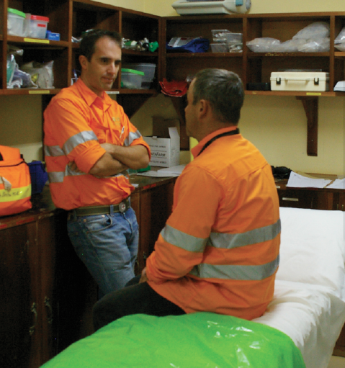
Physical Illness or Injury
If you are suffering from a physical illness or injury and believe that you are unfit for work notify your Supervisor
Notes:
Ok Tedi sites have people trained in first aid and, if the site is in a remote location it will also have trained medical personnel to deal with illness and injury cases.

Slide 21
Safety is EVERYONE’s Responsibility
Take accountability
Maintain a safe and environmentally friendly workplace
Address issues ASAP
Stop work if it’s unsafe
If in doubt – ask your supervisor
Remember our values
Notes:
Explain that:
everyone must take accountability for their own actions and address issues as they arise
every worker has the right to stop work if they think the situation is unsafe or unhealthy
if in doubt, stop and ask your supervisor.
Remember the Ok Tedi values that guide how we do the right thing.
Any questions about this topic?

