Slide 1
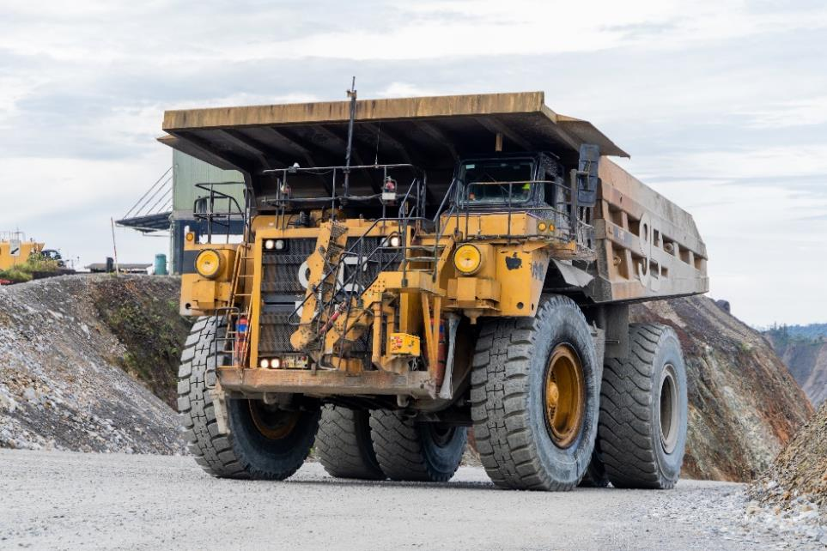

National Mine Safety Week (NMSW) 2023
Low Risk Driving

Slide 2
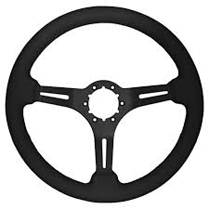
Correct Steering Techniques
Steering is one of the most important elements of driving, consider the following:
Look well ahead
Gentle Grip
Only steer when moving
Both hands on the wheel
Adjust the Wheel

Slide 3
Basic driving techniques
Before going down a hill
Reduce speed and select the correct gear before beginning the descent. The gear should be low enough to slow the vehicle without the constant use of brakes.
Braking going down hills
Brake failure can be prevented by good driving techniques.
Going up hills
Shift down early to prevent engine ‘lugging’ (shuddering or excessive vibration in the engine).

Slide 4
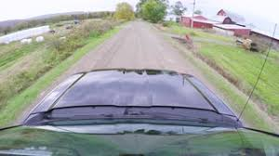

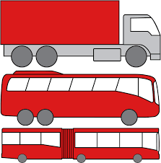
Low Risk Driving
Observation
The key to good observation
is scanning
Here is a summary of a good scanning
routine:
Scan up to 12 seconds ahead
Check your mirrors every 8 - 10 seconds
Check your blind spots using your mirrors
12 Seconds

Slide 5

Low Risk Driving
Following another vehicle
Keep 2-4 seconds behind the vehicle in front
Allows more time to stop
Gives you more time to move
4 Seconds

Slide 6
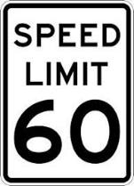

Low Risk Driving
Speed limits
Drive at a speed that is within the speed limit and that will allow you to react and completely stop within the distance you can see is clear.
Road warning signs
Warning signs let you know that road changes are coming up on your drive. These can be permanent or temporary traffic hazards and obstacles.

Slide 7
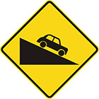
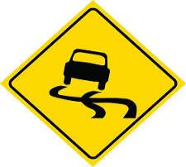
Low Risk Driving
Change in the road direction ahead
These warning signs let you know the road is going to change direction. You should drive with caution within the speed limit and follow the conditions of the road.
Driving in wet conditions
Wet roads reduce tyre grip and can result in loss of control. Drive at a speed that allows you to brake gradually and stop within the distance you can see.

Slide 8
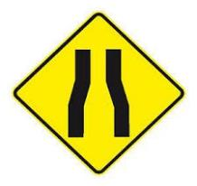
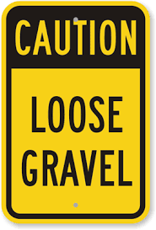
Low Risk Driving
Road and lane positioning
Position your vehicle to maximise the distance from hazards (also called buffering)
Driving on Gravel Roads
When driving on gravel roads or site roads give yourself more time to react, e.g. extend the 2 second rule to a 6 second rule and leave more distance between you and other vehicles. Know your tyres and be aware of reduced traction.

Slide 9
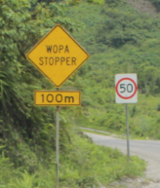
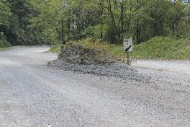
Wopa Stopper
The idea and design behind the Wopa Stopper is to catch the vehicle when there is brake failure. If you are not in control of the vehicle and have no other options available, then steer directly into the Wopa Stopper.

