Slide 1
Conduct Local Risk Control
Training Package
Notes:
Welcome.
Introduce yourself.
Outline your experience.
Explain where the facilities are and any OHS issues if necessary
Timeframe for the course.
Handouts:
- Attendance Sheet - get all trainees to sign
- Training Material (Reference book, permits, etc).
Any questions?

Slide 2
Introduction
To successfully complete this unit you must demonstrate that you can:
Plan and prepare for risk control
Assess and identify unacceptable risk
Identify, assess and implement risk treatments
Complete records and reports
Notes:
Briefly explain:
This information supports competency unit RIIRIS201 which is part of the Resources and Infrastructure Industry (RII) training package.

Slide 3
Operator Obligations
Be fit for work
Comply with your site Code of Conduct
Be qualified and authorised
Select and use the correct PPE
Report unsafe conditions or activities
Report faults
Operate equipment and perform tasks safely
Use site lock and tag system
Notes:
Discuss the obligations of an operator.
Emphasise that the operator’s main obligation is to ensure their own health and safety, and that of others.

Slide 4
Plan and Prepare for Operations
Planning and preparation includes:
Attending shift briefings and handovers
Obtaining, interpreting and applying relevant documentation
Confirming communication methods and requirements for task
Notes:
Outline the process and importance of planning and preparing for a task.
Discuss why it is necessary to have all the information needed to conduct tasks.

Slide 5
Attend Shift Briefings and Handovers
Information includes:
Situational report
What tasks each person will be doing
Location and status of work in area
Known hazards and control measures
Other evens that may occur:
Road closures
Shutdowns
Notes:
Explain the purpose of a shift briefing / handover.
Outline the information that should be discussed during a shift briefing / handover.

Slide 6
Documentation
Documentation |  | Example
Government | Acts | PNG Mining (Safety) Act 1977
 | Regulations | PNG Mining (Safety) Regulations
Industry | Codes of Practice | Hazardous Manual Tasks - Code of Practice
 | Standards | ISO 31000 Risk Management Standard
Organisation | Management Systems | OTML Integrated Management System
 | Policies | Safety and Occupational Health Policy
 | Procedures and Work Instructions | Emergency Response Procedure
External | Equipment Specific Documents | Operations and Maintenance Manual, User Guide, Parts Catalogue
Notes:
Discuss the legislation and site policies relevant to your work site.
List some of the compliance documentation relevant to your work site.
Suggested Activity
Help the learners to access relevant compliance documentation and give them the opportunity to read through the information.

Slide 7
Working with Others
Communicate and coordinate work with others
Effective communication and teamwork helps efficient operations
A team approach can be used to:
Inspect work area
Identify hazards
Determine risk controls
Analyse options
Select and implement controls
Review effectiveness
Complete records
Share information to keep everyone safe
Notes:
Discuss the importance communicating clearly and concisely with others.
Discuss the occasions during the risk control process where you would be likely to communicate with others.

Slide 8
Communication Methods
Oral communication during risk management processes:
Face-to-face
Shift briefings
Safety Shares
Toolbox talks
Communication Equipment
Radio
Phone
Written communication for reporting results:
Risk management tools
Hazard ID form
Safe Work Procedures
Notes:
Discuss using the most appropriate communication methods.

Slide 9
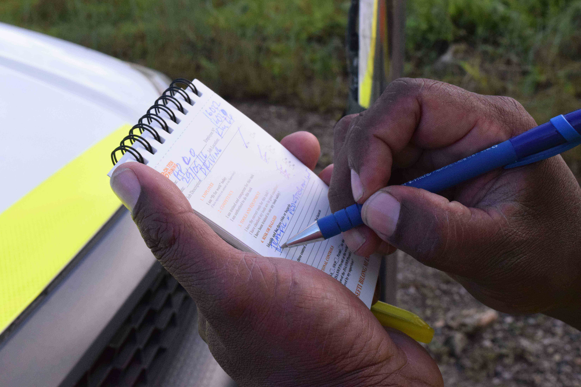
Communication Requirements
Communicating in person:
Speak clearly and directly
Listen carefully
Ask questions and give feedback to confirm your understanding
Respond promptly
Communicating in writing:
Write clearly, use plain words
Keep document brief
Use forms and templates
Read contents before submitting
Communication Equipment
Know how to use
Inspect before use
Have backups
Notes:
Discuss the guidelines for communicating in person and in writing.

Slide 10
Conducting Local Risk Control
Identify the hazards
Identify existing and potential controls
Assess controls and select the most appropriate
Implement controls
Monitor the effectiveness of the controls
Communicate the process and outcomes
Notes:
Outline the steps involved with conducting local risk control.
These steps will be covered in more detail with the next few slides.

Slide 11
Understanding Risk
Notes:
Risk control is everyone’s responsibility.
Define the key terms relating to risk control.

Slide 12
Use Your Senses
Notes:
Remind the learners of the following points:
They should look wide, high, low, close, left, right and behind and use all their senses to identify hazards
Hazards are not always obvious
Several hazards may exist at once.
Fill in the appropriate checklist as you do your inspections.
Suggested Activity:
Have the learners brainstorm all the possible hazards in the classroom.

Slide 13
Major Hazard Scenarios
Notes:
Explain what constitutes a major hazard.
Discuss the purpose of identifying major hazard scenarios and the requirements to use the major hazard scenario register when conducting risk management activities.
ACTIVITY: If time and resources allow, have the participants access the Major Hazard Scenario Register in Sharepoint and discuss.

Slide 14
Common Mine Site Hazards
Notes:
Risks can only be controlled if they are known. The first step is to identify the hazards.
Discuss the process for identifying hazards.

Slide 15
Inspecting the Work Area
Ground and environmental conditions
Potential security issues
Obstructions such as:
Other personnel and equipment
Power / service lines
Drains
Boundary and other markers
Highwall and bench edge instability
Hazardous substances
Notes:
Discuss the importance of conducting a hazard inspection of the work area and why hazard inspections are conducted.
Discuss what to look for when conducting work area hazard inspections.

Slide 16
Inspect Tools and Equipment
Inspect all tools and equipment before and after use
Inspect for:
Faults
Damage
Suitability to task
Faulty or damaged equipment:
Isolate from service
Tag Out of Service
Report
Notes:
Explain how inspecting tools and equipment before and after use is important in the hazard identification process.
Discuss the requirements for finding faulty or damaged tools and equipment.

Slide 17
Observe and Report Unsafe Conditions
Observe and report unsafe:
behaviours
work systems
processes
Report so that no one gets hurt!
Notes:
Discuss the process for reporting unsafe behaviour and conditions.
Emphasise that the purpose of reporting is not to lay blame or get anyone into trouble, but to ensure that an unsafe condition can be addressed before someone gets hurt.

Slide 18
Hazard Identification Tools
Take 5
Stop
Think
Identify
Plan
Proceed
Job Safety Analysis
Team based
Determine Risk Rating
Notes:
Discuss the use of Take 5s and JSAs.
Suggested Activity:
If time permits, get the participants to complete a Take 5 and a JSA for the classroom and the training they are doing.

Slide 19
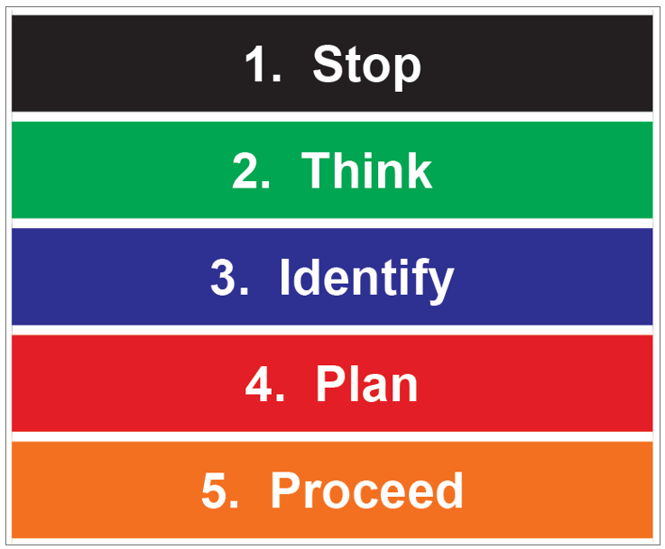
Take 5 Steps
Notes:
Discuss the procedure for completing a Take 5.

Slide 20
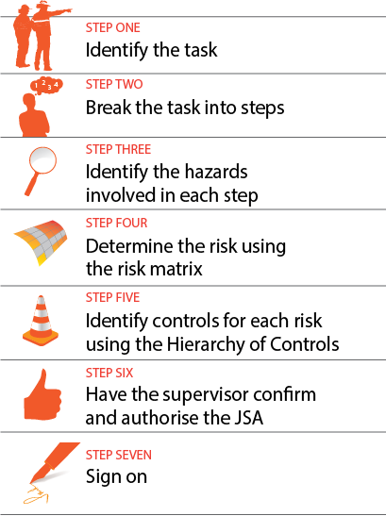
Job Safety Analysis Steps
Notes:
Discuss the procedure for completing a JSA.

Slide 21
Identify Existing and Potential Controls
Talk to others
Check:
Key Control Data Sheets
JSAs, Take 5s, Work Clearances
Procedures and Work Instructions
Reports
Are existing controls effective?
If unresolved hazards, stop work and talk to supervisor
Determine the potential likelihood and consequence of an event if hazards are not controlled
Identify and implement additional controls
Notes:
Explain why it is important to check if there are existing and potential controls for the identified hazard.
Explain:
Where to find this information
Who to speak to
What to do if there are unresolved hazards.
Reinforce that if it is identified that a control is already in place, the control must still be checked and confirmed that they are effective.
Discuss the process to follow if there are still uncontrolled hazards.

Slide 22
Key Control Data Sheets
Developed in consultation with operators and SMEs
3 Sections:
Operational Requirements
Task Requirements
Design Requirements
Notes:
Explain the purpose of, and how to access the KCDS
Discuss the three sections of a KCDS

Slide 23
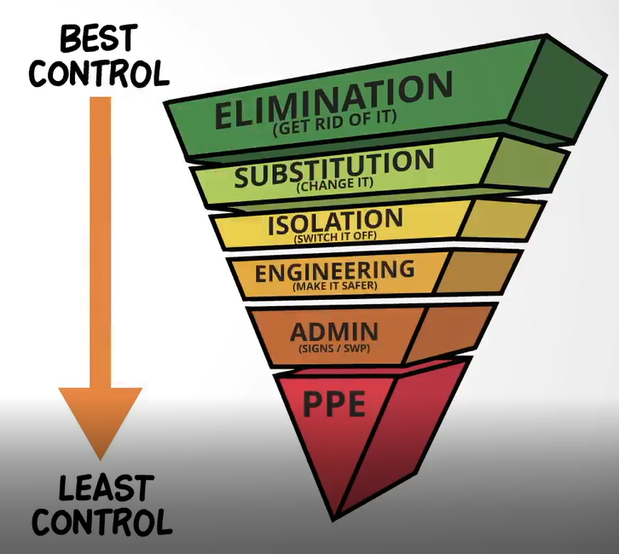
Assess and Select Other Controls
Notes:
Discuss the importance of assessing and selecting the most appropriate controls for the hazard.
Discuss the role of the hierarchy of controls in hazard management.

Slide 24
Safety Management System
A systematic approach to managing workplace health and safety risks
Includes:
The Ok Tedi Way
Duty of Care
OTML Life Saving Rules
Integrated Management System
Policies, Procedures and Work Instructions
Risk Management Tools
Work Clearances
Notes:
Explain the purpose of a Safety Management System.
Discuss the documents that make up OTML’s Safety Management System.

Slide 25
Personal Protective Equipment (PPE)
Notes:
Discuss the mandatory and additional PPE required for certain tasks.
Explain that PPE requirements are discussed at shift briefings, and is displayed on signage.
Emphasise that PPE must be suitable for the task, correctly fitted, clean and undamaged.

Slide 26
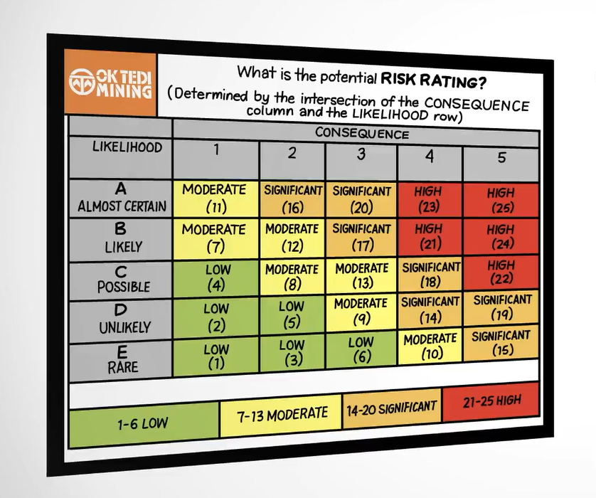
Implement Controls
Reduce the risk So Far As Reasonably Practicable (SFARP)
Determine the risk rating to ensure the appropriate approval level
The risk rating is determined by cross referencing the maximum possible consequence with the likelihood of an event happening
Notes:
Discuss the implementation of hazard controls.
Explain what is meant by the term SFARP.
Explain that risk ranking is used to prioritise information and to ensure the correct level of approval is obtained.
Discuss risk priority - the higher the risk, the higher the priority for establishing controls.
Explain the terms likelihood and consequence.
Note to Trainer: Refer to the definitions and consequences in the site risk matrix tool. Use these definitions to determine the most credible consequence and likelihood of an event.

Slide 27
Determining and Implementing Controls
Talk to others to identify all possible controls
Assess each control in terms of effectiveness versus resources
Select the most appropriate
Develop an implementation plan and get it approved
Implement the plan
Review the outcome
Notes:
Outline the steps involved with determining and implementing the most appropriate controls.
Emphasise that this requires the cooperation and assistance of other personnel who are impacted by the task, the hazard and the control measures, so clear communication is necessary to successfully manage the risks.

Slide 28
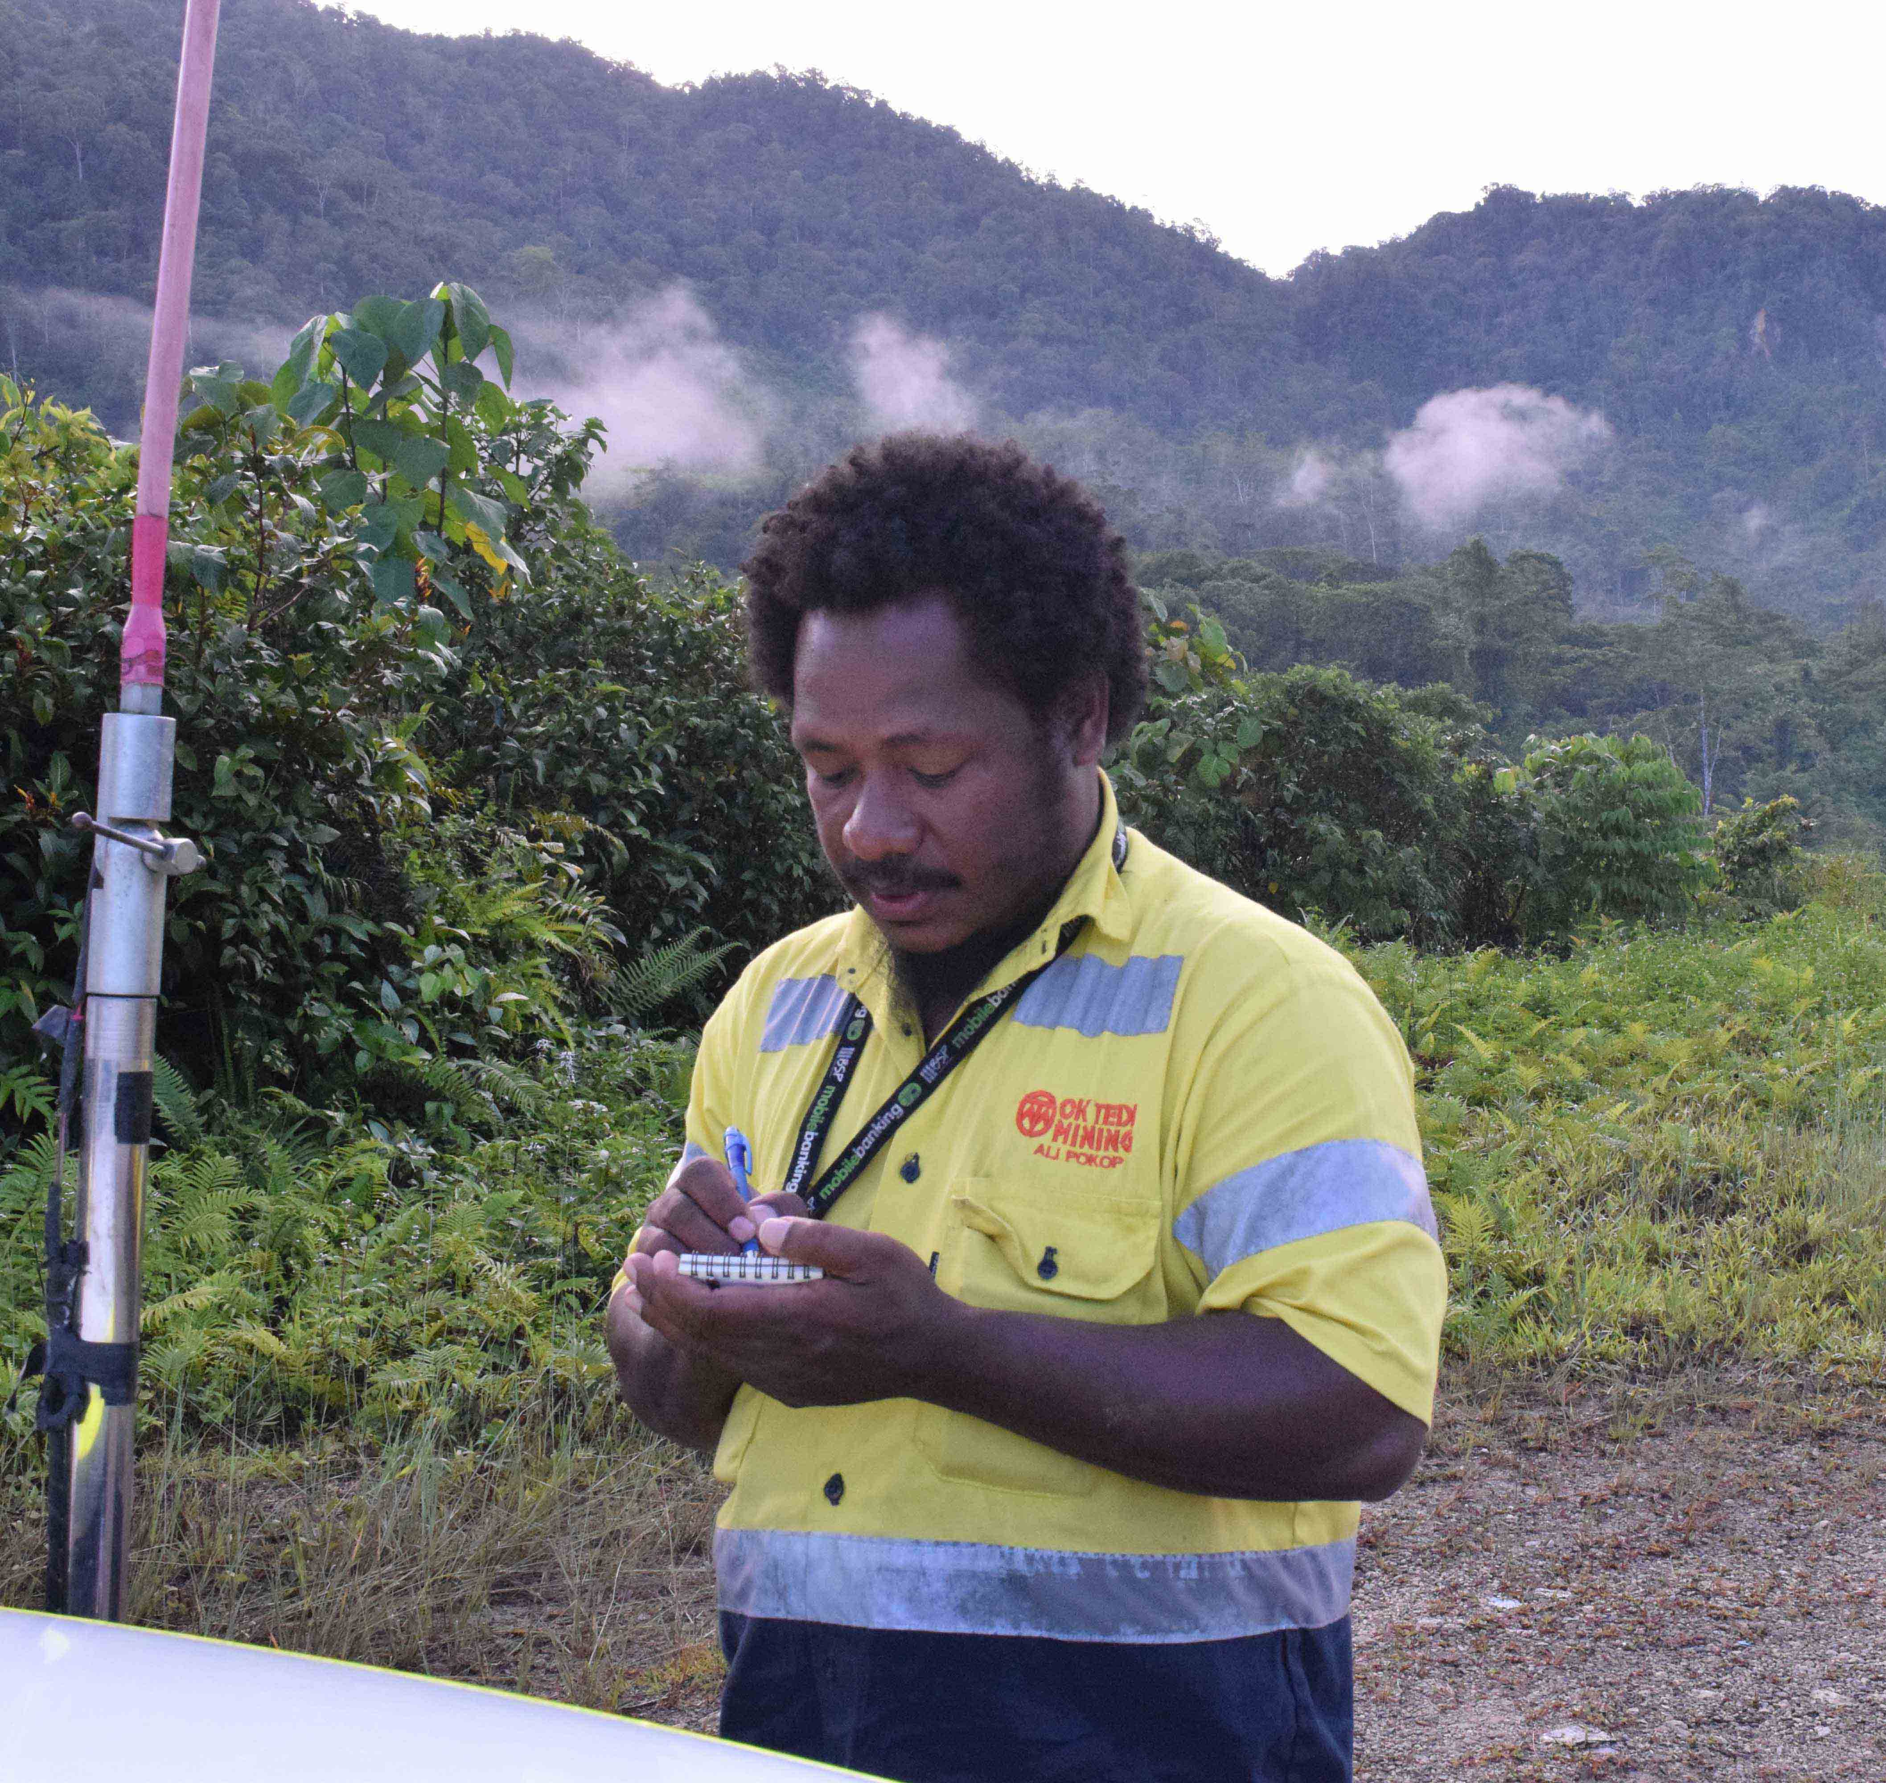
Monitor Controls
Once all controls have been implemented:
Confirm the risk is controlled SFARP
Ask:
What types of controls are provided?
Are they adequate?
Are there enough controls?
Does the combination of controls match the hazard?
Are the controls maintained in working order at all times?
What contingency planning is provided?
Notify supervisor if risk is unacceptable
Notes:
Discuss that controls are monitored to ensure that they are effectively eliminating or reducing the risk to an acceptable level.
Briefly discuss the questions to ask when monitoring controls.
Discuss the action to take if controls are ineffective.
Emphasise that controls can sometimes introduce new hazards and these must also be controlled before work begins.

Slide 29
Recording and Reporting
Important source of information
Way of communicating
Include:
Risk Assessments
Hazard ID reports
Incident reports
Defect reports
Shift reports
Handover reports
Log books and action registers
Notes:
Discuss the importance of recording and reporting hazards and risk control measures.
Briefly explain:
Each report (where applicable)
How the recorded information is used for risk control
How information is stored and communicated.
Suggested Activity
Allow the learners to practice accessing and completing various reports with a real or simulated situation/data.
Explain the process for submitting reports according to OTML procedures.

Slide 30
Summary
Do you have any questions?
Notes:
This training material provided information on using hand and power tools.
Summarise the points.
Ask if there are any questions.
Explain the assessment procedure for this unit.

