Slide 1
Introduction to Major Hazards
Awareness Package

Slide 2
Introduction
Major hazards are those that could result in serious injury or fatality, major equipment or environmental damage or major production losses for the organisation.
During National Mine Safety Week we will be looking at how to control the following Major Hazards:
  Work at Height
  Vehicle Interaction
  Malaria
  Confined Space
  Suspended Loads and Dropped Objects
  Health for Life
  Unplanned Movement of Equipment
  Rotating Equipment.

Slide 3
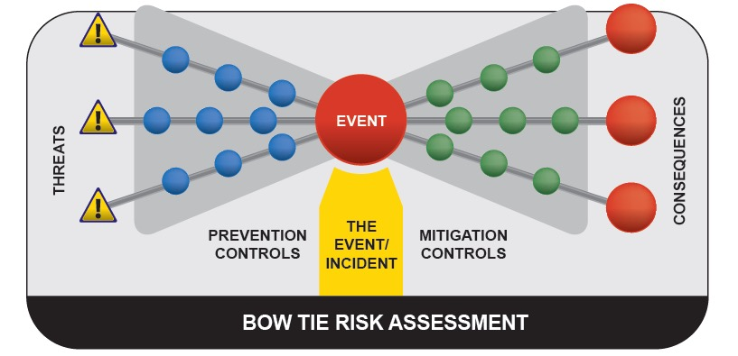
How do we Identify Major Hazards?
Each major hazard scenario is recorded in a bowtie diagram.

Slide 4
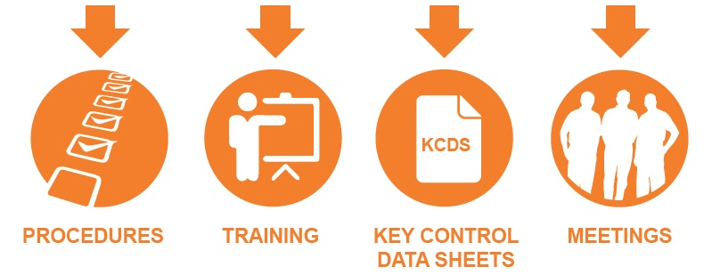
How do we Identify Major Hazards?
Key Controls are identified through this process and communicated across the organisation, in procedures, training and pre-start meetings.

Slide 5
What are Key Controls
  Key Controls are the actions, processes, physical items and behaviours that are the most likely to prevent a serious injury or fatality, large scale equipment or environmental damage and / or major loss to the organisation.
  Key Control Data Sheets (KCDS) have been developed and are available on the OTML internet.
  The KCDS:
    Define the controls that must be in place
    Set out the responsibilities for Supervisors and Operators to implement the controls
    List relevant standards, rules and references to be considered when making changes to equipment, procedures, processes and systems.

Slide 6


Introduction to Major Hazards
Click below to watch a short video introduction about safety, hazards and controls at Ok Tedi.

