Slide 1
Enter and Work in
Confined Space
Training Package
Notes:
Welcome.
Introduce yourself.
Outline your experience.
Explain where the facilities are and any OHS issues if necessary
Timeframe for the course.
Handouts:
- Attendance Sheet - get all trainees to sign
- Training Material (e.g. reference book).
Any questions?

Slide 2
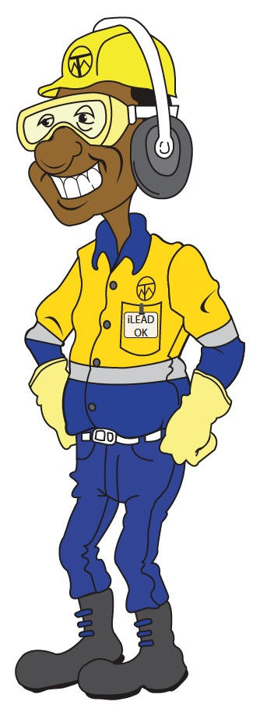
Introduction
  A confined space is an enclosed or partially enclosed space not designed for human occupancy where there is a risk of:
  Unsafe oxygen concentration
  Airborne contaminants
  Flammable airborne contaminants
  Engulfment
  Learning objectives:
  Identify a confined space
  Plan and prepare for entry and worn in a confined space
  Obtain and complete appropriate authorisations
  Identify and control hazards
  Enter and work in a confined space
  Perform post operational tasks
Notes:
Discuss the definition of a confined space.
Explain the following:
Under normal atmospheric conditions the oxygen volume ranges from 19.5% to 23.5%
Airborne contaminants include any:
Dust
Fume
Mist
Vapour
Biological matter
Gas
Other substance or liquid or solid form.
Flammable airborne contaminants include:
Dust
Fume
Mist
Vapour
Gas.
Learning Objectives: By the end of this training the learners will be able to:
Identify a confined space
Plan and prepare for entry and work in a confined space
Obtain and complete appropriate authorisations
Identify and control hazards
Enter and work in a confined space
Perform post operational tasks.
Assessment procedure:
Successful completion of this unit requires that the trainees can demonstrate the required skills, knowledge and practical application in the workplace.
The assessment procedure consists of practical assessment supported by questions asked by the Assessor.

Slide 3
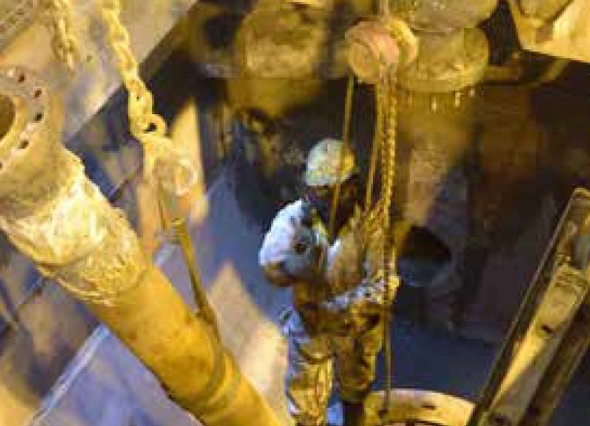
Types of Confined Spaces
  Storage tanks
  Silos
  Process vessels
  Boilers, pressure vessels
  Open-topped spaces, pits, degreasers
  Pipes, sewers, shafts, tunnels
  Ditches, trenches
  Enclosed spaces entered through a small access point
Notes:
Discuss the types of confined spaces and specifically the types and locations of confined spaces at your site.
Explain that on OTML sites a confined space does not include enclosed or partially enclosed spaces that are designed primarily for human occupancy, even when these spaces can have atmospheric hazards due to the activities taking place in them, including:
Offices
Workshops
Abrasive blasting booths
Spray painting booths.

Slide 4
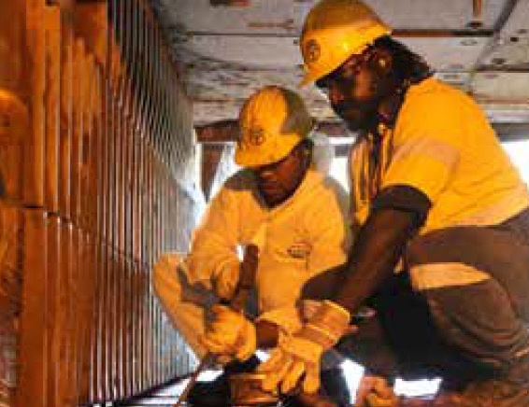
Confined Space Register
  Record of:
  Pre-determined confined space
  Location of confined space
  Confined space number
  Description of confined space
  Signs placed at entry point
Notes:
Discuss the confined space register on your site and where to find it.
If a copy is available show it to the trainees.
Explain the:
Confined space audit process and who conducts it
Confined Space Safety Data Sheets are developed and kept in the register and are used as a reference for JSA, ATW and Confined Space Entry Clearance Certificate
Action to take if trainees believe that there may be an unidentified confined space onsite:
Do not enter space
Contact supervisor immediately
Conduct a risk assessment / audit.
Group Discussion: Discuss the confined spaces in the work area of the trainees.

Slide 5
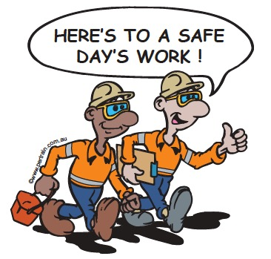
Operator Obligations
  Be physically and mentally fit to enter confined space
  Do not attempt to enter and work in a confined space without:
  training and authorisation
  required ATW and clearances to perform the work
  Select, check and use appropriate PPE
  Report unsafe conditions, activities, incidents or near misses
  Report damaged or defective equipment
  Use your lock and tag system
  Operate equipment within manufacturer specifications
  Adhere to site environmental requirements
Notes:
Discuss the obligations of all personnel who are required to work in or around confined spaces.

Slide 6
Roles and Responsibilities
  Responsibilities vary depending on your role during the work
  Confined Space Entry Authorisation Issuer
  Confined Space Entry ATW and Clearance Acceptor
  Confined Space Entry ATW and Clearance Users
  Confined Space Standby Person
  Confined Space Atmosphere Gas Tester
Notes:
Discuss the roles and responsibilities of personnel in relation to working in a confined space.
While attendees may not fulfill each of these roles it is important that they understand how the roles work together.

Slide 7
Legislation and Site Policies
Documentation |  | Example
Government | Acts | Mining (Safety) Act
 | Regulations | Mining (Safety) Regulations
Industry | Codes of Practice | Code of Practice for Managing the Risk of Falls at Workplaces (Australia)
 | Standards | AS/NZS 1891.4 Industrial Fall-arrest Systems and Devices
Organisation | Management Systems | Authority to Work System
 | Policies | Fit for Work Policy
 | Procedures | Procedures and Work Instructions
Notes:
Explain why workplaces must comply with legislation, standards and site policies.
Outline the documentation that must be accessed and followed to ensure that work activities are compliant.
Outline the requirements of relevant compliance documentation.
Explain where this information can be accessed, e.g. portal, during shift briefing.

Slide 8

Environmental Legislation
  Dust prevention and minimisation
  Control fumes and exhausts
  Water quality
  Noise and vibration control
  Safe handling of hazardous substances
  Waste management
Notes:
Discuss the importance of minimising impact to the environment when working in confined spaces, such as:
Diverting water
Exhausts from purging space
Wastes products
Hazardous substances.
Ask the trainees for suggestions about ways to minimise the environmental impact when working in a confined space.

Slide 9
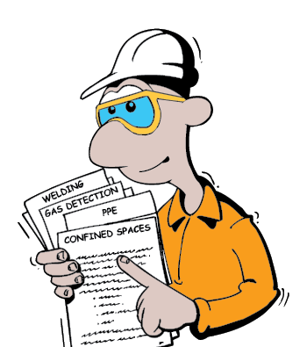
Plan and Prepare for Operations
  Attend shift briefings/pre-start meeting
  Obtain information:
  Job requirements
  Site and task procedures
  Authority to work
Notes:
Explain that no work should start until all the information has been received and understood.
Discuss the importance of work briefings or pre-start meetings.
Discuss the site requirements for planning and preparing for tasks, such as:
Developing a work plan with supervisor
Understanding the task
Gathering all the required information for the task.

Slide 10
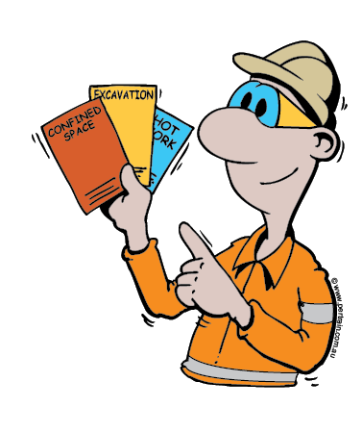
Authority to Work System
  System used to plan, control and complete work safely
  Requires communication, coordination and risk assessment
  All persons involved with ATW must sign on and off
  ATWs may be required for:
  Confined space entry
  Hot work
  Working at height
  High voltage access
  Digging or excavation
Notes:
Explain to the trainees the process of obtaining an Authority to Work and Confined Space Clearance Certificate. If available show the trainees copies of completed forms (site specific).
Explain that:
The Authority to Work and Confined Space Clearance Certificate must be checked and approved by the authorised ATW issuer before work can commence.
Additional clearances may be required due to the type of work to be performed, such as hot work, ground penetration, excavation.

Slide 11
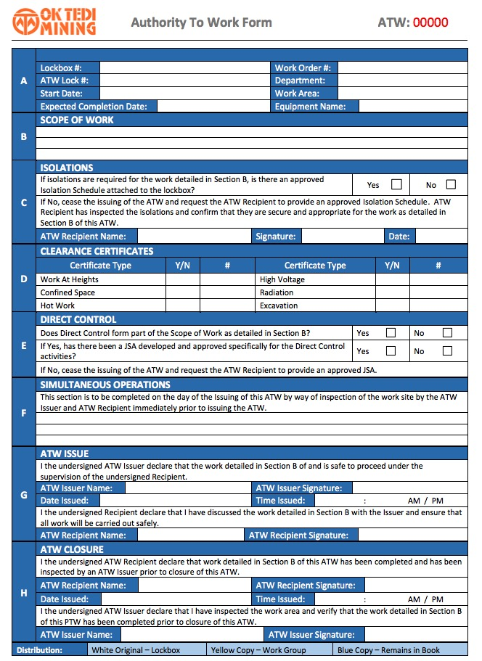
Confined Space Entry Authorisation
Notes:
Discuss the elements that make up the ATW and Confined Space Clearance Certificate, including:
Location
Checks and inspections
Hazards
Controls
Personnel involved
ATW holder
Job steps
Authorisation
ATW closure and sign off.

Slide 12

Hot Work Clearance
  Hot work includes:
  Welding
  Grinding
  Oxy cutting
  Hot Work Clearance must be:
  Completed if hot work is to be conducted in confined space
  Authorised
  Attached to Confined Space Entry ATW
Notes:
Explain your site requirements for performing hot work within a confined space.
Discuss the types of hot work that can be performed in a confined space at your site.

Slide 13
Interpret Information and Plan Work
  Your plan should include:
  How task will be done
  What equipment is needed
  How hazards will be controlled
  What work area preparation is required
  Procedures for communicating and coordinating work with others
Notes:
Discuss the importance of interpreting work requirements and information.

Slide 14

Conduct Site Safety Inspections
  Before starting the task you should:
  Check travel route and work area
  Check access and planned exit route
  Check work area layout and location
  of confined space
  Check support personnel and equipment
  are available
  Coordinate work schedule with other operators
Notes:
Discuss the importance of inspecting the site before starting any work.

Slide 15
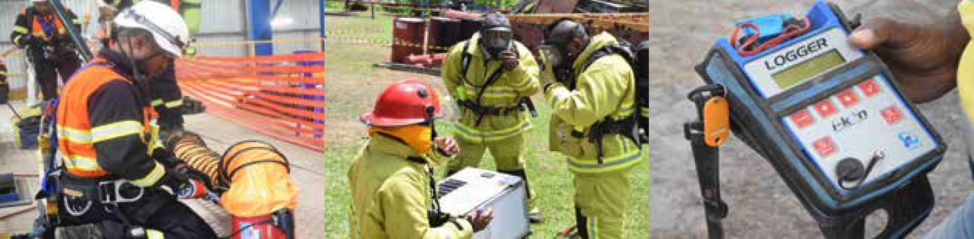
Select Tools and Equipment
  Check you have required safety equipment for task, including:
  Gas detectors
  Respiratory protective devices
  Do not use equipment that is in an unsafe condition
  Respond to alarms and indicators
  Isolate defective equipment and tag out of service
  Report damaged or defective equipment
Notes:
Discuss the importance of selecting appropriate tools and equipment for the task.

Slide 16
Confined Space Hazards
Hazard | Example
Structural | Unstable design, restricted access, restricted working area
Atmospheric | Toxic gases, oxygen too high or too low, flammable and explosive gases, biological contaminants
Energy | Electricity, radiation, stored energy, moving parts
Environmental | Noise, light, visibility, temperature
Surfaces | Irregular, elevated, slippery
Material Shift | Bulk material shifting or collapsing
Barrier Failure | Flooding, release of free-flowing solid
Psychological | Claustrophobia
Notes:
Discuss the hazards associated confined space work.
Give examples of these types of hazards on your site, where applicable.
NOTE: This list above is not exhaustive.
NOTE: Confined space hazards are addressed in detail in the coming slides.

Slide 17
Toxic Gasses
  Effects of breathing in toxic gases include:
  Increased respiration
  Headaches and dizziness
  Impaired judgement
  Drowsiness and fatigue
  Brain and nerve damage
  Respiratory illness
  Cardiac arrest
  Unconsciousness
  Death
Notes:
Discuss toxic gases and confined spaces and the possible health effects/consequences.
Reinforce the following points.
Majority of toxic gases are colourless, odourless and tasteless.
Poisonous gases include:
Hydrogen sulphide
Nitrogen dioxide
Sulphur.
Gases that do not support life include:
Hydrogen
Methane
Nitrogen
Carbon dioxide.
Carbon monoxide is known as ‘insidious’ as it displaces oxygen in the blood.

Slide 18
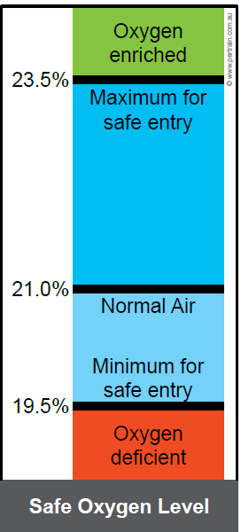
Oxygen Content
  Causes of oxygen deficiency include:
  Combustion from welding
  Inorganic reactions from rust
  Bacterial reaction from sewerage
  Low oxygen levels can cause:
  Breathing problems
  Fatigue
  Unconsciousness
  Death
  Oxygen enriched atmosphere can lead to:
  Material burning easily
  Explosions
Notes:
Discuss the following points.
The air within a confined space can be oxygen deficient or oxygen rich.
Oxygen deficiency can be caused by:
Combustion from welding, heating or cutting
Bacterial reaction - occurs in sewerage
Inorganic reactions - rust in a tank
Oxygen absorption - grain in a silo
Displacement of another gas - nitrogen used to purge a vessel
High oxygen consumption rate - too many people working in the space.
Oxygen rich environments are highly explosive as materials can burn easily.

Slide 19
TOXIC GASES
  Most gases are colourless, odourless and tasteless
  Effects of toxic gases may include:
  Increased respiration and respiratory illness
  Disturbed heart rate and cardiac arrest
  Headaches and dizziness
  Poor muscle control
  Impaired judgement
  Emotional issues
  Drowsiness and fatigue
  Brain and nerve damage
  Unconsciousness
  Death
Notes:
Discuss the characteristics, types and effects of toxic gases in the air.
There is additional information on various toxic gases in the reference book.

Slide 20
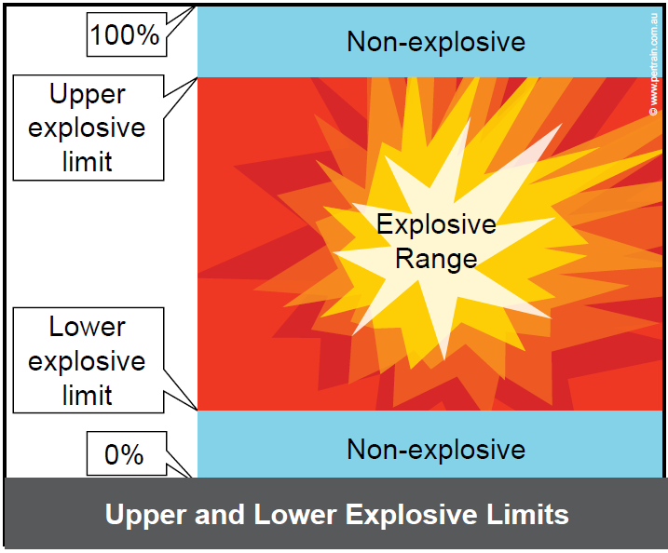
Explosive Atmosphere
Notes:
Discuss the following points regarding explosive atmospheres.
Gases that reach their flammable limits or come in contact with an ignition source can cause an explosion or fire.
A gas will become flammable when its concentration falls within a particular explosive range, for example:
Methane explosive range is 5% to 15%, this means that when the concentration drops below 5% (lower explosive limit LEL) the methane/air mixture is too lean to explode, over 15% (upper explosive limit UEL) the concentration is too rich to support combustion
The risk occurs in the explosive range when the mixture of methane and air is dangerous.

Slide 21
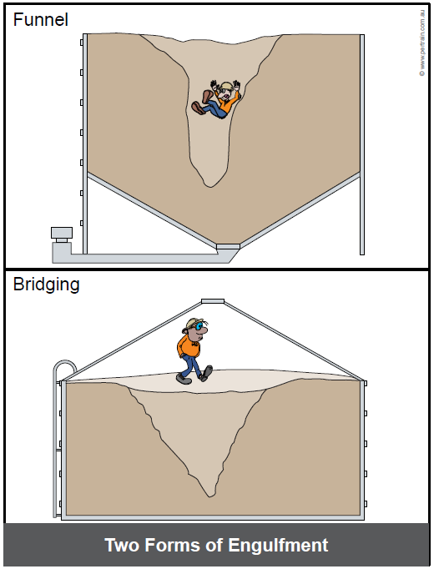
Engulfment - Storage Containers
  Engulfment of stored materials:
  Funnelling
  Bridging
Notes:
Discuss engulfment in storage containers.
Explain what is meant by funnelling and bridging.
Explain the location onsite of similar containers, if applicable.

Slide 22
Engulfment - Excavations
  Material can collapse when trench is not adequately shored
  Use a trench box
  Batter or bench walls
Notes:
Explain how engulfment can occur in an excavation.

Slide 23
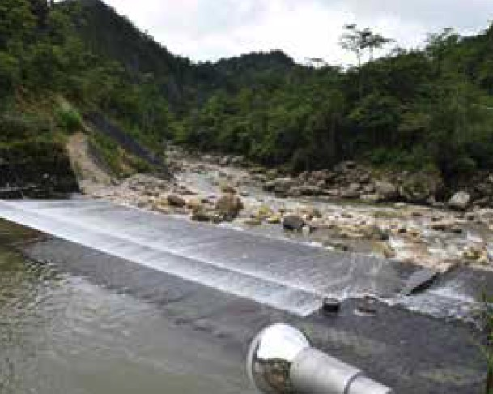
Engulfment - Flooding
  Steam
  Water
  Gas leaks
  Industrial waste
  Sewerage
Notes:
Explain the types of confined spaces onsite that may be subject to flooding if appropriate control measures are not implemented.

Slide 24

Biological Hazards
  Micro-organisms such as:
  Viruses
  Bacteria
  Fungi
  Contact can lead to:
  Infectious diseases
  Dermatitis
  Lung infections
Notes:
Discuss biological hazards associated with confined spaces, particularly working in and around sewers, water treatment plants and grey water run-off areas.

Slide 25
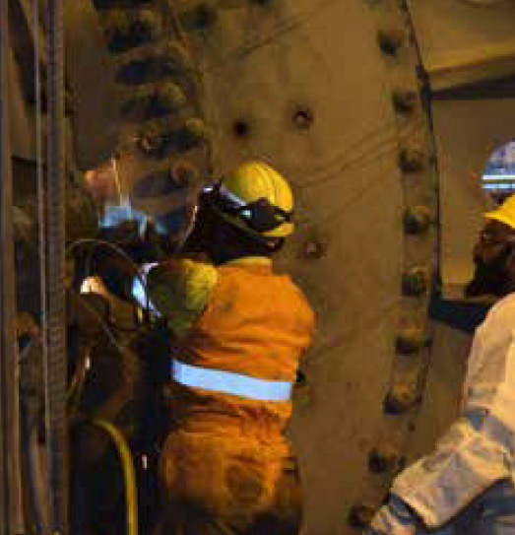
Hot Work and Heat Stress
  Hot work activities can increase potential for:
  Fire
  Explosion
  Heat related illnesses can be caused by poor air movement
Notes:
Discuss the hazards associated with doing hot work in a confined space.
Explain that hot work within a confined space will require an associated clearance certificate.
Explain how quickly heat can build up in a confined space without adequate air flow and that this can cause heat related illnesses.

Slide 26
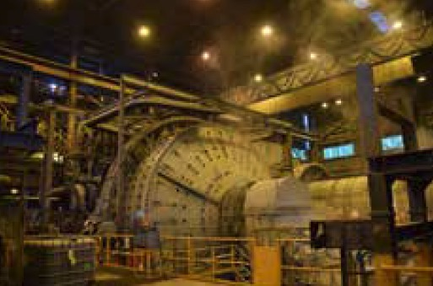
Mechanical Hazards
  Augers
  Agitators
  Blenders
  SAG and ball mills
  Conveyors
  Mixers and stirrers
Notes:
Discuss the potential consequences of working in confined space when mechanical equipment has not been isolated, including:
Struck by moving objects
Entanglement
Crushing
Cutting
Piercing or shearing parts of a person’s body.

Slide 27
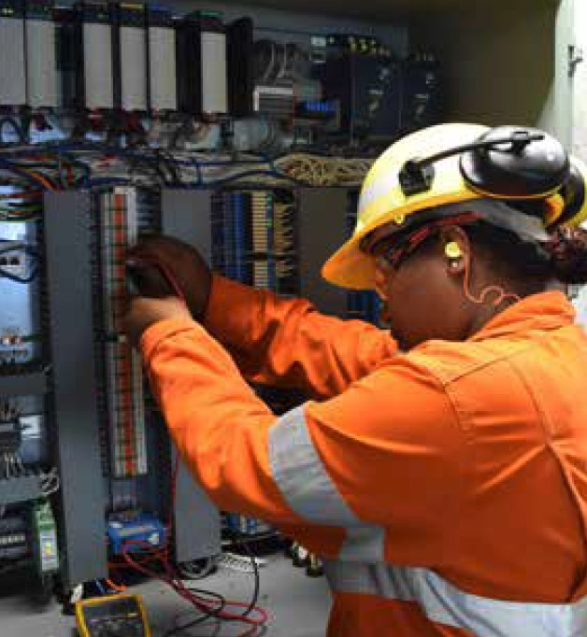
Electricity
  Electrical hazards within a confined space include:
  Damaged or faulty wires, cables
  Arc welding cables
  Wet, humid environment
Notes:
Discuss the hazards associated with using electrical equipment in confined spaces.
Group Discussion: Discuss the hazards that working in and around confined spaces at YOUR worksite presents.

Slide 28
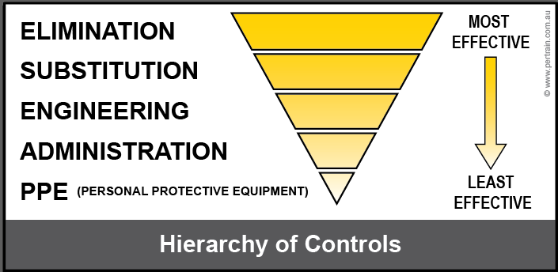
Implementing Controls
  Conduct a personal risk assessment if:
  The task is unfamiliar to you
  You are unsure that your work can be carried out safely
  The task is potentially hazardous
  The task is potentially a high-risk activity
  Use and apply the hierarchy of controls
Notes:
Explain the following points.
That hazards must be identified and controlled to avoid an incident or emergency.
The site hazard analysis tool must be used to identify and control hazards.
Refer to the hierarchy of controls to assist with the implementation of controls.
Group Discussion : Ask the trainees how they would use the hierarchy of controls for confined space entry:
How would they eliminate the hazards?
What can be used as a substitute?
How can the hazard be engineered out?
What administrative controls are available onsite?
What type of PPE would you need to use?

Slide 29
Controls
Hazard | Example of Control Measure
Access | Signage and barricades
Atmosphere | Atmospheric testing Ventilation and purging
Heat | Rotate personnel Limit exposure
Machinery | Isolation
Electricity | Isolation
Engulfment | Isolation Shoring
Flooding | Pipeline isolation
Biological | PPE
Notes:
Discuss the hazards and the suggested control measures.
Discuss the additional controls that are required at your site.

Slide 30
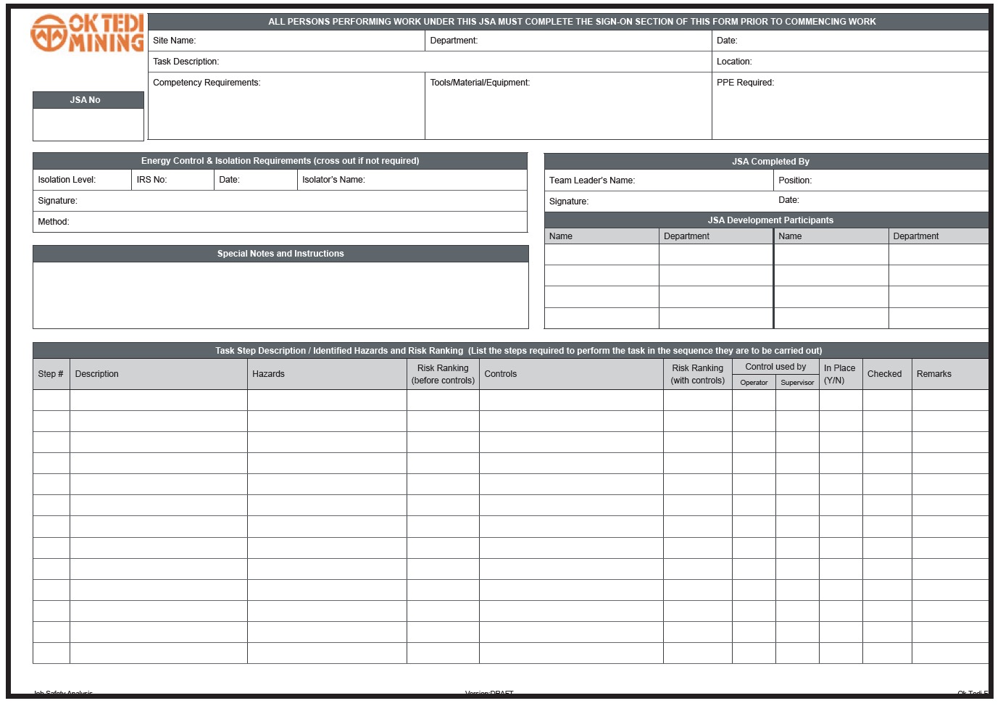
Job Safety Environment Analysis
  Conduct a Job Safety Analysis (JSA) if:
  There are uncontrolled hazards
  There is no written procedure for a complex task
  ATW or clearance is required, for example working in a confined space
  Equipment brought to the site creates a hazard
Notes:
Discuss your site’s process for conducting JSA.
Show the group a copy of your site’s JSA and let them practice completing the form in groups.

Slide 31
Hazard Report Procedures and WI
  Communicates an identified hazard to supervisor and management
  Controls can be put in place to reduce or eliminate the hazard
  Prevents unsafe condition or behaviour causing an incident or emergency
  Procedures comply with legal requirements
  Work Instructions detail how to conduct an activity safely and efficiently
Notes:
Discuss the hazard reporting procedure at your site, including where to access reports or forms, how to complete and submit them.
If possible obtain copies of your sites Hazard Reporting documentation and allow the group to practice completing the form.
Discuss the purpose of Procedures and work instructions.
Explain how to access relevant procedures and WIs.

Slide 32
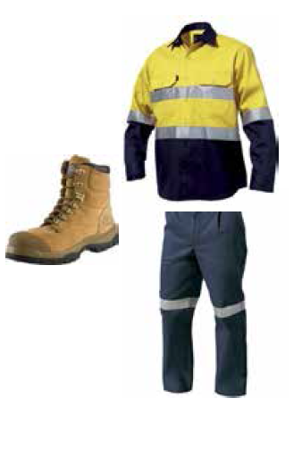
Personal Protective Equipment
  Wear site specific PPE
  Select and wear appropriate PPE for task
  PPE must be clean before use
  Tag out damaged PPE
  Specific PPE for confined space entry
Notes:
Discuss your site requirements for general PPE and PPE specific to working in and around confined spaces.

Slide 33
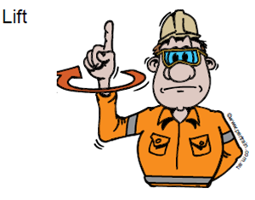
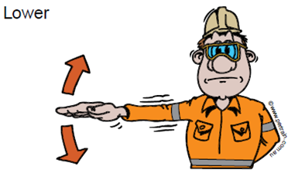
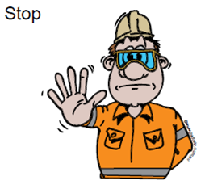
Communications
  Communication between:
  Personnel in confined space
  Confined space standby person
  Communication tools include:
  Two-way radios
  Mobile phones
  Hand signals
Notes:
Explain your site requirements for communication between confined space workers and the standby person.
Demonstrate and allow the group to practice the hand signals used at your site.

Slide 34

Hazardous Chemicals
  Handle hazardous chemicals safely
  Refer to Safety Data Sheets (SDS)
  Chemical properties
  PPE requirements
  Exposure limits
  Environmental requirements
  First aid procedures
  Disposal
Notes:
Discuss the importance of using Safety Data Sheets when using hazardous chemicals.

Slide 35
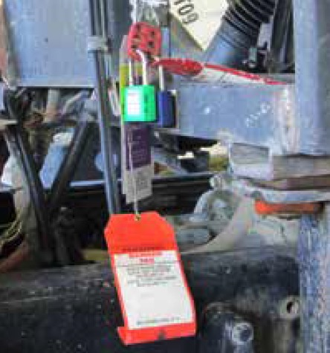
Equipment Isolation and Tagging
  Before entering a confined space isolate all energy sources:
  Turn off energy source
  Release energy
  Lock, support, barricade or chock
  Verify isolations
  Attach personal lock and tag
  Interlocking equipment must also be isolated
Notes:
Explain your site requirements for equipment isolation and tagging.
Discuss the importance of isolating energy sources in and around confined spaces when entry is required.

Slide 36

Manual Handling
  Use SMART lifting technique
  Size up load
  Move load as close to your body as possible
  Always bend your knees
  Raise load with your legs
  Turn your feet in direction you want to move load
Notes:
Demonstrate and explain the SMART lifting technique.
Allow the group to practice lifting various objects using the SMART lifting technique.

Slide 37
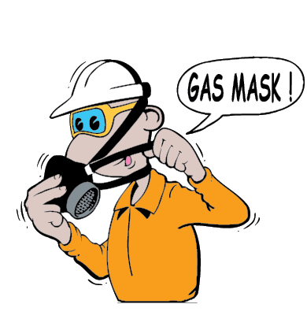
Specific Controls for Confined Spaces
  Specific controls include:
  Signage and barricading
  Ventilation
  Atmospheric (gas) testing
  PPE and breathing apparatus
  Standby personnel
  Emergency response and rescue procedures
Notes:
Outline the specific controls for confined spaces. These are discussed in more detail with the following slides.
Discuss any other controls that are required by your site.

Slide 38

Signage and Barricading
  Protective barriers must be installed in front or around confined space
  Signage must be in place
  Confirm locations of signs and barricades
Notes:
Discuss your site requirements for signage and barricades for confined spaces.

Slide 39
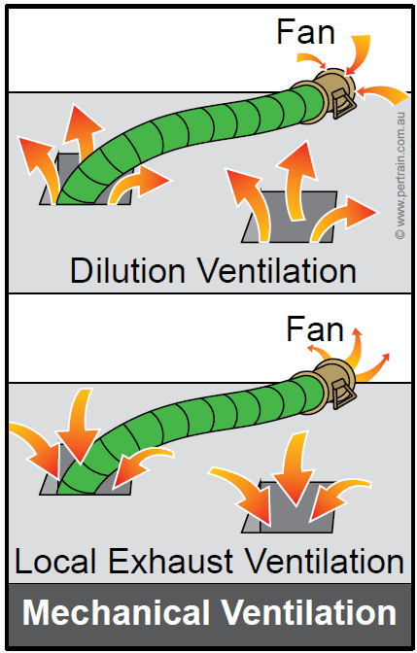
Ventilation
  Ventilation:
  Creates a safe, breathable atmosphere
  Maintains temperature
  Purges / flushes contaminants
  Can be supplied naturally if there are sufficient openings
  Mainly forced by mechanical means
Notes:
Discuss the importance of ventilating a confined space.
Explain how spaces are ventilated, such as:
Opening hatches
Flushing/purging with air
Installation of fans and ducting.
Show and discuss the the Confined Space Ventilation Management Plan for your site, if applicable.

Slide 40
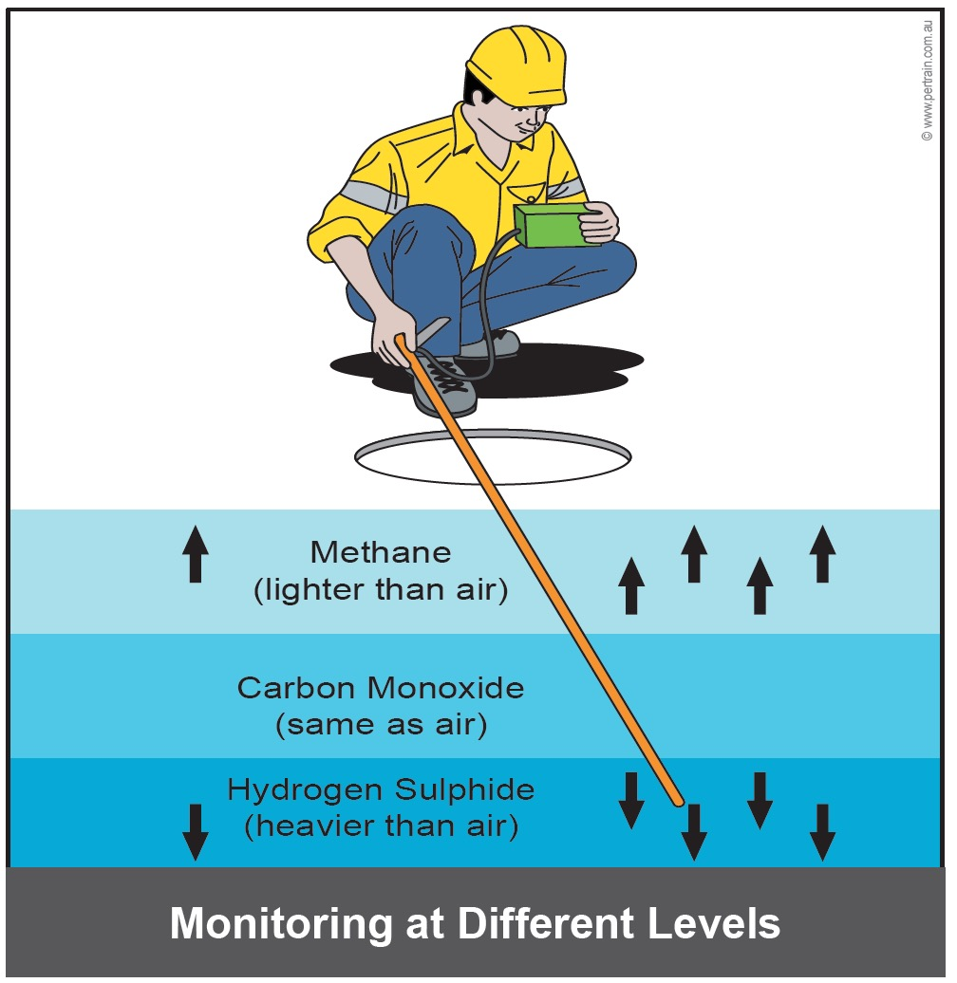
Atmospheric Testing
  Air within confined space must be tested to confirm that it is:
  Free from toxic and flammable vapours
  Fit to breathe
  Testing is conducted:
  By a competent, authorised person
  Using a suitable gas detector
  Results recorded on ATW/Clearance Certificate
Notes:
Explain why atmospheric testing is conducted within a confined space before entry and also throughout the activity.

Slide 41
Testing Process
Stages of Atmospheric Testing
1. | Initial External Test | Test the atmosphere from outside the confined space using probes
2. | Internal Test | Perform tests on all levels of the confined space (side to side and top to bottom)
3. | Test Order | Oxygen Combustible gases Toxic gases
4. | Test Duration | Perform each test for at least the minimum time as specified by the instrument manufacturer
5. | Record Findings | Record the test results on the authorisation, along with the equipment or method used
Notes:
Discuss the following points regarding atmospheric testing.
Gas detectors gauge:
Oxygen content
Airborne concentration of flammable contaminants
Airborne concentration of potential contaminants.
Atmospheric testing is a systematic process, and must be conducted within sequence as shown on the slide.

Slide 42
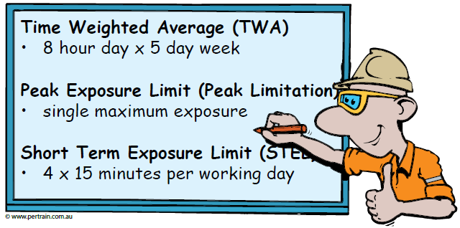
Exposure Standards
Notes:
Explain that the exposure standards for how long a person can be exposed to a vapour/gas/chemical.
Refer to SDS for exposure standards.

Slide 43
Minimum Requirements
Item | Requirements
LEL | Lower Explosive Level (LEL) must be less than 5%
Oxygen | Concentration no less than 19.5% no greater than 23.5%
Contaminants | Must be no greater than exposure standard
Potential | Confirm there is no potential for atmospheric contaminants to fall outside the above ranges
Records | Record all air quality tests accurately
Monitoring | Monitor air quality at intervals as specified by JSA, ATW and clearance certificate
Risk Assessment | Complete a risk assessment if air quality conditions change in confined space
Notes:
Discuss the minimum requirements in the table above.
Emphasise that no person is to remain in the confined space when the concentration of flammable airborne contaminants is greater than or equal to 10% LEL.

Slide 44
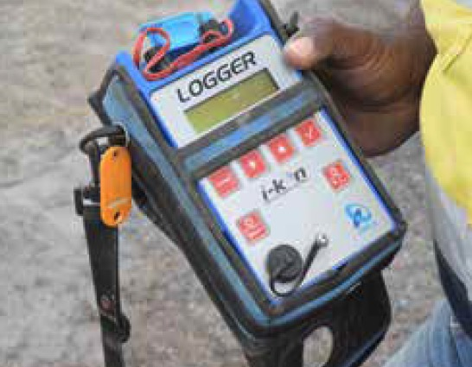
Gas Detection Equipment
  Gas detectors:
  Test air quality:
    Before entry
    Throughout task
  Will sound an alarm
  Commonly test for:
    Carbon monoxide (CO)
    Hydrogen sulphide (H₂S)
    Oxygen (O₂ )
    Combustible gases /dust (LEL)
Notes:
Discuss the use of gas detectors for confined space entry.
If possible have one available for the group to familiarise themselves with.

Slide 45
Gas Detection Terminology
Term | Explanation
Percentage | The percentage is the parts of a substance in 100 parts of air. Oxygen levels are measured in percentages and the working level must be between 19.5% and 23.5%.
Parts Per Million | Parts Per Million (ppm) is the number of parts of a substances in a million parts of air (1 ppm = 0.0001%).
Lower Explosive Limit | Lower Explosive Limit (LEL) is the smallest quantity of gas, which when mixed with air, will burn if ignited. An explosion cannot occur below the LEL because there is not enough fuel and too much air.
Upper Explosive Limit | Upper Explosive Limit (UEL) is the greatest quantity of gas, which when mixed with air, will burn if ignited. An explosion cannot occur above the UEL because there is too much fuel and not enough air.
Notes:
Explain that gas detectors:
Provide information using specific terminology, which is explained in the table on the slide
Can be used to measure for a variety of gases - the most common readings are:
Carbon monoxide
Hydrogen sulphide
Oxygen
Combustible gases / dust (LEL).

Slide 46
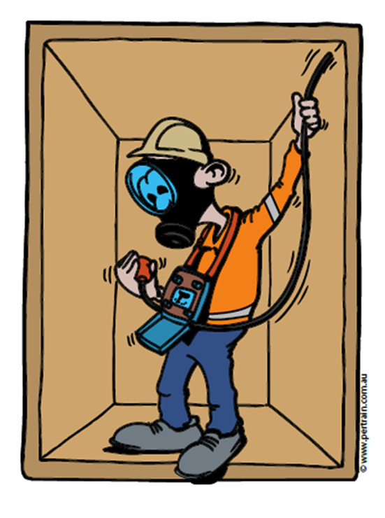
Using a Gas Detector
  Before use check:
  Battery level is adequate
  Detection and alarm system is operational
  Calibration
  Do not enter confined space if the detector indicates toxic atmosphere
  Monitor air continually
  Evacuate immediately if an alarm sounds
Notes:
Discuss the importance of checking the gas detector before use.
Explain what is meant by calibration.

Slide 47
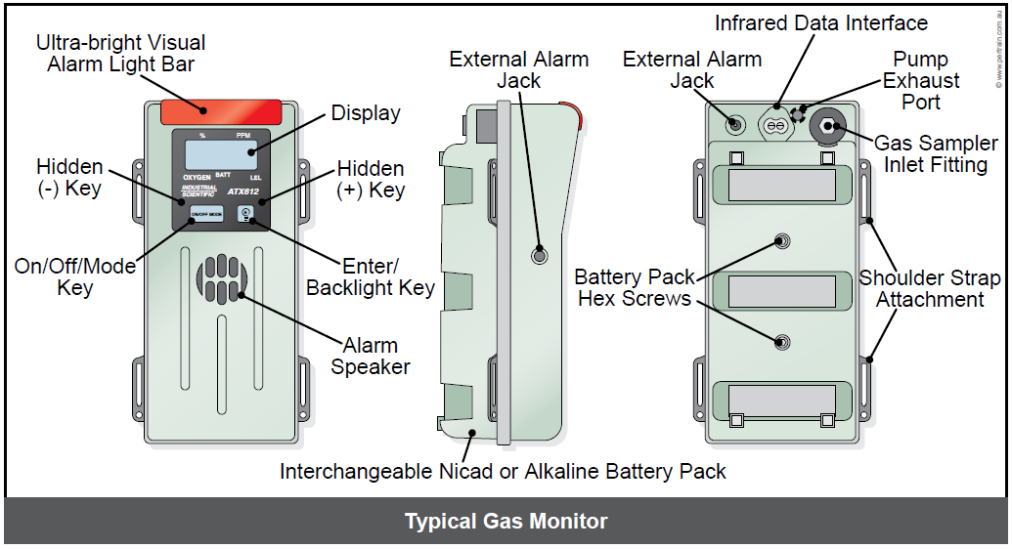
Typical Gas Monitor
Notes:
Discuss the steps to use a gas detector unit.
Press power button
Wait for unit to perform test sequence
Test unit in clean air (bump test)
Lower unit or tube extension into confined space
Test for five minutes
Withdraw unit from space and check for alarms or red lights
Record all readings
Check readings indicate safe levels
Strap unit to your body to monitor for gases after entry.
Re-test space before re-entry.

Slide 48
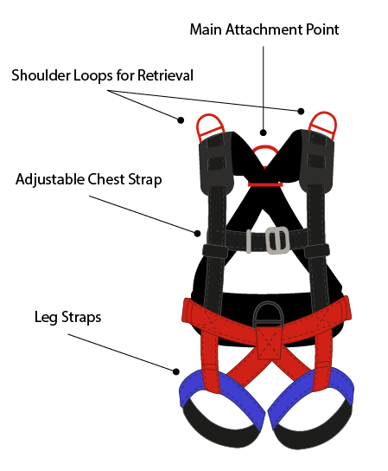
PPE - Safety Harness and Lines
  Safety harnesses and lines are used when:
  There is a possibility of falling during ascent or descent
  Rescue is practicable by direct vertical or horizontal route
  You must be trained and authorised for selection, fitting and use of safety harness and lines
Notes:
Discuss the use of safety harnesses and lines for confined space entry.
Reinforce that all personnel who are required to enter a confined space must be train and competent to wear a safety harness.

Slide 49
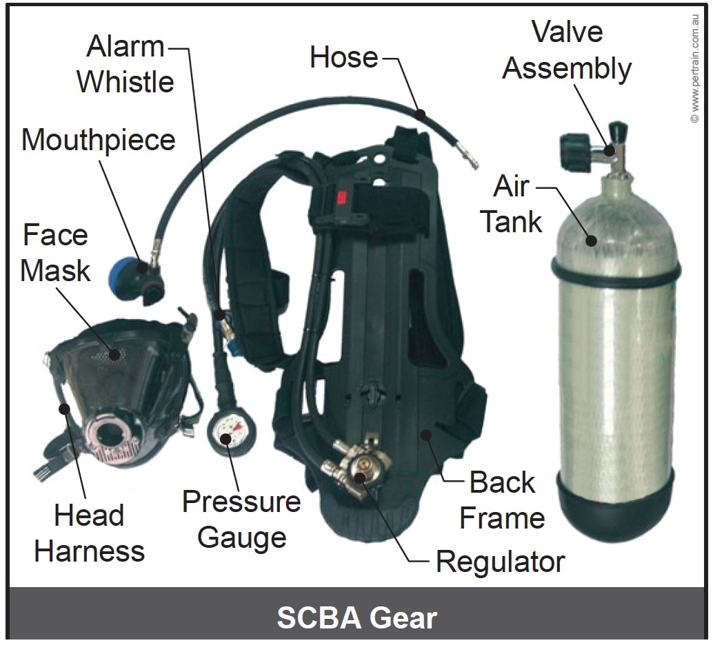
PPE – Respiratory Equipment
  Air supply respirator (SCBA) must be used if atmosphere contains contaminants
  Two types of SCBA
  Closed circuit rebreather
  Open circuit system
  Limitations of breathing apparatus:
  Type, including cylinder size
  Physical condition of the wearer
  Environmental conditions
  Work area layout and work load
Notes:
Explain when to use a respiratory device, for example:
Testing indicated that safe atmosphere cannot be established or maintained
The work in the confined space is likely to contaminate the atmosphere, such as welding.
Discuss the types of respiratory equipment used at your site.
Explain that different types of equipment have different limitations.

Slide 50
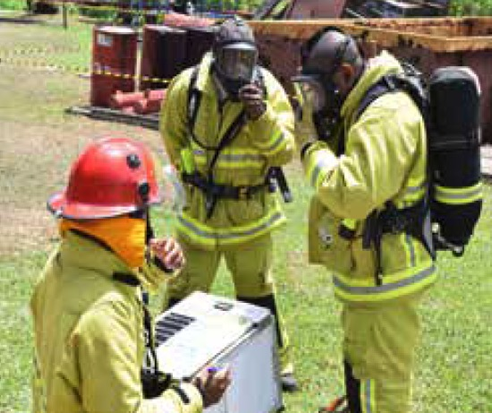
Selecting and Fitting Respirator
  Selection depends on:
  Nature of contaminant
  Level of immediate danger
  Expected time in space
  Expected activity of wearer
  Access to and nature of space
  Flammability of contaminant
  Fit respirator over nose and mouth
  Must have an effective seal against face
  Beards, glasses can compromise fit and seal
Notes:
Explain the following points.
That the correct respirator for the task must be selected, for example a dust respirator will not protect against vapours.
How to correctly fit a respirator.
There are limitations to wearing breathing apparatus, including:
Type of apparatus being used
Physical condition of the wearer, including breathing rate and emotional state
Environmental conditions, including heat and humidity
Work area layout, such as openings may be too small to accommodate wearing of SCBA.

Slide 51
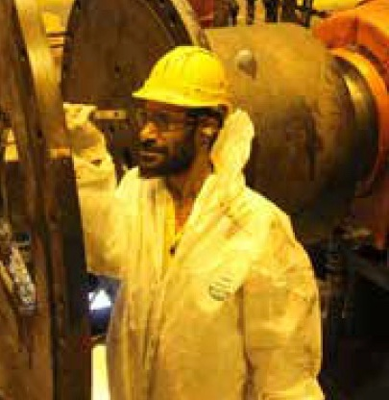
Standby Person
  Standby person must:
  Remain at watch point for duration of task
  Maintain communication with persons inside space
  Initiate emergency response
  Conduct and record air testing
  Check and confirm all personnel entering confined space sign on and off ATW
Notes:
Discuss the role, responsibilities and importance of the standby person.

Slide 52
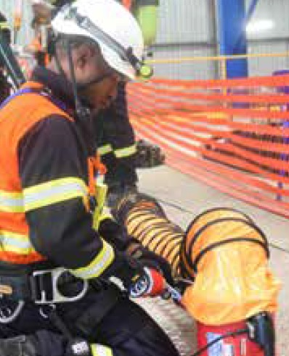
Enter a Confined Space
  Set up work area:
  Signs and barricades
  Set up ventilation
  Position rescue equipment close to point of entry
  Rehearse rescue procedure
  Access confined space
  Sign on to ATW
  Apply locks and tags
Notes:
Discuss setting up of the confined space work area and checking that:
Correct PPE is worn
Barricading and signage is installed
Isolations have been performed
Control measures are in place as required by JSA
Ventilation is installed and activated
Rescue equipment is close to point of entry to space
All personnel understand the emergency response procedure
Communication can be maintained with standby person.
Explain how to safely access the area.
Reinforce the importance of signing onto the ATW and applying locks and tags.

Slide 53
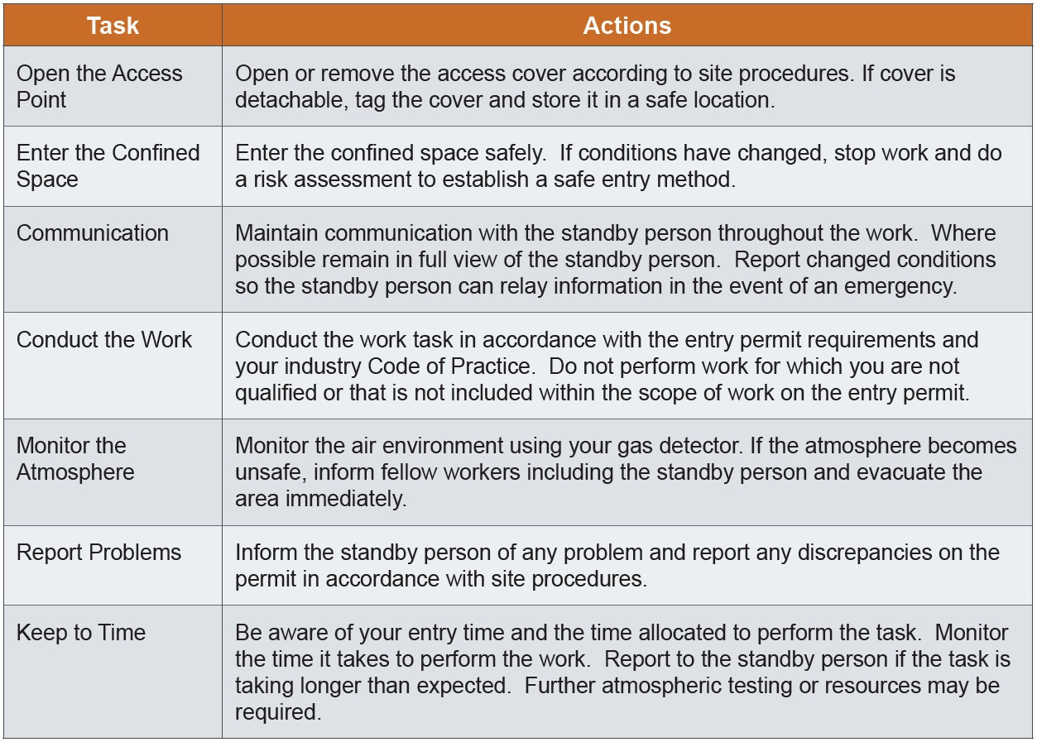
Conduct Work in a Confined Space
Notes:
Discuss the following points for work within a confined space:
Open the access point
Enter the confined space
Communicate with standby person
Conduct the work
Monitor atmosphere
Report problems
Keep to allocated times.
Explain how the image on the slide provides a good example of work in a confined space, because:
The worker is in full view of the standby person
Air flow is being maintained
Heat and fumes are being extracted.

Slide 54
Completing the Work
Remove tools and equipment
Check all personnel exit space
Inspect confined space
Close access point
Secure confined space
Remove locks and tags
Sign off ATW
Notes:
Discuss the steps involved with completing the work in the confined space.

Slide 55
Emergency Response and Rescue
Rescue Method | Description
Evacuation | Alarm is sounded and personnel evacuate the area before an emergency arises.
Self Rescue | An individual recognises critical conditions or symptoms of exposure and exits the space. It does not endanger others.
Non-entry Rescue | Involves removing a person without anyone else entering the confined space by using a safety line attached to harness of person inside confined space.
Entry Rescue | Requires a rescuer to enter space, another worker qualified in confined space rescue must be present outside the space. Rescuer must rear SCBA or supplied air respirator.
Notes:
Discuss the importance of the Confined Space Emergency Response Plan, including:
Everyone involved with the work must read and understand the plan and understand the importance of following the plan.
The plan should be rehearsed as a rescue drill to ensure all members of the team can demonstrate that they understand their role and responsibilities.
Show a copy of your site’s response plan, if available.

Slide 56
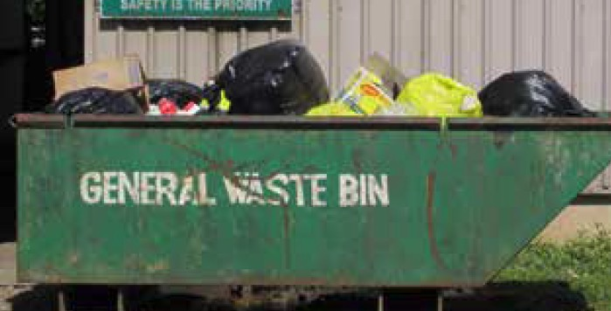
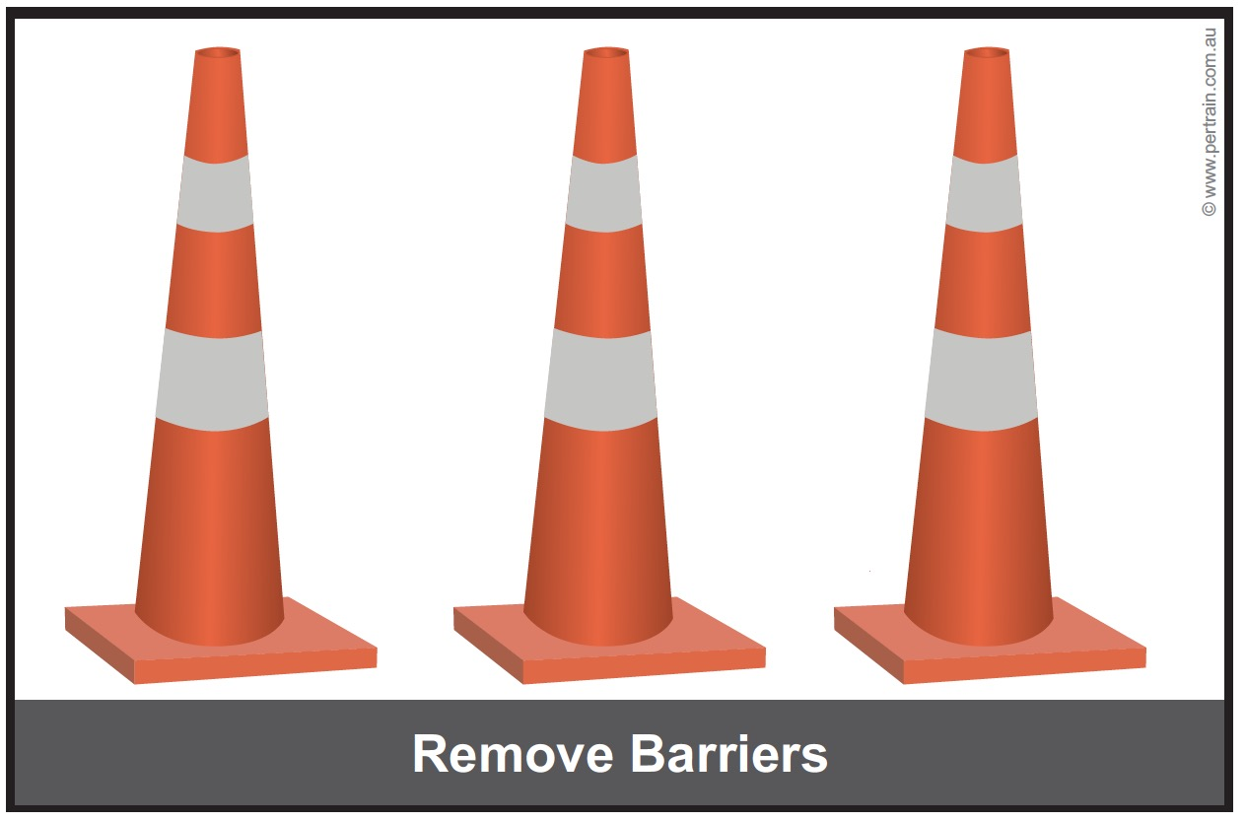
Post Operational Tasks
  Check work complies with requirements
  Remove signs and barricades if area is safe and you are authorised
  Clean, inspect, maintain and store tools and equipment
  Dispose of, or recycle, waste materials
  Perform general housekeeping duties
  Complete end of shift reports and records
Notes:
Discuss the post operational tasks, including:
Removing barricades and signs
Cleaning, inspecting and storing equipment
Disposing of waste products appropriately
General housekeeping duties
Completing appropriate reports and records.
Group Discussion: Ddiscuss the end of shift reports at your site. Make sure that everyone knows how to access, complete and submit records and reports.

Slide 57
Summary
  Remember – Safety is EVERYONE’S responsibility
  In this module we covered:
  Identifying a confined space
  Planning and preparing for entry and work in a confined space
  Obtaining and completing appropriate authorisations
  Identifying and controlling hazards
  Entering and working in a confined space
  Performing post operational tasks
Notes:
Summarise the main points from the training session.
Ask the trainees if there are any questions or comments about the training.
Ask trainees to complete evaluation form (if applicable).
Check everyone has signed the attendance sheet.

