Slide 1
Health and Hygiene
Awareness Package
Notes:
Welcome.
Introduce yourself.
Outline your experience.
Explain where the facilities are (toilet, tea room)
Detail any OHS issues (exits, evacuation signals and muster point).
No mobile phones or radios.
Any questions?

Slide 2

Introduction
Everyone has a responsibility to maintain safe, healthy and hygienic work areas
  OTML provides facilities
  OTML has health and hygiene programs in place
  Employees are responsible for personal hygiene and health
  Everyone must try to minimise the spread of disease
Notes:
Explain that the responsibility for maintaining a safe and healthy workplace rests with everyone.
Outline the programs in place at your site to assist with maintaining health and hygiene at work, including:
Establishing exposure limits to health and hygiene risks such as radiation, heat, bacteria, etc.
Ways of monitoring personal exposure
Training
Environmental monitoring
Food Safety
Provision of appropriate clothing.

Slide 3
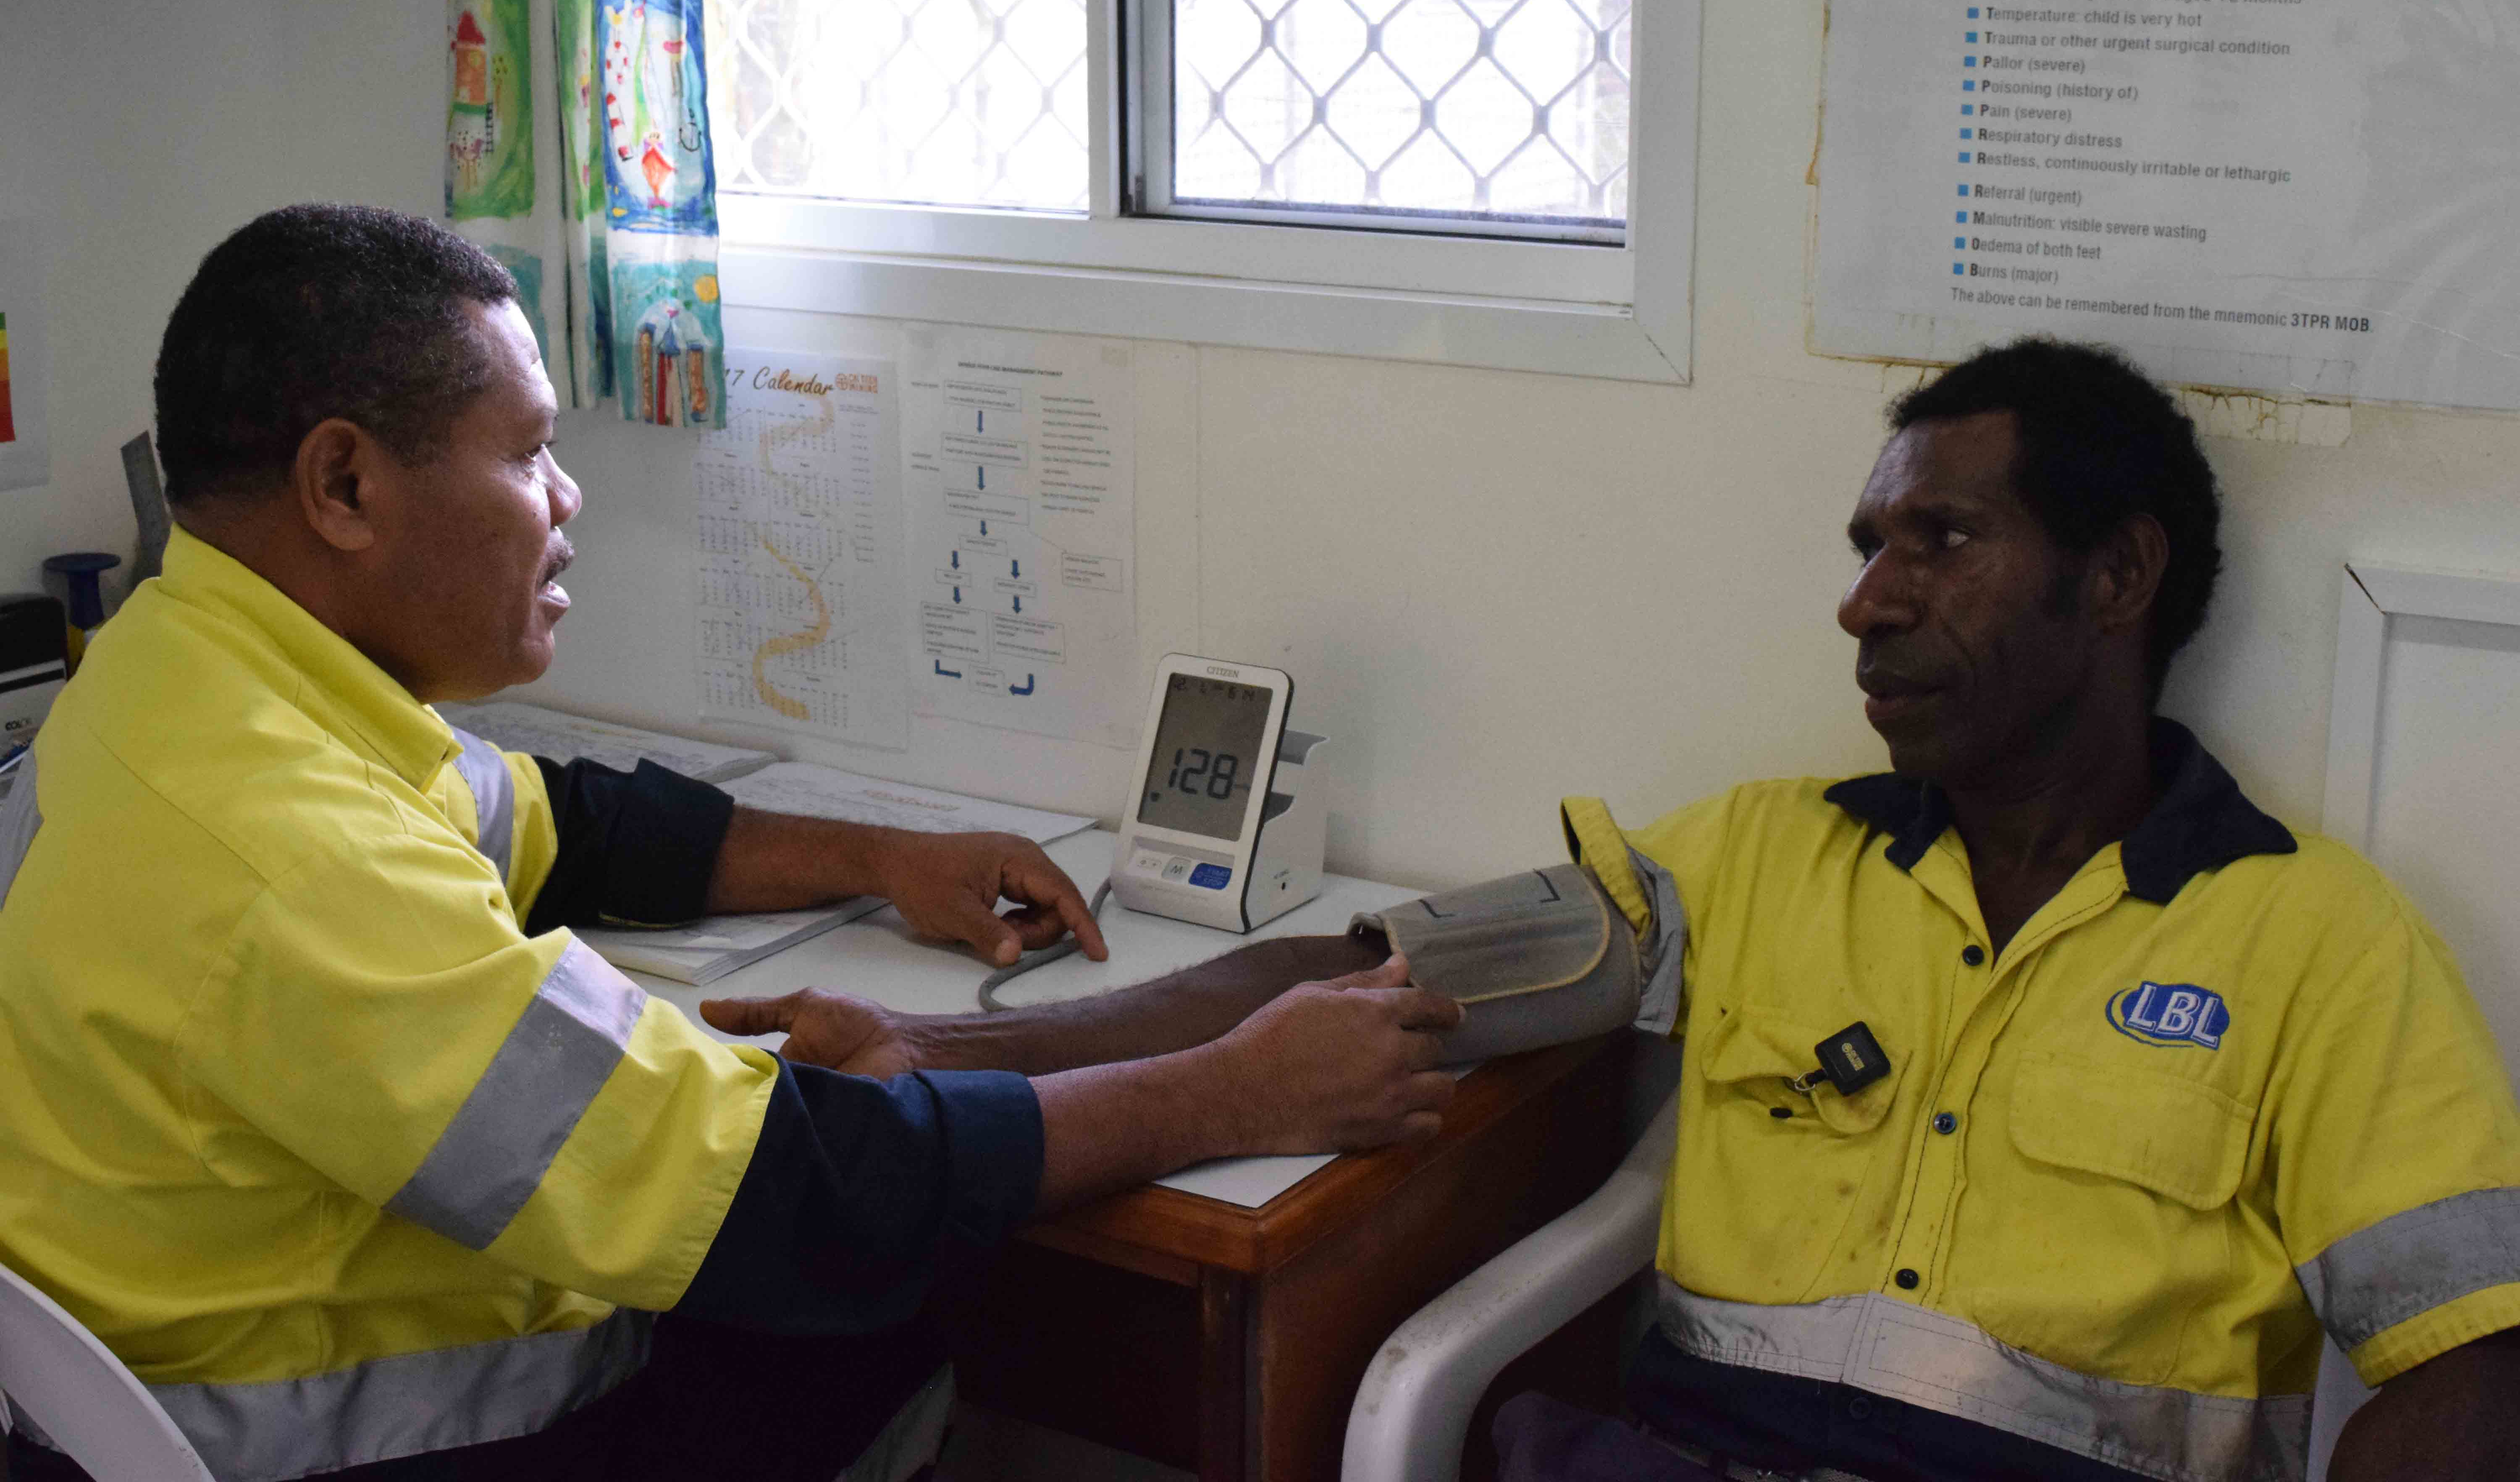
Health Surveillance Monitoring
We monitor health and hygiene to:
  Obtain data
  Determine safe limits
  Choose corrective actions
  Manage issues
We collect health data from SEGs through:
  Biological monitoring
  Monitoring attached to persons
Notes:
Discuss the health surveillance program in place at your site and the different health data collection methods:
Biological – blood test, urine test, lung function test, etc
Monitors attached to personnel – breathing zone monitor, hand held sound level meters, Geiger counter, etc.
Explain that data in relation to health issues and exposure limits is collected under strict guidelines, by authorised personnel, and records are kept confidential.
Discuss the procedure for dealing with potential and actual overexposure.

Slide 4
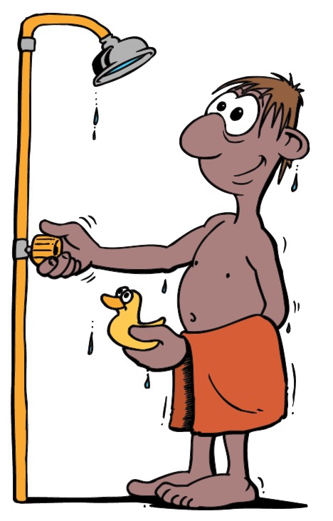
Good Personal Hygiene Practices
Wash hands:
  After using the washroom
  Before eating
  After sneezing or coughing
  After touching animals or anything that is dirty
  When you finish work
Shower or bathe daily, using soap and dry off well
Wash hair
Brush your teeth twice a day
Wear deodorant
Wear clean clothes
Keep nails clean and neat
Notes:
Discuss the actions that everyone can take to help with maintaining health and hygiene at work, including good personal hygiene.
Emphasise that good personal hygiene can help you feel better, lower your risk of getting sick and is good for moral.
Discuss the things that each person can do to maintain good personal hygiene.
Explain that poor personal hygiene can:
increase your risk of illness and infection
increase the germs that you spread
Decrease your general wellbeing
make people stay away from you.

Slide 5
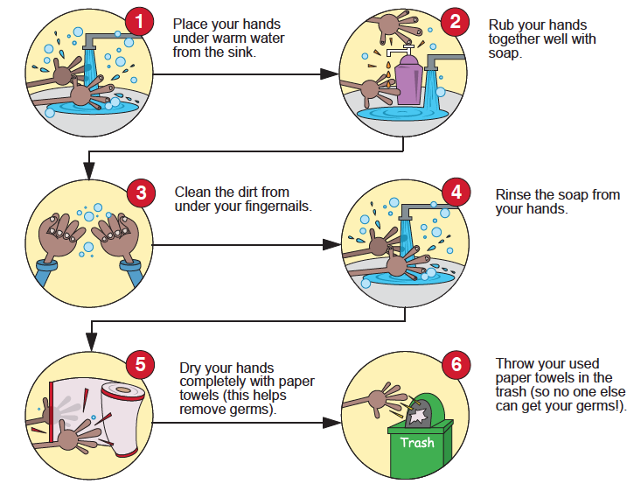
Hand Washing
Many diseases are spread by touching surfaces covered with germs
Hand washing is the
simplest, most important and most effective way to prevent infection and the spread of germs
Notes:
Explain why hand washing is so important.
Demonstrate and discuss the steps to effective hand washing.

Slide 6

More Ways to Prevent Spreading Germs
Minimise the spread of germs by:
  Using your hand or inside your elbow to cover a cough or sneeze
  Covering your nose and mouth with a tissue or handkerchief when you sneeze
  Never spitting on the ground
  Covering cuts / sores
  Not biting your nails
  Not putting fingers into your nose or mouth.
Notes:
Briefly explain that some germs can be transferred through the air. This happens when someone coughs, sneezes or spits.
Discuss the ways to minimise the spread of these air-borne germs.

Slide 7

Workplace Hygiene
Help to keep the workplace clean by:
  Cleaning up spills immediately
  Wiping down surfaces
  Cleaning and putting things away
  Removing clutter and tripping and slipping hazards
  Disposing of waste using the proper bins
  Emptying water from containers
  Reporting maintenance issues
  Ensuring there are enough
  housekeeping supplies
Notes:
Explain the importance of workplace hygiene.
Emphasise that keeping the workplace clean is a team effort.
Discuss the ways in which everyone can contribute to maintaining a clean and hygienic workplace.
Encourage the group to be thoughtful of others and to leave facilities as they would like to find them – clean and tidy.

Slide 8
Dust and Allergens
Reduce your exposure to dust and allergens by:
  Removing the source
  Making sure ventilation is adequate
Tell your supervisor if you are taking any medication, including anti-allergy drugs
Notes:
Define allergens.
Discuss the range of allergens that are common (dust, pollen, foods, etc).
Discuss the effects that allergens can have on people and their work (sneezing, coughing, spreading germs, unable to concentrate, poor morale).
Outline the ways to reduce exposure to allergens in the workplace.
Emphasise that some medications can affect a person’s work. and you should tell your supervisor if you are taking any medication – prescribed and over the counter.

Slide 9
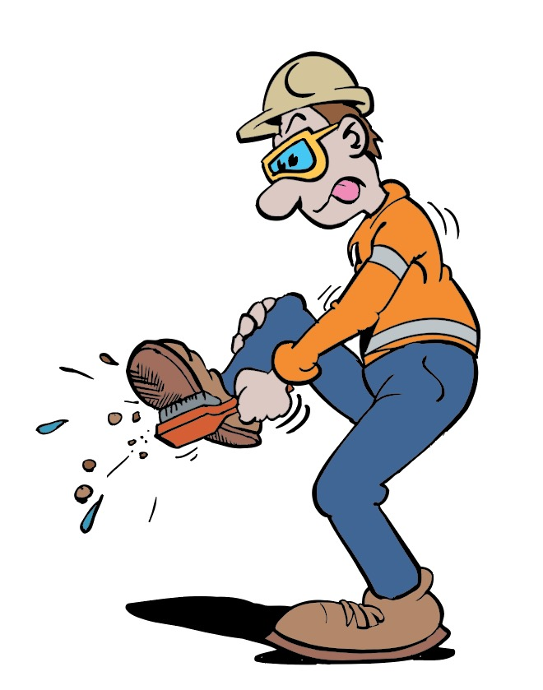
Clean Shoes
Diseases can be carried in mud and animal excretions attached to your shoes
Fungal infections, such as athletes foot and ringworm can be hard to cure
Some fungal infections can be deadly
Wipe your boots / shoes before entering buildings
Notes:
Discuss the types of infections and diseases that can be tracked into the workplace on your shoes and feet.

Slide 10


In the Toilet
Use the toilet correctly to prevent the spread of disease
  Urine and faeces in the toilet bowl
  Wipe up spills and drips immediately
  Flush the toilet or urinal after
  Never use any other container for toilet purposes
  Use enough toilet paper to protect your hands from contamination
  If the toilet has a lid, close it before flushing
  Wash your hands with soap and water after using the toilet
  Dry hands using dryers or paper towel
  Dispose of paper towel in the bin
Notes:
Explain that many diseases are spread via urine and faeces and that a toilet is a hygienic method of disposing of human waste products, minimising the risk of spreading disease.
Discuss correct way to use a toilet and urinal (if applicable).
Emphasise that public and workplace washrooms are areas of high risk in relation to germs as many people touch the same surfaces.

Slide 11
In the Kitchen
Kitchen areas harbor more germs than any other room
Help keep kitchen and dining areas safe and healthy
  Keep surfaces clean and free of crumbs
  Keep surfaces and equipment dry
  Remove materials that could attract mice, rats and other pests
  Do not leave food out to rot or decay – put it in the fridge or rubbish bin
  Clean spills immediately
  Do not use the same cloth for washing dishes and wiping floors
  Dispose of soiled cloths if they can not be washed clean
  Wash all utensils and return them to their correct location after use
Notes:
Explain that kitchen areas harbor more germs than any other room, including washrooms and toilets.
Discuss how to minimise germs in kitchens and dining rooms.

Slide 12

Food Preparation Requirements
No jewellery
Do not work with food if you are sick
Cover cuts and sores
Wash hands often and well
Wear appropriate PPE
Cook food throughly
Prevent food cross-contamination
Keep food at safe temperatures
Wash raw fruit and vegetables
Use potable water
Check use-by dates
Check for dirt, metal, hair, pests
Keep chemicals away from food
Notes:
Discuss the additional health and hygiene requirements for food handlers.
Food handlers will undertake additional training as part of their role.

Slide 13
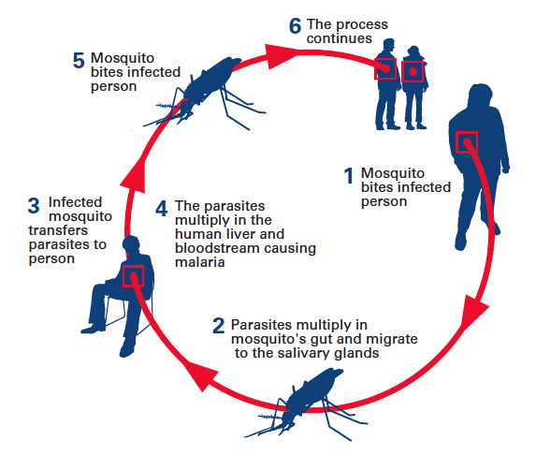
Malaria
Malaria is caused by a parasite which is transmitted by infected mosquitos
Mosquitoes also spread:
  Dengue Fever
  Encephalitis
  Yellow Fever
Minimise the spread of Malaria
by controlling the mosquitoes
Get rid of stagnant water which
is where they breed
Notes:
Explain that serious diseases can be caused by the transfer of germs, viruses and bacteria, e.g. Malaria, HIV / AIDS and Hepatitis.
Give a brief explanation of how malaria is transferred.
Explain that the best way to prevent the spread of malaria is to control the number of mosquitoes in the area. The most effective way to do this is to eliminate the stagnant water sources that mosquitoes breed in, such as choked water drains, tyres or other containers that catch water, empty pot plants of standing water and disperse puddles as quickly as possible.
Other malaria prevention includes wearing long sleeves and trousers (impregnated with insect repellent if possible), wearing an insect repellent with at least 20% DEET in it, working in a screened area (if possible) and not being outside between dusk and dawn when most mosquitoes are out.
For more information on Malaria, there is a Malaria Awareness Package.

Slide 14
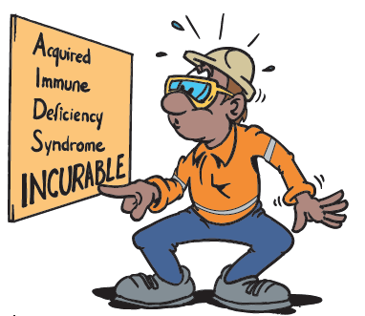
HIV / AIDS
HIV is an immune deficiency virus which leads to Acquired Immuno-Deficiency Syndrome (AIDS)
AIDS is incurable
When a person has AIDS:
  The immune system does not fight infection
  Opportunistic infections develop in the body
HIV is transmitted through body fluids, e.g.
  During sex
  Kissing
  Sharing needles and piercing tools
Anyone can be infected with HIV
A pregnant woman can pass HIV onto
her unborn baby, and to her child when
breastfeeding
Notes:
Give a brief overview of what HIV is and explain that HIV is the virus that leads to AIDS.
Explain that HIV can only be transmitted through body fluids such as semen, saliva, blood.
Emphasise that anyone can be infected with HIV.
There are no ‘risk groups’ only ‘risk behaviours’.
Discuss the risk behaviours that can result in infection, focus on those that are most appropriate to your group / site / situation.

Slide 15
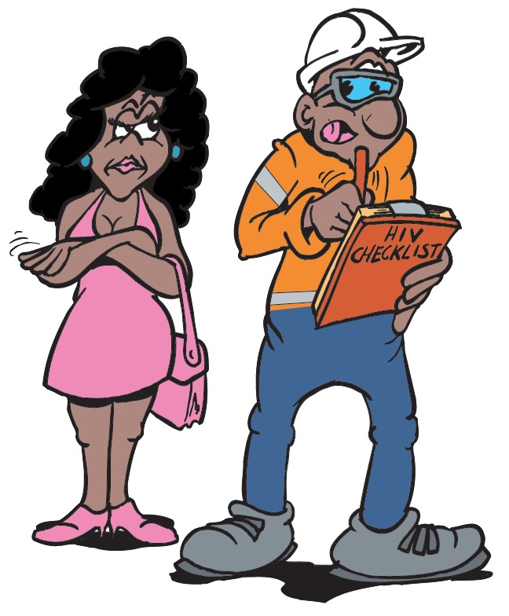
Preventing the Spread of HIV / AIDS
Always have safe sex – use a condom
Make sure that the condom is:
  NOT past its expiry date
  NOT damaged
  used correctly according to the manufacturer instructions
Avoid alcohol and drugs that can affect your judgement
Be a good role model in your community
If you have HIV do not spread the virus to other people
Notes:
Discuss the behaviours that can help to prevent the spread of HIV / AIDS, focus on those that are most appropriate to your group / site / situation.

Slide 16
Hepatitis A, B and C
Hepatitis is a virus that causes inflammation of the liver and can lead to:
  Cirrhosis of the liver
  Liver cancer
  Death
There are three types of Hepatitis:
  Hepatitis A
  Hepatitis B
  Hepatitis C
Notes:
Explain that Hepatitis is a virus that causes inflammation of the liver and can lead to cirrhosis of the liver, liver cancer and death.
There are three types of Hepatitis – A, B and C.

Slide 17

Hepatitis A
Hepatitis A is present in faeces and other bowel secretions
It is transmitted by contact with infected surfaces, utensils, food and water contaminated by faeces
Also transmitted through some sexual activities
Symptoms of Hepatitis A include:
  Fevers and sweats
  Extreme tiredness
  Loss of appetite
  Vomiting
  Diahorrea
  Dark urine and pale faeces
  Jaundice
Notes:
Explain that Hepatitis A is present in faeces and other bowel secretions. It is transmitted by contact with infected surfaces, utensils, food and water contaminated by faeces and also through some sexual activities.
Discuss the symptoms of Hepatitis A.
Emphasise that washing your hands regularly with soap and water can help to prevent Hepatitis A infection as the virus from the faeces / bowel secretions can be washed away before it is transferred into your body through touching eyes, nose, mouth, sores, etc.

Slide 18
Hepatitis B
Often no symptoms
Most people recover
Some people are chronic carriers
  Who are infectious for the rest of their life
  These people must conduct themselves in a responsible manner to avoid spreading the disease
Hepatitis B is transmitted through:
  Infected blood
  Semen / vaginal secretions
  Mucus
  Saliva
  Breast milk
Transmission is common through:
  Birth (from infected mother)
  Unsafe sex
  Needle sharing
Symptoms of Hepatitis B include:
  Weakness and extreme tiredness
  Fever
  Vomiting
  Jaundice
Notes:
Explain that although the symptoms are similar to Hepatitis A, Hepatitis B differs from Hepatitis A in that it is transmitted through infected blood and other body fluids (mucus, saliva, breast milk).
Discuss the ways that Hep. B can be transferred.
Discuss the symptoms of Hep. B.
Explain that many people with Hep. B have no symptoms and most people recover completely.
However some people become chronic carriers who are infections for the rest of their life. These people have a moral and ethical responsibility to take measure to ensure that they do not spread the disease.

Slide 19
Hepatitis C
Hepatitis C is present in the blood
It can be transmitted by:
  Sharing needles
  Needle stick injuries
  Sharing razor blades or toothbrushes
  Unsterile tattooing or body piercing equipment.
Symptoms include:
  Decreased appetite
  Fatigue
  Abdominal pain
  Jaundice
  Itching
  Flu-like symptoms
Notes:
Explain that Hepatitis C is only transmitted through infected blood.
Discuss the ways that Hep. C can be transferred (sharing needles, razors, toothbrushes if the person has bleeding gums or mouth ulcer).
Discuss the symptoms of acute Hep. C.
Emphasise that it would be considered ethically and morally irresponsible if a person knowingly engages in any activities that put themselves or fellow workers in danger of contracting HIV / AIDS, Hepatitis or any other communicable disease.
Discuss the assistance that is available at your site for people who have, or fear they may have, a communicable disease and how this assistance is accessed.

Slide 20
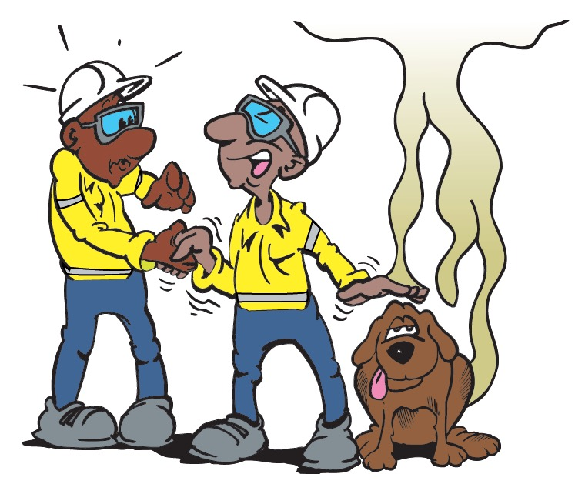
Direct Contact
Direct contact transmission is by touch between two people or a person and an animal
Common infections spread by direct contact:
  Head lice
  Conjunctivitis
  Cold sores (herpes)
  Shingles
  Ebola
Notes:
Explain that infection is usually spread in one of three ways. By:
Direct contact
Indirect contact
Airborne droplets.
People working together and using shared facilities run a risk of passing on infections and diseases.
Explain that, as the name implies, Direct Contact Transmission requires direct contact (touch) between a person and an infected person or animal.
Discuss some of the common infections that are spread by direct contact. Focus on those that are most relevant to your group / site.
Explain that some infections can be transmitted by more than one method. For example head lice can jump from person to person (direct contact), or can sit on a brush or comb until it is used by another person (indirect contact).

Slide 21
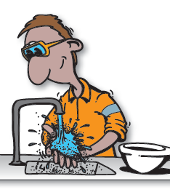
Direct Contact Transmission Prevention
Prevent infection by:
  Avoid contact with infected persons and animals
  Washing hands well and often
  Covering sores / broken skin
  Bath regularly
  Drying skin thoroughly
  Wearing well ventilated boots
  Wearing socks
  Changing socks frequently
  Preventing nail and skin injuries
Notes:
Discuss the preventative measures that can be taken to minimise the chance of direct contact transmission. Focus on those actions that are most relevant to your group.

Slide 22
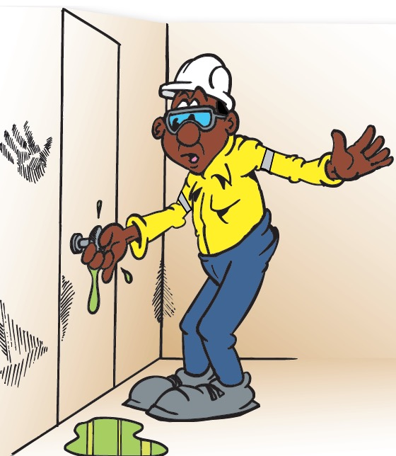
Indirect Contact Transmission
Indirect contact transmission is when a person touches a surface that has been infected with germs from another person, such as:
  utensils
  tools
  hair brushes and combs
  bathroom facilities
  water and food
Spread by indirect contact:
  Fungal infections
  Diahorrea
  Bacterial infections
  Viral infections
  Parasites
Notes:
Explain that Indirect Contact Transmission involves a person infecting a surface or tool and then another person touching that infected item and transferring the infection into their own body by touching their eyes, nose, mouth or a cut or sore on the skin. Some infections do not even need an opening to infect a person.
Discuss some of the common infections that are spread by indirect contact. Focus on those that are most relevant to your group / site.

Slide 23
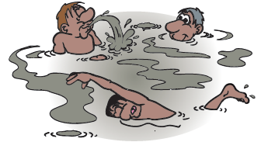
Indirect Contact Transmission Prevention
Prevent infection by:
  Washing hands well and often
  Safe drinking water and adequate sanitation and hygiene
  Safe food preparation
  Good housekeeping
  Not drinking, swimming or playing in infected water
  Cleaning tools and utensils before using them
  Wearing sandals or similar footwear in communal showers
Notes:
Discuss the actions that can be taken to prevent indirect contact transmission. Once again, focus on those actions that are most relevant to your group.

Slide 24
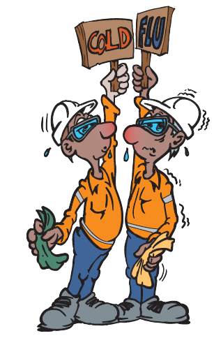
Airborne Droplets
Droplet transmission occurs when bacteria or viruses travel on relatively large respiratory droplets that people sneeze, cough, drip or breathe out
Droplets then land on surfaces or people in close proximity
Common infections spread by airborne droplets include:
  The common cold
  Influenza (the flu)
Notes:
Explain that germs (bacteria and viruses) can travel on respiratory droplets that are sneezed, coughed, dripped or breathed out into the air. Depending of the force of the expulsion, the droplets will travel for a short time and then land on a person or surface. The germs can then be transferred into the body of another person who touches the germs and then touches an opening into their body (eyes, nose, mouth, cut).
The most common infections that are spread by airborne droplets are the common cold and the flu.

Slide 25
Prevent Infection
Prevent infection by:
  Stay away from infected persons
  Wash hands well and often
  Cover nose and mouth when you sneeze or cough
  Not picking your nose
  Use a handkerchief or tissue to wipe or blow your nose and washing handkerchief or disposing of tissue immediately
  Not blowing mucus or spitting on any surface that someone else may touch
Notes:
Discuss the actions that can be taken to prevent infection from airborne droplets. Once again, focus on those actions that are most relevant to your group.

Slide 26
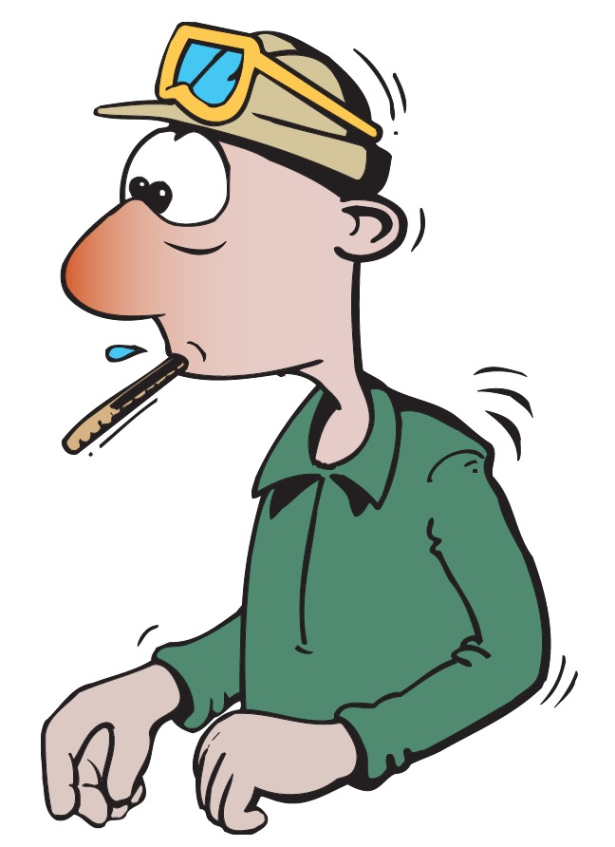
Cold and Flu
Flu is more serious than a cold
Flu symptoms are usually more severe and come on quickly
  Cold symptoms last about a week and include:
  Sore throat
  Runny nose
  Congestion and cough
  Flu symptoms include:
  Sore throat
  Fever
  Head and muscle aches
  Congestion and cough
  Sometimes vomiting and diahorrea
Notes:
Many people tend to think of a cold and the flu as a similar thing. They do share some common symptoms and seem most prevalent at certain times of the year, but they are quite different diseases.
Discuss the difference between colds and flu.
Emphasise that the flu is much more serious than a cold and can even be fatal.
Remind the group that the cold and flu viruses enter the body through the mucous membranes of your nose, eyes and mouth. So every time you touch your hand to one of these areas, you could be infecting yourself with a virus.
Emphasise the importance of keeping hands germ-free with frequent washing to prevent both flu and cold symptoms.

Slide 27
Summary
Health and safety is everyone’s responsibility.
You can help by:
  Complying with health and hygiene standards and requirements
  Reporting health and hygiene issues to your Supervisor
  Maintaining a good standard of personal hygiene
  Practicing good housekeeping
  Protecting yourself from disease and preventing the spread of germs
Treat your workplace and co-workers with respect
Stop work if you think it is unsafe or unhealthy to continue
If in doubt talk to your supervisor
Notes:
Emphasise that health and safety is everyone’s responsibility.
Summarise the points from this package:
OTML has a number of Health and Hygiene Programs in place
Occupational Health Surveillance is used to:
Identify exposure to health and hygiene risks
Maintain exposure within acceptable levels
Establish health priorities and global risk controls.
Good personal hygiene is essential for health and wellbeing of yourself and others
The importance of proper hand washing
How to prevent germs from spreading
The importance of workplace hygiene and how each person can contribute
Serious diseases (Malaria, HIV / AIDs and Hepatitis) – their causes and preventative measures
How disease is spread and how to minimise the spread.
Remind the group that no work is so important that it should pose a risk to the health and safety of workers. If a worker feels it would be unsafe or unhealthy to keep working he or she should stop work and talk to their supervisor.

