Slide 1
Mental Health
National Mine Safety Week – Day 5
Notes:
Welcome.
Introduce yourself.

Slide 2
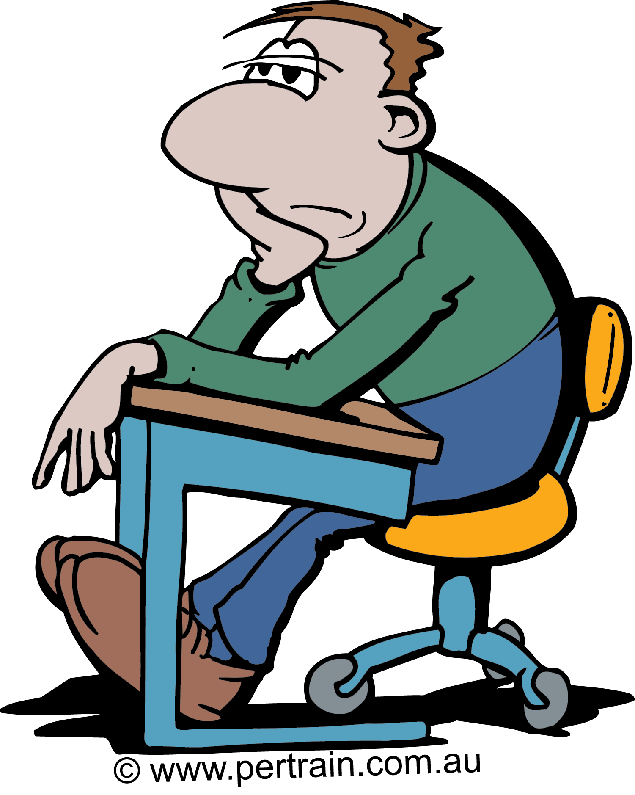
What is Mental Health?
Mental Health is defined by WHO as a state of well-being in which the individual or employee:
Realises his/her own abilities
Is able to cope with normal stresses of life
Is able to work productively and fruitfully
Is able to make a contribution to his/her community
Mental Health affects how we think, feel and act.
Notes:
Discuss what mental health is.

Slide 3
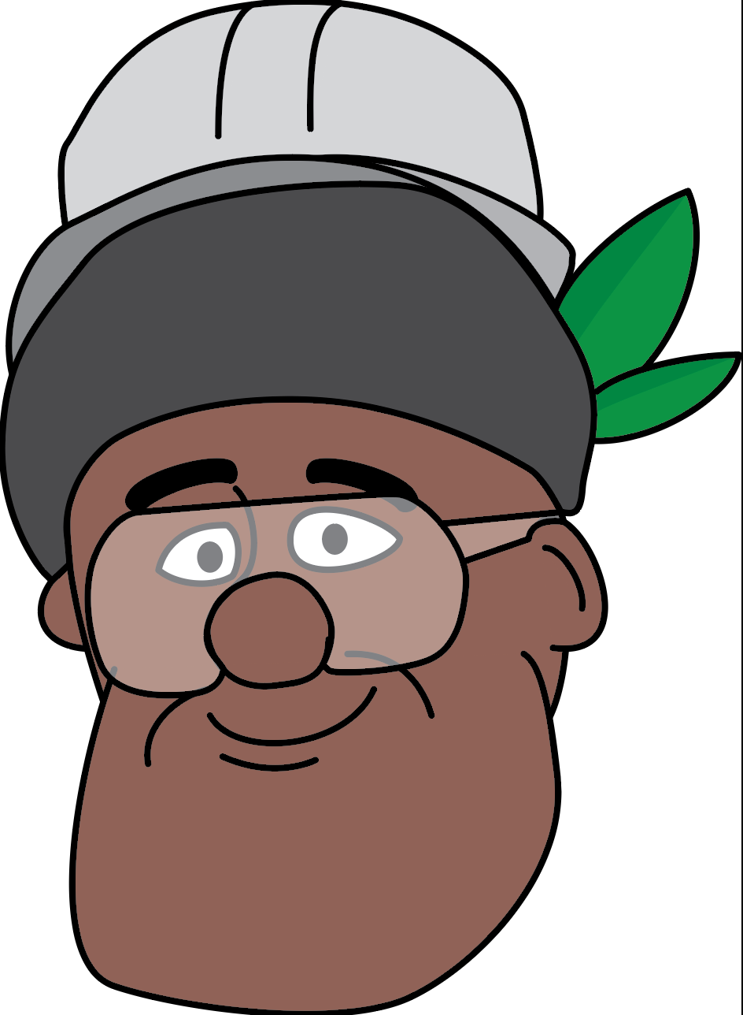
Good Mental Health Characteristics
A person in good mental health, has the ability to:
Learn
Feel
Express and manage a range of positive and negative emotions
Form and maintain good relationships with others.
Notes:
Discuss the characteristics of a person who has good mental health.

Slide 4
Why are we talking about mental health?
Many countries, including PNG, have experienced destruction from Covid-19 infection.
It has affected our mental capacity to adapt and adjust to the new normal protocols and adhere with the changes occurring all around us.
Studies have shown that isolation and social distancing has had a direct effect on many people’s mental health.
Some people are fearful about contracting the virus.
Others are anxious about family and friends.
Many people will have suffered bereavements, often without the chance to say good bye or attend funerals and proper burials.
Some people fear for their job security, returning to workplace and financial concerns.
Some employees are working longer, irregular hours and are combining work with other family responsibilities leading to poor work-life balance, fatigue and poor concentration at work.
Notes:
Discuss the link between Covid-19 and mental health.

Slide 5
Why are we talking about mental health?
Studies have shown that isolation and social distancing has had a direct effect on many people’s mental health.
Early research on the impacts of lockdown, included the findings of:
Fatigue
Musculoskeletal conditions
Poor work-life balance
Reduced exercise
Increased alcohol consumption and cigarette smoking
Appetite decreased / increase (food binging).
In relation to mental health specifically, employees develop reduced motivation, loss of purpose and motivation, anxiety and isolation which may lead to depression and thoughts of self harm.
Notes:
Discuss the link between Covid-19 and mental health (continued).

Slide 6
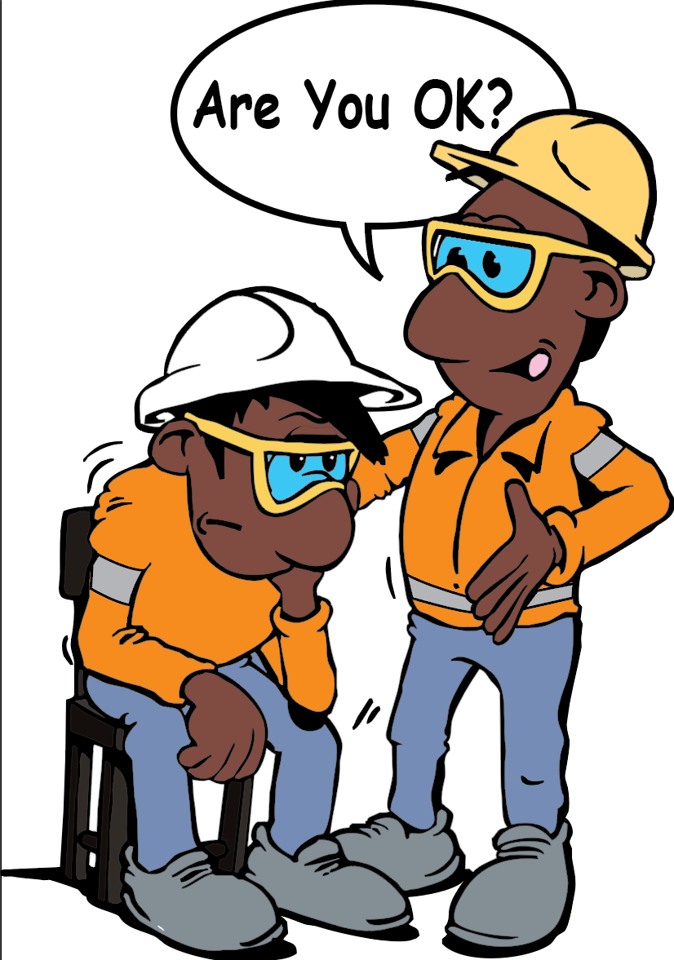
Potential Signs of a Mental Health Issue
The following MAY indicate a mental health issue.
Working long hours / not taking breaks
Increase sickness absence or lateness
Mood changes
Distraction, indecision or confusion
Withdrawal
Irritability, anger or aggression
Uncharacterised performance issues
Over reaction to problems or issues
Disruptive or anti-social behaviour
A change in general appearance, behaviour, cognitive function, judgement.
Trust your gut! If you think someone is acting strangely, ask them:
Notes:
Emphasise that everyone is different. Not everyone will show the same signs.
Look for changes, such as change in general appearance (posture, dressing, hygiene), behaviour (attitude to others, eye contact), cognitive functions (knowing where they are, time, date, memory, attention span) or judgement (making poor decisions, making mistakes, risky behaviour).
Trust your gut! If you think someone is acting strangely, ask them if the are OK and if there is anything you can do to help them.

Slide 7
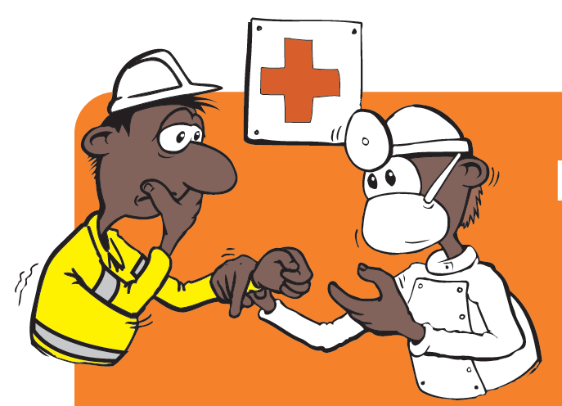
From the Medical Team
There are a variety of mental health issues.
Some are temporary, some are long term.
Some can be controlled using behaviours and coping strategies, some require medication.
A health professional may undertake a mental health examination (MSE) to identify the presence and severity of a mental health condition and identify if a person poses a risk to themself or others.
MSE may be done during pre-employment intake assessment medical checks or at any time where there is a concern about a person’s mental health. A mini MSE may also be conducted following a head injury.
Results of the MSE are confidential and are conducted to ensure that the person can get the help they need.
Notes:
Discuss the role of medical health professionals in relation to mental health.

Slide 8
What Can We Do?
Communicate
Communicate regularly with your work mates about health and well being, including mental health..
Well being
Take part in, and encourage others to take part in activities that encourage physical, mental, social and spiritual wellbeing.
Find out and share information about where to go for mental health support.
Doing things with others also provides the opportunity to share thoughts and experiences.
Raise Awareness
Mental health issues can affect all of us at some time.
Be part or the solution.
Help to raise awareness of mental health.
Work towards creating a culture where it is acceptable to talk about and seek help for mental health issues.
Notes:
It is well known that most employees do not feel comfortable speaking about low mental health, especially here in PNG. People develop the mindset that when individuals seek mental health assistance, they assume that the person is mentally ill.
This is NOT the case!
Mental health issues are something that can affect all of us at some time.
Be part of the solution. Discuss the things that everyone can do to help create acceptance of mental health issues and to help anyone who may be struggling with their mental health.

Slide 9
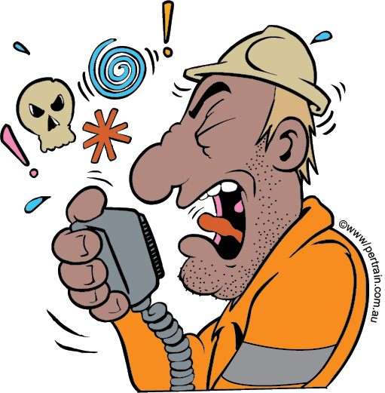
Do you Feel or Experience the Following:
Disturbed sleep or decreased need for sleep
Nervous/panic attacks and have unknown fears
Feel sick when you know you are alright
Loose concentration or have poor concentration
Increased risk behaviours (addictions, habits)
Increased absenteeism from work
Suddenly sad or anxious or crying spells
Tired and drained out the whole day
Difficulty in maintaining relationships
Depressed mood, unable to enjoy activities
Change in libido (sex drive)
Loss of interest in activities you liked before
Excessive energy
Increased irritability
Forgetfulness
Change in appetite (increase or decrease)
Excessive worry, over thinking, feelings of guilt
Fatigue
Isolation
Hallucinations
Impulsiveness
Suspiciousness
Suicidal or homicidal thoughts.
Help is available. Don’t be afraid to ask.
Contact EHW Medical Team.
Notes:
Check in with your mental health. Ask yourself if you are feeling or have experienced these. If you are concerned, contact the EHW Medical Team. They are here to help.

Slide 10
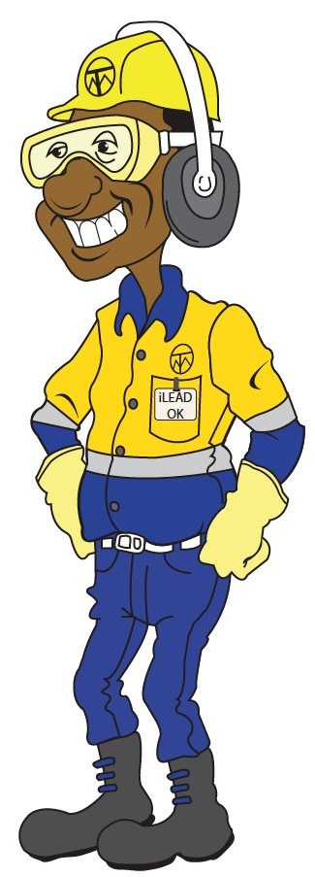
Summary
Mental health is very important as it affects us in the way we think, feel, act and cope with our day to day issues.
Good mental health helps us to have the ability to learn, feel, cope, interact and manage our daily activities.
A mental health issue is nothing to be ashamed of.
If you are concerned about your mental health, or someone else’s, talk to a doctor, friend, your supervisor or contact the EHW Medical Team.
Change the culture. It is OK to talk about mental health!
Notes:
Summarise what good mental health is and what someone with a mental health concern should do.
Remind workers that there is no shame in seeking help for a health issue, including mental health.
Ask if there are any questions or comments about this topic.

