Slide 1
Fit for Work Overview
National Mine Safety Week – Day 2
Notes:
Welcome.
Introduce yourself.

Slide 2
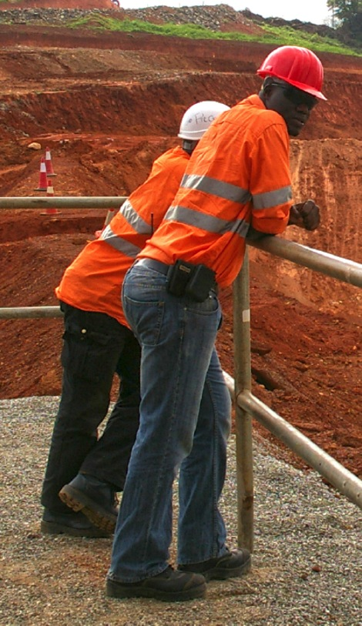
Introduction
Being fit for work means being in a physical, mental and emotional state that allows you to perform your work to the standards set by Ok Tedi, and in a manner that will not put yourself or others at risk.
Fitness for work can be affected by many factors including:
Fatigue
Emotional issues and stress
Inappropriate use of alcohol
Use of illicit drugs
Taking some types of prescribed medications
Physical difficulties.
It is important to identify when an individual is not fit for work at an early stage and to provide support and assistance when it is required.
Final determination of being fit for work is based on the opinion of the principal employer, manager, superintendent, line leader and the individual.
Notes:
Explain that mining work is physically demanding and requires mobility, strength, good posture, reach, fine motor skills and an aerobic capacity to perform the relevant tasks.
Being ‘fit for work’ means that, as an individual, you must be in a physical, mental and emotional state that allows you to perform your work to the standards set by Ok Tedi, and in a manner that will not put yourself or others’ safety or health at risk.
Discuss the factors that can affect a person’s fitness for work.
Emphasise the importance of identifying if someone is not fit for work at an early stage.

Slide 3
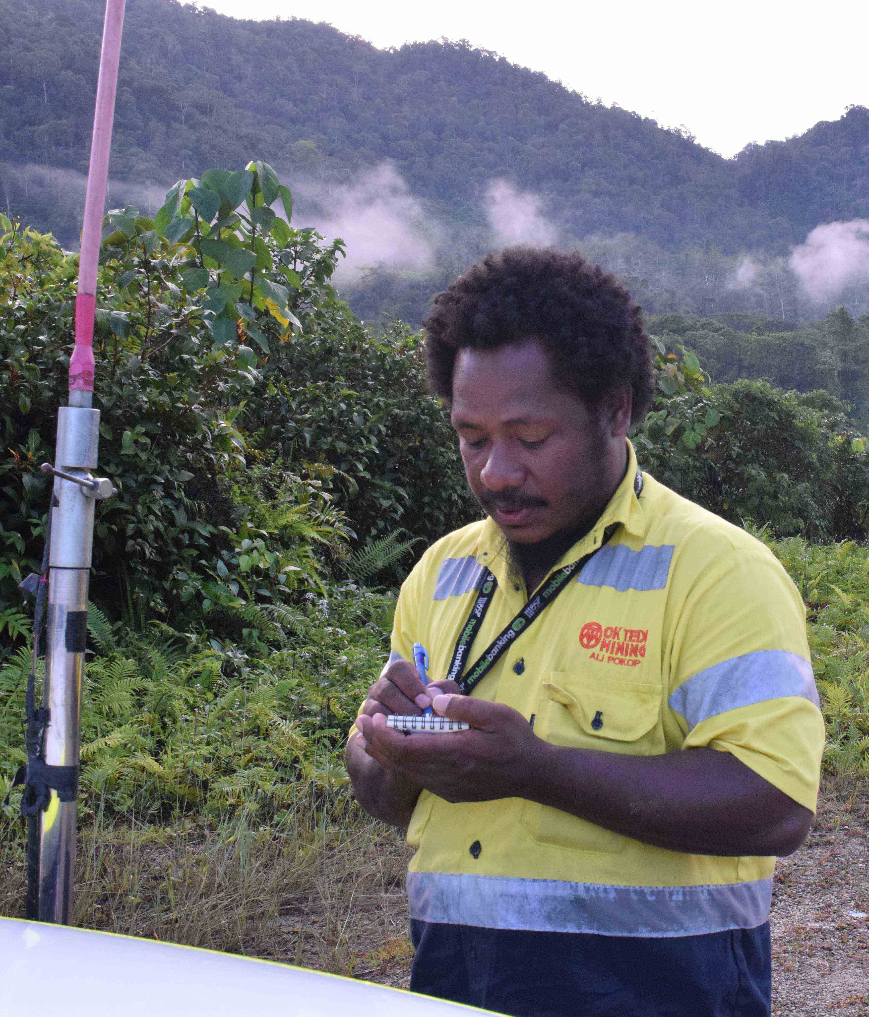
Your Obligations
Come to work in a condition to perform duties without risk to yourself or others.
Notify your Supervisor if you:
Believe that you are unfit for work
Believe that someone else is not fit for work
Know of someone who has unauthorised possession of alcohol, consumes alcohol, or takes illicit drugs at the workplace or during the work period.
Use medication as directed by a medical practitioner or the manufacturer.
Cooperate in alcohol and drug testing.
Assess your own fitness for work at the end of shift to ensure you are okay to commute home.
Notes:
Discuss the obligations that workers, contractors and visitors to site have to Ok Tedi.

Slide 4
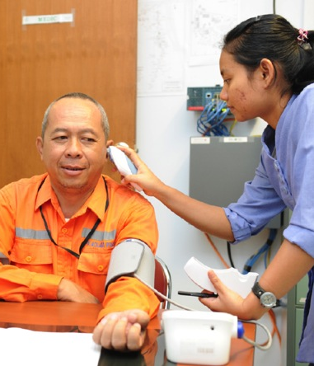
Fitness for Work Assessments
Assessments are conducted:
Following an accident or any reportable incident
If a Supervisor has reasonable grounds to suspect that you could be unfit for work
On a random basis while at work
As part of a pre-employment medical examination.
Assessment methods include:
Face-to-face discussion
Observation of work performance
Medical assessment
Alcohol and drug testing
Employee self-testing for alcohol and other drugs.
NOTE: If you refuse to be tested the matter will be treated as if the test result was positive.
Notes:
Explain that Ok Tedi has an obligation under Workplace Health and Safety Legislation to ensure that everyone on a Ok Tedi site is fit for work. One method for meeting this obligation is to conduct fitness for work assessments.
Explain what happens if a person refuses to be assessed or tested.
Emphasise that the primary reason for instigating a fitness for work assessment/test is to ensure safety and wellbeing.

Slide 5
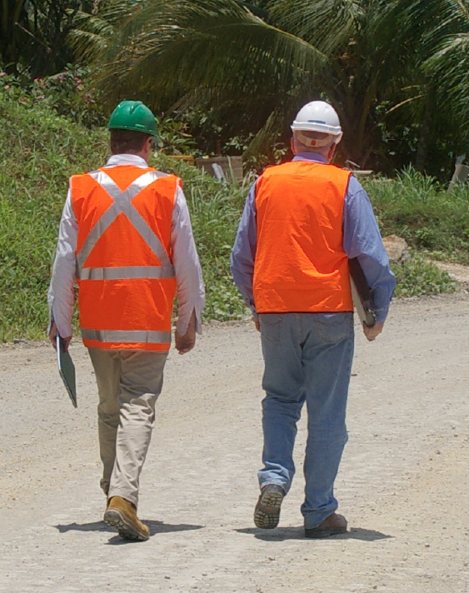
What Happens if You are Unfit for Work?
You will be:
Removed from the workplace
Prohibited from driving a vehicle or operating machinery
Transported back to your home or accommodation
Provided with a letter stating why your are in breach of the fitness for work and wellbeing procedure and a copy of any positive test results.
NOTE: All information relating to an individual’s condition is confidential.
Notes:
Explain that:
Managers and Supervisors take the actions when an individual is deemed unfit for work for any reason.
Accommodation is the camp in a remote location or to their home in a residential location.
Information is subject to legal and legislative requirements and is available on a strictly ‘need-to-know’ basis. Failure of any individual to maintain confidentiality will result in disciplinary action.

Slide 6
Return to Work
Before Ok Tedi employees are permitted to return to work, they:
Must meet with their Manager or Supervisor and demonstrate that they are fit for work
Produce a negative drug and alcohol result
Demonstrate that the cause of the problem has been addressed.
Employees can access sick leave and then accrued annual leave during the period that they are unable to demonstrate that they are fit for work – they can also access the EAP.
On return to work, employees must demonstrate a clear and consistent improvement in their job performance.
If an immediate danger exists as a result of an individual’s state (e.g. drug overdose or potential for suicide), the Manager or Supervisor will take appropriate action which may include getting external assistance.
Notes:
Explain that employees who have breached Standard HE ST-04 Fitness for Work can access the Employee Assistance Program (EAP) to address work and personal problems. If you are a Ok Tedi employee, this service is available to your immediate family members.
If an immediate danger exists (e.g. drug overdose or potential for suicide), the Manager or Supervisor will take appropriate action which may include gaining external assistance.

Slide 7
Impact of Fatigue on Fitness for Work
Fatigue can significantly affect your capacity to function:
Decreased performance and productivity
Increased potential for injuries
Fatigue can occur following:
Physical exertion
Emotional exertion
Inadequate or disturbed sleep
Illness.
Lack of sleep is the main cause of fatigue.
Take steps to ensure that you do not present to work in a fatigued state.
Inform your Supervisor if you think you present a risk to yourself or others.
Identify and address the factors that are contributing to the fatigue.
Follow the OTML Fatigue Management Guidelines.
Seek professional help if necessary.
Notes:
Discuss the impact and causes of fatigue.
Explain that lack of sleep is the number one cause of fatigue. If you are fatigued then getting more than 7-8 hours of sleep a night is critical.
Discuss the measures that you can take to control fatigue.

Slide 8
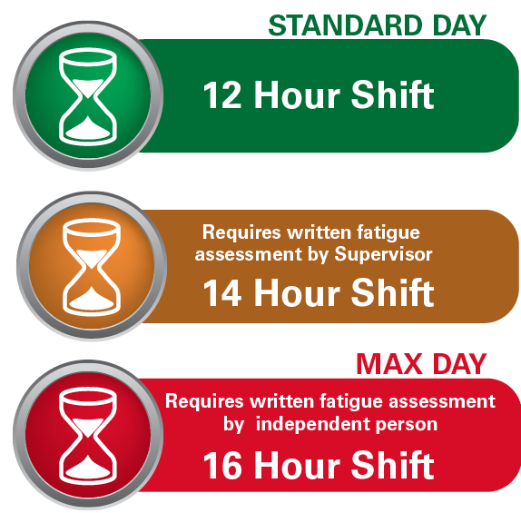
OTML Fatigue Management Guidelines
Shifts must be less than 16 hours in a 24 hour period
If a 12 hour shift is extended up to 14 hours, the Supervisor completes a written fatigue assessment before the extended work period
If a shift is extended beyond 14 hours the Supervisor and an independent must complete the written fatigue assessment
Where the maximum 16 hours on site is worked, alternative transport home is a MANDATORY requirement
The minimum break following an extended work period is 10 hours
Broken shifts must not be more than 12 hours in a 24 hour period
Notes:
Explain that:
Ok Tedi has the guidelines to control the risk of individuals becoming fatigued through working additional hours or shift work.
No shift is to be greater than 16 hours total in a 24 hour period.
Where a 12 hour shift is extended up to 14 hours (2 hour extension) a written fatigue assessment is completed by the supervisor of the person proposed to work the extended shift before commencing the extended work period.
Where a shift is extended beyond 14 hours (>2 hour extension) a written fatigue assessment is completed with the assistance of an independent person (such as the shift Emergency Response Officer) before commencing the 15th hour of work.
A person working any shift of 16 hours or more is offered alternative transport to their place of residence. For example, taxi or other travel provided by another person not suffering from, nor considered to be at risk from fatigue.
The minimum break following an extended work period must not be less than 10 hours.
Personnel working broken shifts should not work more than12 hours in a 24 hour period.
Regardless of the length of shift, if a worker, Superintendent, or Supervisor assesses a worker as suffering fatigue, or being at risk from fatigue, the Superintendent or Supervisor will arrange a means of alternative travel.

Slide 9
Impact of Emotional State on Fitness for Work
Your fitness for work may be affected by an altered emotional state:
Anxiety
Depression
Stress
Post traumatic stress disorder (PTSD)
Eating disorders.
Your emotional state impacts on how you think, behave and interact with others.
Notes:
Explain that:
An individual’s fitness for work may be compromised by an altered emotional state (e.g. stress, depression, anxiety, eating disorder) which can pose a risk to themselves or others.
Your emotional state impacts on how you think, behave and interact with others.
Discuss the effects of stress, mental illnesses, and emotional issues on a person’s ability to work.

Slide 10
Suicide
If someone tells you that they intend to commit suicide, you have an obligation to stay with that person and seek help from your Supervisor or EAP personnel who will advise you what to do.
Some warning signs of suicide are:
Talking, writing or joking about death
Talking about people who have committed suicide
Withdrawing or avoiding contact with other people
Giving away personal possessions
Saying good-bye in a meaningful way
Making arrangements for their funeral
Risk-taking behaviour
Deliberate self-harm or a suicide attempt
Recent discharge from a psychiatric unit
Evidence of depression
Sudden calmness.
Notes:
Discuss the warning signs of suicide and what to do.

Slide 11
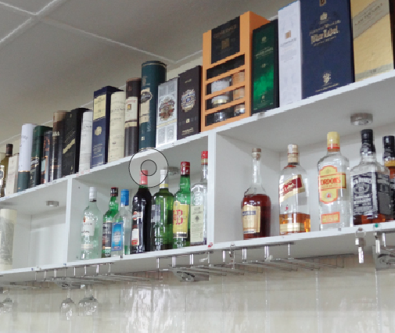
Impact of Alcohol and Drugs on Fitness for Work
Ok Tedi has a Zero tolerance policy for alcohol and illicit drug use in the workplace.
All employees, contractors and visitors must have a 0.00 breath alcohol concentration and a confirmed negative drug test result.
Alcohol and drugs include:
All substances containing alcohol
Drugs such as amphetamines, barbiturates, benzodiazepines, cannabinoids, cocaine, LSD, methadone
Opiates including over-the-counter and prescription medication
Betel nut.
Notes:
Discuss Ok Tedi’s alcohol and drug use policy – Zero tolerance.
Explain that individuals who present to work and have a positive reading will be sent back to the camp or their home and further action will be taken.

Slide 12
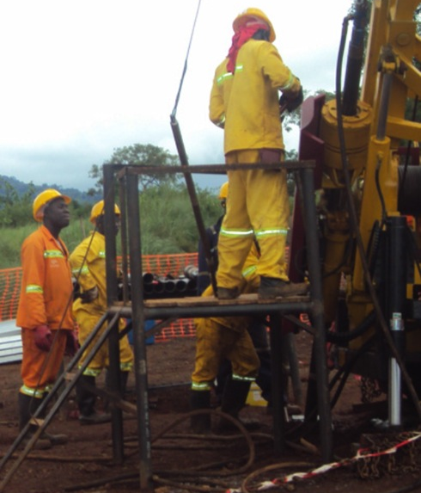
Effects of Alcohol, Illicit Drugs and Prescribed Medications
Side effects of alcohol, illicit drugs and some medications impact your ability to:
Remain awake
Remain alert
React in a timely manner
Make good judgement calls
Function normally physically.
Symptoms are similar to fatigue:
Erratic, abnormal or unusual behaviour
Increased rate of near misses or incidents
Deteriorating work performance.
Notes:
Discuss the side effects of alcohol, illicit drugs and some prescription and over-the-counter medications, including:
erratic, abnormal or unusual behaviour
increased rate of near misses or incidents
deteriorating work performance.

Slide 13
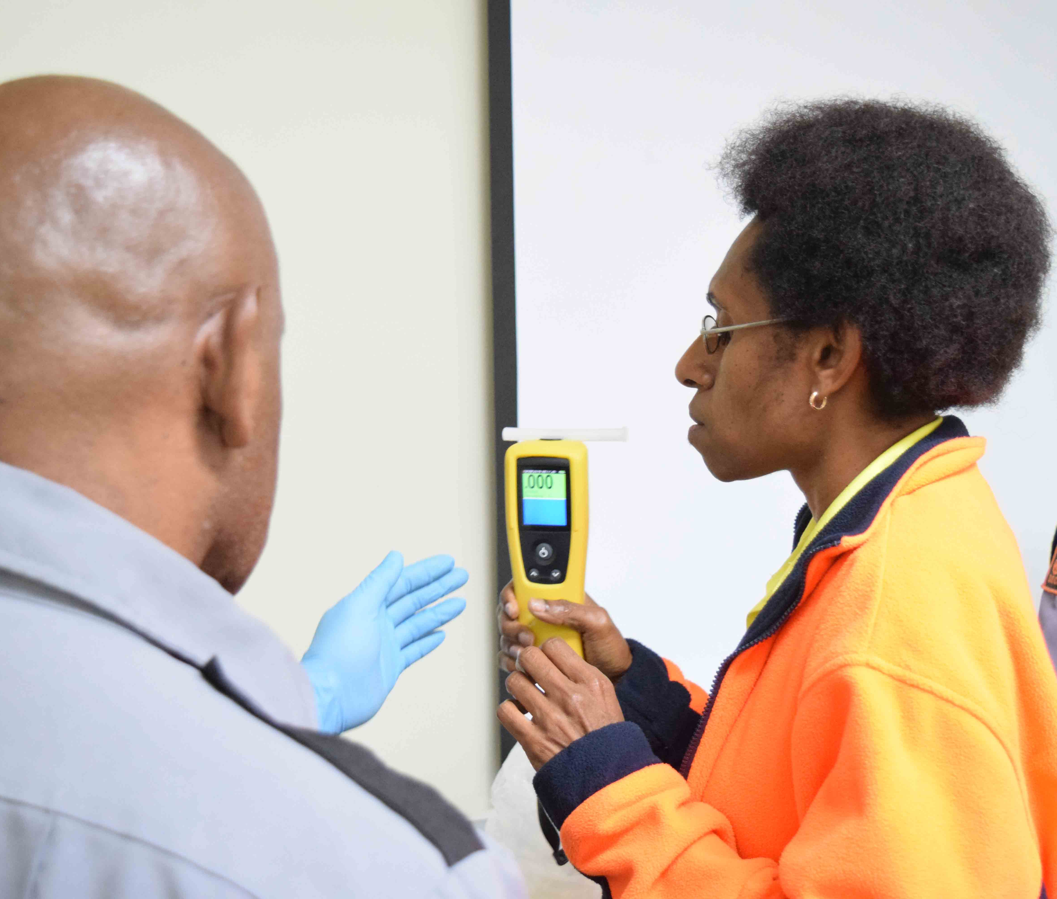
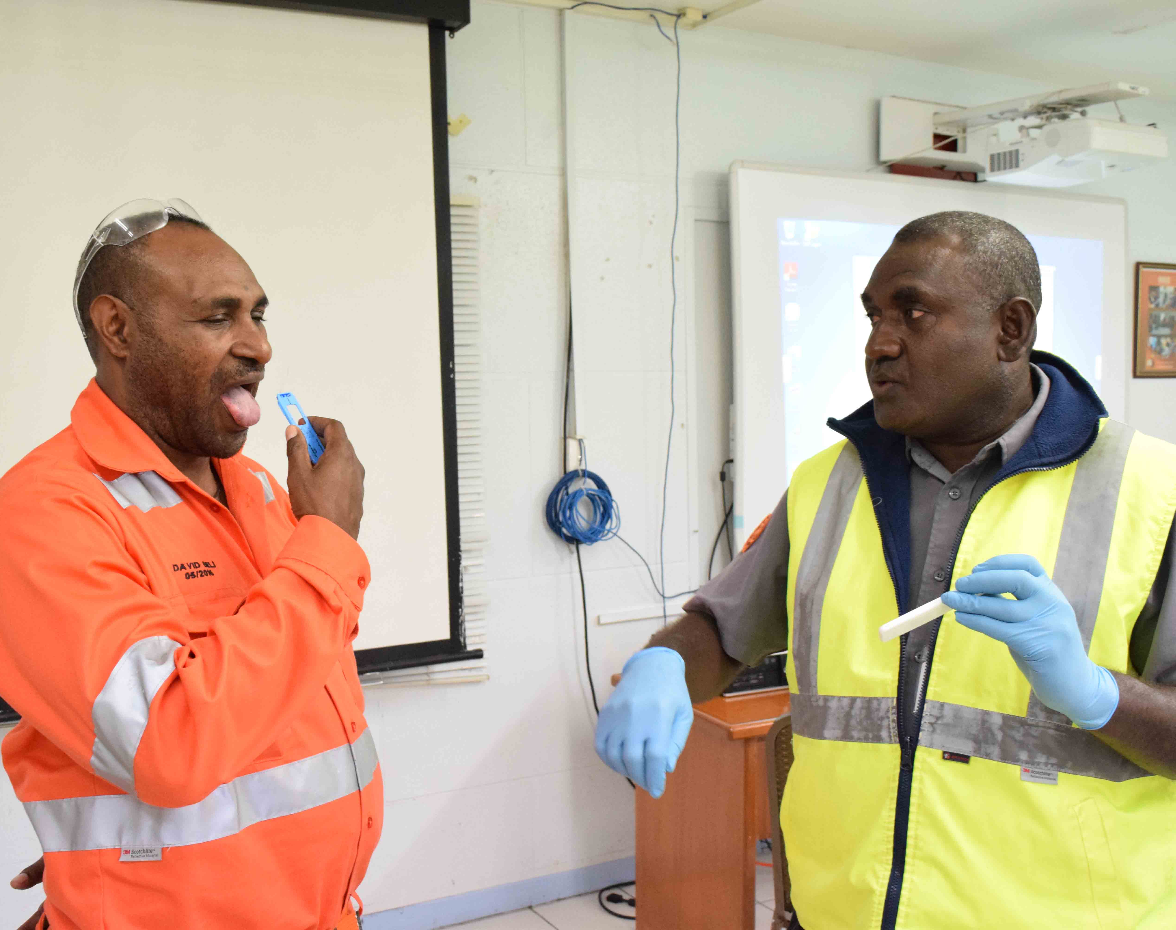
Impact of Alcohol and Drugs on Fitness for Work
Persons working or visiting a Ok Tedi site may tested at any time and without notice
Drug and alcohol testing is carried out:
As part of the pre-employment health assessment
When there is reasonable grounds to suspect a problem consistent with the use of drugs or alcohol
Following a reportable accident or incident
On a random basis in accordance with Ok Tedi procedures.
All employees, contractors and visitors must have a 0.000 breath alcohol concentration and a confirmed negative drug test result.
Notes:
Ok Tedi employs suitably trained and authorised personnel to collect breath specimens for alcohol screening, and saliva and urine samples for drug screening.
Any person working or visiting a Ok Tedi site may be requested to provide a sample of urine or saliva and/or undertake a breath analysis test at any time and without notice.

Slide 14
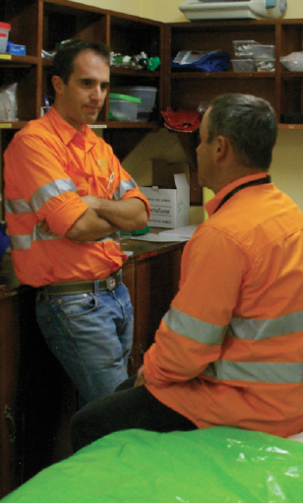
Impact of Illness or Injury on Fitness for Work
If you are suffering from a physical illness or injury and believe that you are unfit for work notify your Supervisor.
If you are sick – stay at home.
If you have cold or flu-like symptoms:
Isolate at home
Advise your supervisor
Get a covid test if possible.
If you are injured at work – ensure an incident report has been fully completed, signed by the appropriate person and submitted.
If you are injured at home and you feel your injury may affect your work, or may be made worse by working, contact your supervisor or HR team to discuss what to do.
Notes:
Ok Tedi sites have people trained in first aid and, if the site is in a remote location it will also have trained medical personnel to deal with illness and injury cases.
If you are sick – stay home and advise your supervisor.
If you are injured – advise your supervisor and/or HR Team and complete all required reports.

Slide 15
Summary
You have a responsibility to present to work in a fit state.
Take accountability for your own actions:
Get plenty of sleep
Address emotional issues, talk to someone who can help (medical professional, EAP, friend, supervisor)
Zero tolerance for alcohol and drugs at work
Stay at home if you are sick
Record details of workplace injuries.
Address issues ASAP
Stop work if it’s unsafe.
If in doubt – ask your supervisor.
Follow OTML standards, guidelines and procedures.
Notes:
Explain that:
every worker has a responsibility to present for work in a fit state to do their job safely and effectively
everyone must take accountability for their own actions and address issues as they arise
every worker has the right to stop work if they think the situation is unsafe or unhealthy
if in doubt, stop and talk your supervisor.
Follow OTML standards, guidelines and procedures that are put in place to keep everyone safe and healthy.
Ask if there are any questions or comments about this topic.

