Slide 1
Fatigue, Drugs and Alcohol
National Mine Safety Week – Day 3
Notes:
Welcome.
Introduce yourself.

Slide 2
Introduction
Fatigue is a physical condition that occurs when a person’s physical or mental limits are reached.
Fatigue can reduce performance and productivity and can increase the risk of incidents and injury.
Ok Tedi recognises that a person’s fitness for work can be adversely affected by many factors including:
Fatigue
Inappropriate use of alcohol
Use of illicit drugs
Some prescribed medications.
Notes:
Fatigue is a physical condition that occurs when a person’s physical or mental limits are reached. Fatigue can reduce performance and productivity and can increase the risk of incidents and injury as two recent high potential incidents have shown.
OHS Standards and Guidelines in relation to Fatigue management are part of OTML’s Fit for Work Policy which applies to all OTML employees, contractors/consultants and visitors required to access OTML work sites and facilities.

Slide 3
What Causes Fatigue?
Major factors contributing to, and increasing the risk, of fatigue include:
Insufficient good quality sleep
General fitness issues (poor diet, dehydration, lack of exercise)
Stress or anxiety
Work conditions (poor ventilation or lighting, monotonous or repetitive work, irregular and/or unpredictable working hours)
Some medical conditions and medications.
Fatigue can:
Be caused by alcohol and/or drug use
Be worsened by alcohol and/or drug use
Lead to increased alcohol and/or drug use.
Notes:
Explain the most common factors that contribute to fatigue or increase the risk of fatigue.

Slide 4
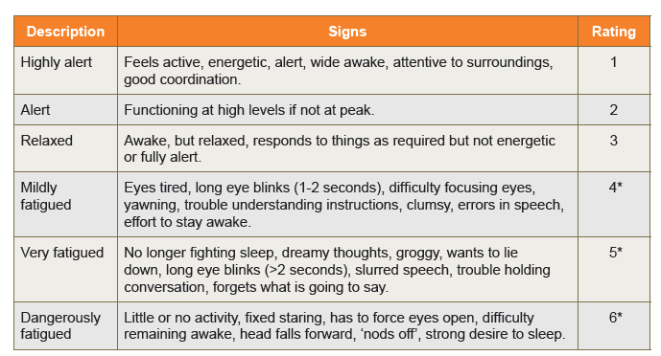
Signs and Symptoms of Fatigue
*** Individuals with ratings 4, 5, and 6 should not operate plant and equipment
Notes:
Remind workers of the signs of fatigue and how this relates to work fitness.

Slide 5
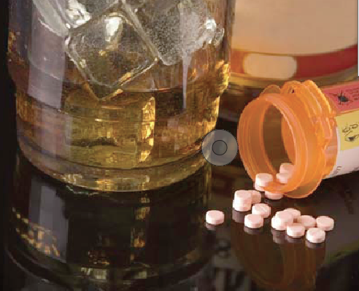
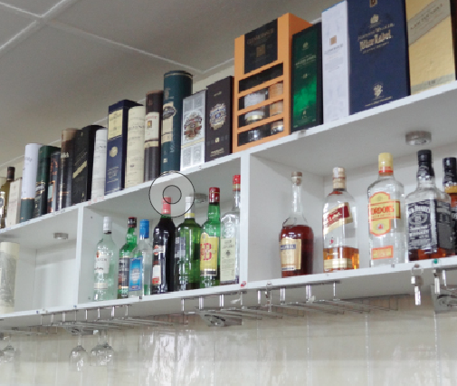
Alcohol, Illicit Drugs, Prescribed Medications
Ok Tedi has a Zero tolerance policy for alcohol and illicit drug use in the workplace.
All employees, contractors and visitors must have a 0.00 breath alcohol concentration and a confirmed negative drug test result.
Alcohol and drugs include:
All substances containing alcohol
Drugs such as amphetamines, barbiturates, benzodiazepines, cannabinoids, cocaine, LSD, methadone
Opiates including over-the-counter and prescription medication
Betel nut.
Notes:
Discuss Ok Tedi’s alcohol and drug use policy – Zero tolerance.

Slide 6
Alcohol
Alcohol is a depressant that increases sleepiness. However, it can also disrupt sleep and reduce sleep quality.
1-2 standard drinks may help workers fall asleep faster.
5 or more drinks will increase their chances of waking early when the most restful sleep occurs.
Alcohol reduces the dreaming stage of sleep which is important for memory, learning and regulating nervous system activity and mood.
It also increases daytime sleepiness and physical and mental impairment in someone who is already fatigued.
Notes:
Explain that workers who have difficulty sleeping sometimes use alcohol and/or drugs to help. This is only a short term solution and may make things worse in the long run.
Discuss the effects of alcohol on sleep patterns.

Slide 7
Drugs
Drug use can also affect fatigue. Workers may use over the counter (OTC), prescribed, and/or illicit drugs to:
Overcome the effects of fatigue to meet work, social, and family commitments
Treat other medical conditions and experience fatigue as a side-effect
Counteract feelings of fatigue when they are ‘coming down’ or withdrawing from drug use.
Notes:
Discuss the reasons why workers may use drugs.
Emphasise that whatever the reason, the supervisor must be informed of any medication (whether prescribed by the doctor, or bought at the chemist or shops) so the worker and supervisor can determine if there are any possible effects on the worker and workplace.

Slide 8
How do drugs affect sleep?
Betel Nut:
Chewing betel nut can lead to a dependence and an increased tolerance, meaning you will need more to feel the same effects
Opiods (including over the counter pain medication):
Can mask a more serious underlying condition.
Side effects of chewing betel nut include altered speech, increased sensitivity to heat and cold, high blood pressure, mood swings, irritability, anxiety, loss of concentration and disturbed sleep.
Affects sleep patterns and reduces the quality and amount of sleep.
Other drugs (including methamphetamine, cocaine, cannabis):
Methamphetamine disrupts brain chemistry and prevents sleep, sometimes for several days. Can also cause depression and anxiety
Other drugs can cause strange dreams and insomnia.
Notes:
Discuss the effects of drugs on sleep patterns.

Slide 9
Drug and Alcohol Testing
Ok Tedi has a ZERO TOLERANCE policy for alcohol and illicit drug use in the workplace.
All employees, contractors and visitors must have a 0.000 breath alcohol concentration and a confirmed negative drug test result.
Ok Tedi employs suitably trained and authorised personnel to collect breath specimens for alcohol screening, and saliva and urine samples for drug screening.
Drug and alcohol testing is carried out:
As part of the pre-employment health assessment
When there is reasonable grounds to suspect a problem consistent with the use of drugs or alcohol
Following a reportable accident or incident
On a random basis in accordance with Ok Tedi procedures.
Individuals who are being tested are allowed to have a witness present.
Any person working or visiting an Ok Tedi site may be tested at any time without notice.
Notes:
Discuss the Requirements of OTML’s drug and alcohol testing policy.

Slide 10
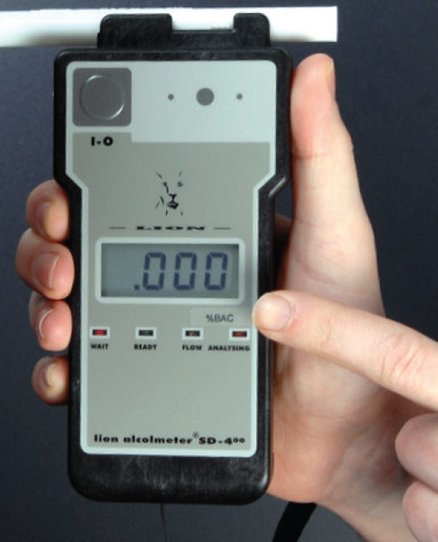
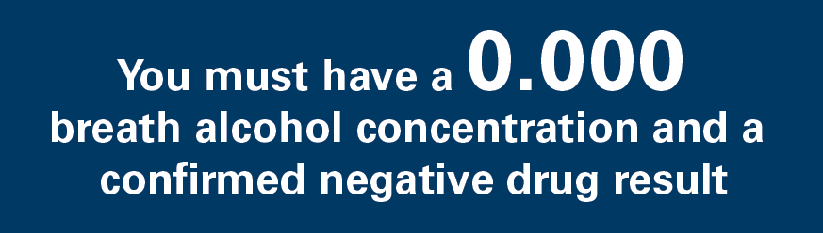
Alcohol and Drug Testing (cont.)
Breath test for alcohol:
If a positive result is obtained from a breath test, a confirmatory test is performed after a 20 minute interval
If the second test is positive, both tests are recorded and treated as a positive result
If the second test is negative, the individual is cleared for work
Saliva test for drugs:
If a positive result is obtained from a saliva test then a confirmatory test is performed using a urine sample
Tampering:
If you tamper with test samples or results you will be summarily dismissed
Notes:
Explain that if a positive alcohol reading is obtained from a breath test, a confirmatory test is performed after a 20 minute interval. If the second test is positive, then both tests are recorded and treated as a positive result. If the second test is negative, the individual is cleared for work.
If a positive drug result is obtained from a saliva test then a confirmatory test is performed using a urine sample.
Explain that at Ok Tedi, tampering with test samples or results is a serious matter and is dealt with quickly by dismissing the employee or banning contractors and visitors from Ok Tedi sites.

Slide 11
Self-test Kits
Alcohol
Breath analysis self-testing equipment is accessible
If a positive reading results from the self-test, advise your supervisor immediately that you cannot commence work
The test will not result in disciplinary action provided that the self-test was undertaken before entering the main gates and starting work
If you self-test after starting work and a positive reading is obtained then disciplinary action may be taken
Drugs
Self-test drug kits can be purchased at the employee’s own expense
Notes:
Explain that anyone can access the breath analysis self-testing equipment.
If the reading is positive, advise your supervisor immediately that you cannot commence work.
The test will not result in disciplinary action provided that the self-test was undertaken before entering the main gates on site, before starting work, and before being informed that a random test is required.
Sick leave or annual leave entitlements can be considered on an individual basis.
Disciplinary action will be taken if a positive reading is obtained after your have presented for work.
Self-test drug kits are not provided free of charge by Ok Tedi.

Slide 12
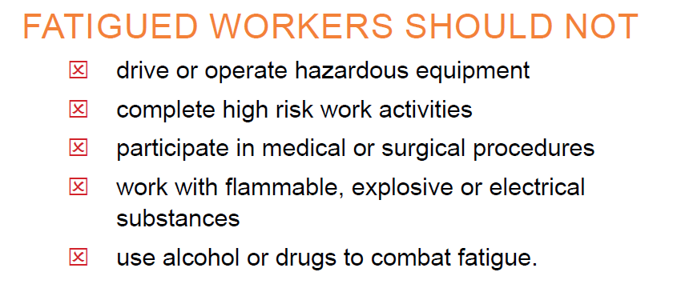
Summary
Remember: Everyone has the right and responsibility to stop work if they believe they or their co-workers are too fatigued to safely continue.
Notes:
Summarise what a fatigued worker should NOT do.
Emphasise that everyone has the right and the responsibility to stop work if it is unsafe to continue.

Slide 13
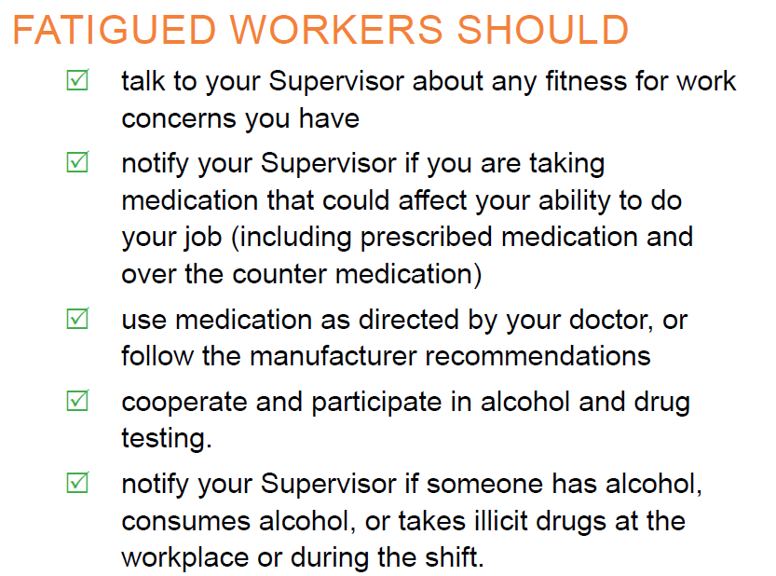
Summary
Remember OTML has a Zero Policy for drug and alcohol use at work.
Notes:
Summarise what a fatigued worker SHOULD do.
Remind learners that Ok Tedi Mining has a Zero tolerance policy for drug and alcohol use at work.
Ask if there are any questions or comments about this topic.

