Slide 1
Advance Safety Awareness
National Mine Safety Week – Day 4
Notes:
Welcome.
Introduce yourself.

Slide 2
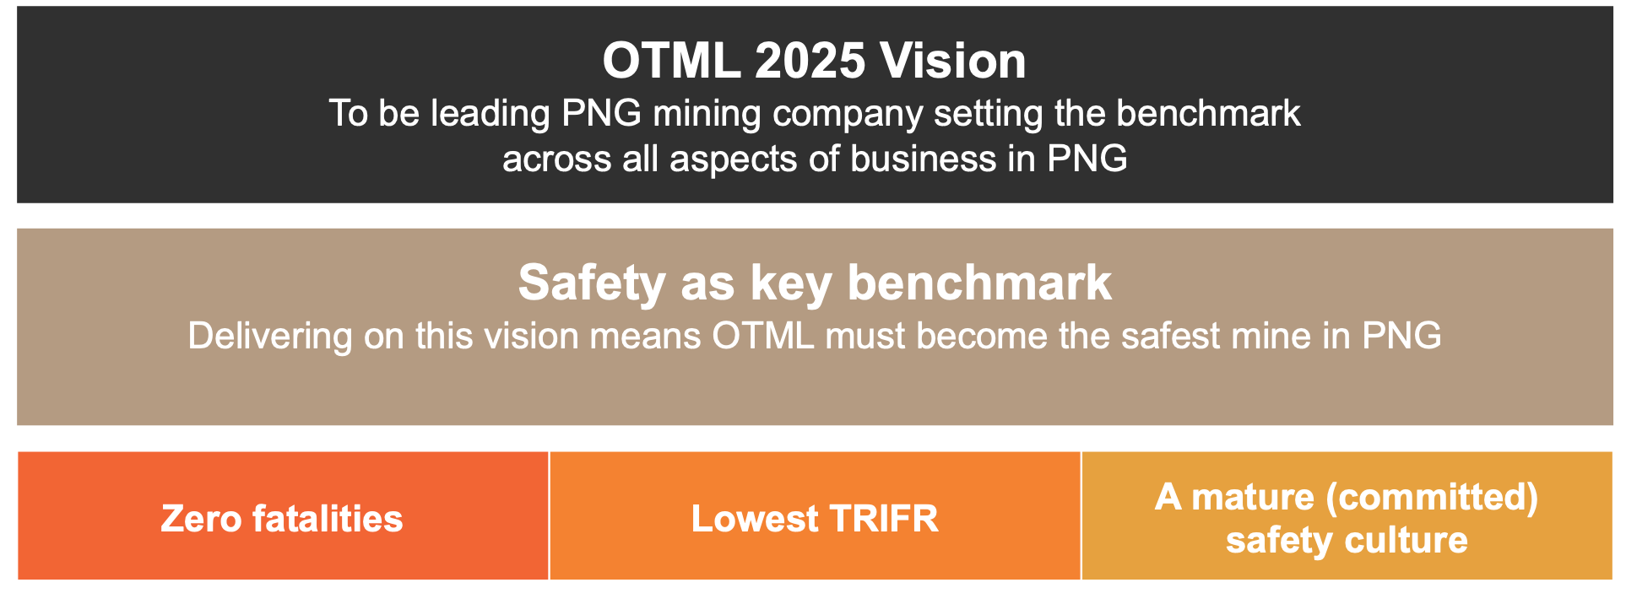
Purpose
ASA (Advanced Safety Awareness) Coaching
To increase safety awareness and change mindsets in order to reduce the behaviors that cause workplace injuries and incidents.
The shift from reactive to proactive safety is key to preventing fatalities, lowering TRIFR and building a mature and sustainable safety culture.
3 Year Safety Plan
Safety Behavior | Risk & Audit |
Occupational Health & Hygiene | Standards & Systems
Notes:
Explain the purpose of the ASA program.

Slide 3
ASA Program Overview
The program has 4 points of contact to close the loop on behavioral change:
Individual Survey to measure safety beliefs
1 on 1 Coaching
Follow up Supervisor Interaction
Recording & Reporting
Notes:
Explain the four steps in the ASA program.

Slide 4
1. The Survey
The survey measures 5 components:
Beliefs
Attitudes
Responsibility
Motivation
Stress
The survey is completed online or in paper format
An individual report is prepared for discussion with the employee in the Coaching session
Notes:
Discuss the survey components.
Emphasise that there are no right or wrong answers. The survey is just a starting point.

Slide 5
2. One-on-One Coaching
OTML employees and contractors are trained as coaches
Coaches conduct a 90 minute, one-on-one Coaching session with other employees and contractors:
Understanding of safety beliefs
The individual’s Survey results
Development of individual safety commitments
Notes:
Discuss what happens in the 1-on-1 coaching session.

Slide 6
3. Supervisor Follow Up Interaction
Supervisors receive the employee’s Coaching Certificate and Safety Commitments.
They use this as an opportunity to follow up with the employee to check how they are doing with their Commitments and to offer their support.
Notes:
Explain that the supervisor will follow up and offer support.
Emphasise that the supervisor will not receive individual survey responses, these remain confidential between the employee and their coach.

Slide 7
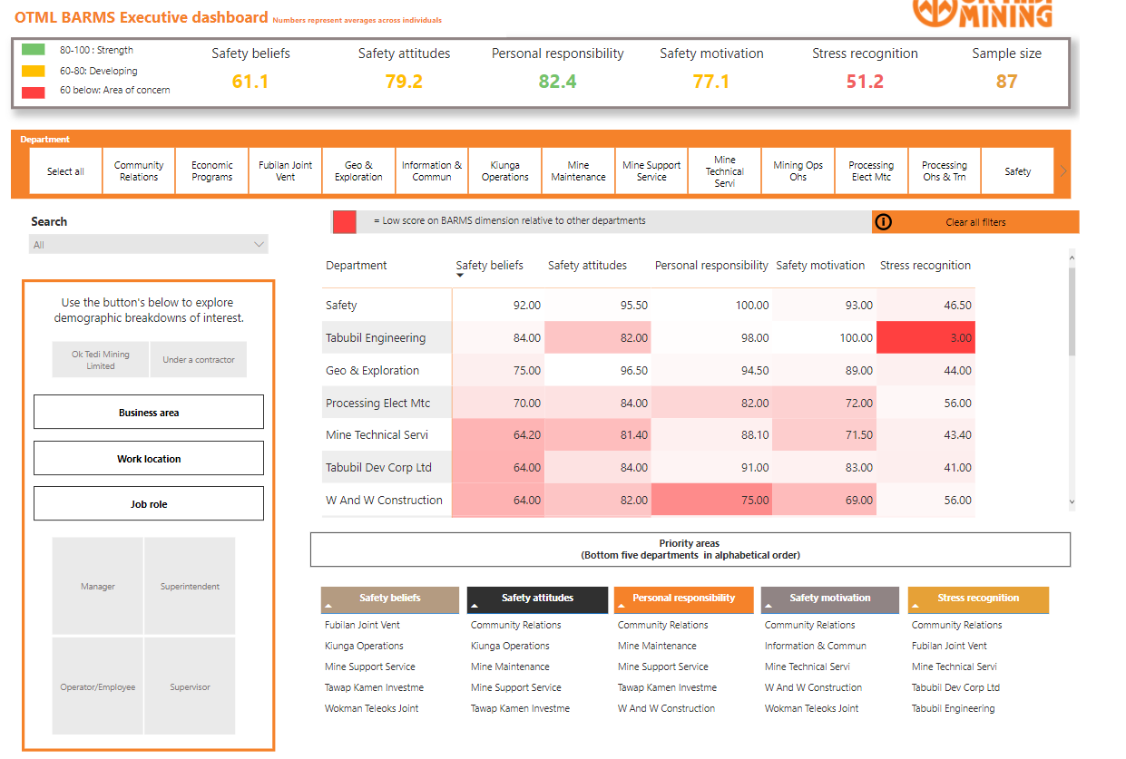
4. Recording and Reporting
All information is entered into a data base to provide lead indicator information on safety
Notes:
Explain that the information is entered into a data base and this information is used to report against our safety benchmark.
Emphasise that individual results are not reported, only the overall data.

Slide 8
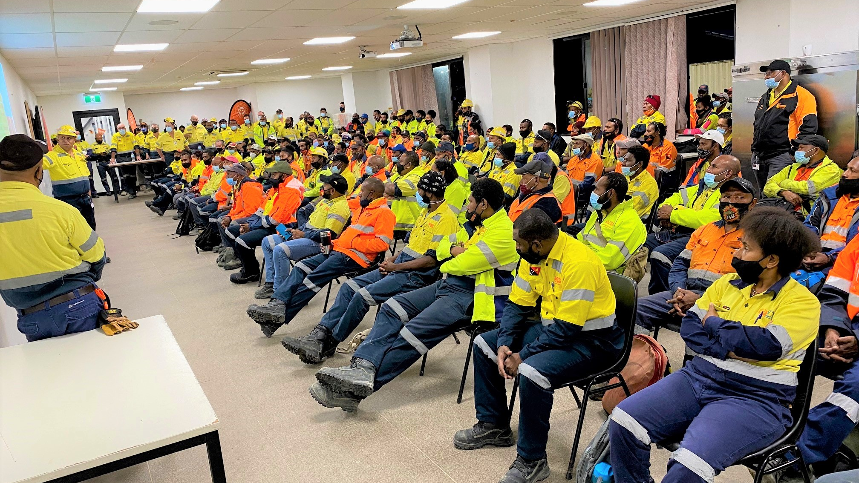
ASA Program Update
As at the end of 2020 all OTML employees had been coached
Due to personal circumstances, the previous consulting company was not able to continue to provide support
Mining Leaders Group (who provide our Leadership Development Program 2) were contracted to develop and continue the roll out of ASA Coaching
The focus for 2022 will be on those employees who have commenced since the previous program and the key contractors
Notes:
Discuss the ASA program update and plans for the future.

