Slide 1
Pasin Ok Tedi
Integrity

Slide 2
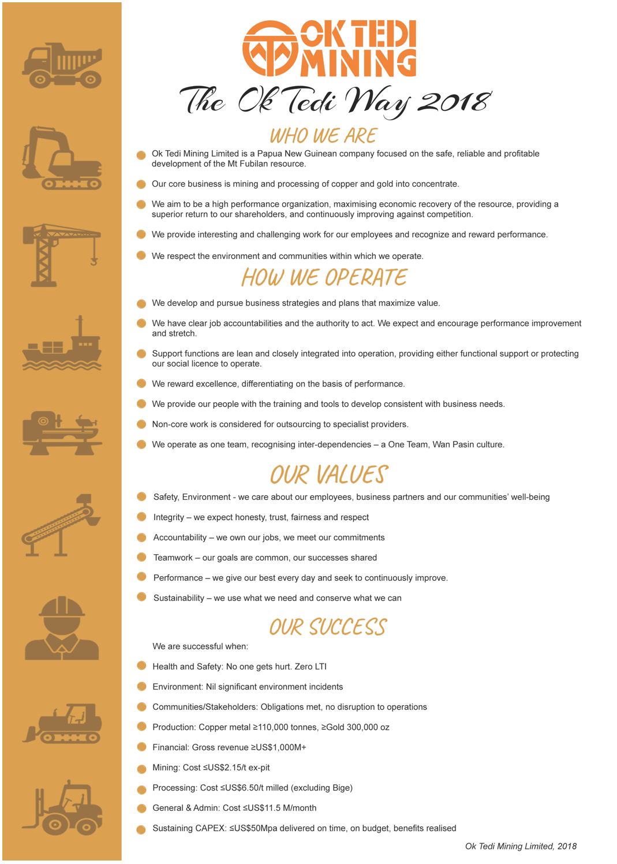
The Ok Tedi Way
The Ok Tedi Way is a statement of who we are and how we operate
It is based on our values
Notes:
The Ok Tedi Way is a statement of who we are and how we operate,
Our values are
Safety, Environment – we care about our employees, business partners and our communities well being
Integrity – we expect honesty, trust, fairness and respect
Accountability – we own our jobs, we meet our commitments
Teamwork – our goals are common, our success shared
Performance – we give our best every day and seek to continuously improve
Sustainability – we use what we need and conserve what we can

Slide 3
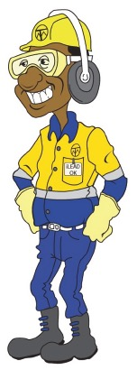
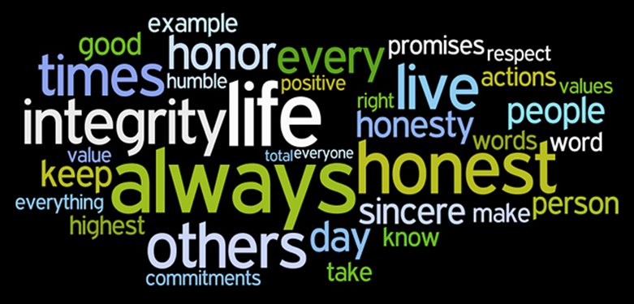
This month we focus on:
Integrity
Integrity - being honest & having good
moral principles.

Slide 4
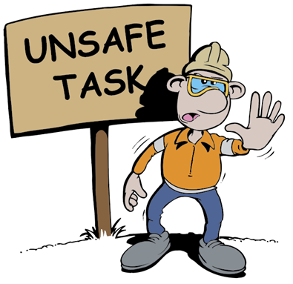
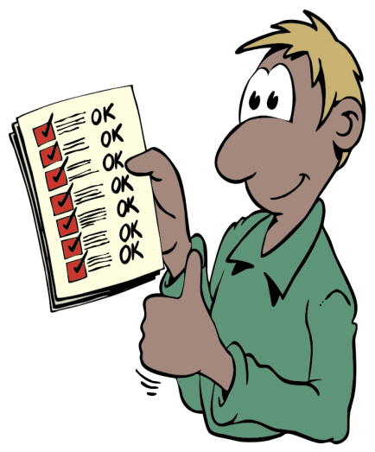
What does Integrity look like
Speaking the truth
Stopping unsafe behaviour
Reporting accurately and honestly
Looking after equipment and PPE
Treating everyone equal
Admit mistakes
Notes:
Integrity is speaking the truth, or telling the truth.
It is reporting accurately and honestly
It is not lying, cheating or starting false rumours.
It is not falsifying records or reports.

Slide 5
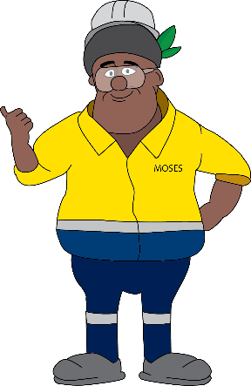
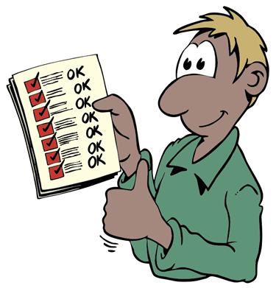
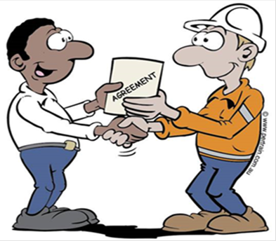
How can we practice Integrity
You can start by:
Follow OTML Golden Rules
Follow ALL OHSE Policies Procedures &
Follow Code of Conduct Guidelines
Notes:
Follow OTML golden rules, safety procedures and guidelines in the Code of Conduct.
Respect others. Respect their religion, beliefs and nationality. Treat everyone fairly.
When we make a commitment to do something, let’s make sure we do it.

Slide 6
Achieving Success Means -
We expect honesty, trust, fairness and respect
DO …
Speak the truth
Respect confidence
Admit mistakes
Report accurately
Respect others property
Do what we commit to do
Respect the views of others, hear them out
Be consistent, principled and fair
Treat everyone equally
Respect diversity
DO NOT …
Lie or cheat
Hide mistakes
Start false rumours
Breach confidence
Talk behind people’s backs’
Falsify records
Steal or mistreat others property
Ignore others or talk over them
Make ad hoc or arbitrary decisions
Discriminate against others
Let others down
Take short cuts

