Slide 1
Pasin Ok Tedi
Team Work

Slide 2
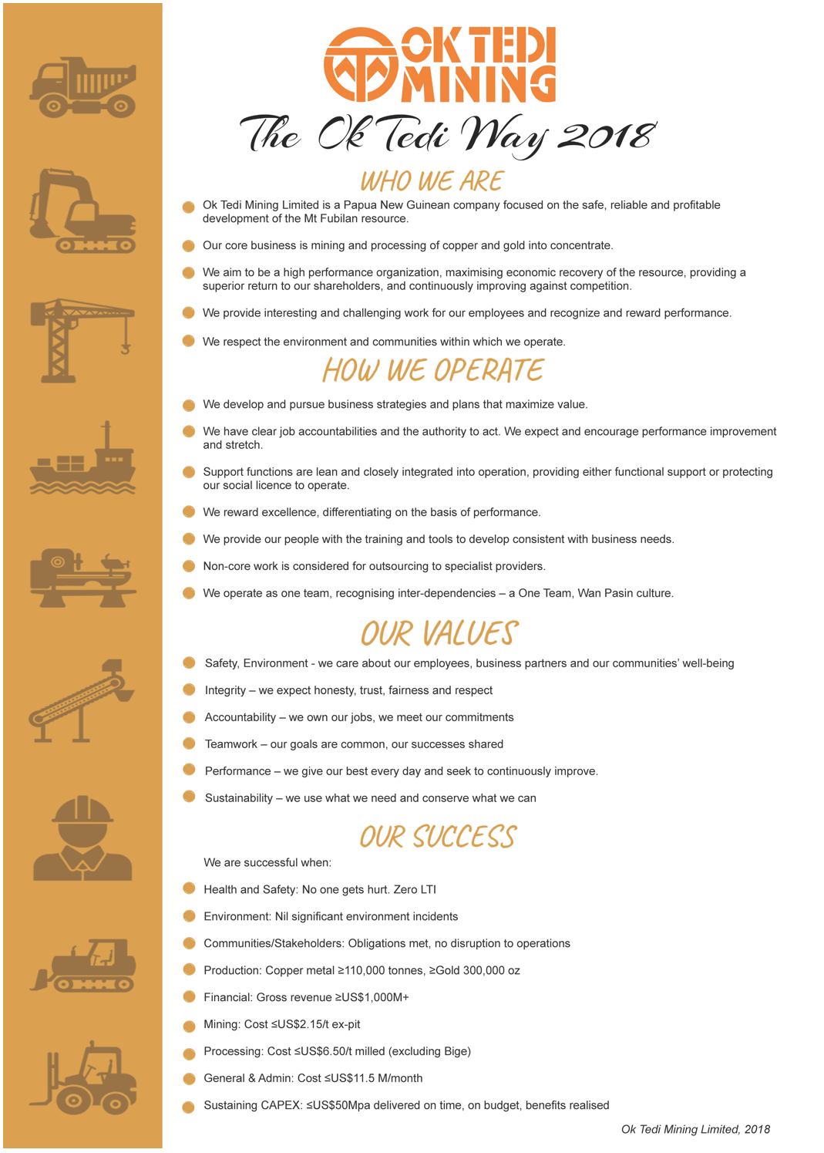
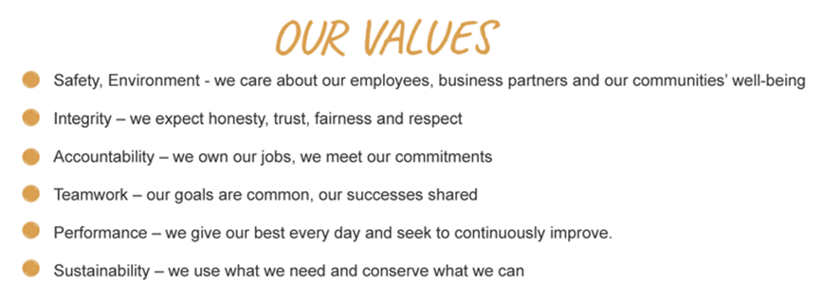
The Ok Tedi Way
The Ok Tedi Way is a statement of who we are and how we operate
It is based on Our Values
Notes:
The Ok Tedi Way is a statement of who we are and how we operate,
Our values are
Safety, Environment – we care about our employees, business partners and our communities well being
Integrity – we expect honesty, trust, fairness and respect
Accountability – we own our jobs, we meet our commitments
Teamwork – our goals are common, our success shared
Performance – we give our best every day and seek to continuously improve
Sustainability – we use what we need and conserve what we can

Slide 3
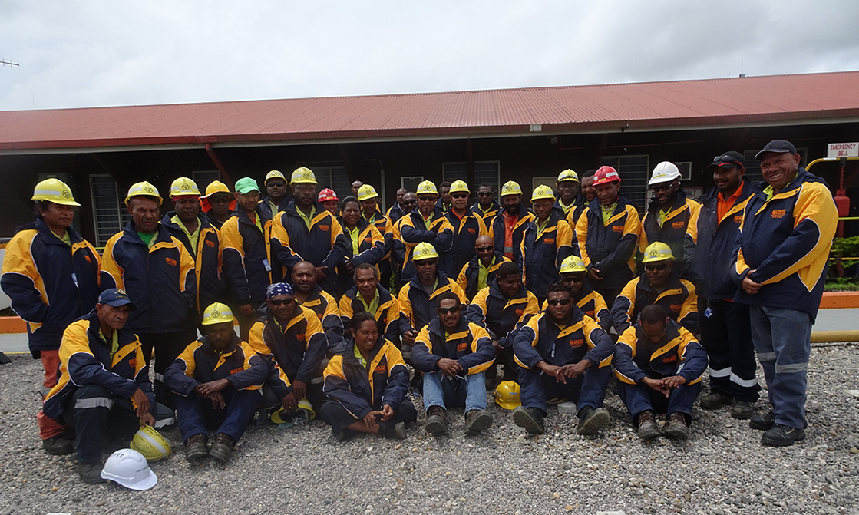
Correct Behaviour - Team Work
Our goals are common, our successes shared
Notes:
Supervisor: Explain this in pidgin to your group.
Stress the importance of working together as one team and how Team Work plays an important role in the overall OTML goals.
Mention various departments and contractors (business partners) and how you all work together. Each having separate goals but ultimately working towards a common OTML goal.

Slide 4
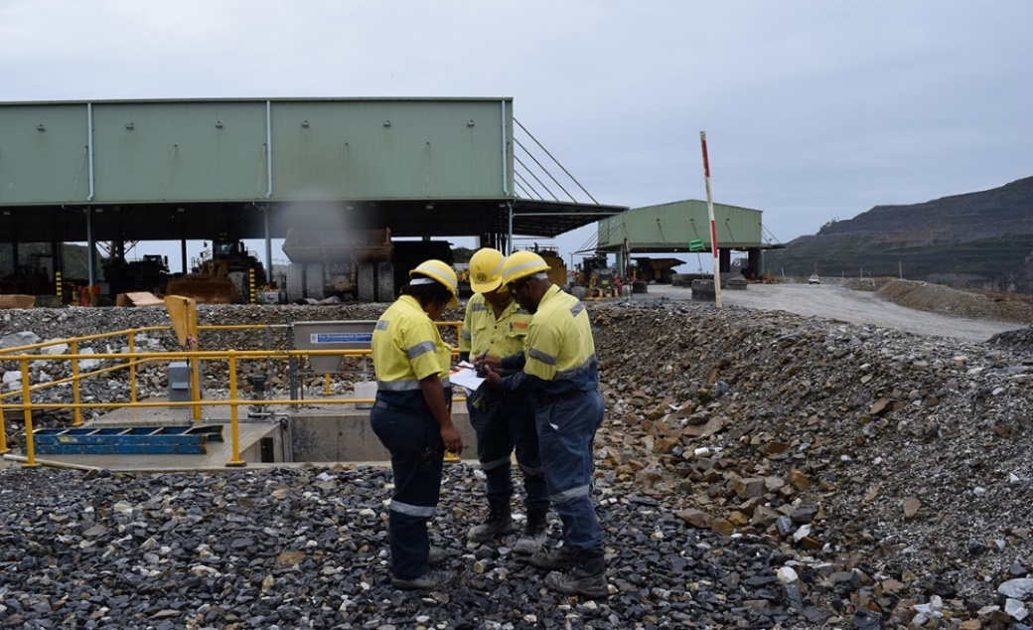
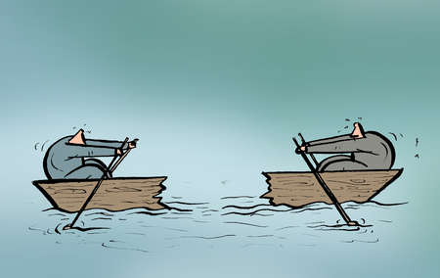
Team Involvement
Involve the team in setting goals and plans.
Do not ignore input from others– we all have the same common goals.
Notes:
Supervisor: Provide examples of this behaviour

Slide 5
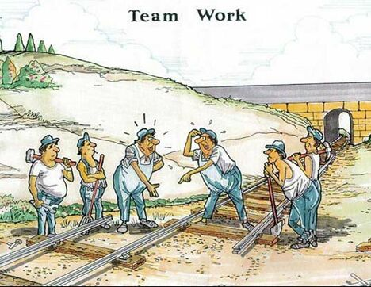
Share Critical Information
Share information with others in the team.
Withholding critical information can cause serious setbacks and injury.
Notes:
Supervisor: Provide examples of this behaviour

Slide 6
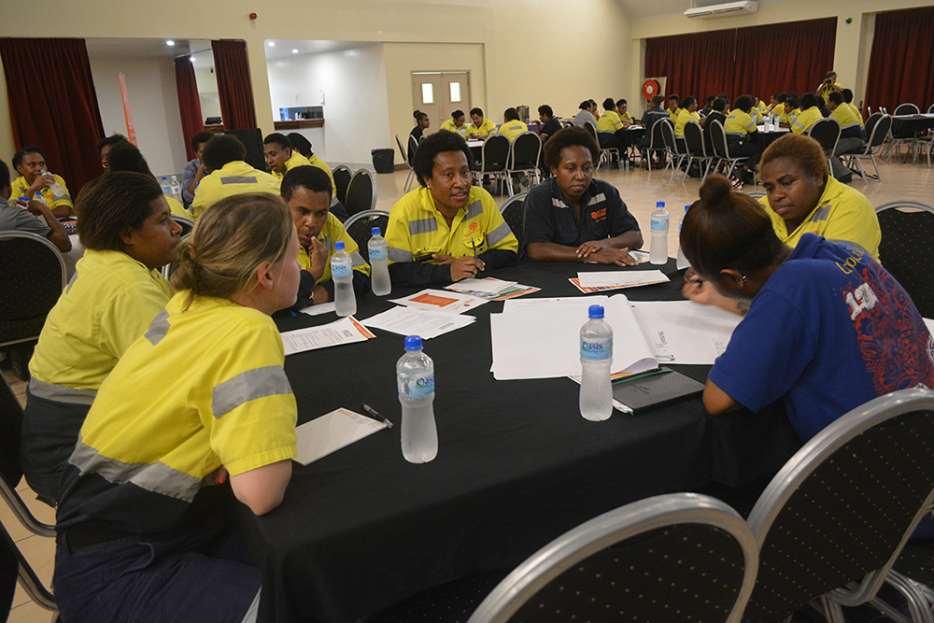
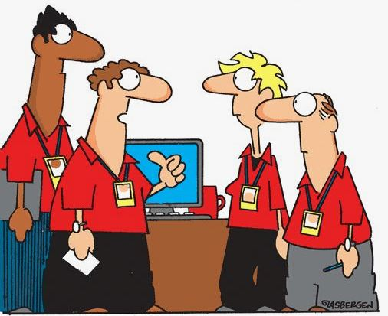
Correct Behaviour
Seek Views from others
Always seek views from others.
Do not assume that you have all the answers.
I make the decisions around here
Notes:
Supervisor: Provide examples of this behaviour

Slide 7
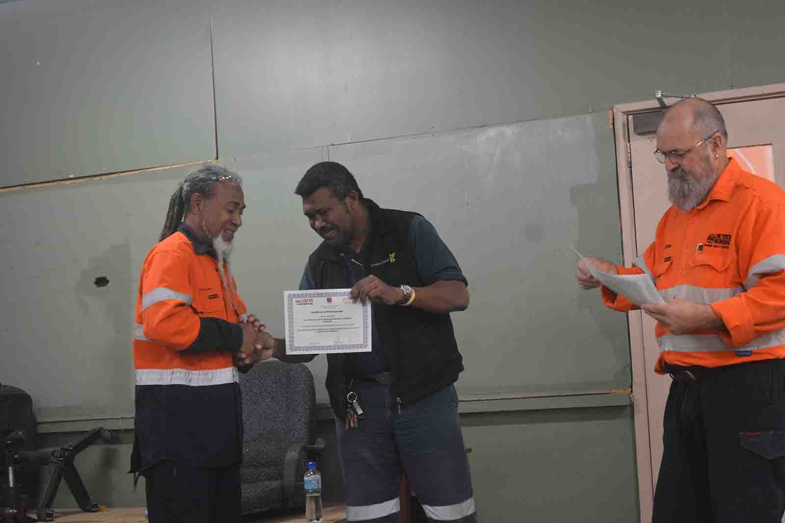
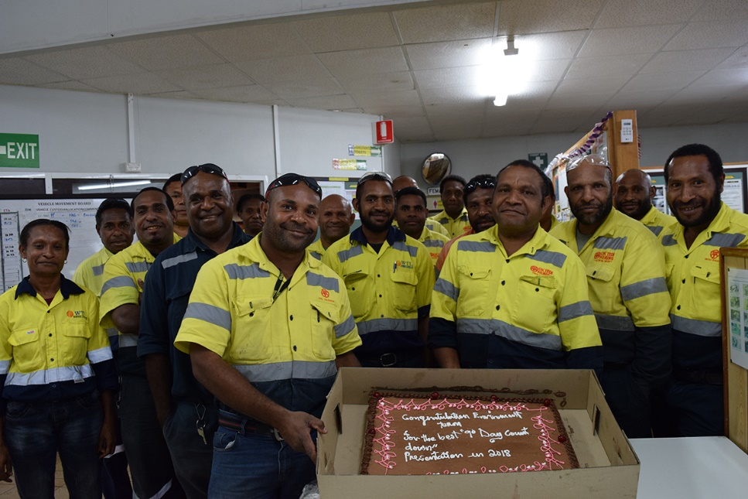
Recognize Individuals & Team Contributions
Recognize individual contributors.
Recognize team contributions.
Notes:
Supervisor: Provide examples of this behaviour

Slide 8
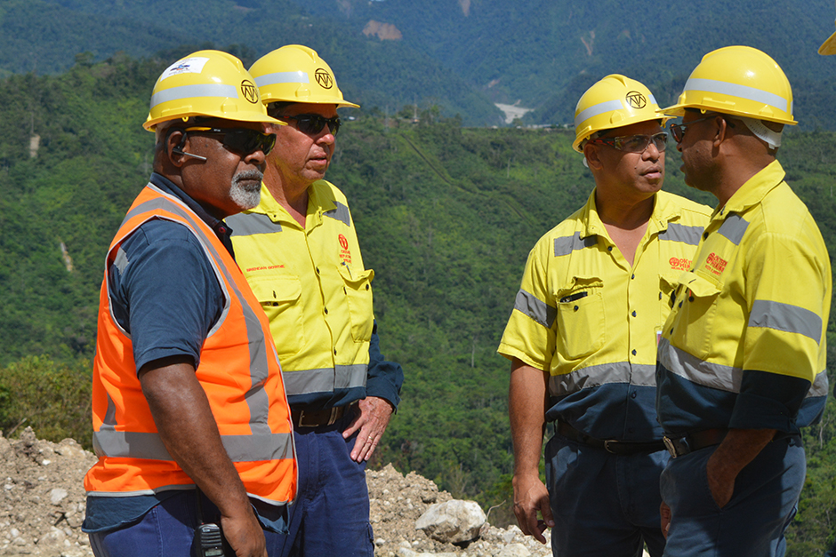
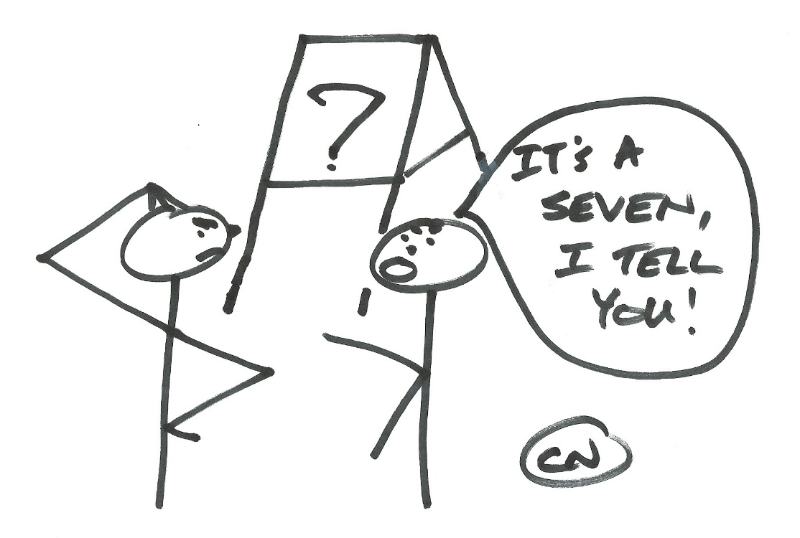
Defining Clear Roles & Responsibilities
Define clear roles and Responsibilities.
Give clear and simple instructions.
Notes:
Supervisor: Provide examples of this behaviour

Slide 9
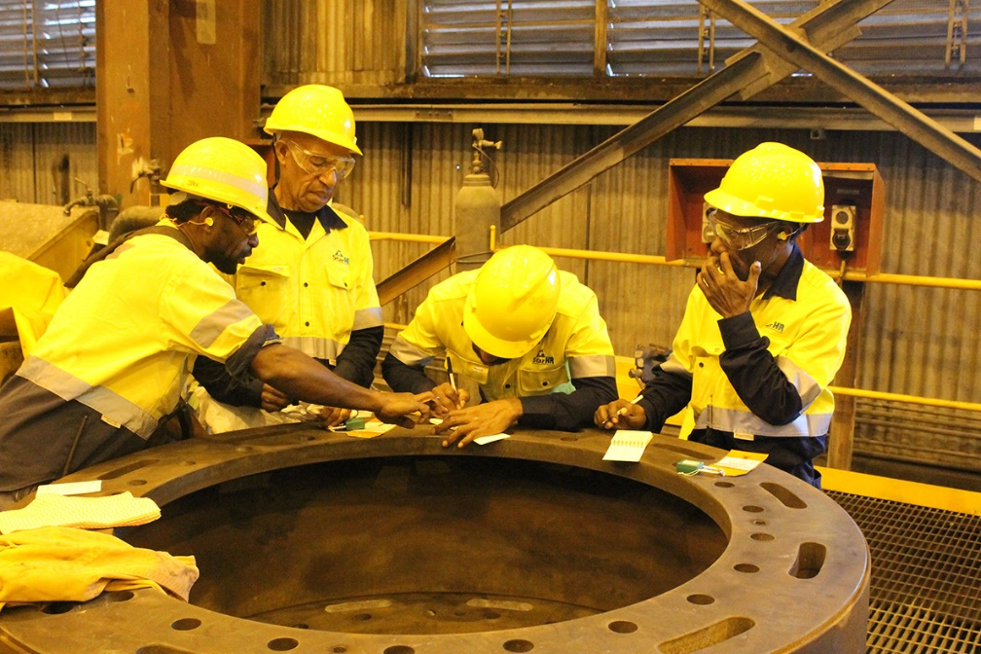
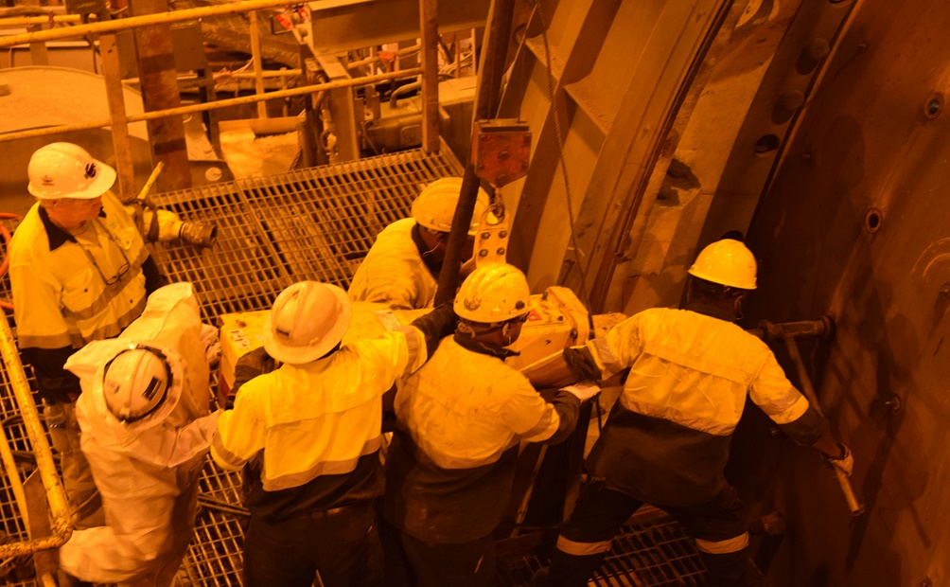
Being clear on the “what” and “how”
Everyone knows what to do….
And how to do it
Notes:
Supervisor: Provide examples of this behaviour

Slide 10
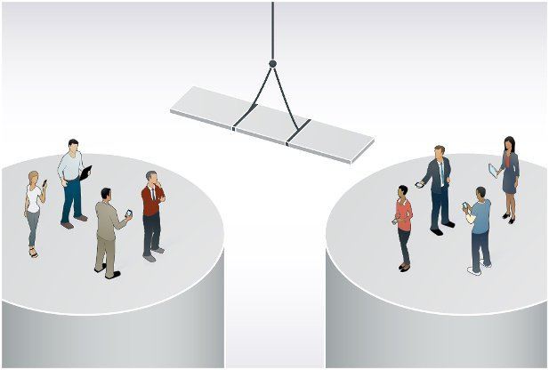
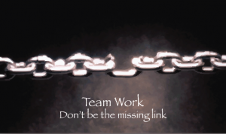
Develop an understanding on how your team affects others
DO NOT Build and maintain silos
Connect silos
Your input is an important link in the team. Others rely on you.
Notes:
Supervisor: Provide examples of this behaviour

Slide 11
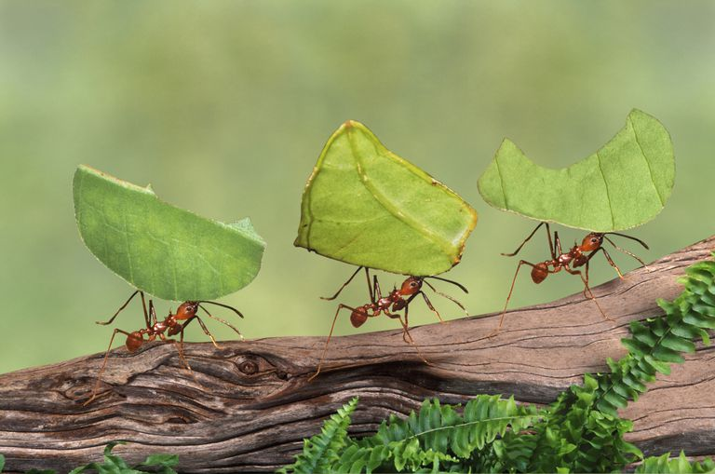
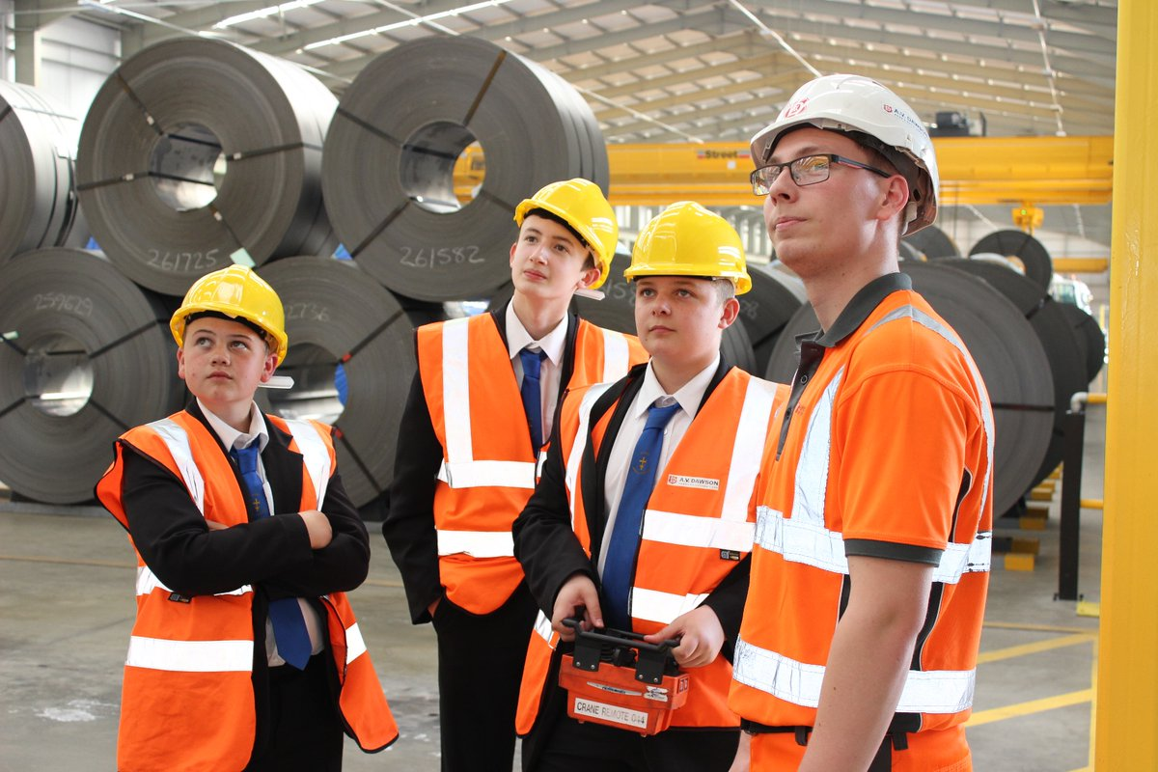
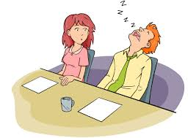
Contribute our best every day
Give your best every day.
Don’t let other team members down.
Notes:
Supervisors: Mention those in your area that people can talk to if they have any queries:
Mine: Florentina Masi and Masket Siune
Mill: Isaac Kwetok, Bani Bani Jnr , Samantha Andreas, Simon Timil
Engineering & Projects: Bridgette Seseve
CR and ER: Estella Cheung and Kuam Sanewai
Transport: Karo Yama
Whitehouse: Beverley Pasen, Tracey Hart, Pondros Posanau and Anna Ila
Asset Management: Robin Wavite
Tabubil Laydown: Dexter Wagambie
Kiunga: Hillary Turnamur
Bige: Steve Hoap
Port Moresby: Jennifer Maroroa

