Slide 1
Pasin Ok Tedi
Performance

Slide 2
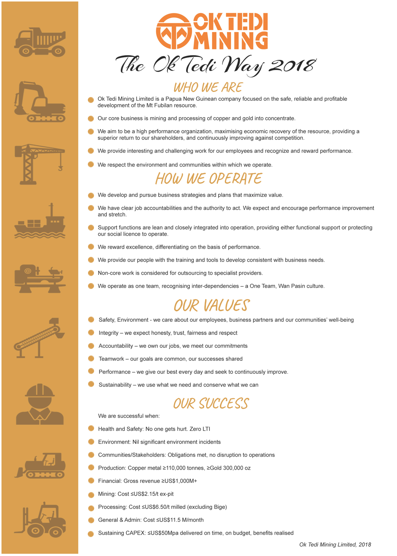
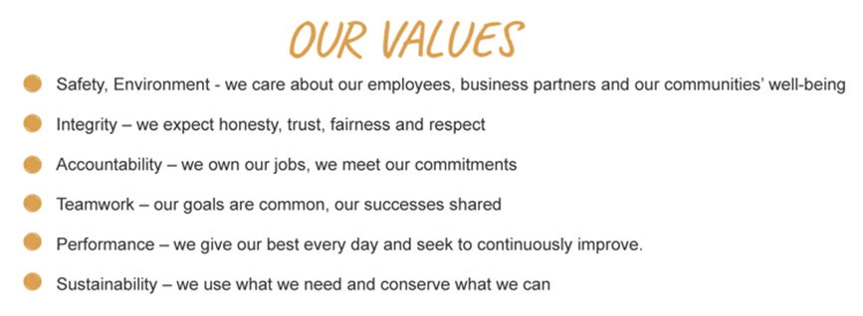

The Ok Tedi Way
The Ok Tedi Way is a statement of who we are and how we operate
It is based on Our Values
Notes:
The Ok Tedi Way is a statement of who we are and how we operate,
Our values are
Safety, Environment – we care about our employees, business partners and our communities well being
Integrity – we expect honesty, trust, fairness and respect
Accountability – we own our jobs, we meet our commitments
Teamwork – our goals are common, our success shared
Performance – we give our best every day and seek to continuously improve
Sustainability – we use what we need and conserve what we can

Slide 3
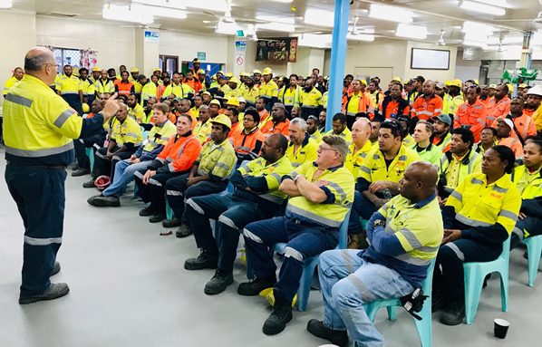
Performance
At OTML we give our best every day and seek to continuously improve
Notes:
.

Slide 4



Do your best to….
Ask Questions
Provide clear directions, seek clarifications
Suggest improvement and coach others
Help others succeed and improve

Slide 5
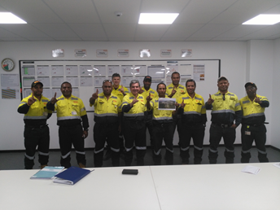
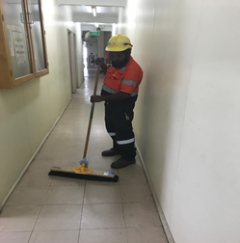
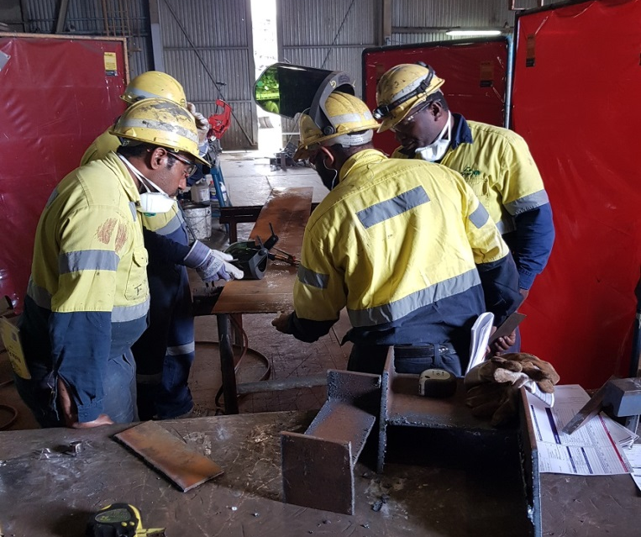
Do your Best to….
Plan our work and work our plan
Know that what you do is important to OTML

Slide 6
Do your Best to….
Be fit for work
Be positive – display a “can do” outlook

Slide 7
Do your Best to…
Set high personal standards
Look for stretch, challenge
Be open to new ideas

Slide 8

But do your best Not to….
Make assumptions
Hold back
Be vague about expectations
Accept any outcome
Withhold critical information

Slide 9

Do your best Not to….
Stay within your comfort zone
Be fatigued, unfit, being absent
Accept mediocrity
Be stuck in custom and practice
Drag others down by being negative

Slide 10

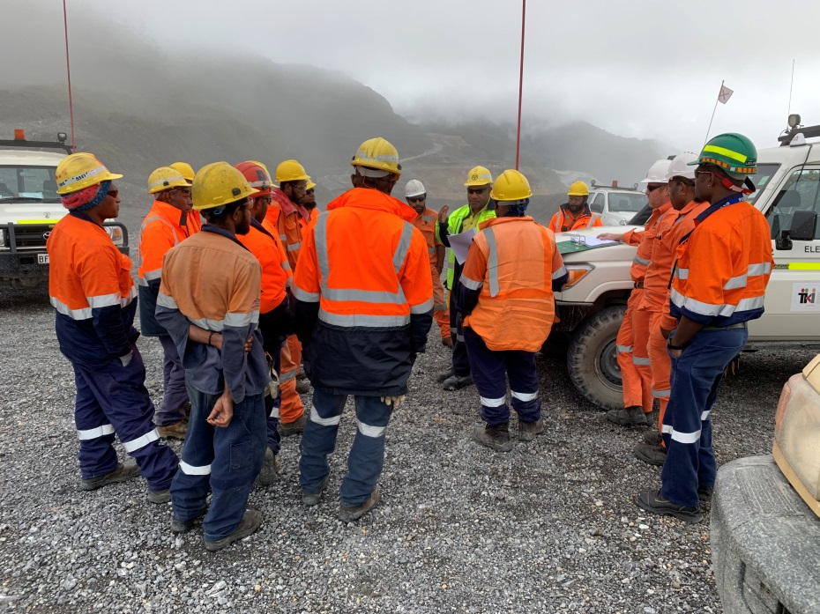
One Team and Strong Performance
In 2019, lets promote team work to deliver another strong performance for OTML and PNG as a whole.

Slide 11



Take Pride- Perform your Best
Take PRIDE in our contribution to OTML, WP and PNG
It should not just be about showing up
Lets give our best every time
Proud PNG Owned Company
96% of workforce is of PNG origin
Provided PGK17.3M for OTDF programs
Contributed PGK 1,374M to the WP and PNG economy
Contributed PGK5.5M to TCS infrastructure projects

