Slide 1
Pasin Ok Tedi
Accountability

Slide 2
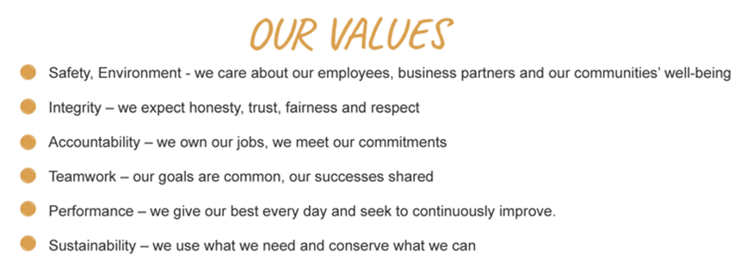
The Ok Tedi Way
The Ok Tedi Way is a statement of who we are and how we operate
It is based on Our Values
Notes:
The Ok Tedi Way is a statement of who we are and how we operate,
Our values are
Safety, Environment – we care about our employees, business partners and our communities well being
Integrity – we expect honesty, trust, fairness and respect
Accountability – we own our jobs, we meet our commitments
Teamwork – our goals are common, our success shared
Performance – we give our best every day and seek to continuously improve
Sustainability – we use what we need and conserve what we can

Slide 3
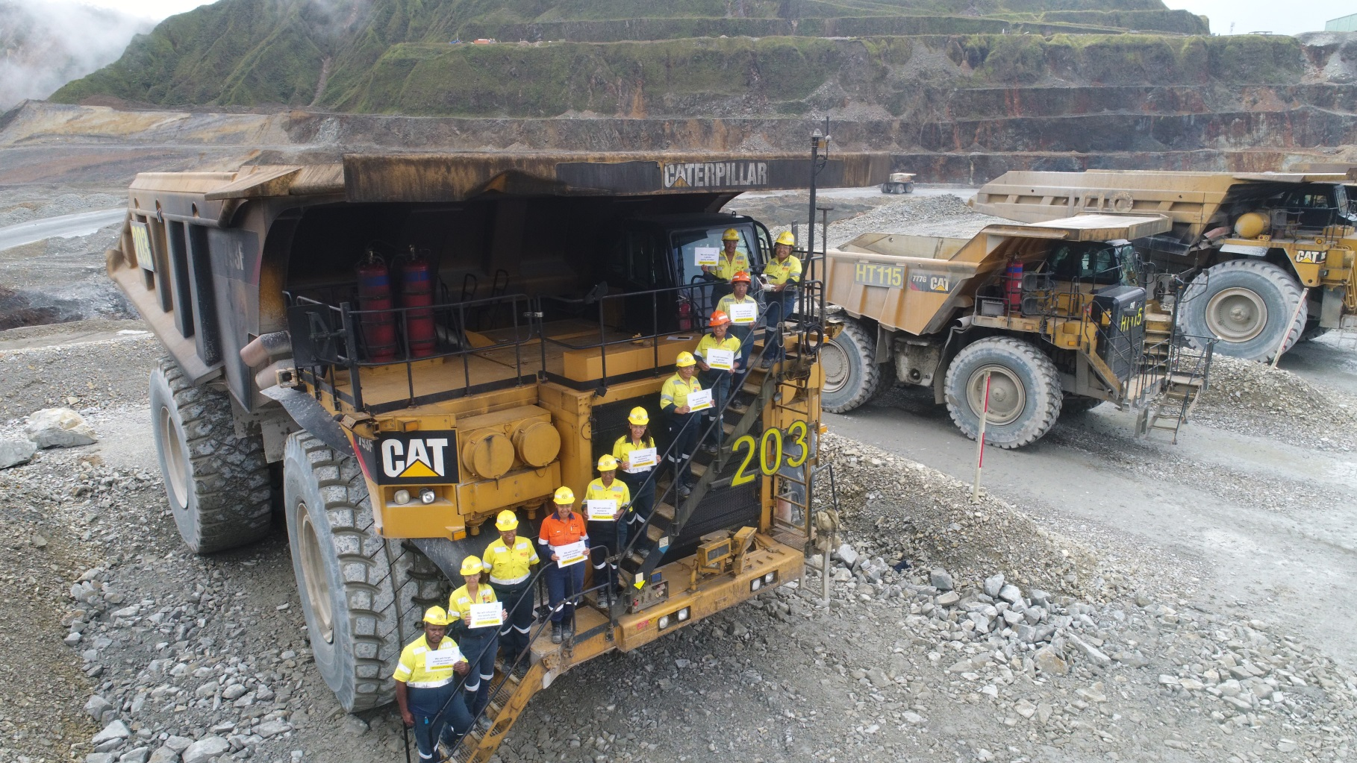
Accountability
We own our jobs, we meet our commitments
Notes:
Supervisor: Explain this in pidgin to your group.
Stress the importance of working together as one team and how Accountability plays an important role in the overall OTML goals.
Mention various departments and contractors (business partners) and how you all work together. Each having separate goals but ultimately working towards a common OTML goal.

Slide 4
Correct Behaviour
Keep your word. A commitment is a promise
Stop Making excuses – near enough isn’t good enough
Follow up on what others say they will do. Delegate with controls/checks
It is not about assuming others will cover any gaps
Notes:
Supervisor: Provide examples of this behaviour

Slide 5
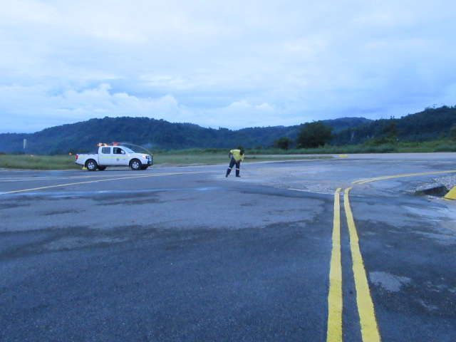
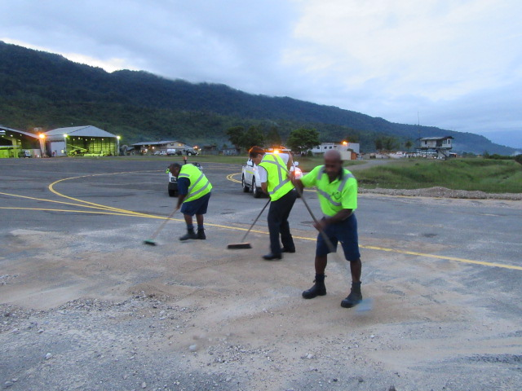
Correct Behaviour
Do Your Best
Do your best every day…
And not being carried by others
Notes:
Supervisor: Provide examples of this behaviour

Slide 6
Admit Mistakes
“The best way to learn from your mistake is to admit them rather then to blame them on someone else.” (unknown)
Notes:
Supervisor: Provide examples of this behaviour
Own the mistake.
Apologise when you’re wrong.
Learn from your mistakes

Slide 7
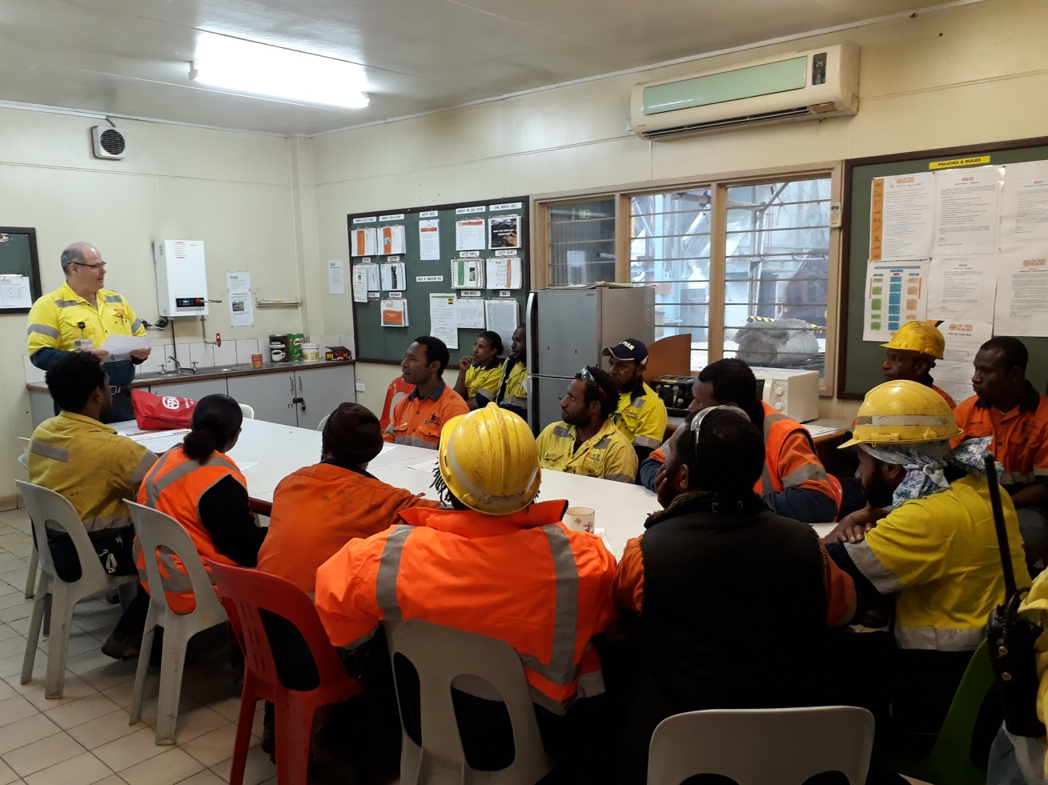
Report Progress
Report progress and don’t hide shortcomings
Notes:
Supervisor: Provide examples of this behaviour
Eg:
Share team successes in your pre-starts or toolboxes
Share outcomes of leadership meetings with your teams or crews
Encourage feedback on projects

Slide 8
Provide Early Warning
Provide early warning of problems
Don’t create surprises at last minute
You can do this by:
Reporting Near Miss
Stopping a job if you see it is unsafe
If you feel unwell or fatigued, speak to your supervisor
If something is bothering you, speak to a friend or counsellor
Notes:
Supervisor: Provide examples of this behaviour
Examples:
1. Report Near Miss
2. Stop a job if you see it is unsafe
3. If you feel unwell or fatigued, speak to your supervisor
4. If something is bothering you, speak to a friend or counsellor.

Slide 9
Take Pride
Take PRIDE in our contribution to OTML, WP and PNG
It should not just be about showing up
Proud PNG Owned Company
96% of workforce is of PNG origin
Provided PGK17.3M for OTDF programs
Contributed PGK 1,374M to the WP and PNG economy
Contributed PGK5.5M to TCS infrastructure projects
Notes:
Supervisor: Share details below to team (2017 Annual review)
Proud PNG Owned Company
96% of workforce is of PNG origin
Provided PGK17.3M for OTDF programs
Contributed PGK 1,374M to the WP Province and PNG economy
Contributed PGK5.5M to TCS infrastructure projects

