Slide 1
Vehicle Interaction
Awareness Package

Slide 2
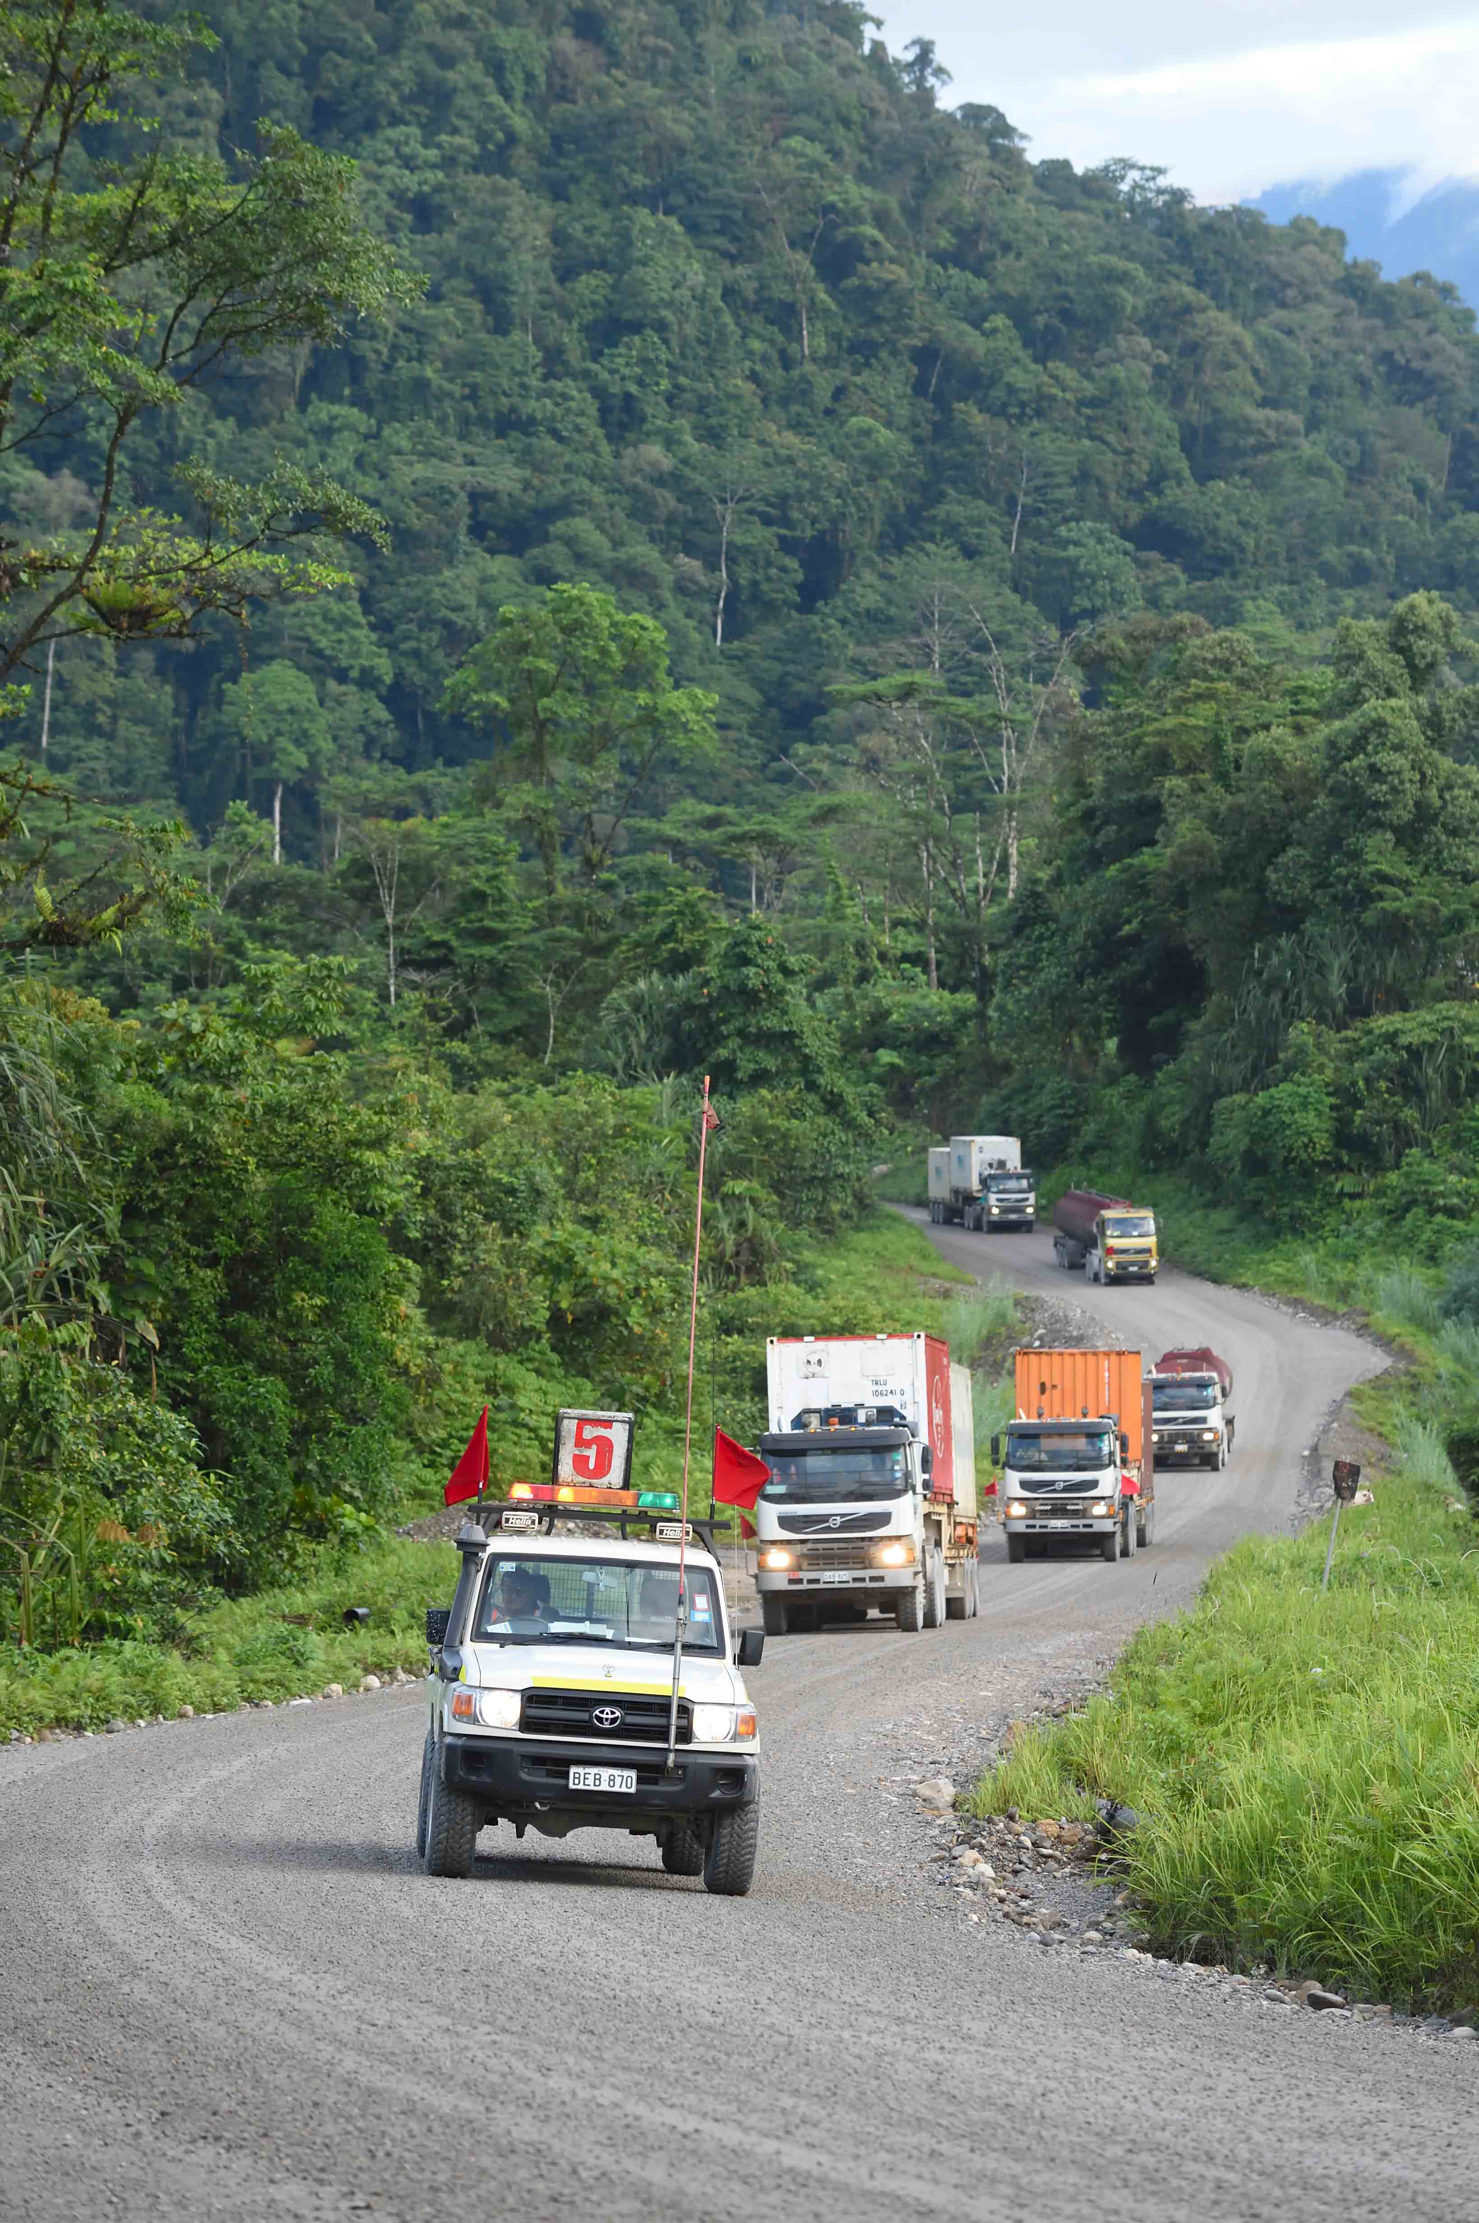
Introduction
Vehicle interactions (with other vehicles, signs, buildings and people) are one of the most commonly reported incidents on site
Two of the contributing causes are usually:
Poor vehicle inspections and maintenance
Human error.

Slide 3
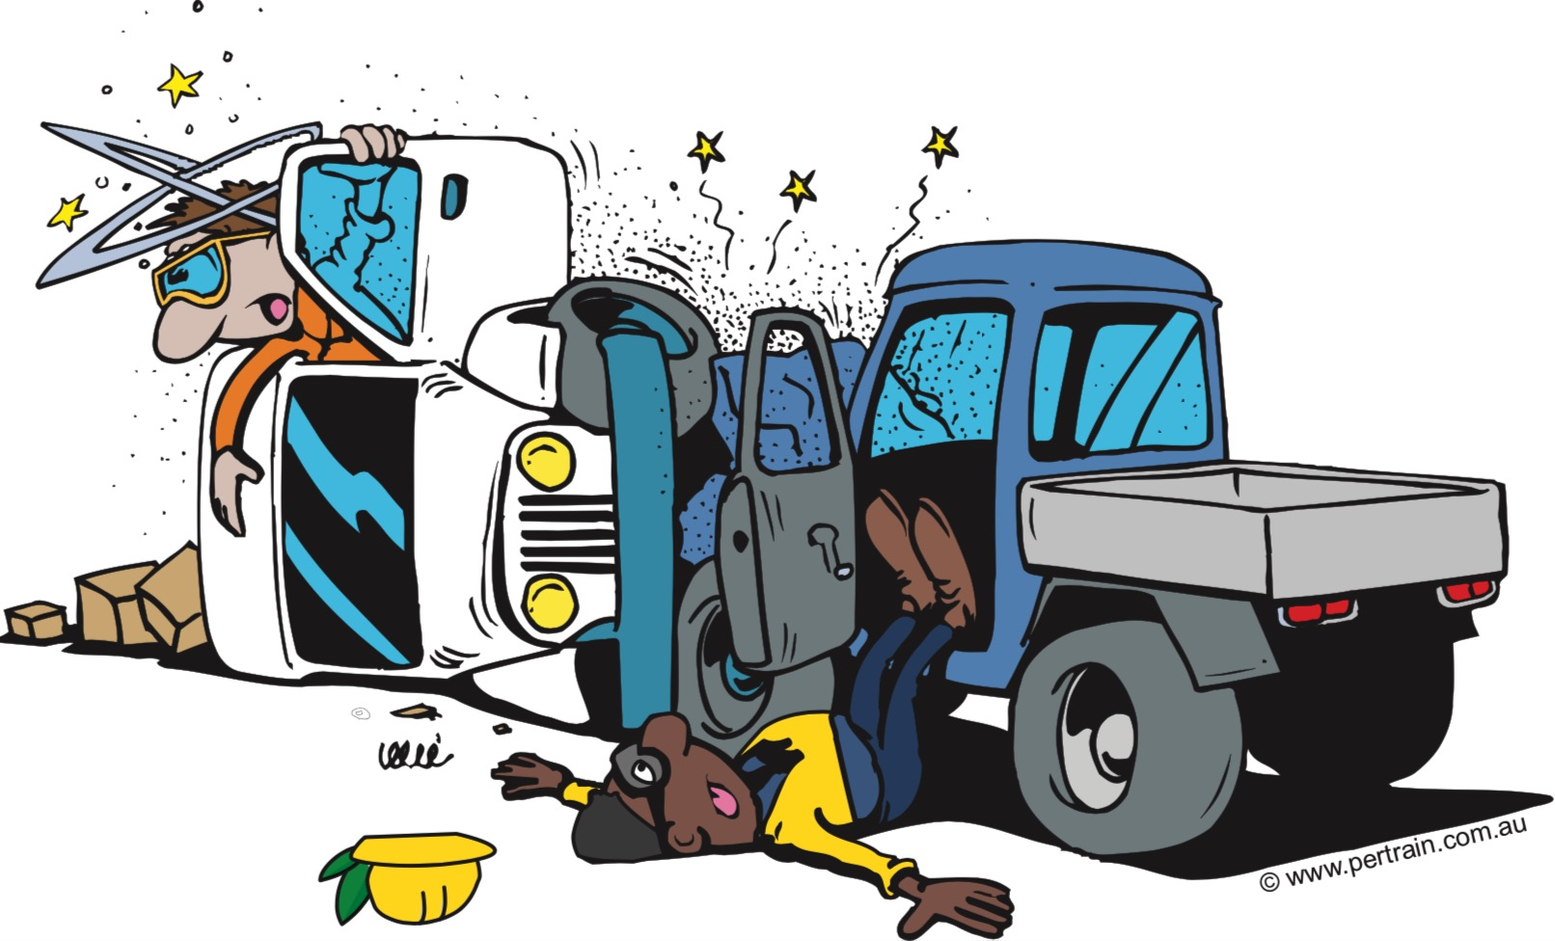
The Hazards
The hazards associated with operating vehicles vary depending on the size of the vehicle, the conditions, location and operator behaviour.
Driving hazards can be categorised into 3 areas.
Environment
Vehicle
People (drivers / operators and pedestrians)
YES THAT MEANS YOU!

Slide 4
Controls
Be competent to drive the type of vehicle you are operating
Be authoised to drive on site
Do a pre-start inspection EVERY TIME
Equipment must be fit for purpose and in good operational condition
Equipment must have ALL safety requirements, e.g. flashing light, horn, visibility flag, seatbelt, collision alert
Follow procedures
Obey traffic rules and signage
Drive to conditions
Be the CONTROL not the HAZARD

Slide 5
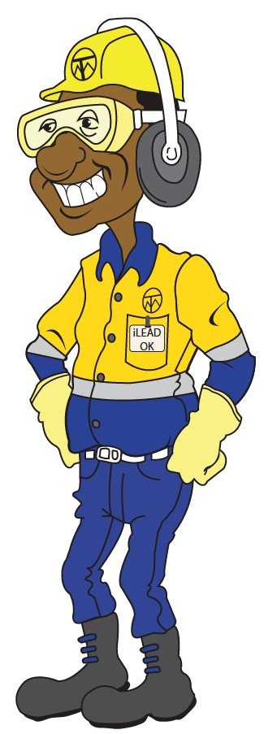
Vehicle Interaction Key Controls
Click below to watch a short video about the key controls
for vehicle interaction hazards.

