Slide 1
Unplanned Movement of Equipment
Awareness Package

Slide 2
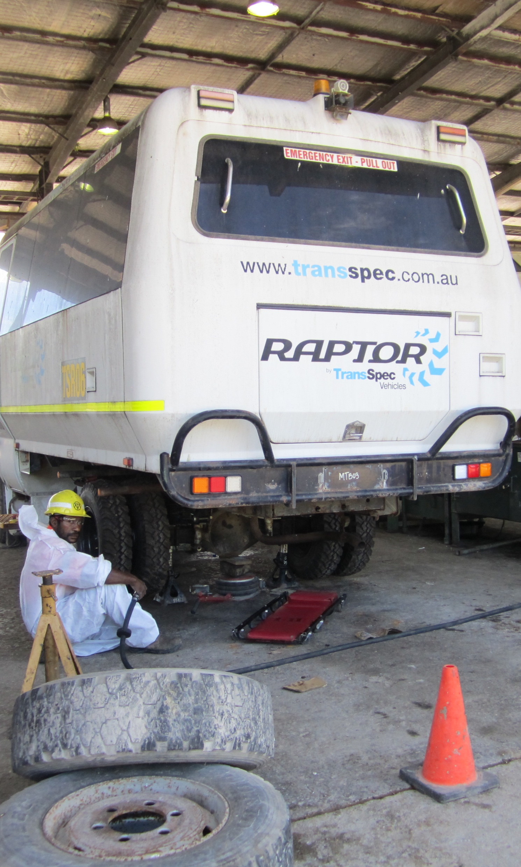
Introduction
Unplanned movement of plant, equipment or equipment components is a major cause of injury and equipment damage at OTML.
This hazard is often associated with:
Park up
Inspections
Maintenance
Loss of equipment control.

Slide 3
What are the Hazards Associated with Unplanned Equipment Movement?
Unplanned movement may include:
Load shift or load loss
Loss of control during operations e.g. skids, equipment runaway, rollover
Unexpected start-up or movement of equipment during inspections or maintenance
Contact with moving components, e.g. rotating cylinders, pinch points
Equipment failure, e.g. jacks, brakes, wheels
Movement after park-up.
The other major hazard in relation to unplanned movement of equipment is when personnel enter an operational area without the equipment operator knowing.

Slide 4
Controls
Correct isolation of plant and equipment, LOCK OUT TAG OUT
Other controls include:
Exclusion zones
Machine guards
Ensuring parked equipment is fundamentally stable
Wheel chocks, drains
Load security
Inspections and maintenance
Follow procedures
Operate to conditions.

Slide 5
Unplanned Movement Key Controls
Click below to watch a short video about the key controls
for unplanned movement of equipment.

