Slide 1
Rotating Equipment
Awareness Package

Slide 2
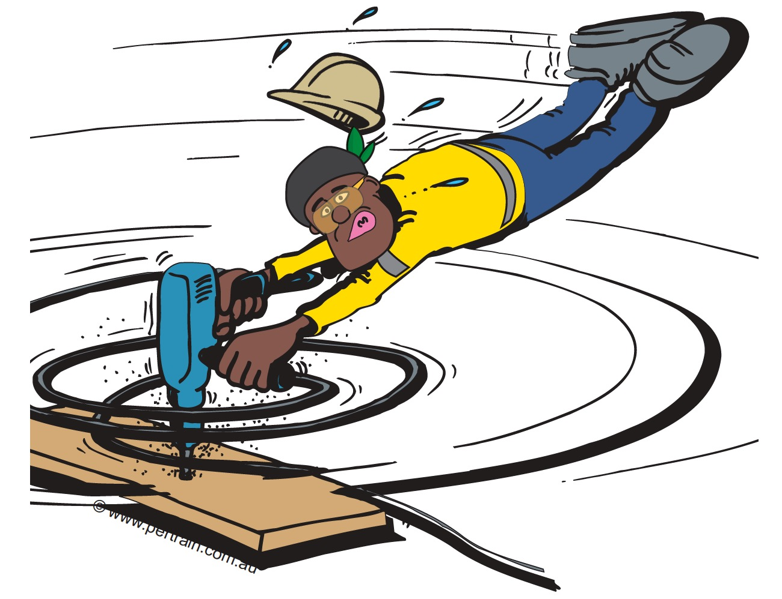
Introduction
Rotating equipment can pull a person into equipment if just a small part of clothing, a lanyard or a hand tool, gets caught in the rotating component.
Rotating equipment can also eject parts, debris, tools and off-cuts, at speed and often to a great distance.
Rotating Equipment includes:
Drills
Augers
Conveyors
Mills
Agitators
Idlers
Fans
Gears
Rotors

Slide 3
What are the Risks Associated with Rotating Equipment?
The most serious consequence of a person being caught in rotating equipment is death
Other risks include:
Entanglement
Crush injury
Amputation
Equipment damage
Excessive noise and vibration, particularly if equipment is worn or damaged
Production loss

Slide 4
Controls
Key Control Data Sheets
Use and apply the hierarchy of controls
Controls include:
Operators trained and authorised
Risk assessment before every job
Isolation of the hazard (Lock Out Tag Out)
Separation of people from the hazard
Emergency stop systems
Signage displaying direction of rotation
Inspections and maintenance of equipment and controls
Emergency response preparedness
Procedures, Registers, Authority to Work

Slide 5
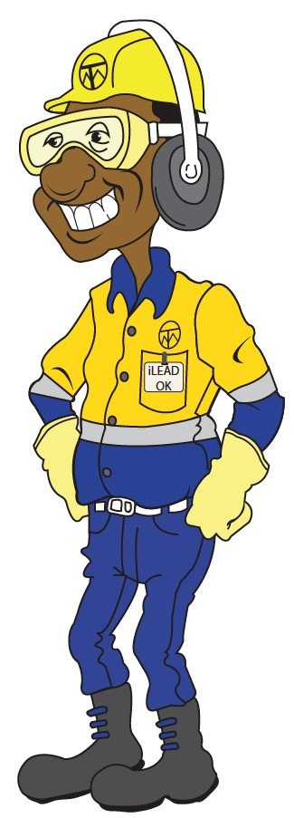
Rotating Equipment Key Controls
Click below to watch a short video about the key controls
for rotating equipment hazards.

