Slide 1
RIIWHS204D Work Safeyl at Heights
Training Package
Notes:
Welcome.
Introduce yourself.
Outline your experience.
Explain where the facilities are and any OHS issues if necessary
Timeframe for the course.
Handouts:
- Attendance Sheet - get all trainees to sign
- Training Material (Reference book, permits, etc).
Any questions?

Slide 2
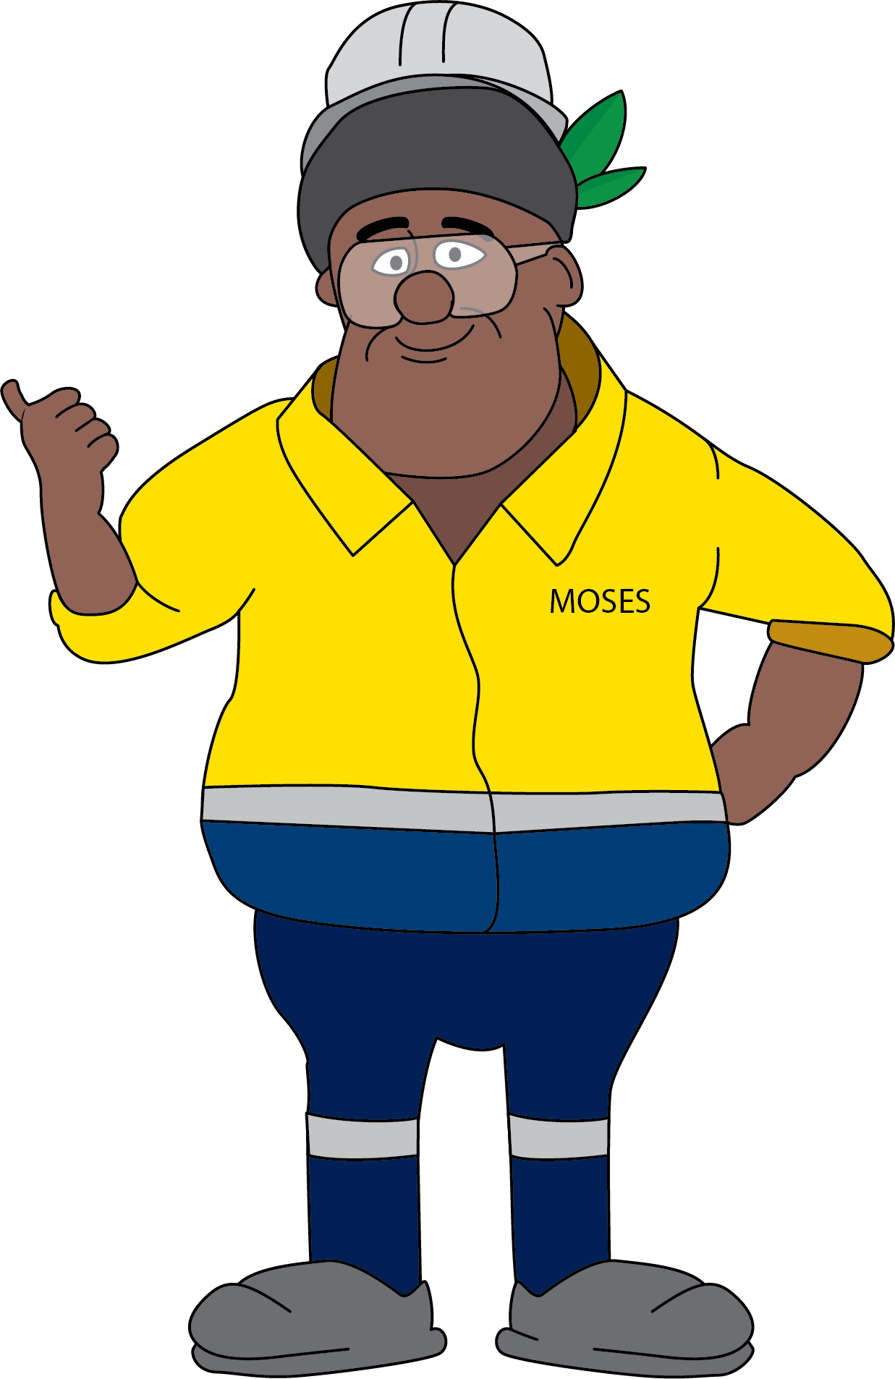
Introduction
RIIWHS204D Work Safely at Heights
This resource will assist you to:
    plan and prepare for work
    select and install the right equipment for the work
    comply with procedures and authorisations
    identify and control hazards
    perform work at heights
    perform post operational tasks
Notes:
Briefly explain:
The training material supports competency unit RIIWHS204D which is part of the Resources and Infrastructure Industry (RII) training package.
The competency unit requires that the learner can demonstrate the required skills, knowledge and practical application in the workplace.
A Statement of Attainment may be issued if this unit is not done as part of a qualification.
Explain the assessment procedure.

Slide 3
What is Work at Height
Work at height takes place where there is potential:
    To fall 1.8m or more
    To be seriously injured in a fall of less than 1.8m
    To fall from one level to another as a result of working within 2m of an open edge
    For materials to fall on to people working or travelling below
Notes:
Discuss the definition of work at height and how it relates to OTML sites.

Slide 4
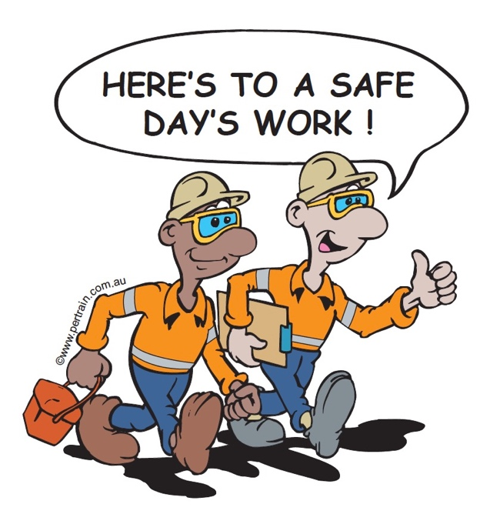
Operator Obligations
Physically and mentally fit for task
Trained and authorised
Ensure SWP, JSA and ATW in place
Select, check and use appropriate PPE
Report unsafe conditions, incidents and near misses
Report damaged /faulty equipment
Operate equipment in line with manufacturer and site requirements
Adhere to site environmental requirements
Notes:
Discuss the obligations of personnel required to work at heights.

Slide 5
Legislation and Site Policies
Documentation |  | Example
Government | Acts | Mining (Safety) Act
 | Regulations | Mining (Safety) Regulation
Industry | Codes of Practice | Code of Practice for Managing the Risk of Falls at Workplaces (Australia)
 | Standards | AS/NZS 1891.4 Industrial Fall-arrest Systems and Devices - Selection, use and maintenance
Organisation | Management Systems | Risk Management System
 | Policies | Fit for Work Policy
 | Procedures | Safe Work Procedures
Notes:
Explain why workplaces must comply with legislation, standards and site policies.
Outline the documentation that must be accessed and followed to ensure that work activities are compliant.
Outline the requirements of relevant compliance documentation for work at height.

Slide 6

Plan and Prepare for Operations
Attend shift briefings/pre-start meeting
Obtain information:
    job requirements
    site and task procedures
    ATW and clearances
Notes:
Explain that no work should start until all the information has been received and understood.
Discuss the importance of work briefings or pre-start meetings.
Discuss the site requirements for planning and preparing for tasks, such as:
developing a work plan with supervisor
understanding the task
gathering all the required information for the task.

Slide 7
Authorisation to Work System
Notes:
Discuss the site Authorisation to Work System.
Discuss the requirement for a clearance certificate
Discuss the elements that make up the Work at Heights clearance certificate, including:
location
checks and inspections
hazards
controls
personnel involved
ATW holder
job steps
authorisation
fall recovery plan

Slide 8
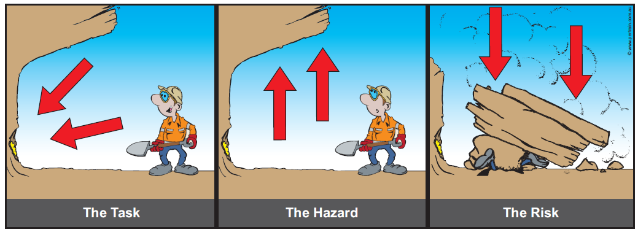
Hazards
A hazard is a condition or situation that has the potential to cause injury, damage or loss to personnel and/or equipment
A risk is the likelihood that a harmful consequence may result from exposure to a hazard
Notes:
Define the terms hazard and risk.
Discuss the role of managers, all employees and personnel working at height, in relation to hazard identification and risk management.

Slide 9
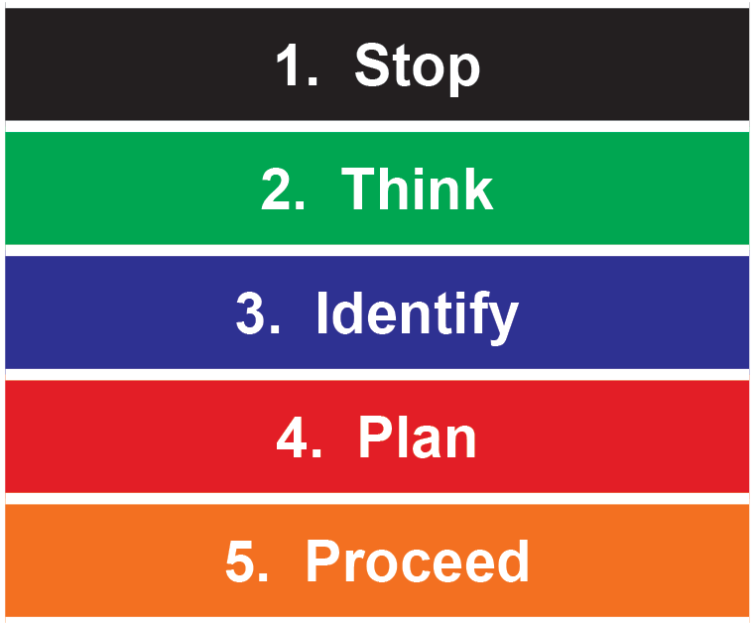
Hazard Identification
Notes:
Discuss the general process for personal hazard identification and risk assessment using a Take 5.
ACTIVITY – if time allows, have the participants complete a Take 5 for a task they do. Discuss.

Slide 10

Conduct Site Safety Inspections
Work area layout
Ground conditions
Physical condition and safety of surfaces
Change in levels
Stability of structures
Entry to and exit from work area
Missing edge protection, guards, etc
Weather conditions
Notes:
Discuss the importance of inspecting the site before starting any work and the types of things to look for in relation to working at height.
Note that this list contains examples and is not exhaustive.

Slide 11
Types of Hazards
Hazards associated with working at heights include:
    falls from height or into a pit or excavation
    dropped objects striking a person below
    contact with overhead power lines
    suspension trauma
    changing weather conditions
    poor manual handling technique
    untrained, inexperienced, unauthorised personnel completing the task or entering the work area
Notes:
Discuss the hazards associated with working at heights.
Note that this list contains examples and is not exhaustive.
Discuss additional hazards that may be present at your site.

Slide 12
Hazard Report
Communicates an identified hazard to supervisor and management
Controls can be put in place to reduce or eliminate the hazard
Prevents unsafe condition or behaviour causing an incident or emergency
Notes:
Discuss the hazard reporting procedure at your site.

Slide 13
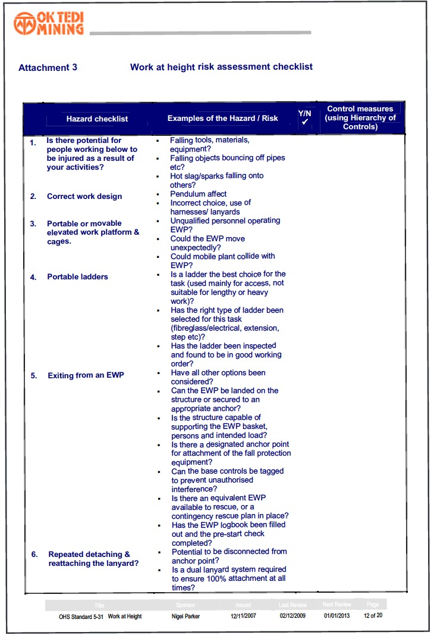
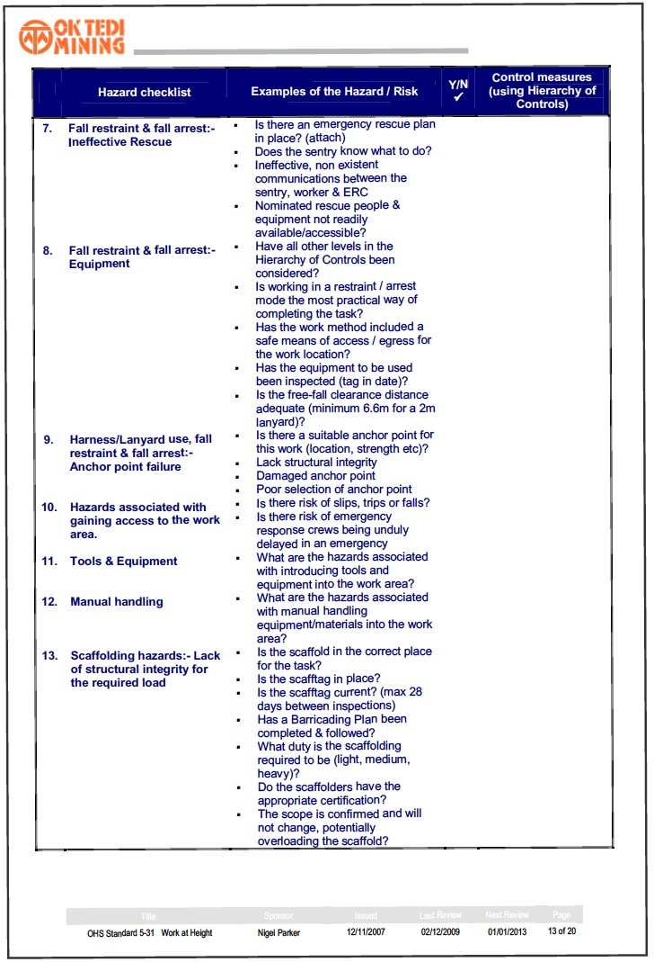
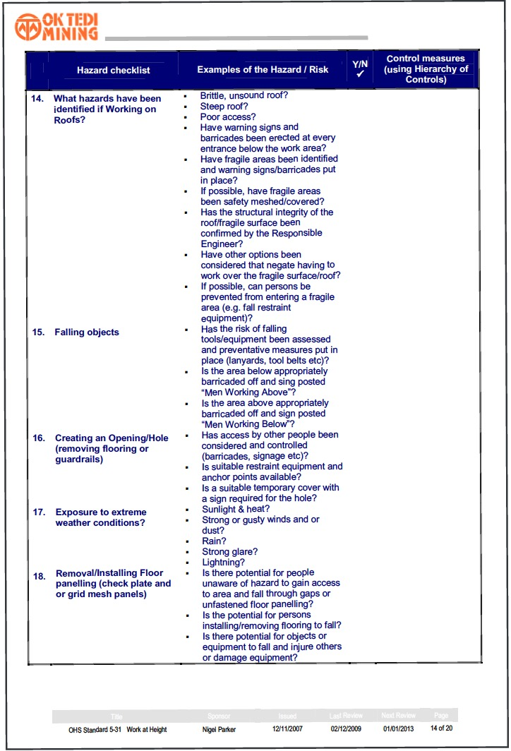
Risk Assessment Checklist
Notes:
Discuss the purpose and use of the Work at height Risk Assessment Checklist.
NOTE: A copy is in the Appendix at the back of the Learner’s Resource book.

Slide 14
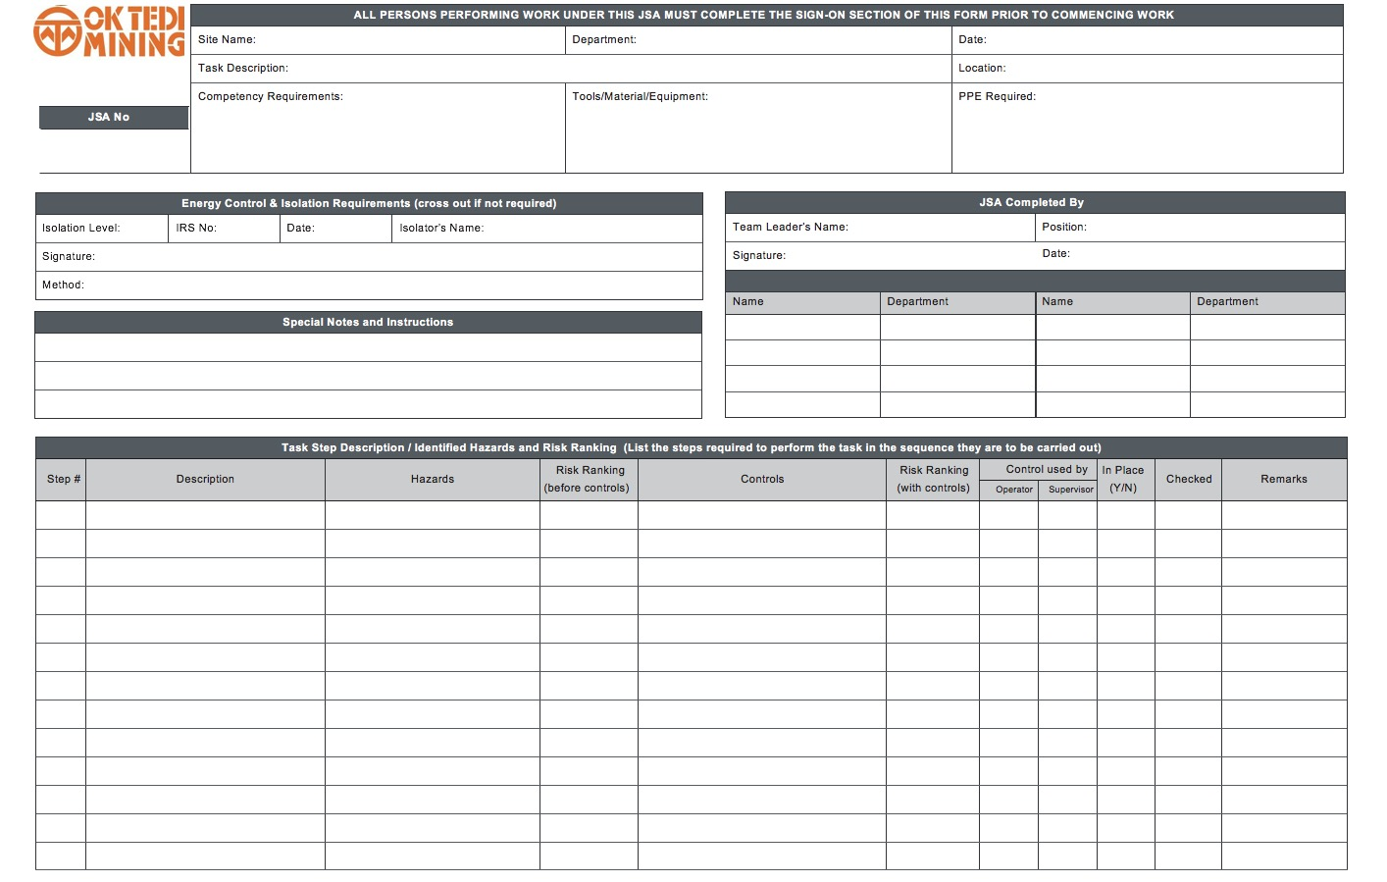
Job Safety Analysis
Notes:
Discuss the purpose and use of the JSA.
ACTIVITY – if time allows, have the participants work in groups to complete a JSA for a task at their work place. Discuss.

Slide 15
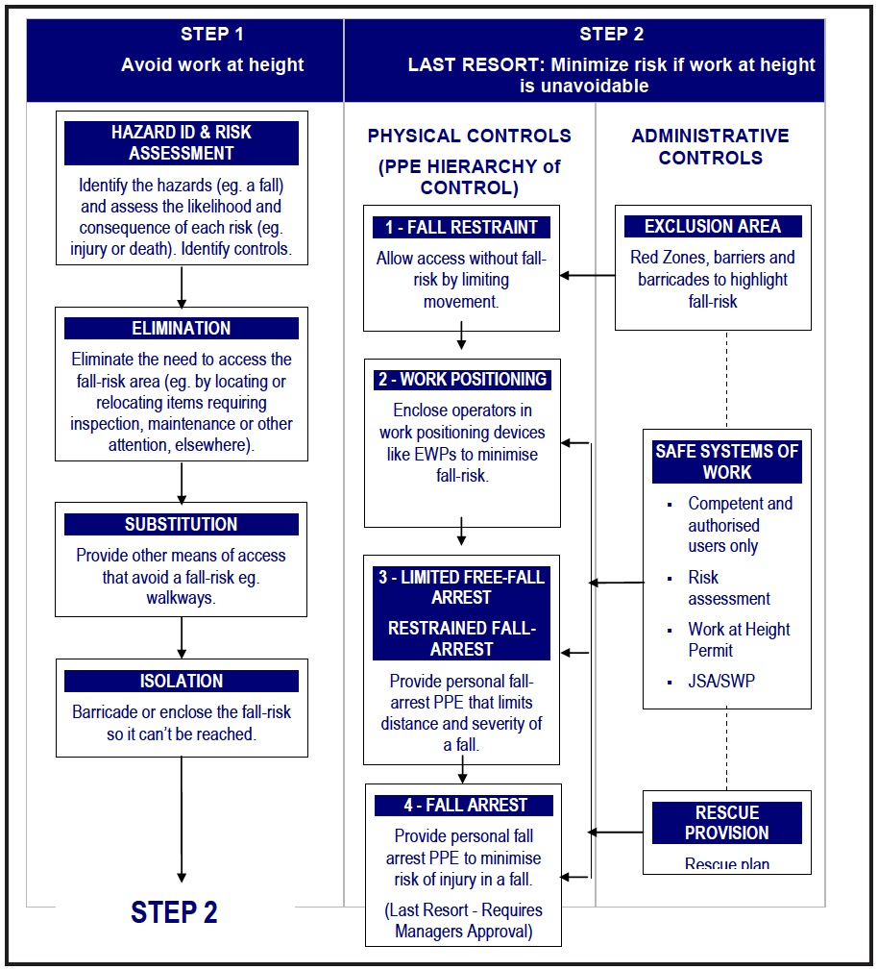
Hazard Control Options
Notes:
Discuss the Hierarchy of applying Controls to eliminate hazards or minimise the risks when working at heights.

Slide 16
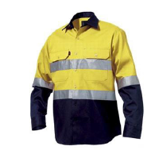
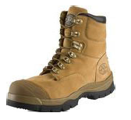
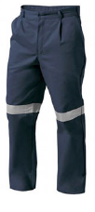
Personal Protective Equipment (PPE)
Basic and specialised PPE
PPE must be:
    clean
    undamaged
    fitted
    inspected before each use
    inspected 6 monthly by authorised
    person
Notes:
Discuss the site requirements for PPE for working at height.
ACTIVITY – if time allows, demonstrate inspecting work at height PPE using the PPE checklist (in the Appendix at the back of the reference book).

Slide 17
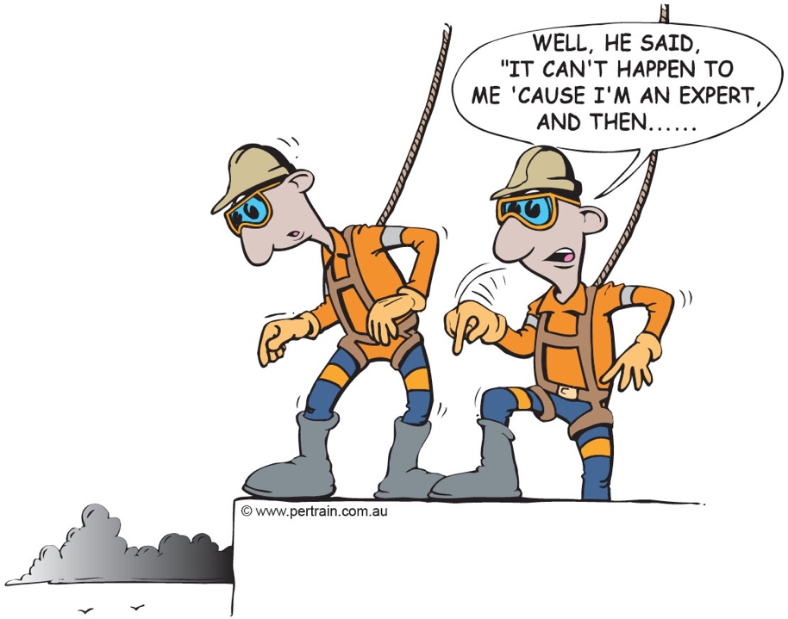
Fall Protection Systems
Restraint devices prevent a person from falling
Fall arrest systems stop a person from falling too far
Follow procedures
Do not work alone
Notes:
Discuss the types of fall protection equipment:
restraint devices
fall arrest systems.
Explain when personal fall protection must be used and the precautions to take.

Slide 18
Restraint Devices
Restraint belt or work positioning harness
Fall restraint line
Fall prevention static line
Self-locking triple action hooks or karabiners
Anchorage points
Notes:
Demonstrate and discuss the devices that make up a restraint system.

Slide 19
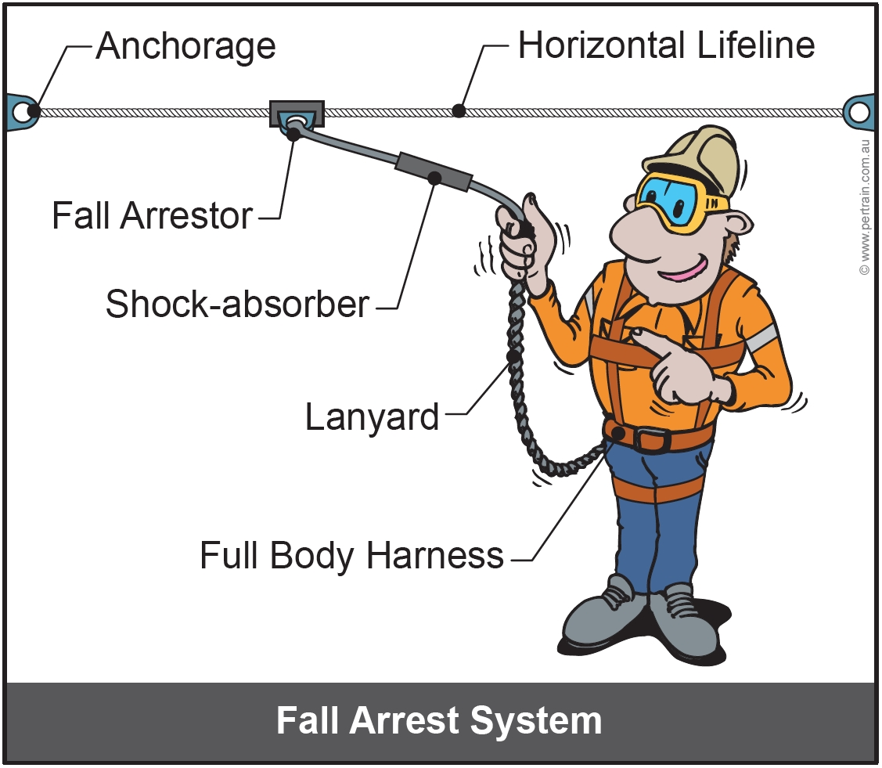
Fall Arrest Systems
Notes:
Demonstrate and discuss the devices/components that make up a fall arrest system.
Discuss the requirements when working with a fall arrest system.

Slide 20
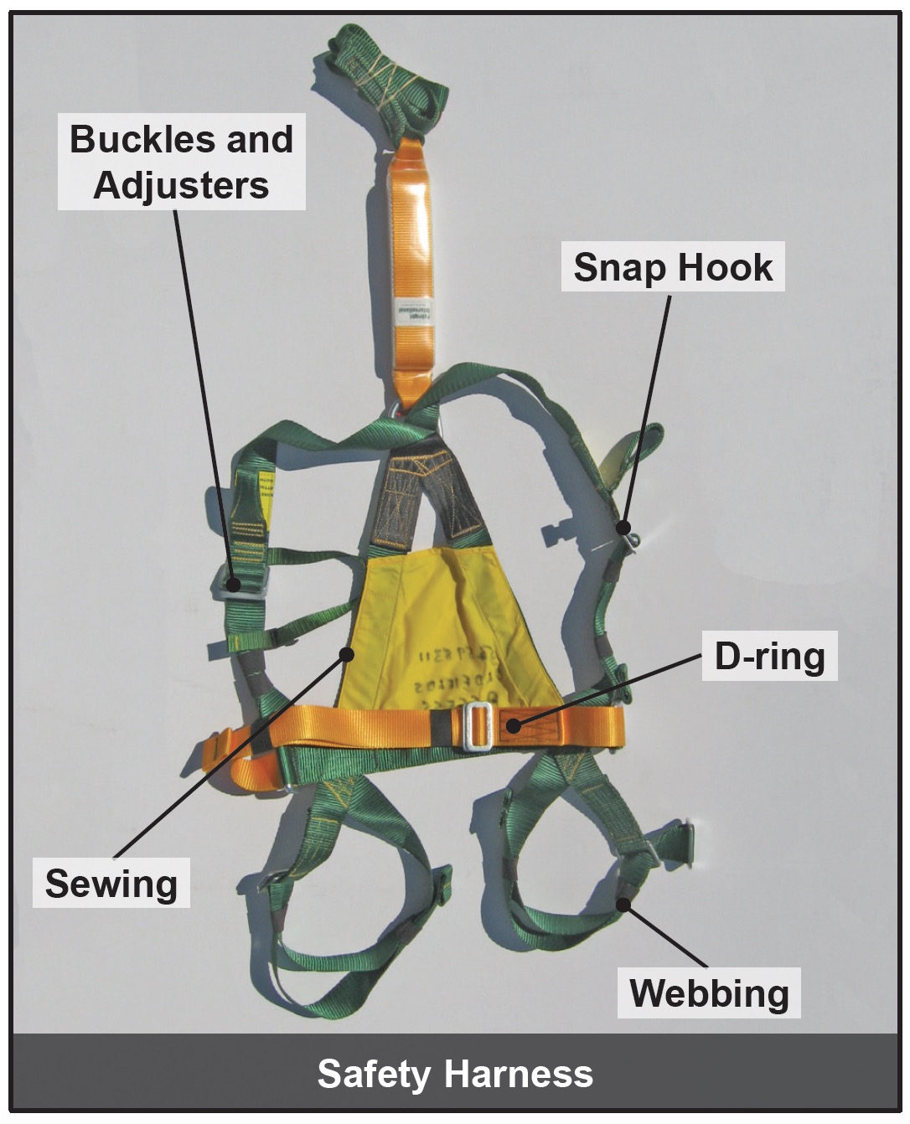
Safety Harness
Notes:
Discuss the use and fitting of safety harnesses.
Explain the need to conduct a thorough inspection of the safety harness before use.
Demonstrate inspecting a harness and explain all of the inspection points, including the inspection date.

Slide 21
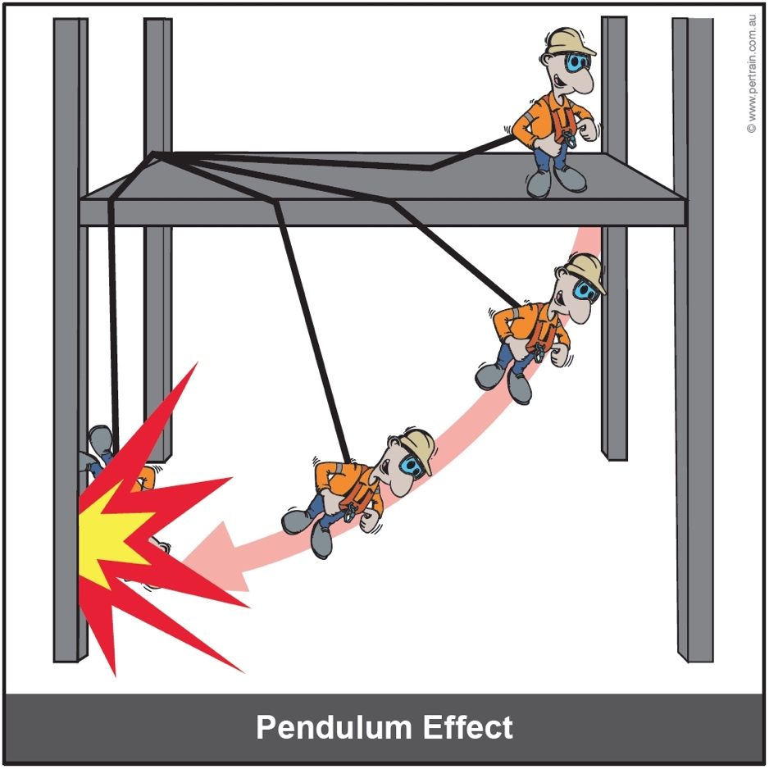
Anchor Points
Anchor points must:
    support a worker in the event of a fall
    withstand a static load of 15kN (1500 kg)
Authorised personnel will test and colour code the anchor points
Position anchor points to avoid the pendulum effect
Notes:
Discuss the purpose of anchor points.
Explain the requirements for anchor points.
Outline the pendulum effect and describe how to locate anchor points to avoid it.

Slide 22
Suspension Trauma
Never work alone when using fall protection
Use a harness that allows your legs to be kept horizontal
Where possible, move your legs in the harness
Keep legs as high as possible and head as horizontal as possible
Notes:
Explain suspension trauma and the causes.
Outline the symptoms of suspension trauma.
Emphasise the severity of suspension trauma.
Discuss the procedure for rescuing a suspended person.

Slide 23
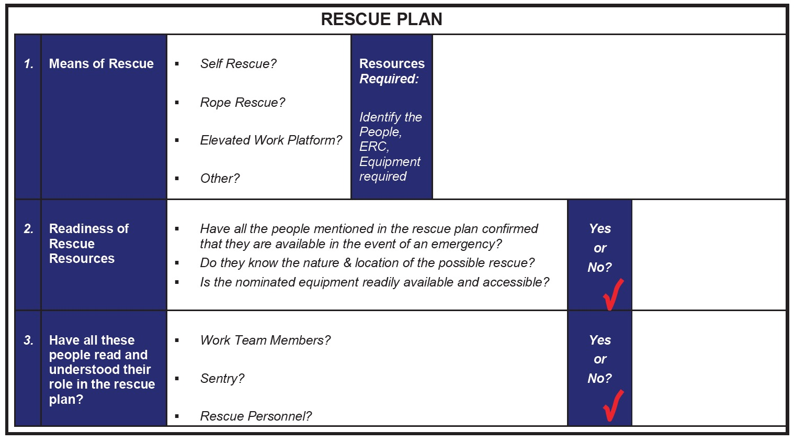
Rescue Plan
Notes:
Refer to the rescue plan in the Appendix at the back of the reference book andiscuss the site requirements for a Work at Heights Rescue Plan.

Slide 24
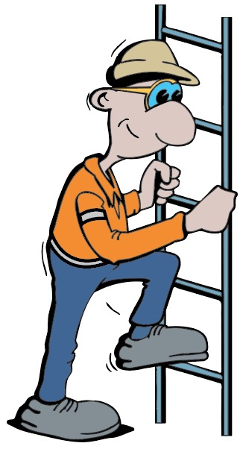
Minimise Climbing Fall Risks
Use proper technique
Nonslip steps, hand holds
Keep clean and in good repair
Face towards ladder/steps
Do not have hands full and use hand holds
Never jump onto or off elevated work area
Notes:
Discuss ways to minimise the risk of a climbing fall.

Slide 25
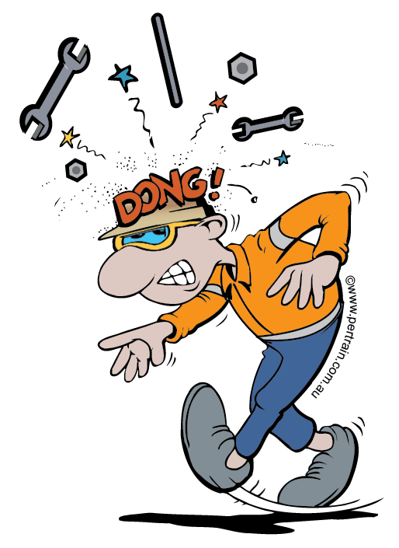
Objects Falling From Heights
Secure tools to tool belt
Use rubber matting on platform floor
Keep tools / equipment away from edge
Secure unused items and remove asap
Keep work platform tidy
Do not balance tools on platform controls
Create a drop zone
Install overhead protection
Secure items being raised or lowered
Never throw objects or stand under a load
Notes:
Discuss the:
importance of securing items to prevent objects falling from heights
possible consequences of objects falling from heights
actions you can take to minimise the risk.

Slide 26
Select and Inspect Equipment
Consult with authorised personnel to select appropriate equipment and tools
Equipment must be suitable for the task and conditions
Operate equipment that you are competent and authorised to use
Notes:
Discuss the importance of selecting appropriate tools and equipment for the task.

Slide 27
Equipment Checks and Inspections
Check serviceability of tools and equipment
Do not use equipment in an unsafe condition
Check work at heights equipment for:
    test and inspection tags currency
    damage, wear, corrosion or distortion
    clear labelling for safe working loads
Isolate defective equipment, report and arrange for maintenance or repairs
Use equipment as per manufacturer guidelines
Keep equipment clean
Notes:
Discuss the site requirements for inspecting equipment before use.

Slide 28
Install and Use Equipment
Basic and specialised equipment
Equipment must:
    comply with approved design standards
    be used as per manufacturer and site specifications
Before starting work at height check:
    job authorisation, procedure, JSA and clearances are complete
    personnel are qualified and authorised for the task
    Safe Working Load is sufficient if an EWP is required
    correct equipment is available and serviceable
    spotter is allocated
    signalling procedures are confirmed
Notes:
Discuss the importance of correctly installing and using equipment for work at heights.
Discuss the importance of performing checks before starting work.
Note: this list contains examples only.

Slide 29
Basic Equipment - Signage
Signs draw attention to hazards
Do not move safety signs unless authorised
Report or replace damaged signs
Notes:
Discuss the purpose and types of signs to be used when working at heights.
Explain the site procedures for using and replacing signs.

Slide 30
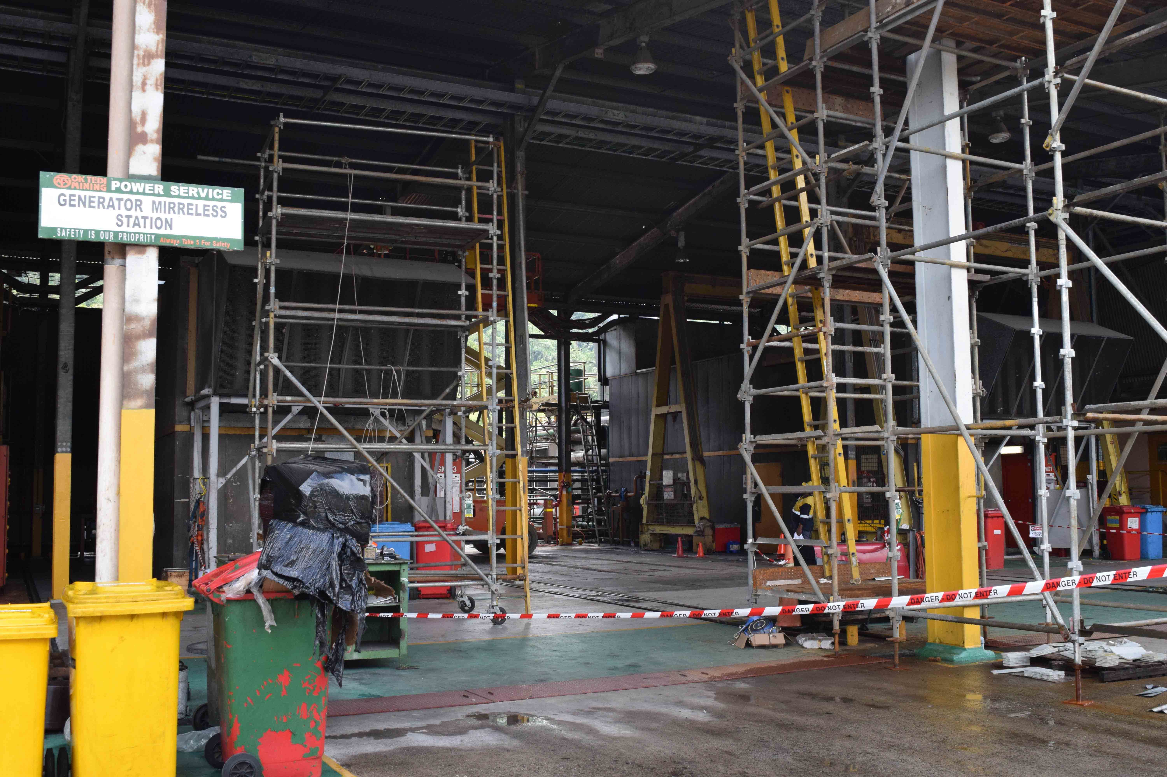
Basic Equipment - Barricades
Barricades should be:
    at least 1 metre high
    square, erect and level
    at least 2 metres back from
    elevated area
Do not enter a barricaded area without authorisation
Warning and Protective Barricades
Notes:
Outline the classes of barricades.
Discuss the requirements for barricades.
Explain the purpose and types of warning barricades used at the work site.
Explain the purpose and types of protective barricades used at the work site.

Slide 31
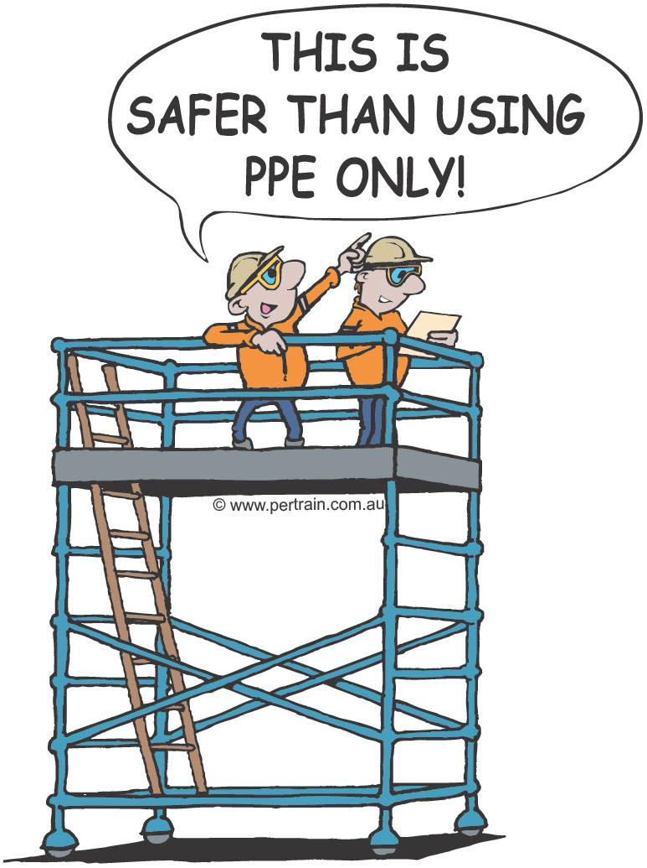
Scaffolding
Installed by qualified and authorised scaffolder
Do not interfere with the construction of scaffolding
Scaffolding must be inspected regularly
Notes:
Explain the standards and requirements for scaffolding.
Discuss the benefits of using scaffolding.

Slide 32
Ladders
Must comply with design and usage standards
Use only for lightweight work and short duration
Inspect before use
Ladders include:
    fixed
    portable (step and extension)
Notes:
Explain the standards and requirements for ladders.
Discuss the use of fixed ladders.
Discuss safe climbing of fixed ladders.

Slide 33
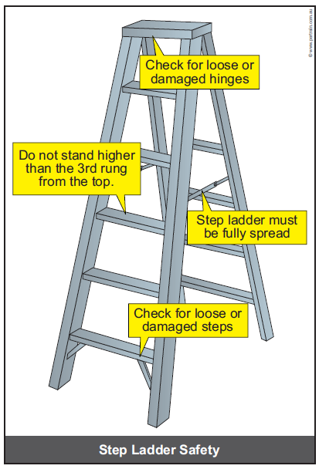
Step Ladders
Correct length
Place on a level, firm surface
Use only in fully opened position
Ladder spreaders must be tight
Replace defective ladder immediately
Do not lean out past confines of ladder
Do not stand higher than third rung
Notes:
Explain the correct use of step ladders and the precautions to followed.

Slide 34
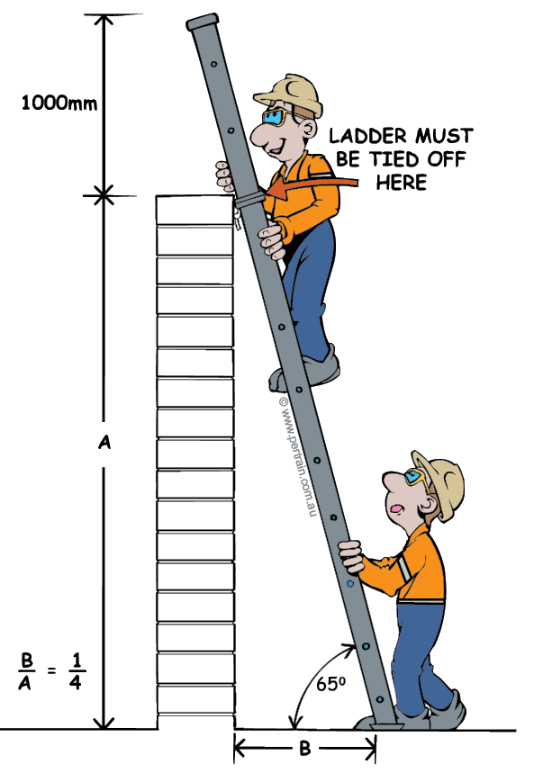
Straight and Extension Ladders
Ladder should protrude 1m
No metal ladders near electricity
Install away from access areas
Place on level non-slip surface
Secure the ladder at the top
Wear safety harness
Face the ladder, 3 point contact
Carry tools in a bag or pull up using a rope
One person on a ladder at a time
Notes:
Explain the correct use of straight and extension ladders and the precautions to followed.

Slide 35
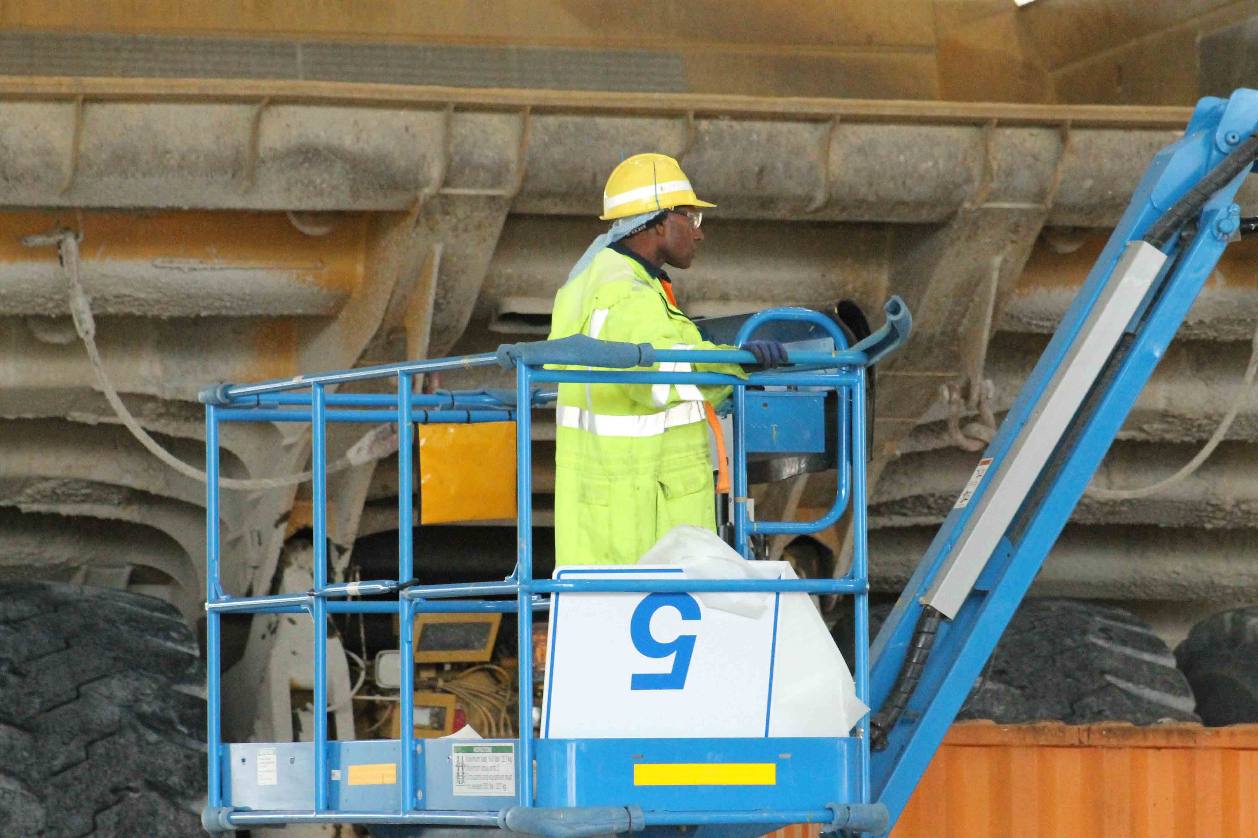
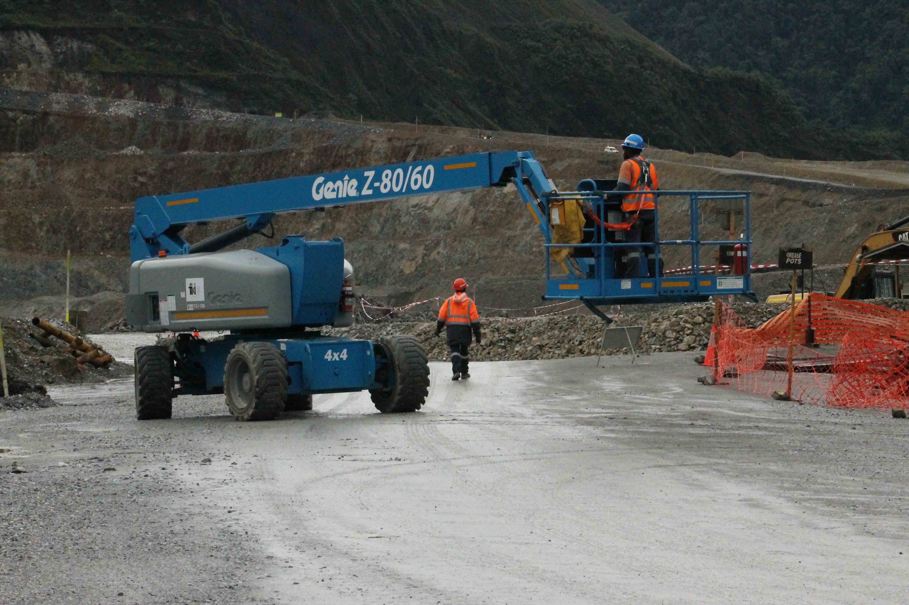
Specialised Equipment - EWP
Notes:
Outline the types of work platforms – EWP and mobile work platform of scaffold.
discuss the features and use of EWPs.
Emphasise that personnel must wear a fall arrest device connected to a dedicated anchor point in the basket.

Slide 36
Elevating Work Platform Hazards
To avoid an EWP incident:
    stabilise the work platform
    do not exceed SWL of machine
    locate tools and materials safely, securely and evenly
    identify emergency stop button locations
    only climb in carrier while it is on ground
    check that risk control measures cover contingencies
    check distance from overhead electrical cables
Notes:
Discuss the hazards of working with elevating work platforms.
Explain the safety precautions that must be observed at all times when working with elevating work platforms.

Slide 37
Electrical Hazards
Contact with overhead power lines is a major hazard when operating an EWP
Follow state and site regulations regarding distances and no go zones when working near overhead power lines
Notes:
Discuss the dangers of overhead electrical cables.
Explain No Go or Exclusion zone limits.
Emphasise the importance of maintaining constant awareness about the location of overhead power lines.
Explain that different states have different legislation regarding distances from power lines, and outline your site orders.

Slide 38
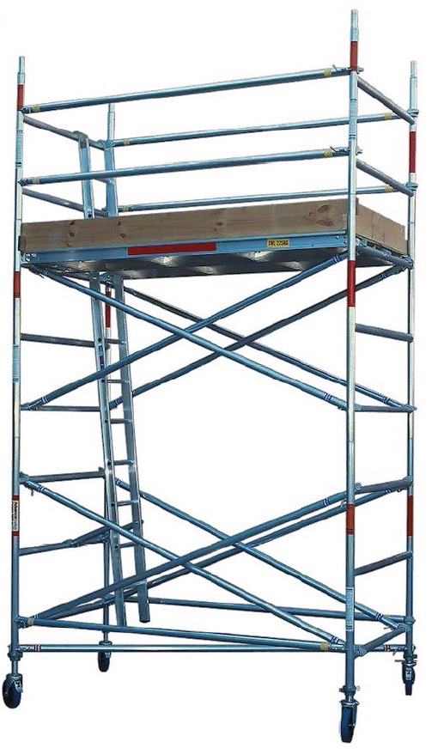
Mobile Scaffold/Work Platform
Must be erected by qualified and authorised scaffolder
Check no power lines or other overhead obstructions
Ground must be firm and level
Barricade the base
Castors must be locked before people access scaffold
Notes:
Describe mobile scaffolds and work platforms.
Discuss the control measures to be used when working with mobile scaffolds or work platforms.

Slide 39
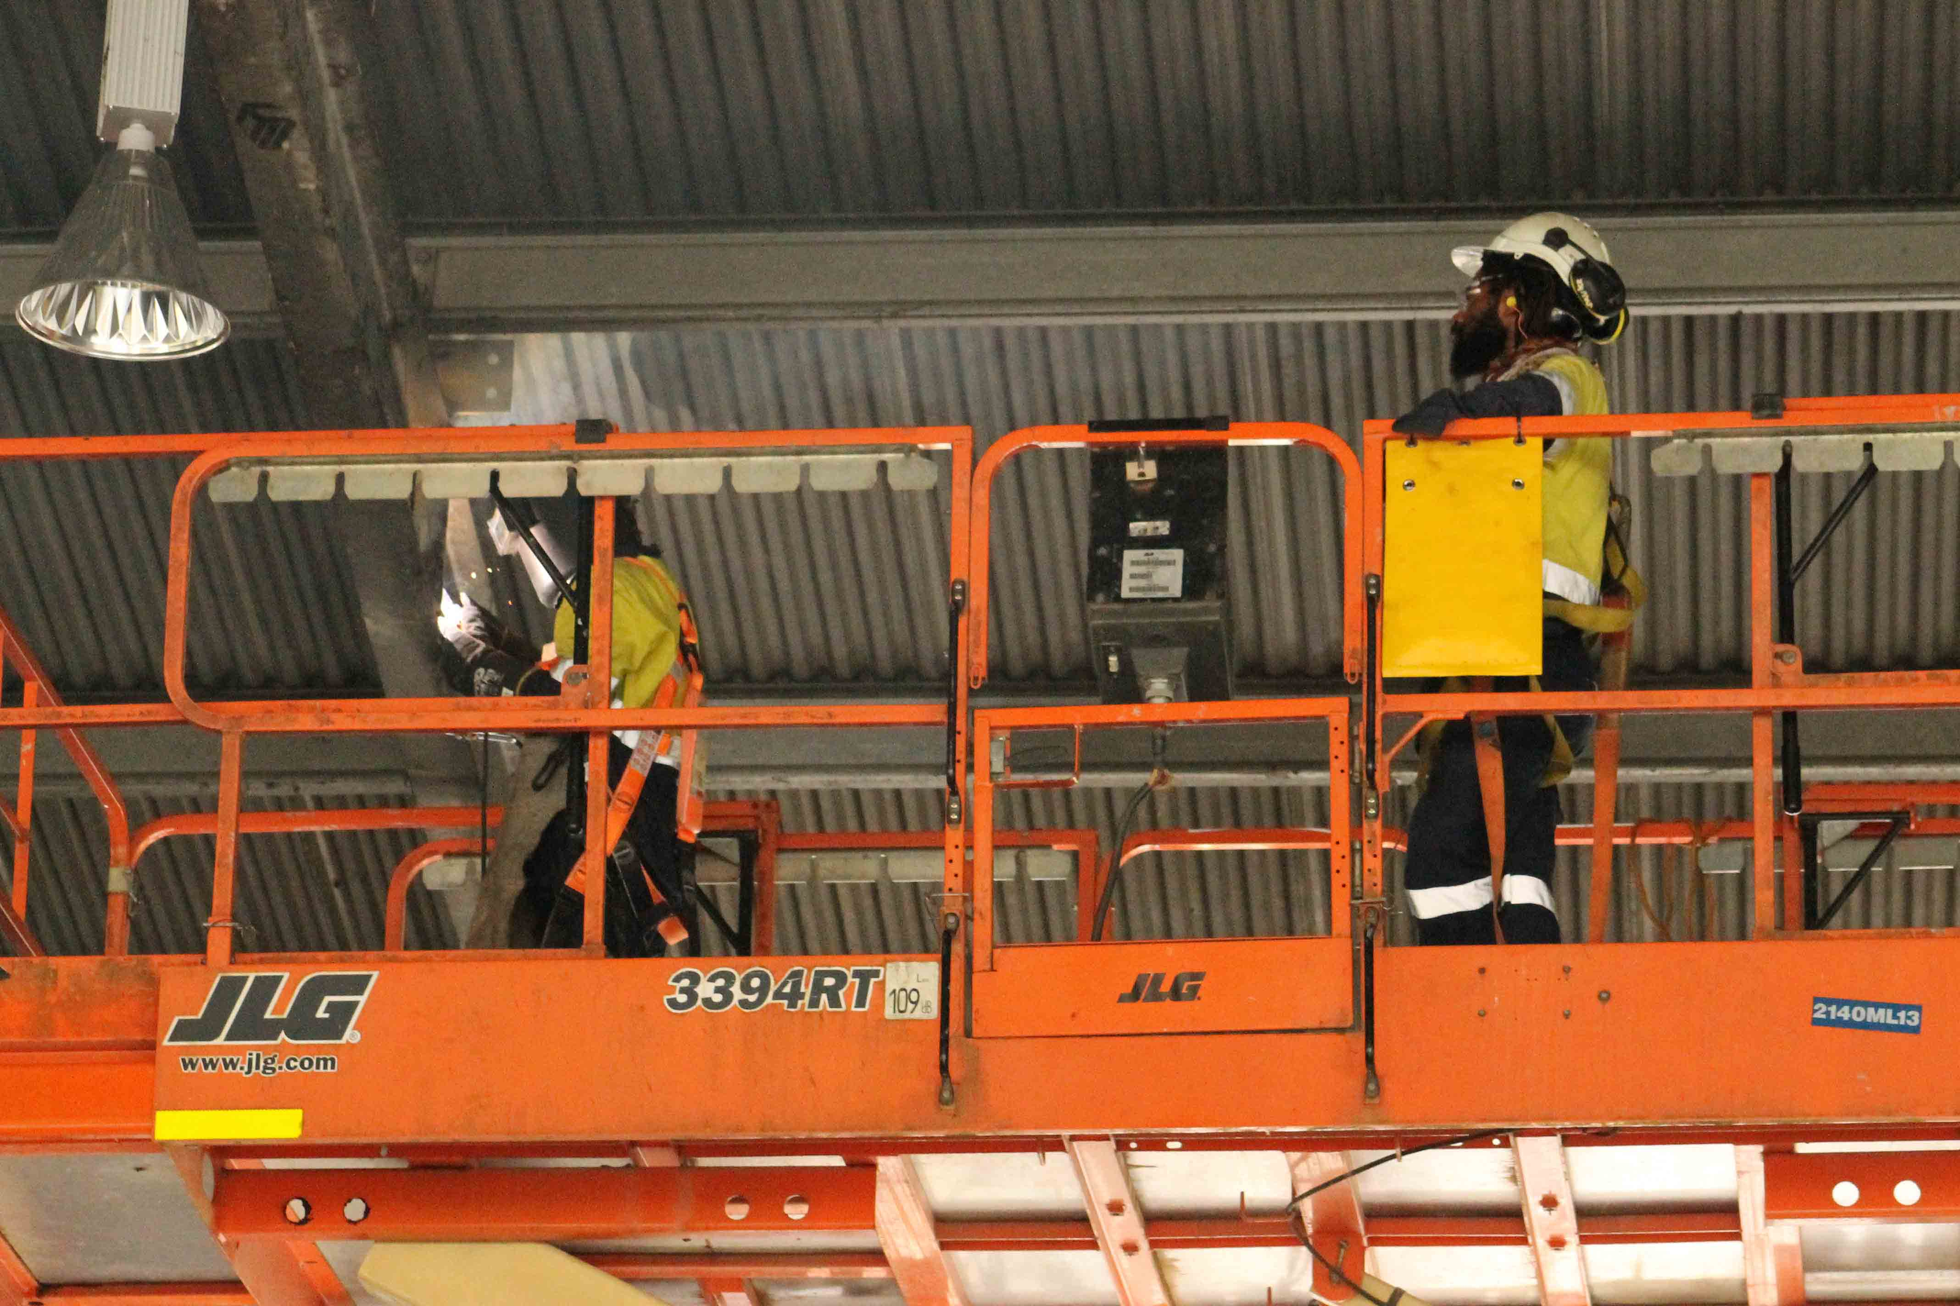
Edge Protection
Edge protection should be used on:
    walkways
    ramps
    landings
    stairways
    work platforms
Notes:
Discuss the purpose and requirements for edge protection.
Describe toe boards and explain the requirements for toe boards.

Slide 40
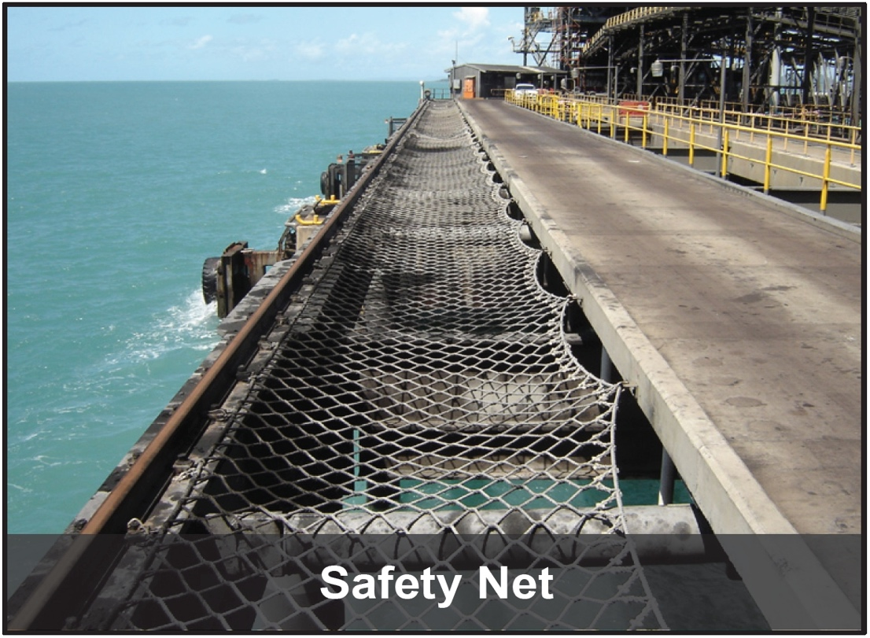
Catch Platforms and Safety Nets
Fall arrest measures
Catch platform is erected below work area
Safety net can be attached to a scaffold, under or adjacent to a work area
Notes:
Discuss the purpose and correct location of catch platforms and safety nets.

Slide 41
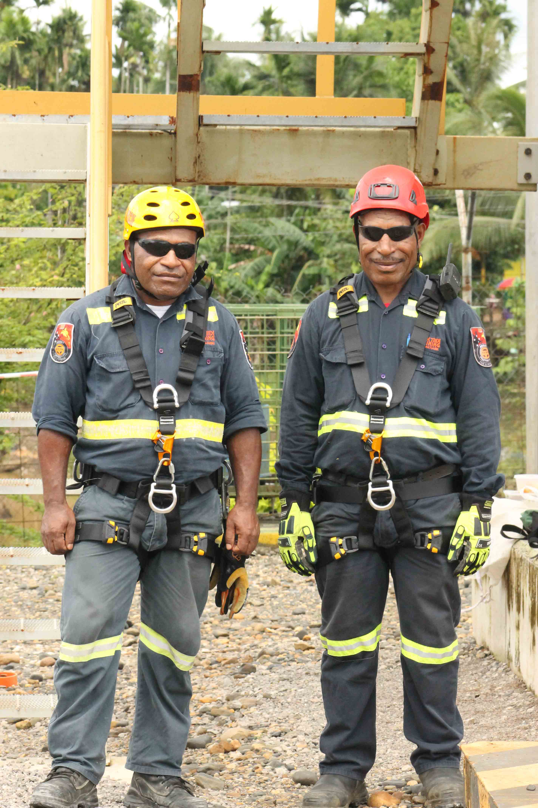
Working Safely at Heights
Secure hard hats with a chin strap
Identify and barricade drop zone
Inspect equipment
Use tool lanyards, nets, tool bags and matting
Anchor points clearly labelled
Documentation in place
Fall protection installed correctly (check with authorised personnel)
Notes:
Discuss the general requirements for working safely at heights.

Slide 42
Specific Requirements
Type of Work at Heights | Examples - Specific Requirements
Permanent Platforms and Handrails | Designed, engineered and installed by qualified and authorised personnel Kick/toe board installed Top rails 900-1100mm from platform One or more mid rails installed between top rail and platform Handrails not to be used as anchor points
Elevated Work Platforms (EWP) | Conduct a risk assessment to address: overhead hazards drop zones slew radius Safe Work Load (SWL) Do not use in windy conditions Conduct a pre-start inspection SWL must be displayed and not exceeded Fully compliant anchor point installed Use a harness and lanyard system Must be operated by trained and authorised personnel
Notes:
Explain that sites will have additional requirements for working safely at height.
The table provides some examples of requirements.
Discuss your site specific requirements.

Slide 43
Specific Requirements
Type of Work at Heights | Examples - Specific Requirements
Scaffolding | Assembly, dismantling or modifications over 4m conducted by licenced scaffolder Climbing outside scaffolding prohibited Top rail, mid rail and kick boards installed Access only via approved stairways or ladders Inspected, approved and tagged by authorised person ‘Scaff Tag’ displayed stating: SWL date of last inspection name of person who inspected scaffold Scaffold without ‘Scaff Tag’ is considered unsafe and prohibited from use
Mobile Scaffolding | Same as scaffolding Do not relocate with people in it Lock castor wheels before use
Notes:
Explain that sites will have additional requirements for working safely at height.
The table provides some examples of requirements.
Discuss your site specific requirements.

Slide 44
Specific Requirements
Type of Work at Heights | Examples - Specific Requirements
Workboxes (Suspended from crane) | Must be approved and registered for use, with a compliance plate SWL must be displayed Fully compliant anchor point fitted Use full body harness and lanyard Licensed crane operator Do not use in excessive wind conditions Crane must be stationary Minimum of two people in workbox
Ladders | Use only industrial rated ladders (including step ladders) Inspect before use Use only for access to work area Secure the ladder on firm level ground Establish a drop zone
Notes:
Explain that sites will have additional requirements for working safely at height.
The table provides some examples of requirements.
Discuss your site specific requirements.

Slide 45
Specific Requirements
Type of Work at Heights | Examples - Specific Requirements
Fall Restraint | Preferred option for fall protection Anchor points must be rated to 15kN Wear full body harness Restraint mechanism must be double action or double locking Personnel must never work alone
Fall Arrest | Rescue plan must be in place Personnel must never work alone Personnel must be trained and authorised to use fall arrest equipment Consists of fully body harness, lanyard and anchor point
Notes:
Explain that sites will have additional requirements for working safely at height.
The table provides some examples of requirements.
Discuss your site specific requirements.

Slide 46
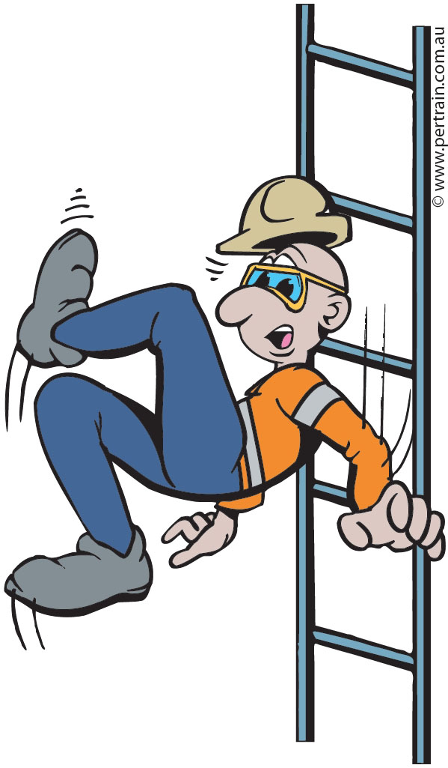
Workplace Access
Ladders must be secure at the correct angle
Clear obstructions
Adequate lighting
Steps and handrails secure and clean
Check for slips and trip hazards
Guardrails and toe rails secure
Barricade area to prevent
unauthorised access
Notes:
Discuss the importance of checking that access to the workplace is safe.
Explain the guidelines for making access to the workplace safe.

Slide 47

Equipment Transport
Inspect the transport route for hazards before relocating the equipment
Ensure that ground conditions are suitable
Check for adequate overhead clearance
Notes:
Discuss transporting the equipment to the work site.
Explain the precautions to be followed when transporting equipment.

Slide 48
Tool Management
Do not climb or descend a ladder while carrying tools
Carry tools in a tool belt
Use a rope to raise the tools in a container
If you are using an EWP, secure tools and equipment before raising the platform
Notes:
Discuss the importance of managing tools while working at heights.
Explain the precautions to be observed to prevent tools or equipment falling from heights.

Slide 49
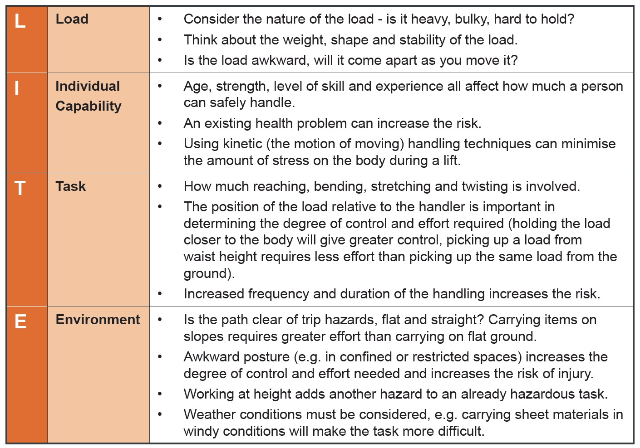
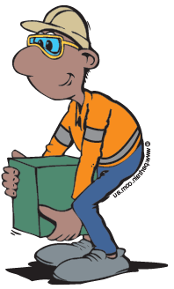
Manual Handling
Notes:
Explain the importance of safe manual handling.
Discuss the features of the LITE lifting technique.

Slide 50
Monitor Controls and Safety Measures
Following safe work practices
Monitor controls and safety measures regularly
Ensure that:
    barricades and signage are visible and in good condition
    protective devices such as guard rails, hand rails, foot walks and toe boards remain effective
    lifting equipment has not been altered
Reassess and adjust controls to suit changed conditions
Notes:
Discuss the need to monitor the control measures that are in place.
Explain the precautions that must be observed for the duration of the working at heights task.

Slide 51
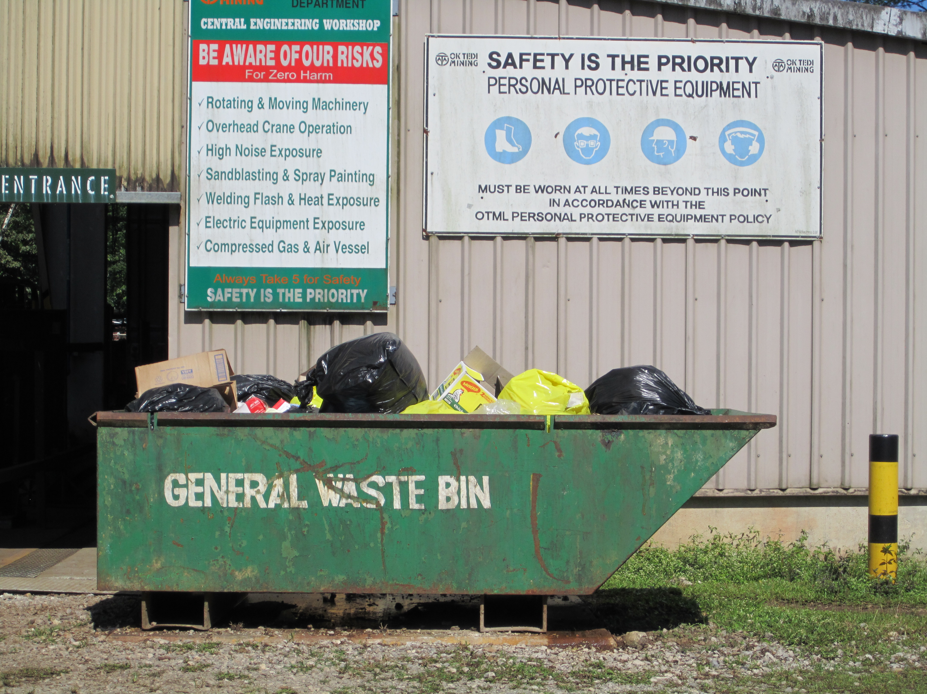
Post Operational Tasks
Check work complies with the task requirements
Dismantle safety systems
Sign off ATW
Clean, inspect, maintain and store tools and equipment
Clean up work area
Complete and submit reports
Attend shift handover
(if required)
Notes:
Discuss the required post operational tasks, including the following.
Ensuring the work is compliant.
Removal of safety systems.
Discuss the importance of signing off the ATW when leaving the work site.
Explain the site procedures for Work at Heights ATW sign-off, closing and filing.
Inspection and care of equipment after use and site defect reporting procedures.
Work area clean up including waste management and general housekeeping.
Site reporting requirements.

Slide 52
Summary
Do you have any questions?
Notes:
This training material provided information for working safely at heights.
Explain the assessment procedure for this unit.

