Slide 1
Isolate and Access Plan
Training Package
Notes:
Welcome.
Introduce yourself and outline your experience.
Explain where the facilities are and any OHS issues
Timeframe for the course.
Handouts:
- Attendance Sheet - get all trainees to sign
- Training Material (Reference book, forms, locks, tags, etc).
Any questions?

Slide 2

Introduction
RIISAM202D Isolate and Access Plant
This resource contains information that will assist you to:
    determine the required plant isolations
    isolate plant according to site procedures
    complete the Authority to Work form
    de-isolate and restore plant to service.
Notes:
Briefly explain:
The training material aligns to competency unit RIISAM202D which is part of the Resources and Infrastructure Industry (RII) training package.
The competency unit requires that the learner can demonstrate the required skills, knowledge and practical application in the workplace.
A Statement of Attainment may be issued if this unit is not done as part of a qualification.
Explain the assessment procedure.

Slide 3
Isolation
Action to prevent uncontrolled release of energy
Energy release may cause injury to personnel or damage to plant and equipment
All potential sources of energy connected to the plant must be isolated
Isolation includes not only the section being work on but also all associated systems
Follow the scope of work
Notes:
Explain the purpose of isolation.
Discuss the importance of isolating not only the plant but all associated systems.
Discuss what is meant by the ‘scope of work’ and how this relates to isolation of plant.

Slide 4
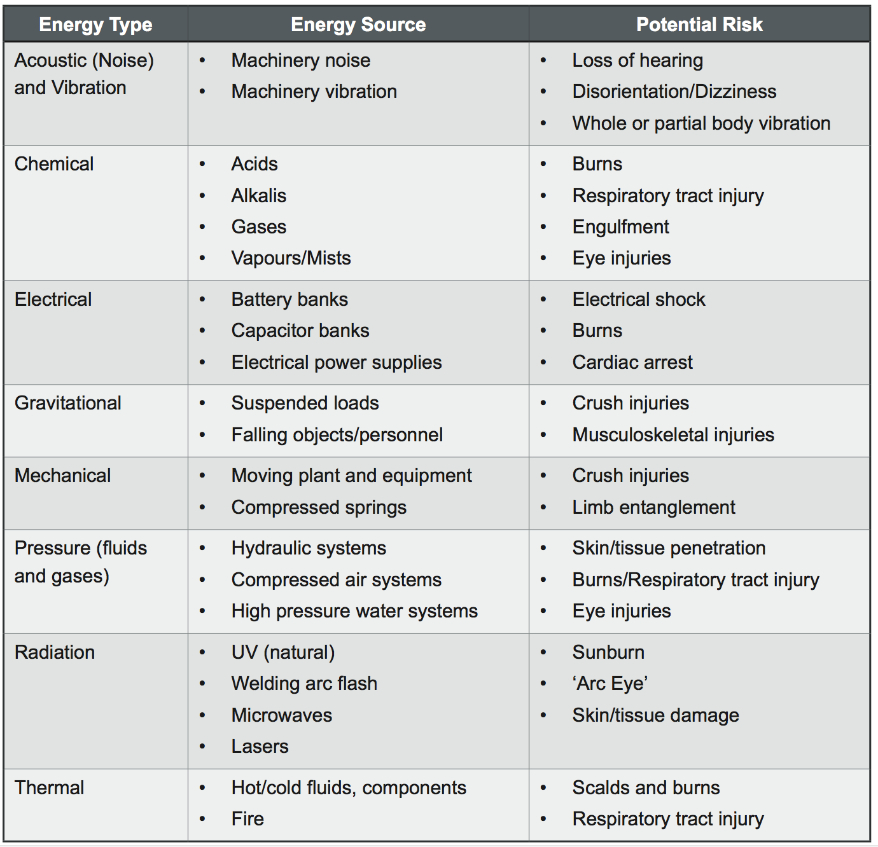
Types of Energy
Check the work site database for information on:
    energy sources and locations
    approved isolation points
    approved isolation methods
Notes:
Explain the importance of knowing all the energy sources associated with the work to be done.
Suggested Activity:
Ask the learners for examples of energy types and sources common to their work area.
Discuss the risks that each poses.

Slide 5

Operator Obligations
Be physically and mentally fit for the task
Do not attempt to access or isolate plant without:
    Training and authorisation
    Required authorisations for the work
Select, check and use appropriate PPE
Report unsafe conditions, activities, incidents or near misses
Report damaged or defective equipment
Operate equipment within specifications and limitations
Adhere to site environmental requirements
Notes:
Discuss the obligations of personnel who are required to access and isolate plant.

Slide 6
Compliance
Documentation |  | Example
Government | Acts | PNG Mining (Safety) Act 1977
 | Regulations | PNG Mining (Safety) Regulations
Industry | Codes of Practice | Hazardous Manual Tasks - Code of Practice
 | Standards | ISO 31000 Risk Management Standard
Organisation | Management Systems | OTML Integrated Management System
 | Policies | Safety and Occupational Health Policy
 | Procedures and Work Instructions | Emergency Response Procedure
External | Equipment Specific Documents | Operations and Maintenance Manual, User Guide, Parts Catalogue
Notes:
Discuss the legislation and site policies relevant to your work site.
List some of the compliance documentation relevant to your work site.
Suggested Activity:
Help the learners to access relevant compliance documentation and give them the opportunity to read through the information.

Slide 7
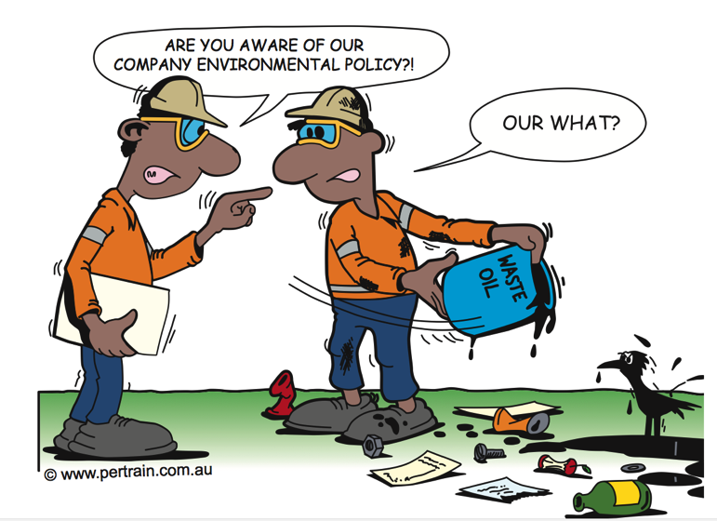
Environmental Issues
The site Environmental Management Plan will include procedures and practices for:
    Dust prevention and minimisation
    Control of fumes including exhaust gases and smoke
    Water quality control
    Waste management
    Handling of dangerous
    substances and chemicals
Notes:
Explain the site Environmental Management Plan that applies to isolating and accessing plant.
Discuss the procedures and practices that must be carried out to comply with the environmental requirements.
Suggested Activity:
Demonstrate how to access your site’s environmental management plan.
Allow the learners time to familiarise themselves with the requirements of the plan.

Slide 8
Plan and Prepare for Operations
Obtain all relevant information
Identify, record and confirm plant to be isolated
Confirm the work to be carried out
Perform a complete hazard identification and risk analysis
Ensure that all required authorisations are in place before work starts
Notes:
Discuss the preparations for work.

Slide 9

Obtain Relevant Information
Information may include:
    Scope of work
    Time schedule
    How the task fits in with other work
    Quality and quantity indicators
    Resources
    Communication methods
    Procedures and work instructions
    Authorisations and licenses required
    Identified hazards and required controls
Notes:
Discuss the types of information that may be provided before work starts.
Explain how this information will be accessed and/or provided.

Slide 10
Interpret Information
Interpret information
Check the work site for variations in the information
Apply work procedures and instructions
If you do not have enough information or you do not understand it, talk to your supervisor before starting work
Notes:
Discuss how to interpret the work information.
Explain how to check for variations between the information that is provided and the conditions at the work site.

Slide 11
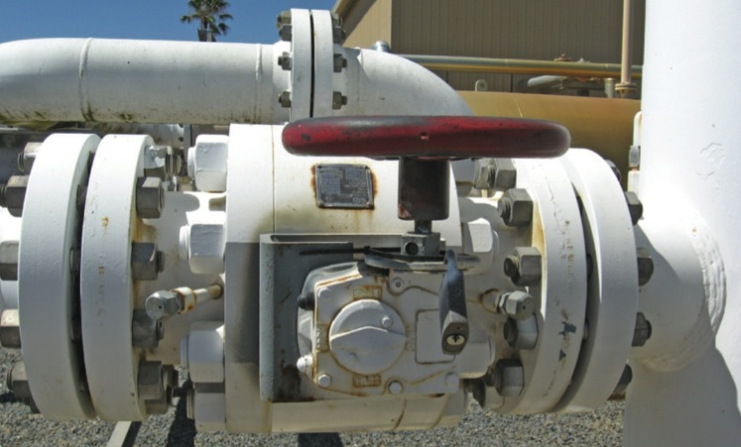
Identify Plant to Be Isolated
Discuss planned work with the plant operator
Inspect the plant and the work site
Identify the plant status
Note requirements for any change of status before or during isolation
Apply diagnostic techniques to identify problems
Access site information about the plant
Notes:
Discuss how to identify the plant to be isolated.
Explain how to access information about the plant item:
company asset catalogue
work site component inventory
schematics, diagrams and drawings
manufacturer and/or operator manuals
plant operator.

Slide 12

Confirm Work Requirements
Work requirements may include
    Plant location and identification
    Plant status
    Operating parameters
    Equipment specifications
Documents may include
    Procedures and work instructions
    Defect reports
    Diagrams, plans and schematics
    JSA
    Authority to Work conditions, limitations, scope of work
    Manufacturer / supplier manuals
Notes:
Discuss how to confirm the work requirements.
Explain how to check the required documents.

Slide 13

Coordinate Isolation with Other Operators
Coordinate task with all personnel involved in the task:
    Control centre/base camp
    Supervisor or other person requesting the work
    Person in charge of work
    Contractors
    Work party
    Plant operators
    Other personnel
Resolve coordination activities before
starting work and throughout the task
Notes:
Discuss the coordination requirements.
Suggested Activity:
Revise your site’s main communication methods and use of relevant communication equipment.

Slide 14
Complete the Isolation Sheet
Summary of location
Description of plant or equipment
Isolation action(s) required
Restoration steps
Sign name and date
Second person check
and confirm
Notes:
Discuss the preparation of the Isolation sheet.
Explain how to use the Isolation sheet.
Explain that the Isolation sheet may also be used during the de-isolation process.

Slide 15
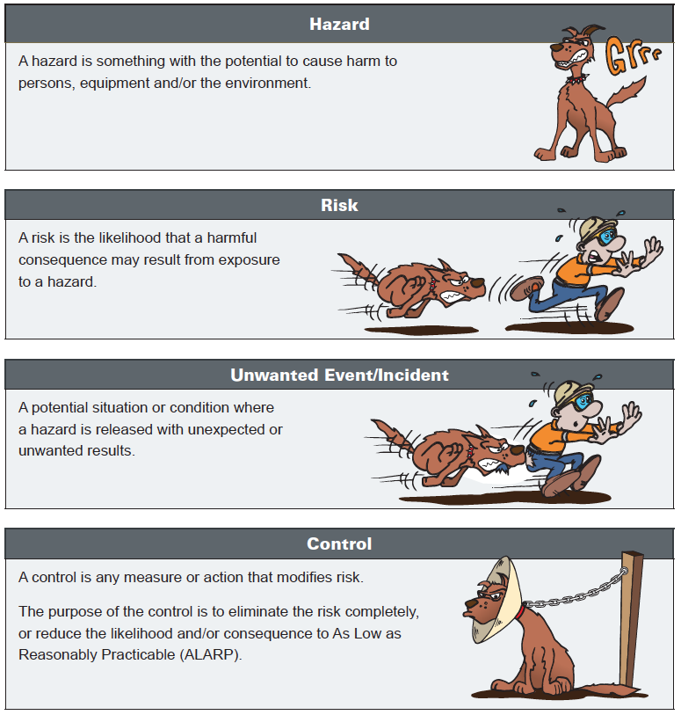
Identify Hazards and Control Risks
Notes:
Emphasise the difference between hazards and risks.
Explain the hazard identification procedure at your work site.
Outline the common hazards that may be associated with accessing and isolating plant.
Suggested Activity:
Revise / practice the use of your site’s hazard identification tool (e.g. Take 5).

Slide 16
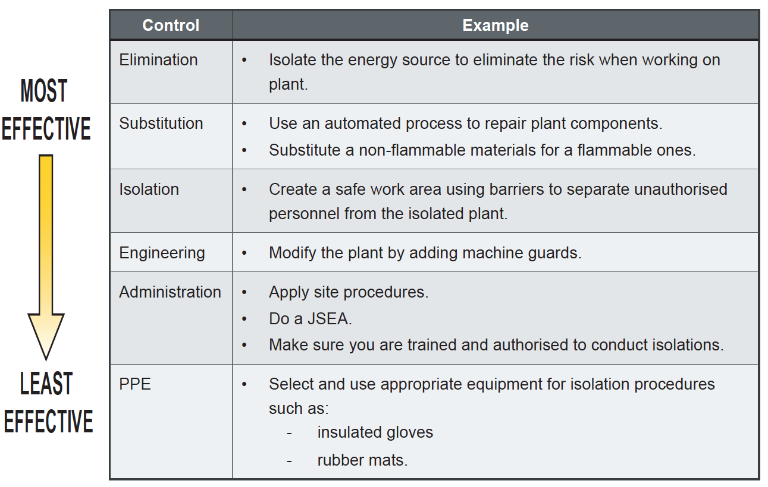
Hierarchy of Controls
Notes:
Discuss the hierarchy of controls.
Explain that a combination of controls is usually required.
Discuss the need to reduce the risk to As Low As Reasonably Practicable (ALARP).

Slide 17
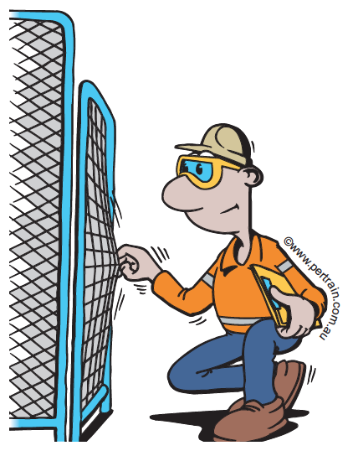
Isolation: Safe Work Area
Maintain good housekeeping for:
    Tools and equipment
    Hazardous chemicals
    Flammable materials
Create an exclusion zone using:
    Barricades or fences
    Witches hats
    Tape
    Warning signs
Notes:
Discuss how to provide a safe work area using isolation controls.
Discuss the signage and barricade requirements for the work site.

Slide 18

Hazard Identification Tools
  Take 5
    Stop
    Think
    Identify
    Plan
    Proceed
  Job Safety Analysis
    Team based
    Determine Risk Rating
    Do if:
      You answer ‘No’ to a Take 5 question
      A procedure is not available
      The task involves a number of people
      Conditions have changed and new hazards may exist
Notes:
Discuss the use of Take 5s and JSAs.
Suggested Activity:
If time permits, get the participants to complete a Take 5 and a JSA for the classroom and the training they are doing.

Slide 19
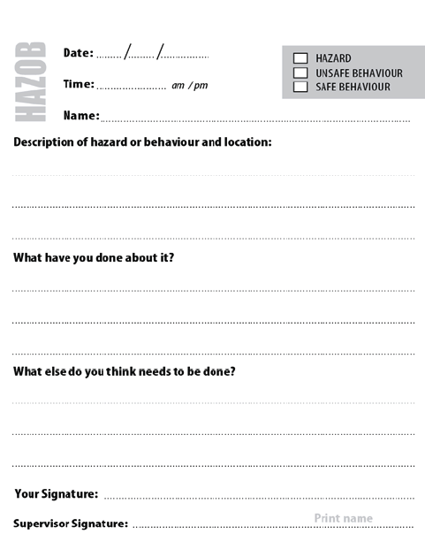
Administration: Hazard Report
Communicates information about hazards
Prevents an unsafe condition or behaviour from causing an incident
Identifying the hazard enables the risk to be reduced or eliminated
Notes:
Discuss the importance of hazard reports.
Outline the hazard reporting procedure at the work site.
Suggested Activity:
Show the learners how to access your site’s Hazard Reporting system.
Allow the learners to complete a hazard report based on the JSA they completed in the previous task.

Slide 20
Administration: Procedures and Work Instructions
Follow the site procedures and work instructions for tasks, such as:
    Boarding and disembarking vehicles
    Working behind protective barriers
    Clearing blockages and spills
    Working with moving parts
    Working around hot machinery
    Accessing and isolating plant
Ensure that you are trained and authorised to access and isolate plant
Notes:
Discuss the procedures that apply to accessing and isolating plant or equipment at your site.
Suggested Activity:
Show the learners how to access your site’s standard procedures.
Allow the learners time to familiarise themselves with the site procedures in relation to isolation and access of plant.

Slide 21
Training and Authorisation Levels
Typical levels of authorisation for isolators:
    Level 1 Authorised Isolator
    Level 2 Authorised Isolator
    Authorised HV Isolator
    Authorised Radiation Safety Officer (RSO)
    Independent Verifier of Isolations
    Tag Holder
Notes:
Discuss the authorisation levels that apply to isolators.
Explain that authorised isolators must be trained, assessed as competent, authorised and appointed to perform specific isolations.

Slide 22
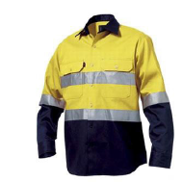


Personal Protective Equipment (PPE)
PPE must be clean, in good condition and properly fitted
PPE includes:
    Fire resistant clothing
    High voltage isolation gloves
    Non-conductive footwear
    Non-conductive platforms/rubber mats
Additional PPE may be required
Notes:
Discuss the site requirements for PPE.
Discuss the different PPE required in relation to working with different energy sources, e.g. mechanical isolation vrs electrical isolation.

Slide 23
Authority to Work
A system for planning and controlling work so it can be done safely.
Procedure involves:
    Risk assessment
    ATW application
    Implement controls
    ATW issue
    Work starts
    Work completed
    ATW surrendered
    Removal of controls
    Confirmation
    ATW closed
Notes:
Emphasise that the Authority to Work system is used to plan, control and complete work in accordance with safe work practices.
Explain the procedure for obtaining an ATW.
Explain that plant isolations may be performed in order to meet the conditions of an ATW already raised.

Slide 24
Requesting ATW
    Liaise with supervisor or ATW issuer
    Confirm operational requirements
    Supply all required information
    Submit application to the relevant person
    Allow sufficient time for ATW to be prepared
Notes:
Discuss how to request am ATW.
Emphasise that the request is NOT an authority to proceed. Work must not start until the ATW and and associated clearances have been issued.

Slide 25
ATW Issue
When the ATW is issued:
    Confirm the ATW is accurate and complete
    Discuss the hazards and required controls
    Confirm your understanding of the job task, limits and requirements
    Sign and date the ATW
ATW issuer will sign and date ATW to issue it
Each person working under the ATW must read and sign the ATW
ATW must be placed in the required location (at the work site or central location)
Notes:
Discuss the procedure for issuing the ATW.

Slide 26
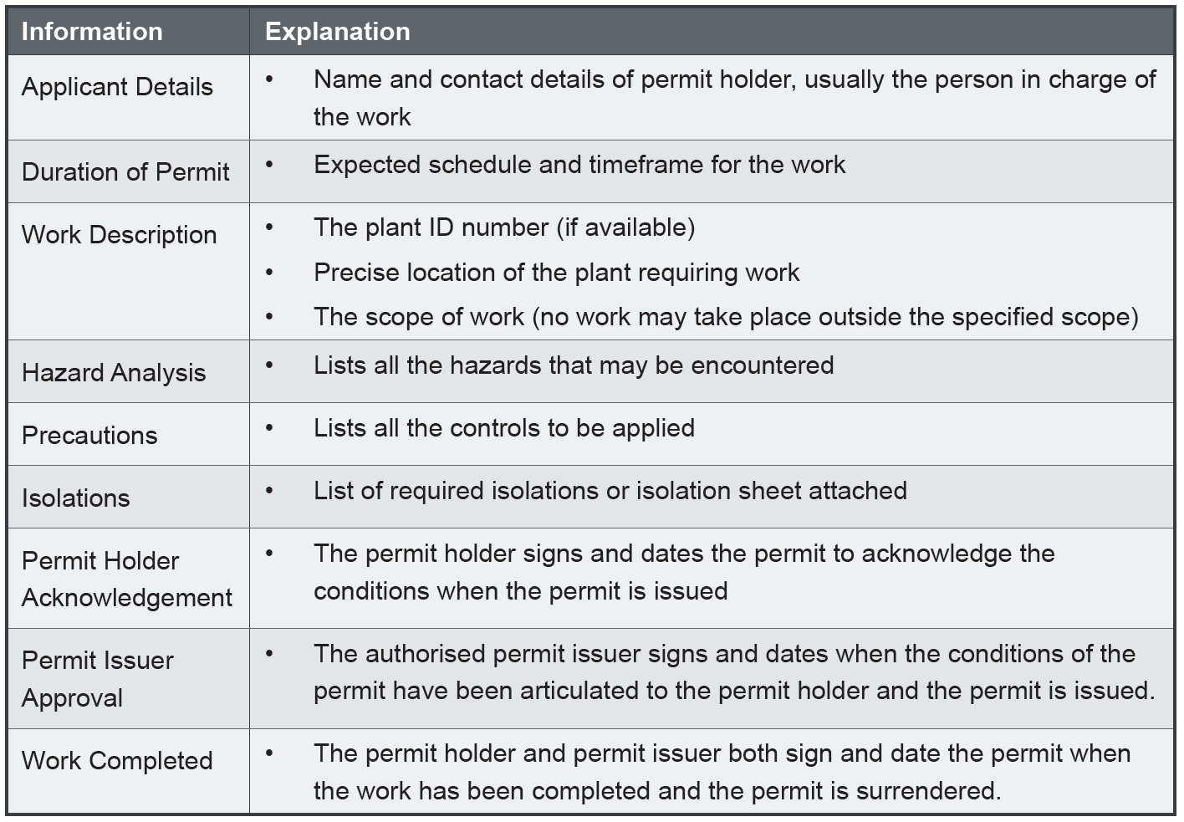
ATW Information
Notes:
Discuss the information that is required on the ATW.
Suggested Activity:
Allow the learners to practice completing an ATW for a real task or site based scenario.

Slide 27
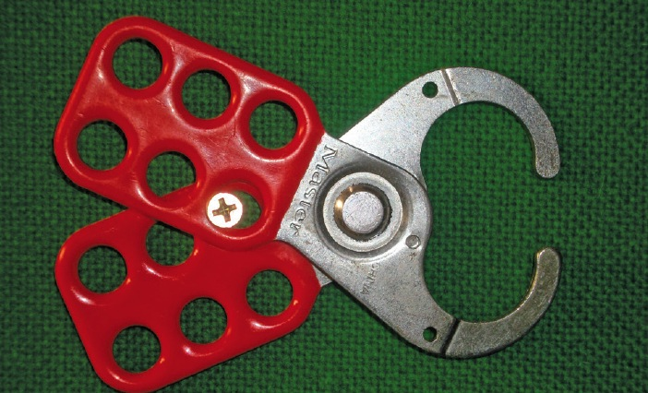
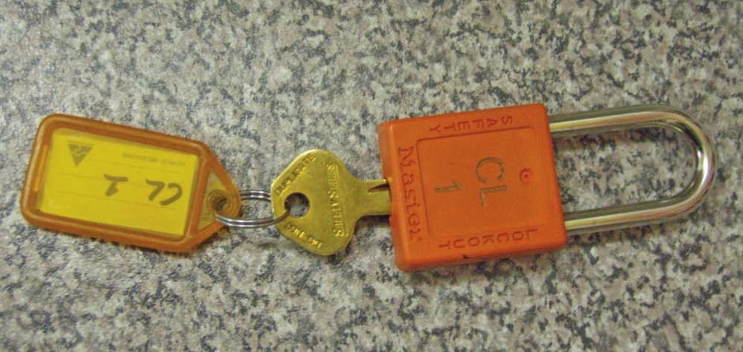
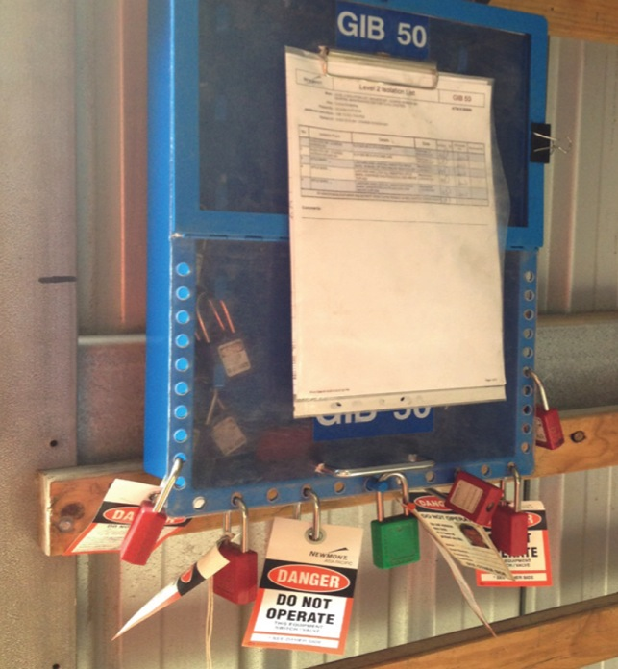
Isolation Equipment
Notes:
Discuss the various types of isolation equipment and the functions of each type.
Explain who is authorised to use the various equipment and where it is access from/returned to.
Explain that the Safety Lock key is usually held in a lock box or isolation key rack in the plant control room for the duration of the isolation.

Slide 28
Personal Lock
Property of the person working on the job, or supplied by site
Used with a Personal Danger Tag to identify who is working on the plant
Before applying personal lock:
    Read ATW and any associated clearance certificates
    Make sure you understand the task and agree to the conditions
    Sign on to the ATW and JSA
Remove lock at end of work or on ATW suspension
Notes:
Discuss the purpose and use of a Personal Lock.

Slide 29
General Rules for Locks and Tags
Tags provide warning and information
Do not start or operate equipment with a lock and tag
Fasten tags securely
Ensure that interlocking equipment is also isolated
Notify supervisor if you cannot find the isolation point
Dispose of tags according to site procedures
Tags alone do not isolate plant
Tag types may include Danger Tag, Test Tag, Control Point Tag, Out of Service Tag, Information Tag
Notes:
Discuss the general rules for locks and tags.
Emphasise that the appropriate tag must be used.
Discuss the use of different tag types, showing the appropriate tags from your site.

Slide 30
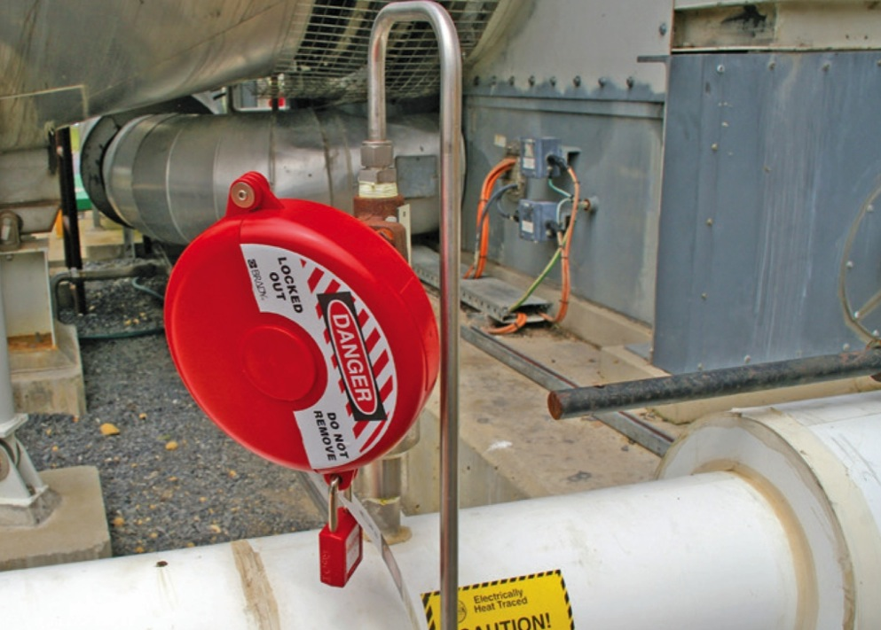
Lock Out Devices
Pins
Slings
Wheel chocks
Energy Isolation Switches
Spades
Blanks
Isolation valves
Manually check the efficiency of lock out
devices
Notes:
Discuss the various lock out devices at the work site.
Discuss the precautions that must be taken when using lock out devices.

Slide 31
Barriers and Barricades
    Machine guards
    Fences
    Witches hats and bollards
    Danger, caution and warning tape
Notes:
Discuss the use of barricades and other devices.
Emphasise that barriers must not be moved or tampered with.
Explain that warning or information tags must be attached to barricades.

Slide 32
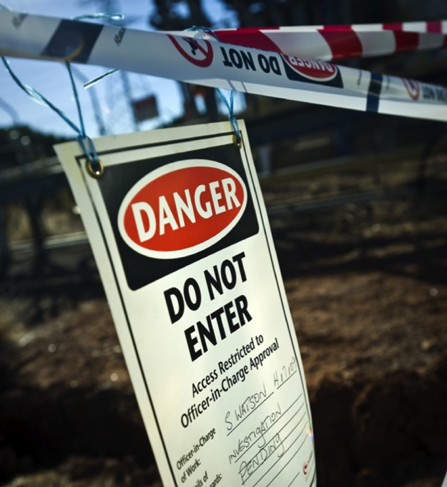
Signs
Warning signs indicate hazards
Danger signs indicate the risk of severe injury
Signs must be fastened securely and clearly visible
Notes:
Discuss the use of warning and danger signs.
Suggested Activity:
Have a variety of isolation devices available. Demonstrate how to inspect devices for damage and faults and what to do if you come across unservicable equipment (complete defect report, tag out, report to supervisor or maintenance).
Allow the learners to become familiar with various isolation devices by inspecting them for damage and faults.

Slide 33
Performing Plant Isolations
The authorised isolator is responsible for:
    Obtaining permission to isolate the plant
    Performing isolations
    Conducting a risk assessment
    Securing the isolation points
    Ensuring all energy sources have been removed or isolated
    Ensuring that personnel involved in the task:
      Understand work conditions
      Read and sign the required documents
      Attach their personal locks
    Informing the supervisor when the plant is safe to return to service
Notes:
Explain the situations where isolations are required.
Discuss the role of the authorised isolator.
Outline the precautions that must be observed before starting to perform isolations.

Slide 34
Isolation Procedure
Stop, turn the plant off and remove energy sources
Isolate and purge the plant
Test the plant for proof of isolation
Lock and tag the plant in the isolated position
Notes:
Outline the general steps in performing an isolation.

Slide 35
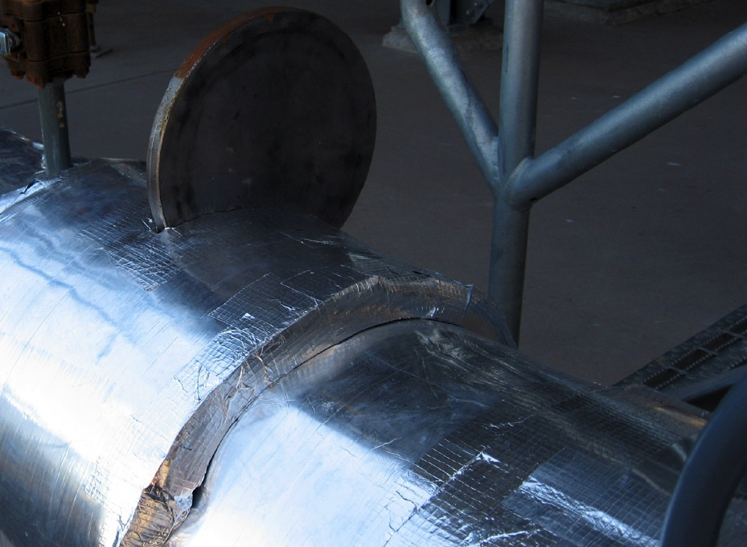
Positive Isolation
Segregates hazard source from plant / equipment to prevent energy flow
Most effective type of isolation
Notes:
Explain the term positive isolation.
Emphasise that positive isolation is the most effective type of isolation.
Give some examples of positive isolation.

Slide 36
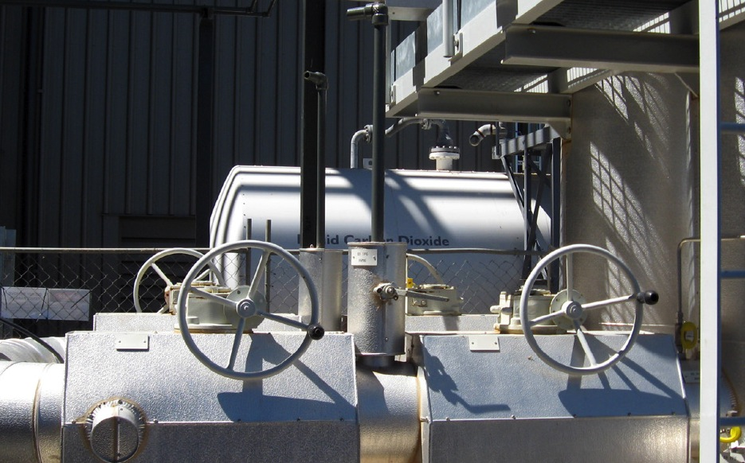
Proved Isolation
Does not involve disconnection or a positive break
Interrupts the energy flow to a specific section or component
Notes:
Discuss the difference between positive isolation and proved isolation.
Give some examples of a proved isolation.

Slide 37
Isolation Methods
Select the correct method for the energy source:
    Electrical
    Mechanical
    Liquids, gases and vapours
    Pressurised vessels
    Kinetic energy
    Potential energy
    Confined spaces
    Thermal energy
Notes:
Discuss the types of energy sources and the relevant isolation requirements.

Slide 38
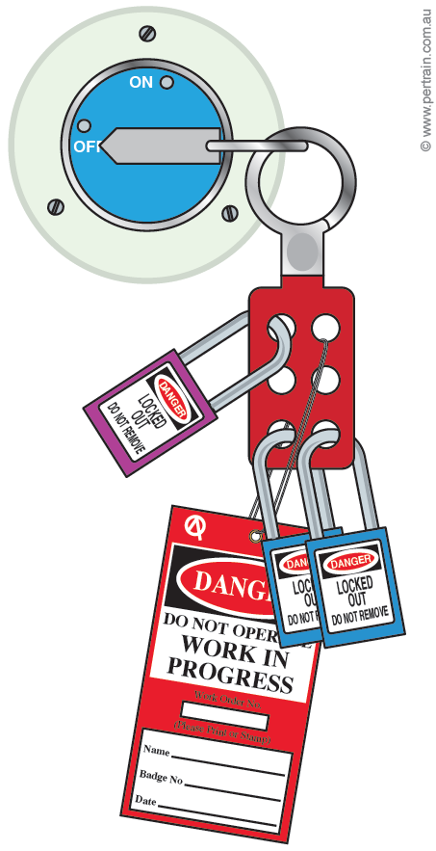
Electrical Isolations
Regard all electrical conductors as live until proved de-energised
Use the appropriate method to isolate electrical energy:
    Open an electrical isolator
    Disconnect a conductor
    Remove a fuse
Preferred method is a physical break by removing a component
Notes:
Discuss the method for conducting electrical isolations.
Outline the precautions that should be observed when performing electrical isolations.

Slide 39
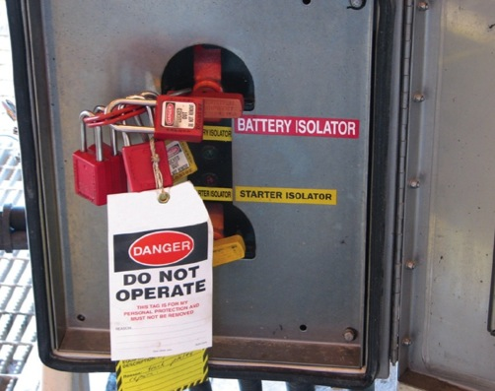
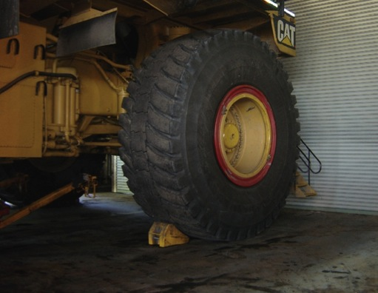
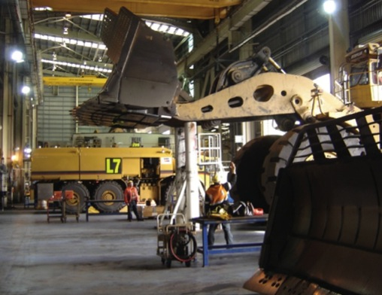
Mechanical Isolations
Notes:
Discuss the methods for applying mechanical isolations.
Outline the precautions that must be observed when applying mechanical isolations.

Slide 40
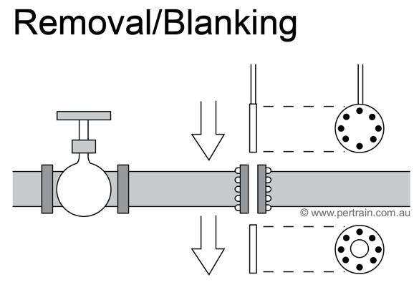
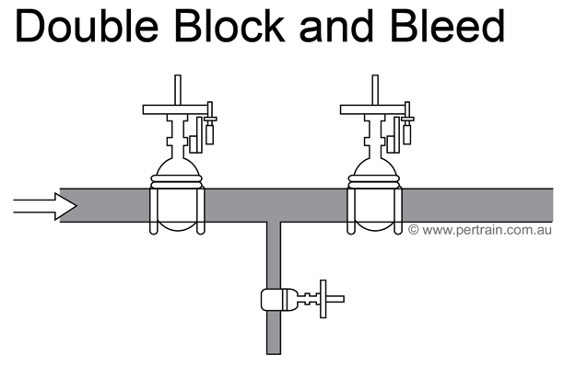
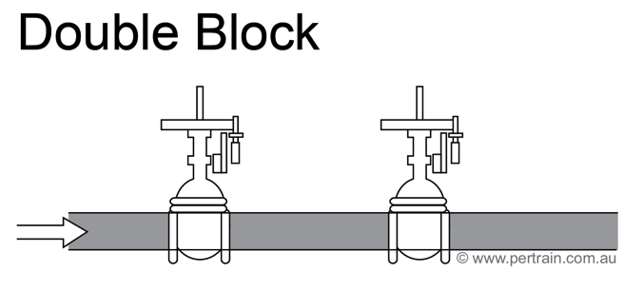
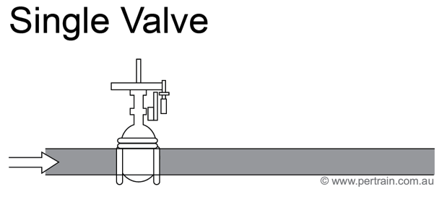
Liquids, Gases and Vapours
Notes:
Explain the methods for isolating liquids, gases and vapours.

Slide 41
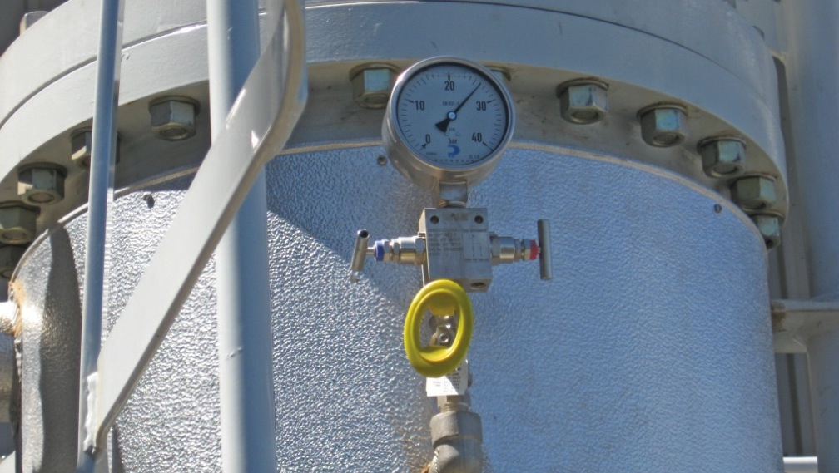
Pressurised Vessels
Avoid pressure increase due to ambient temperature changes
Prevent build-up of excessive pressure
Vacuum can form preventing release of pressure
Notes:
Discuss the precautions to be taken when isolations involve pressurised vessels.

Slide 42
Other Energy
Kinetic
    Restrict devices that are free to move with an appropriate method
    These methods should be made part of the isolation when they are to remain in place throughout the work
    Temporary methods should be considered part of maintenance activity
    Consider crush and pinch hazards
Potential
    Devices capable of stored energy state should be isolated in a zero or minimum energy state
    Objects that may fall or cannot be brought to a low energy state should be restrained appropriately
Notes:
Discuss the methods to isolate kinetic energy.
Discuss isolating devices that have potential energy.

Slide 43
Thermal Energy
Ensure thermal energy is reduced to safe limits as defined by site procedure
Conduct risk assessment if thermal energy cannot be reduced sufficiently
Take precautions, including PPE, in all thermal energy situations
Notes:
Discuss the methods to isolate thermal energy.

Slide 44
Other Isolations
High voltage plant
Chemical systems
Operator standby
Biological
Vibration
Radiation
Moving parts or devices
Remotely operated equipment
Fire/explosion hazards
Sound energy
Hot work
Hydraulics/pneumatics
Notes:
Discuss other hazardous energy sources that may require isolation.
Suggested Activity:
Take the learners onto site and demonstrate using various isolation devices to isolate a range of plant.
Allow the learners to practice using different isolation devices on a range of plant items.
NOTE: All students must be wearing correct PPE and follow site safety procedures at all times.

Slide 45
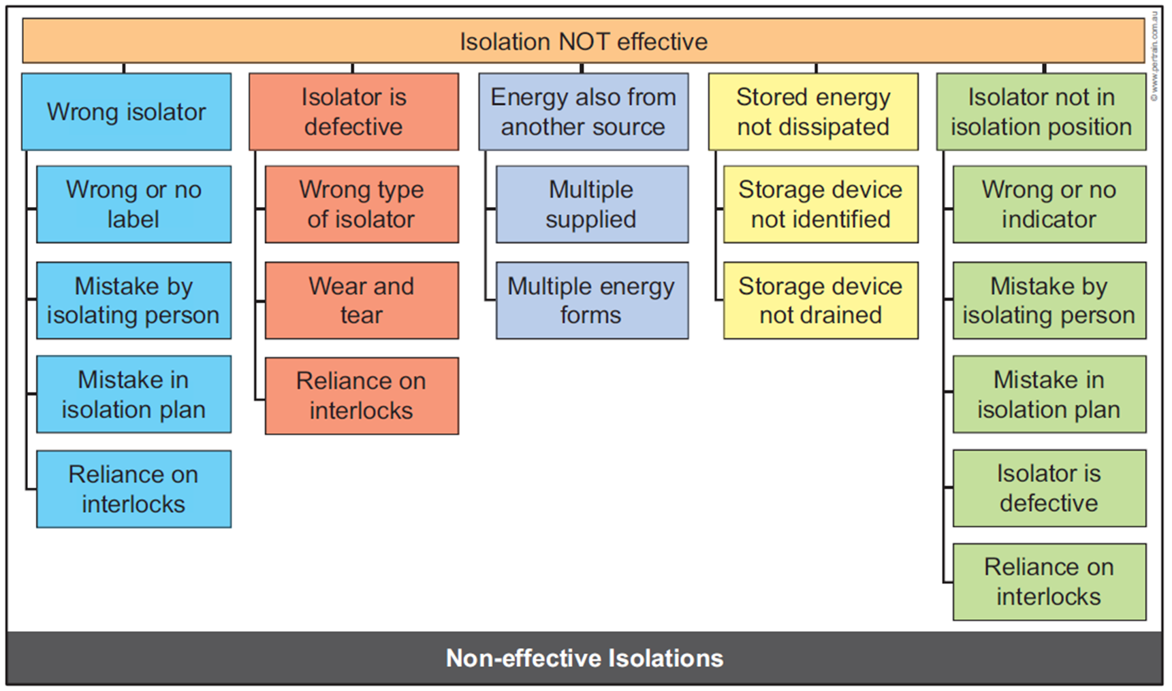
Non-effective Isolations
Notes:
Discuss the possible reasons for non-effective isolation.
Outline the procedures for dealing with non-effective isolations.

Slide 46
Completion of Isolation and Handover
Complete all documentation including isolation sheet
Inform relevant personnel that isolation is complete
Ensure personnel have completed sign-on / sign-off arrangements
Notes:
Outline the steps to hand over the work when the isolation task is complete.

Slide 47

Clear the Work Area
Confirm personnel have vacated the area
Verify tools, equipment and unused locks and tags have been removed
Confirm isolated area is safe
Remove barricades and signs unless required for continued work
Ensure test certificate has been supplied for electrical work
Notes:
Discuss the process for clearing the work area.

Slide 48
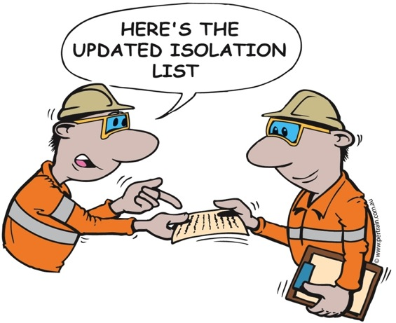
Hand Over Plant
Inform authorised person when isolation complete
Return all documentation and complete ATW form
Discuss isolations/controls with relevant personnel
Ensure all isolations are confirmed
Sign off ATW and associated clearance certificates
Return isolation keys
Store unused locks and tags
Notes:
Discuss the procedures for handing over plant.

Slide 49
De-isolation
Maintenance or repair work will take place once isolations are applied
Person in charge of work will return ATW to the authorised person when work is complete
Surrender of ATW signals plant is ready for de-isolation
Plant can be de-isolated and returned to service provided there are no linked ATWs to other jobs
Notes:
Discuss the steps that indicate when plant may be de-isolated.

Slide 50
Coordination
Coordinate with relevant personnel before starting de-isolation:
    Control centre personnel
    Supervisor
    ATW issuer
    Maintenance personnel
    Other personnel performing work in the area
Notes:
Discuss the importance of coordinating the de-isolation.

Slide 51
Prepare for De-isolation
Work complete
Inspect area for non essential items
Components intact and in place
Hazards controlled
Guards in place
Plant in safe and suitable condition
Work area is clear of personnel
Sign on/sign off procedures completed
Check for links between isolation sheet and other ATWs
All ATWs signed and returned to ATW issuer
Notes:
Discuss how to prepare for de-isolation.

Slide 52
De-isolation Procedure
Refer to site procedures
Obtain appropriate documentation
Access isolation keys
Remove isolation locks and tags
Change isolation plant status
Document all changes
Record each restoration
Ensure plant is safe for operation
Notes:
Discuss the de-isolation procedure.
Discuss the use of a restoration sheet.
Suggested Activity:
Demonstrate and allow the learners to practice completing a de-isolation sheet (if applicable to your site).

Slide 53
Housekeeping and Documentation
Dispose of used tags according to procedures
Return isolation locks, keys and other devices to designated location
Confirm all ATWs are cancelled
Complete all documentation
File ATWs, isolation sheets, restoration sheets
Fill out log books, activity sheets and reports according to procedures
Complete end of shift or handover report
Notes:
Discuss the housekeeping and documentation requirements.

Slide 54
Non-compliance
Stop work immediately
Review JSA to confirm non-compliance
Report non-compliance to supervisor or safety representative
Do not recommence work until the work is compliant and authorisation to restart has been given
Notes:
Discuss the steps to be taken if work does not comply with the scope of work, ATW or JSA.

Slide 55
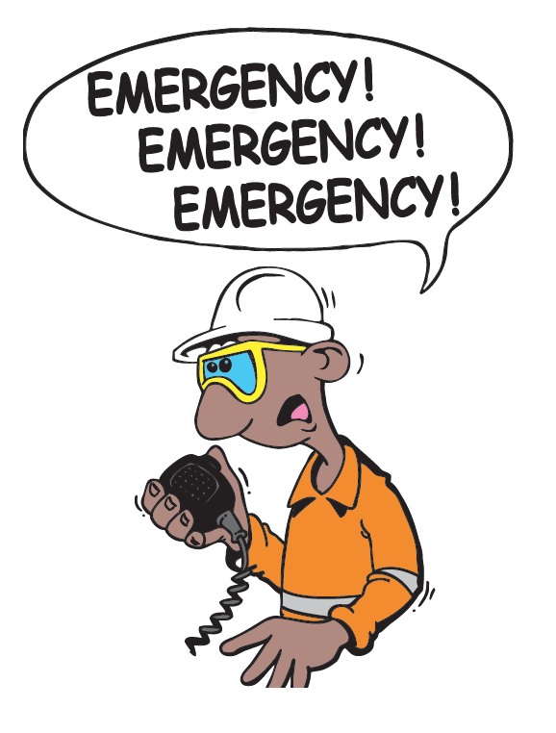
Emergency Response
Notify emergency services response team immediately
Use nearest or most effective communication device
Provide relevant information:
    Name
    Location
    Nature of the emergency
    Number of persons injured
    Type of injuries
    Assistance required (e.g. Ambulance, fire)
    Hazards
Follow the instructions given to you by emergency personnel
Notes:
Discuss the emergency response procedure at the work site.

Slide 56
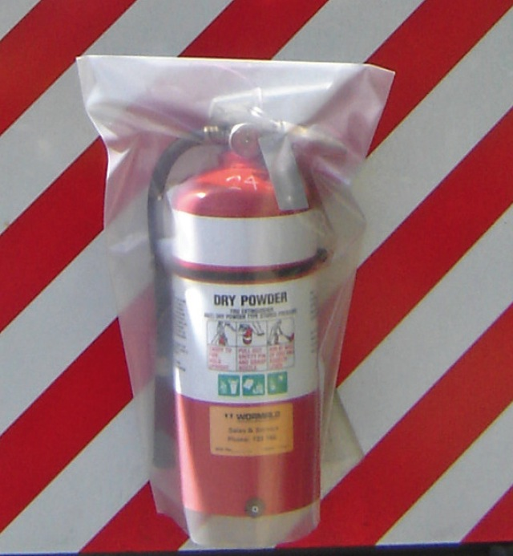
Fires
Stop operations
Stop mobile equipment in a safe location
Shut down plant or equipment and isolate
Activate fire suppression if necessary
Initiate emergency response
Use fire extinguisher to control the fire if safe
Move away to a safe location
Notes:
Outline the procedure in the event of a fire.

Slide 57
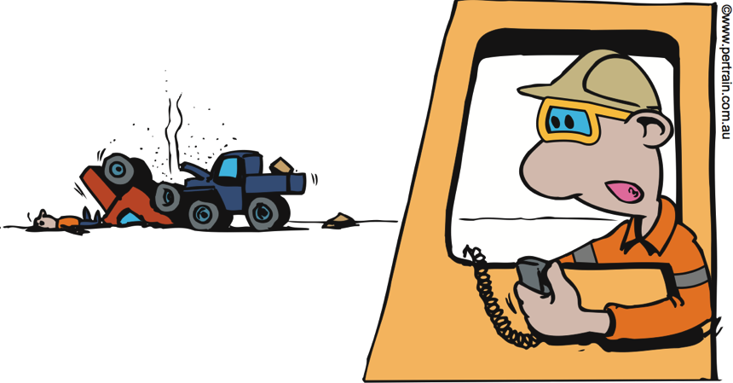
Incidents Involving Vehicles
Report accidents immediately
Do not disturb the scene except to save life or prevent further injury
Place cones or lights around the accident
Contact relevant rescue authority to call for assistance
If necessary escort emergency vehicles to the scene
Notes:
Discuss the steps in dealing with an accident or incident involving vehicles.

Slide 58
Summary
Do you have any questions?
Notes:
Provide a summary of the training material.
Ask if there are any questions.
Explain the assessment process.

