Slide 1
Vehicle and Mobile Equipment Park-up
Awareness Package
Notes:
Welcome.
Introduce yourself.
Outline your experience.
Explain where the facilities are and any applicable OHS issues.
Any questions?

Slide 2
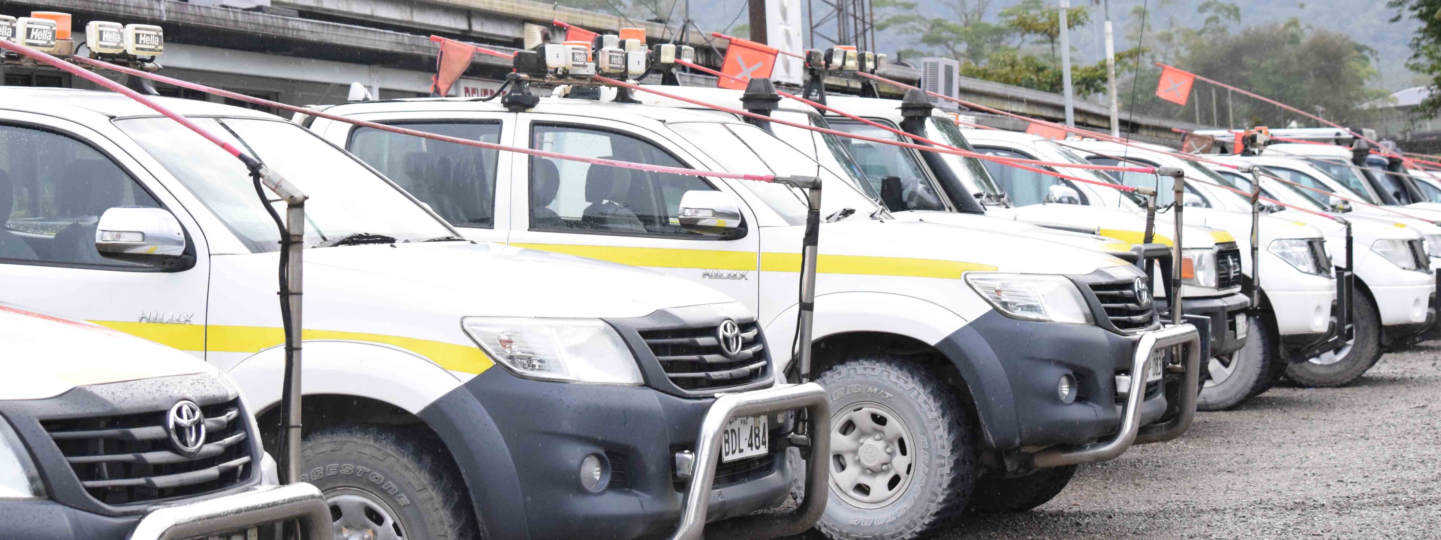
Protecting People and Equipment
Incorrect park-up is a major cause of vehicle incidents.
Park-up is the act of bringing a vehicle or mobile equipment item to a stop, shutting down all systems as per the manufacturer’s recommendations and ensuring that the vehicle is FUNDAMENTALLY STABLE and will not move unexpectedly.
Notes:
Explain that this training will familiarise the group with the required information to park up safely on OTML sites.

Slide 3
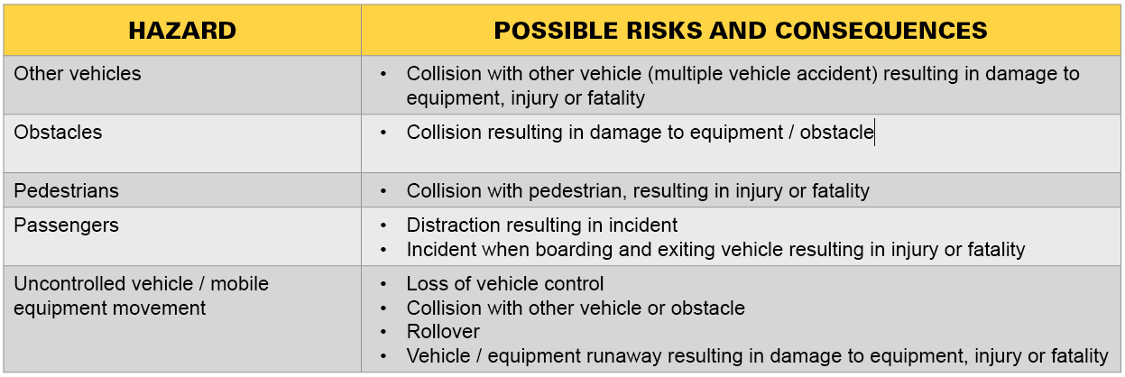
Park-up Hazards and Risks
Notes:
Explain that incidents that involve collisions and uncontrolled movement of vehicles and mobile equipment injure personnel and cause damage to equipment and structures.

Slide 4
General Principles for Park-up
Follow manufacturer’s recommendations
Park light vehicles and heavy equipment separately
Park in a V-drain, over a hump or turn front wheels into the kerb, rill or embankment or chock the wheels
Park on level ground
Park away from traffic flow and be visible to other road users
Park so you can drive forward when leaving the parking space
Lower implements to the ground
NOTE: Never leave a running vehicle unattended
Notes:
Explain that drivers and equipment operators read and understand the equipment manufacturer’s manual in relation to stopping and parking equipment and also follow OTML procedures.

Slide 5
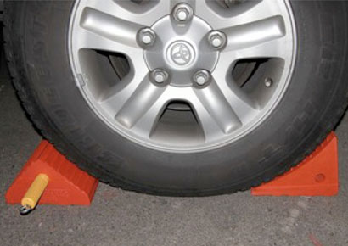
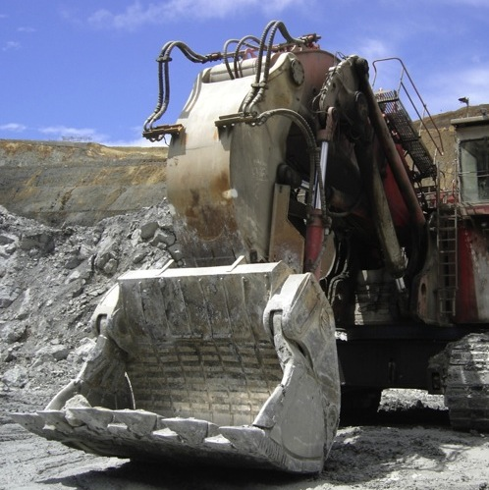
Fundamentally Stable
Means that the vehicle / mobile equipment will not move when the transmission is neutralised and the park brake is off
Once the vehicle / mobile equipment is fundamentally stable shift the transmission into gear and apply park brake
NOTE: All parked-up vehicles must be fundamentally stable before the operator leaves the vehicle
Notes:
Define the term Fundamentally Stable.
Explain that uncontrolled movement causes injuries such crush injuries, strains and fatalities.
Discuss the actions that an operator can take to make sure that their vehicle is fundamentally stable.

Slide 6
Pedestrian and Passenger Safety
Look out for, and give way to, pedestrians
When stopping to allow passengers to disembark or to unload cargo, consider:
Other traffic in the area
Ground conditions
Other in the area
Park-up and shut down vehicle before passengers disembark
Driver / operator must stay in vehicle when passengers on board
Pedestrians must stand well clear of equipment and maintain visual contact with drivers / operators
Notes:
Explain that vehicle drivers and equipment operators:
Cannot rely on pedestrians and passengers to do the right thing
Have an obligation to protect the health and safety of others as well as themselves
Should display courteous behaviour to pedestrians and passengers.

Slide 7
Signage
Parking bays
Areas delineated as go-lines and dead-lines
General parking areas
Pedestrian movement / crossings
Overhead services (including clearance distances)
NOTE: Obey all signage
Notes:
Explain that drivers/operators must obey the sign’s message.

Slide 8
Warning Signals
Be aware of equipment around you
Listen for audible warnings such as horn or reversing signals
Horn signals:
One blast before starting the engine
Two blasts before moving forward
Three blasts before reversing
Wait 5-10 seconds after signalling to enable personnel to move to a safe location before moving the machine
Notes:
Explain that drivers, mobile equipment operators and pedestrians must remain alert for moving traffic in park-up areas and when exiting vehicles.
Discuss the audible signals that relate to moving off from a park-up.

Slide 9
Dismounting from Parked Equipment
Dismount only where ladders, nonslip steps and hand holds are provided
Do not use controls as hand holds
Make sure that steps and handholds are secure and clean
Face towards the machine when dismounting
Maintain three point contact with steps and handrails
NEVER dismount when a machine is moving
NEVER jump off a vehicle
Keep your body and clothing clear of all pinch points
Check ground before stepping off
Notes:
Explain that injuries can occur when footing is lost as a result of material accumulating on steps, or losing grip due to oil or grease build-up on handrails.
Explain that three point contact with steps and handrails (two feet and one hand or one foot and two hands).
Empahsise the importance of never jumping off a vehicle.

Slide 10
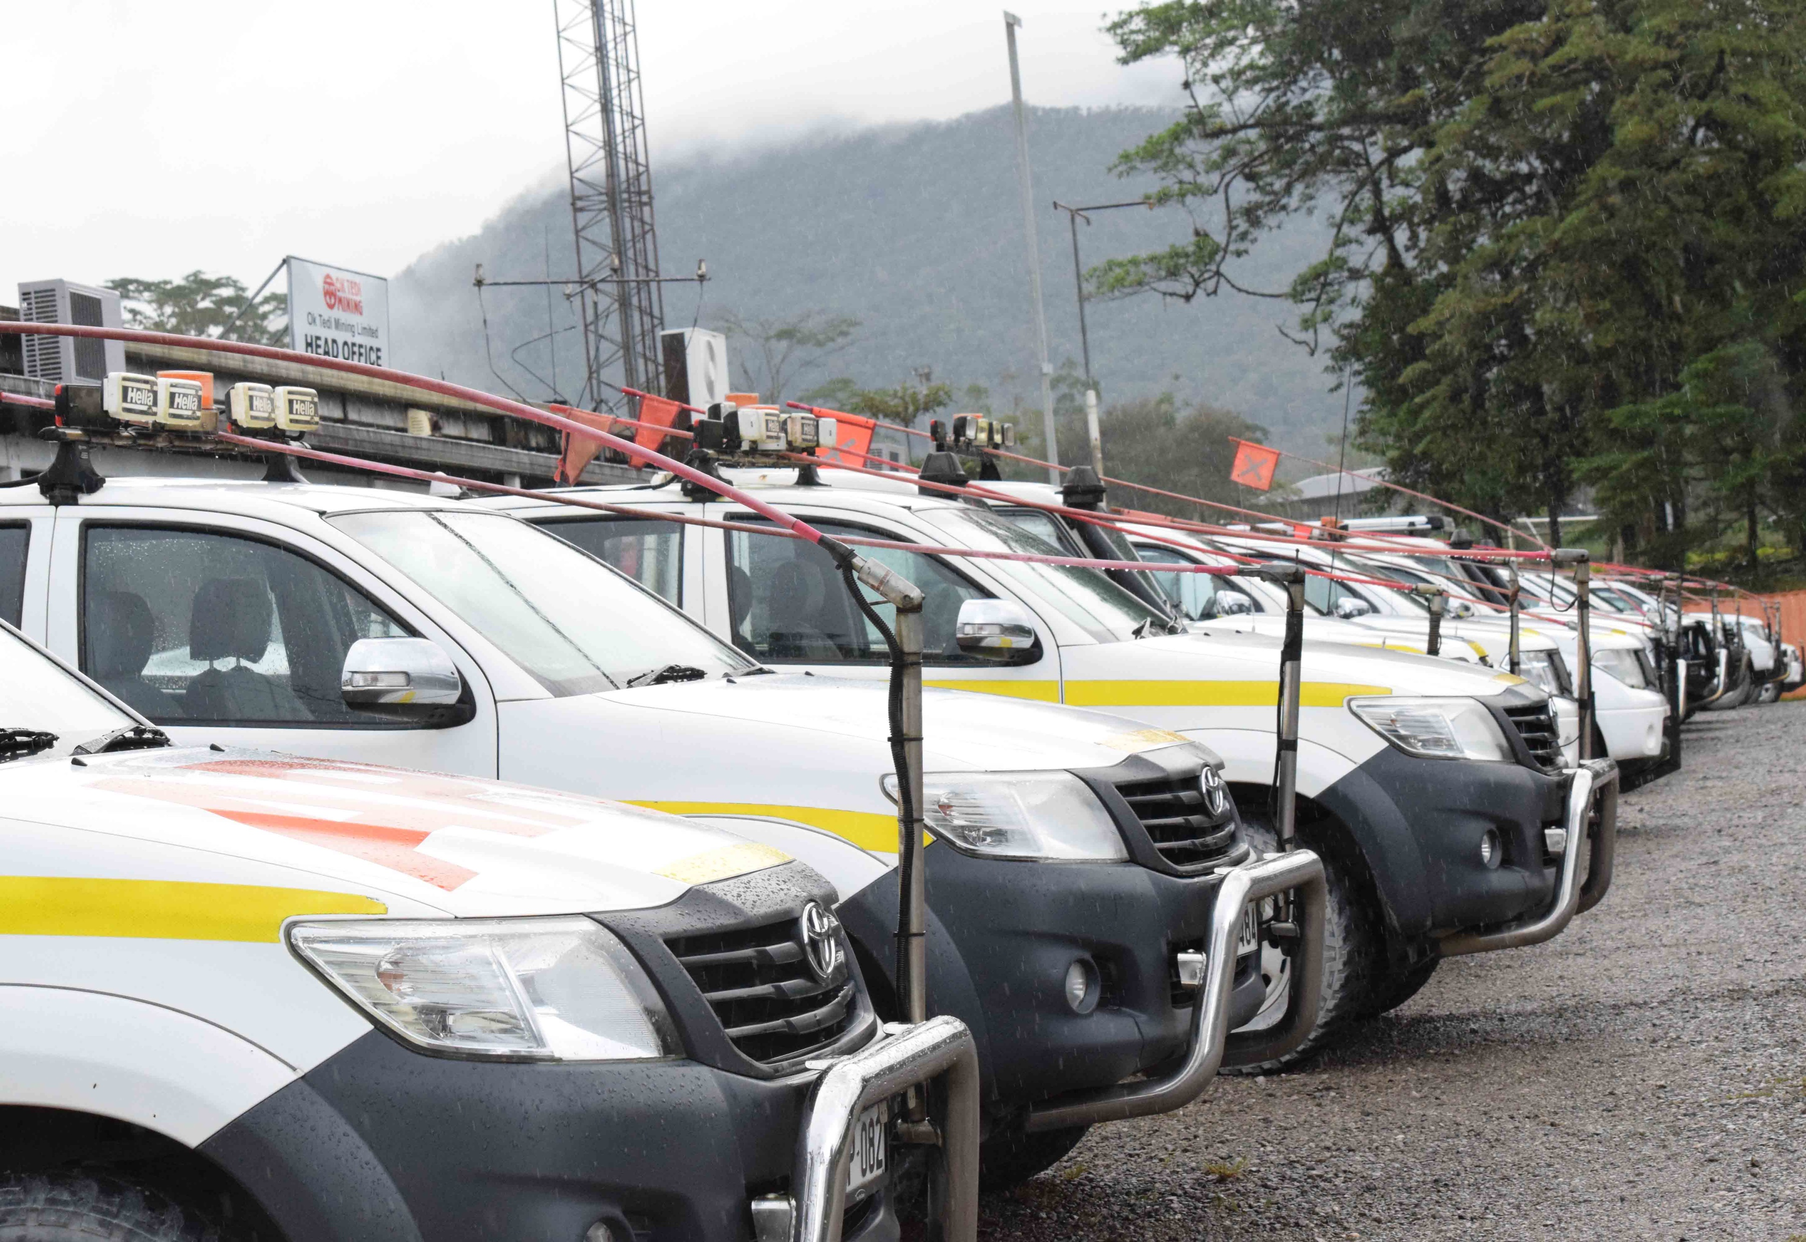
Surface Car Parks
Use designated park-up areas
Reverse park
Go-lines, dead-lines and other dedicated park-up areas ensure operator safety
Notes:
Explain that reverse parking is advised as it reduces the likelihood of collision with pedestrians and other vehicles when the vehicle leaves the parking bay.
Explain that dedicated park-up areas minimise the risk of injury and equipment damage by ensuring adequate separation is allowed.

Slide 11
Underground Park-up
Park 20 metres away from an intersection or significant change of grade
Angle vehicle towards the wall with the downgrade wheels on full lock towards the wall to prevent runaway
Have the bullbar (front of machine) or bumper (rear of machine) within 1 metre of the wall
Apply the hand brake / park brake
Put transmission into correct gear
Turn the engine off
Leave keys in ignition
Keep rotating beacon on
NOTE: Never walk between any vehicle and the mine wall
Notes:
Emphasise the importance of never walking between any vehicle and the mine wall. as the vehicle may move forward unexpectedly and pin you to the wall.
Explain that parking:
directly on the incline or decline or in perimeter drives may impede any emergency response
less than 20 metres from an intersection, or from a significant change of grade to ensure any other vehicle entering the area has sufficient time to stop.
Explain that further information on parking articulated equipment is provided during site training/authorisation.

Slide 12
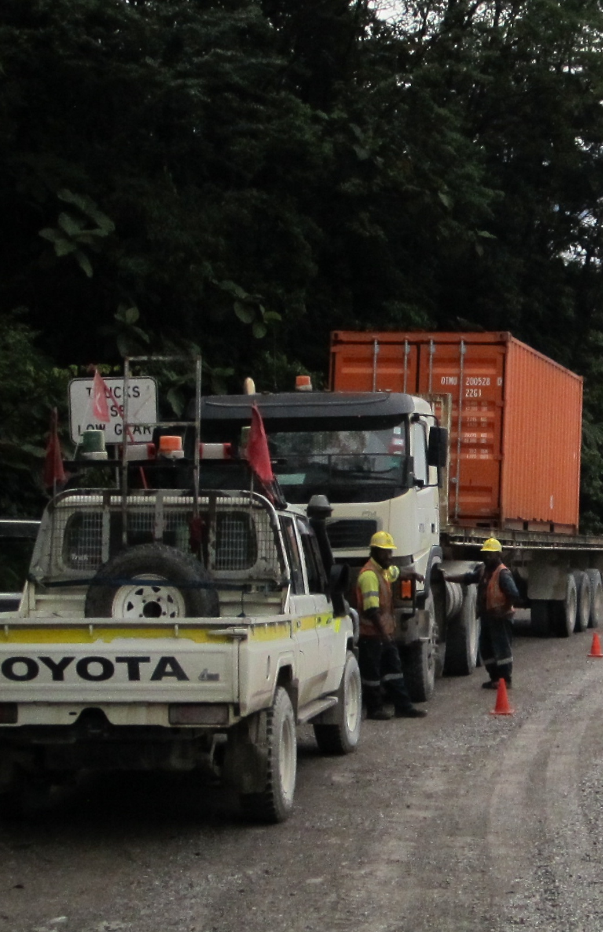
Operational Area Park-up
Do not park within 50 metres of operating machines unless in a designated parking area
Make positive contact with the operator of operating equipment before parking in an operational area
Park on safe and level ground with front wheels turned into a berm
Chock wheels to prevent uncontrolled movement
Lower attachments/implements to the ground
Notes:
Explain importance of:
Maintaining positive contact with equipment operating in the vicinity
Maintaining a 50 metre separation distance
Following equipment manufacturer recommendations for park-up.

Slide 13
Operational Area Park-up (Cont.)
Apply brake
Shift transmission into correct gear
Turn off the engine
Leave rotating beacon on
DO NOT park or stand a vehicle:
Where it will create a hazard for other traffic
Behind other parked or standing vehicles where the vehicle cannot be clearly observed
Under or near high walls
On a haul road unless in an emergency
Near a corner
Opposite another vehicle on a haul road (park on the same side of the road)
Notes:
Explain that when selecting a park-up position, drivers/operators must consider the visibility of the parked vehicle by other road users.

Slide 14
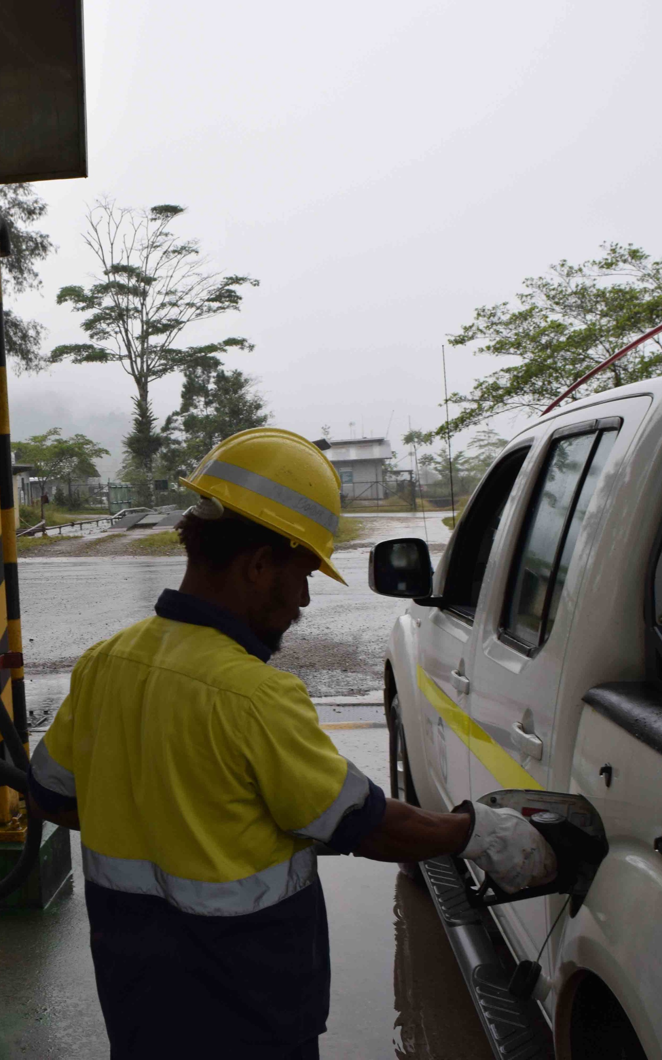
Park-up for Refuelling
Coordinate with other personnel in the area
Only refuel at a designated fuel bay
Approach the refuelling area at low speed
Follow safe driving practices when manoeuvring to the fuel bay
When in position, put transmission into correct gear and apply brake
Shut down the vehicle
Dismount and leave the vehicle cabin, but stay with the vehicle while it is being refuelled
Passengers must not remain in the vehicle while it is being refuelled
Notes:
Explain that the vehicle must be parked and shut down in accordance with manufacturer’s recommendations and site procedure for refuelling.
Emphasise that only authorised personnel can refuel vehicles underground.

Slide 15
Emergency Park-up
Understand, memorise and use the correct emergency procedures
Do not place yourself in unnecessary danger
Do not inflict further injuries when moving an already injured person
Contact your supervisor
Place hazard signs to warn others
Notes:
Discuss the emergency park-up procedure in place at your site.

Slide 16
Equipment Runaways
If you lose control of a vehicle while driving:
Apply the service brakes
Apply the emergency brakes
Change down gears to reduce speed, if possible
Lower attachments to the ground to act as a brake
Ease the vehicle into a wall or safety barricade
Do not engage the transmission in the opposite direction to the vehicle’s movement as the engine could stall resulting in no engine braking or service brakes and loss of steering control through the hydraulic system.
DO NOT attempt to jump from, or leave, a moving vehicle
NEVER attempt to board a runaway vehicle as the risk of being run over is extreme
Notes:
Explain that equipment runaway incidents have a high potential of serious injury or fatality, therefore it is important to follow equipment manufacturer recommendations and applicable site procedures.
Stress the importance of NEVER attempting to board a runaway vehicle or exit a runaway vehicle – slips and trips resulting in vehicle running over personnel.

Slide 17
Summary – Safety is Everyone’s Responsibility
Follow OTML guidelines and procedures
Obey signage instructions
Park vehicles and mobile equipment in designated parking areas
Make sure vehicle is fundamentally stable
Shut down engine before exiting a parked vehicle
Ensure path is clear of obstructions and personnel before moving from a parked position
Use appropriate communication warning signals
Notes:
Summarise presentation and ask group for questions.

