Slide 1
Health for Life
Awareness Package
Notes:
Welcome.

Slide 2

Introduction
What would happen if you got sick and could no longer work?
How would your family cope without you?
Notes:
Discuss these questions with the group.

Slide 3
Major Health Problems
The major health problems currently affecting PNG according to the World Health Organisation:
  Malariaia
  Tuberculosis (TB)
  Diarrheal diseases (spread by poor hygiene)
  Acute respiratory disease
The OTML Health Team has also identified the following as major health hazards that can affect workers at OTML:
  Lifestyle diseases (High blood pressure, coronary artery disease, diabetes, obesity)
  Fatigue
  HIV / AIDS
Notes:
Discuss the identified major health hazards that can affect workers at OTML.

Slide 4
Controlling Major Health Problems
Think about life-long health as a journey…
  First figure out where you are now
    Do a health assessment
  Then decide where you want to be for the rest of your life
    Be healthy, happy, spending time with family and friends
    Living long enough to see your children grow up and become self-reliant
    See your hard work and sacrifice come into fruition / reality
  Gather the resources that can help you get from where you are to where you want to be
    Make lifestyle changes
      Stop smoking
      Reduce or stop alcohol
      Diet control and exercise
Notes:
Think about life-long health as a journey…

Slide 5
The Health for Life Book is part of Ok Tedi’s Employee Health and Wellness Program.
It has been designed to help you:
  Assess your own health
  Access professional help when needed
  Make healthy choices that can lead to better health for life.
STEP 1: Get a map
Notes:
Get a map – the Health for Life Book.
Throughout this training participants will be completing their Health for Life Assessment.

Slide 6
Make sure your vehicle (your body) is tuned up and ready to go:
Do a self assessment and / or
Visit a professional (Doctor, Nurse, Counsellor, etc)
Use the right fuel:
Plenty of healthy food
Lots of water
Limit alcohol (none at work)
Give up smoking
No drugs (including Betel Nut)
Keep your vehicle running smoothly:
Fresh air
Sleep
Physical activity and exercise
Time with friends and family
Relax
STEP 2: Tune up
Notes:
You might need a Tune Up – Do an assessment, see a professional, use the right fuel, keep running smoothly.

Slide 7
Every person is different.
Your journey will not be the same as anyone else.
Although you may go to some of the same places and do some of the same things.
Some of the resources available to help you choose YOUR journey include:
The Health for Life book
The OTML Health and Well being brochures and awareness packages.
Resources are available from the OMTL Intranet.
STEP 3: Choose the best route
Notes:
Your journey if for YOU.

Slide 8
It’s not a race to get somewhere!
Your journey is about making healthy choices and changes today and every day for the rest of your life.
Don’t try to change everything at once.
Start with one healthy change, then make another, and another. Choose things you like:
Find a sport you enjoy
Go for a walk with a friend instead of having an after work drink
You don’t have to go without desert after dinner, but choose fruit and yoghurt rather than cake and
ice-cream.
Experiment – you might discover new healthy foods or a sport or activity that you’ve never tried before.
STEP 4: Enjoy the trip
Notes:
It’s not a race. Make healthy choices every day and enjoy your life.

Slide 9
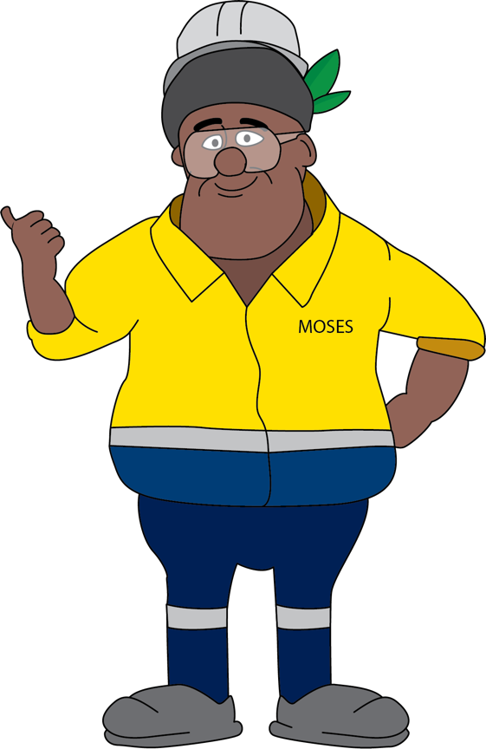
Resources
Let’s look at some of the Health and Well-being resources that are available on the OTML Intranet.
Health for Life Book
Fatigue and Work
TB
Eye Health
HIV / AIDS
Healthy Mouth & Teeth
Malaria
Notes:
Let’s take a closer look at some of the resources that are available on the OTML Intranet.

Slide 10

The Health for Life book has two sections:
Section 1: Health Assessment
  During your health assessment, our health professionals will record your assessment results to give you a snapshot of your current health level, and help you to establish realistic goals to improve your health.
Section 2: Education
  This section contains practical information about health issues and risks, and how they can be managed simply by you.
Return to Main Menu
Notes:
Access, show and discuss the Health for Life Booklet.
ACTIVITY
Hand out a copy to each person.
Have each person write their name on page 2 and complete the responses in the ‘Check 1’ column on page 2.
Note: Where there is a number, have the participants write the corresponding number in the column. Where there is no number, have them tick any that apply.
Ask the participants to complete the Check 1 column on pages 3 – 6 over the next couple of weeks.

Slide 11

The Eye Health brochure has information on:
Typical Injuries, such as chemicals, foreign body in eye, blunt trauma, allergic reaction, eye diseases and computer use disorders.
Tips for healthy eyes:
  keep active
  eat fruit and vegetables
  eat less fat and have more fibre in diet
  drink plenty of water
  quit smoking
  wear sunglasses
  have regular eye checks
  rest your eyes when working on the computer.
Return to Main Menu
Notes:
Access, show and discuss the eye health brochure.
ACTIVITY
Have each person complete the assessment on page 7 in the ‘Check 1’ column.

Slide 12

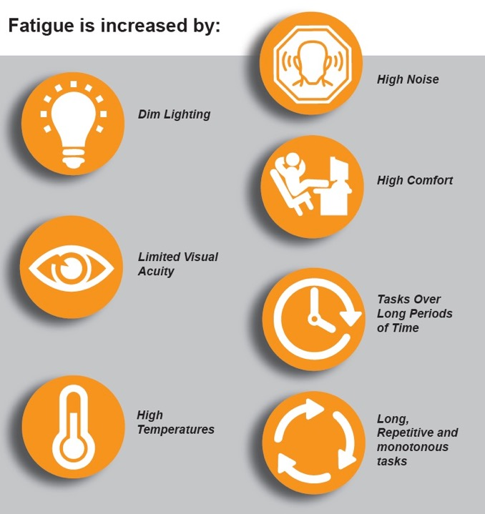
The Fatigue and Work brochure has information on the impacts and signs of fatigue and tips for preventing fatigue.
Return to Main Menu
Notes:
Access, show and discuss the fatigue and work brochure.
ACTIVITY
Have each person complete the assessments on pages 8, 9 and 10 in the ‘Check 1’ column.

Slide 13
Chewing Betel Nut can cause gum disease and mouth ulcers. Bacteria and food can also cause damage to teeth and gums.
The Healthy Mouth and Teeth brochure looks at what causes tooth decay and treatment options.
It is recommended that you brush your teeth at least twice a day for healthy teeth, gums and mouth.
Return to Main Menu
Notes:
Access, show and discuss the mouth health brochure.
ACTIVITY
Have each person complete the assessment on page 11 in the ‘Check 1’ column.

Slide 14
Tuberculosis or TB is an infectious disease that affects any part of the body. It is spread when an infected person coughs or sneezes without covering their mouth.
TB is curable as long as it is diagnosed early and the required medication is taken regularly.
Not everyone who has the TB germ will develop the TB disease.
TB can affect nearly all parts of the body.
See your doctor if you have any of the signs or symptoms of TB as listed in the brochure.
Return to Main Menu
Notes:
Access, show and discuss the TB brochure.
ACTIVITY
Ask if anyone would like to commit to setting a quit date for smoking on page 20 of the Health for Life Book.
Encourage participants to quit together and to support each other to succeed.

Slide 15
HIV stands for Human Immunodeficiency Virus. It is a virus that is most commonly spread through sexual activity and sharing needles or syringes. HIV attacks the body’s immune system, making it weak and unable to fight off opportunistic infections such as pneumonia or cancers. This condition is called AIDS (Acquired Immune Deficiency Syndrome).
HIV and AIDS is NOT curable. But with treatment people can live for a long time with a good quality of life.
The only way to know for sure if you have HIV is to get tested, so see your doctor.
If you have HIV it is important that you do not pass it on to anyone else.
Return to Main Menu
Notes:
Access, show and discuss the HIV / AIDS brochure.

Slide 16
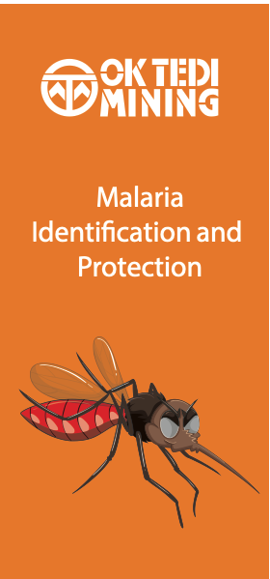
Malaria is caused by the Plasmodium parasite.
It is transmitted from one person to another by the bite of an infected anopheles mosquito.
Malaria is preventable and curable.
Symptoms include fever and flu-like symptoms, headache, back and joint pain, tiredness, nausea, vomiting and diarrhea.
Protect yourself from becoming infected covering up with long sleeves, long pants, socks and shoes, applying insect repellent, sleeping under a mosquito net, keeping doors and windows closed, using the air-conditioner, and destroying mosquito breeding sites (stagnant water, such as puddles, containers, old tyres and wheel ruts).
Next Slide
Notes:
Access, show and discuss the malaria brochure.

Slide 17
Resources
Other resources are being developed and these will be included on the OTML Intranet in the future.
High Blood Pressure
Smoking
High Cholesterol
Obesity
Alcohol
Nutrition
Physical Exercise
Diabetes
Notes:
Let’s take a closer look at some of the resources that are available on the OTML Intranet.

Slide 18
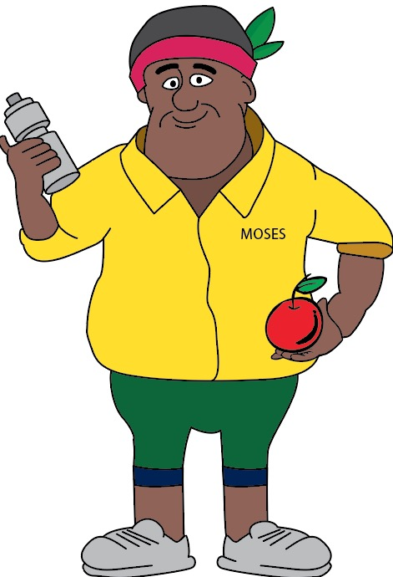
Summary
Complete your Health Assessment in the Health for Life book
Know where to go for help
Life is an opportunity and is lived only once.
Remember, YOUR health is in YOUR hands:
  Eat well
  Move more
  Quit drugs (including alcohol, smoking, betel nut)
  Be happy.
Notes:
There is not enough time in this training session to go through all the information in the Health for Life book and the Health and Well-being brochures available on the OTML Intranet.
Ask participants to take advantage of the resources available and to complete their ‘Check 1’ Health Assessment over the next couple of weeks.
Emphasise that if anyone has concerns about any aspect of their health and well-being that there is help available. Numbers and websites are listed in the Health for Life Book and include:
Counselling and testing for sexually transmitted infections and HIV – Ph. 649 3226 or 649 3059
The Employee Assistance Program – Ph. 649 3011
Quitnow (Smoking) - www.quitnow.info.au
Summarise the main points.
Ask for and answer any questions.
Why not finish off the session with a few stretches and exercises (see page 24 of the Health for Life Book).

