Slide 1
Malaria
April Health Theme

Slide 2
What is MALARIA?
Malaria is an infectious disease caused by a parasite called plasmodium of which there are four types and is spread by Female Anopheles Mosquitoes:
The four types of plasmodium parasites are
Plasmodium Falciparum (PF) – If left untreated, can lead to severe malaria causing shock, brain injury/damage, kidney & liver failure, coma and death
Plasmodium Vivax (PV) – If left untreated, can remain in the liver causing sickness for years or recur at irregular times for months or years. May also cause severe malaria at times
Plasmodium Ovale (PO) - Recurrence similar to PV with milder symptom
Plasmodium Malariae (PM) – If left untreated, can recur after several months/years
Malaria caused by Plasmodium falciparum can be life threatening if not treated properly.

Slide 3
Malaria Statistics in Brief
In 2017
An estimated 219 million cases world-wide an increase by 2 million from 217 million cases in 2016
An estimated 435 000 died globally an increase by 16 000 compared from 451000
In PNG, 478,340 case were reported of which 3000 deaths occurred
In Tabubil, about 802 positive cases of Malaria were reported in 2018.
OTML Employees 133,
OTML Dependents 77,
Contractor employees 381
Contractor dependents 32.

Slide 4
Malaria Incidence – Tabubil Hospital Statistics
Malaria Incidence in OTML Operational Sites
Health Facility | Year | Confirmed Malaria Cases | Lost Work Days
Bige OTML Clinic | 2017 | 150 | 121.2
 | 2018 | 172 | 115
Kiunga OTML Clinic | 2017 | 396 | 150.5
 | 2018 | 373 | 147.5
Tabubil Hospital | 2017 | 736 | N/A
 | 2018 | 802 | N/A

Slide 5
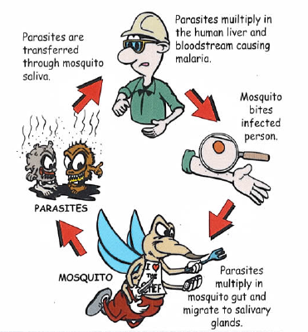
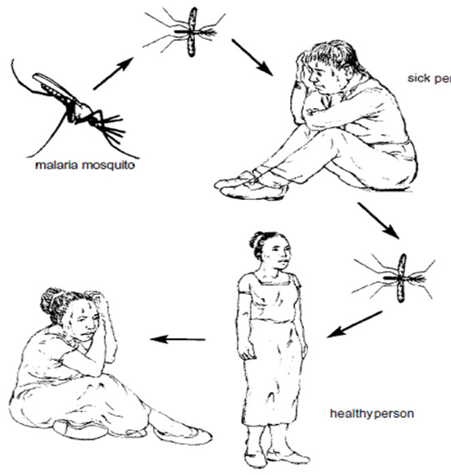
How Malaria Parasites are Transmitted by Mosquitoes
Flies over and Bites a infected person with malaria during a blood meal
Sick person
Malaria Causing Mosquito
Infected mosquito
Healthy Person Bitten by Infected Mosquito
Healthy Person becomes Sick after 7 – 21 days
A female anopheles mosquito bites a person who is sick with malaria during a blood meal and draws/sucks malaria parasites into its system.
The parasites are then injected into the next person (healthy person) during another blood meal.
The parasites grow and start to destroy the body’s red blood cells and the person starts to feel sick after 7 – 30 days after being bitten

Slide 6
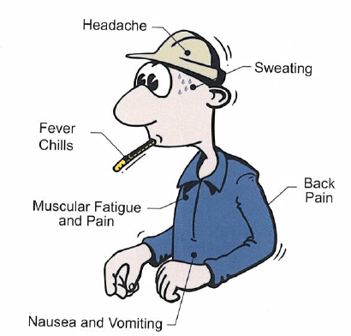
Symptoms and Treatment of Malaria
Clinical symptoms of malaria can range from very mild to severe:
Fever and flu-like illness that may come and go
Headache
Backache
Joint aches and pain
Muscle ache
Tiredness
Nausea and vomiting
And diarrhoea
Because of the loss of red blood cells, anaemia and jaundice(yellow colouring of skin and eyes) can occur.
Note: Not all the above symptoms need to be present. Malaria should be suspected if you have any of these symptoms, even if they are mild seek medical help immediately.

Slide 7
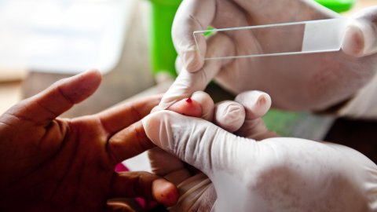
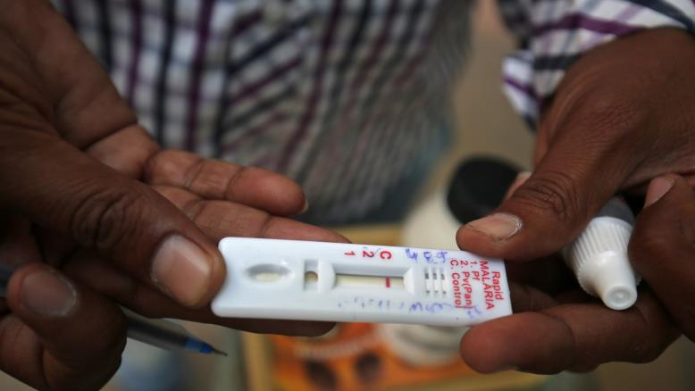
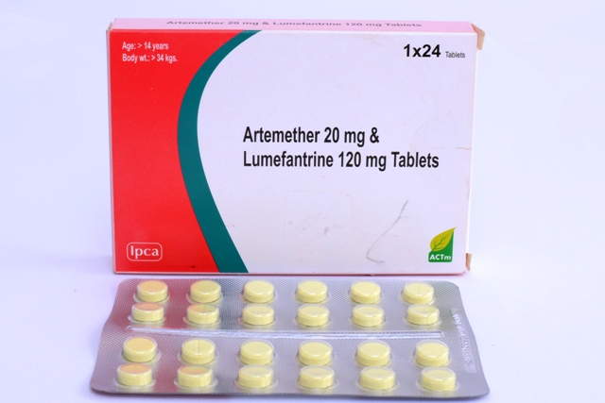
Diagnosis and Treatment of Malaria
Diagnosing Malaria
A Rapid Diagnostic Test (RDT) is done once malaria is suspected. Result is made available in 10 -15 minutes
A Blood Slide is taken at the same time to confirm the diagnosis
Treatment
Always
Take the Doses as prescribed at the Right Time
Complete your medications for the Duration of Time as prescribed
Do Not Stop medications early
You can develop resistance if you continue to miss medications

Slide 8
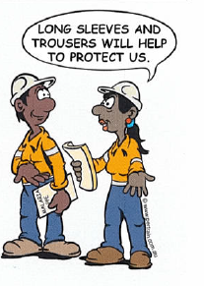
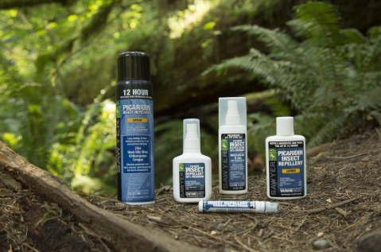
Preventing Malaria – Personal Protection
Clothing
Cover as much of your skin as possible by wearing long pants, a long sleeved shirt, shoes and socks.
Wear light coloured clothes
Wear insect-treated clothing when working on night-shift
Insecticides are available as soaks and sprays and usually lasts through several wash
Insect Repellent
Apply insect repellent that contains at least 20% DEET to exposed skin
Reapply after swimming or excessive sweating
Read directions provided on the labels
Be aware that allergic reactions can occur in some people

Slide 9
Preventing Malaria – Personal Protection
Sleeping Quarters
Ensure window and door screens are undamaged and fit snugly to frame.
Sleep under insecticide treated mosquito nets.
If sleeping outdoors, treat bedding and clothing with insecticide.
Use knock-down aerosol sprays to kill mosquitos inside the building.
Air conditioning also helps to keep the mosquito away.

Slide 10
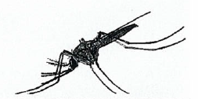
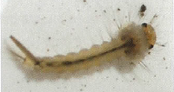
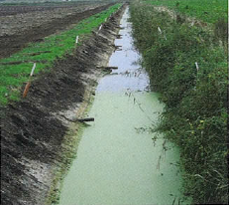
Preventing Malaria – General Protection Programs
Mosquito Identification Program
Vector Mosquito surveillance and monitoring - Provide detailed information about the number and type of mosquito in the area. Also provides information about the occurrence and distribution certain vector species within a control region.
Breeding site monitoring Program
Mosquito breeding activity surveillance - Regular monitoring provide information for preparing control and eradication treatments. Also provides information of a mosquito vector breeding activity.
Drainage Program
Prevent stagnant water build-up. Anopheles mosquito favours ground pools with an abundance of organic matter for breeding.

Slide 11
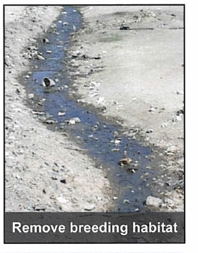
Preventing Malaria
Removing Mosquito Breeding Habitat
Anopheles mosquitos like to breed in:
Salty, brackish and stagnant water
Pig wallows
Blocked drainage
Swamps
Puddles & wheel ruts
Chemical Treatments
Larvicidal Treatments – can either be bacteria or insect hormonal growth regulators applied to stagnant water(ground pools especially) to control mosquito larvae
Adulticide Chemicals – chemicals used in fogging and spraying to control adult mosquitos.
Indoor Residual Spraying – process of spraying inside of dwellings with an insecticide to kill and deter mosquitos. Bed nets are also sprayed with insecticide.

Slide 12
Checklist for Malaria Control

Slide 13
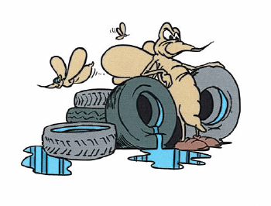
Summary
Malaria is a preventable disease. Take responsibility to protect yourself and others from the disease.
Wear protective clothing and apply insect repellent.
Fill all ground pools and puddles. Don’t let water stagnate in containers such as empty bottles, cans and old tyres.
If you have cold or flu symptoms, seek site medical treatment quickly
Follow site guidelines for the prevention of malaria
Facts to Remember:
Be aware of the risk
Avoid being bitten by mosquitoes.
Take antimalarial drugs(chemoprophylaxis) when visiting malaria endemic areas
Immediately seek medical attention if symptoms develop.

Slide 14
For Further Information
Contact the following:
Tabubil OTML Clinic – Ext: 3222
Employee Health & Wellness – Ext: 3806
Folomian Clinic – Ext: 3464
Bige Clinic – Ext: 5179
Kiunga Clinic – Ext 3711

