Slide 1
Malaria
Awareness Package

Slide 2
Introduction
Malaria is a preventable disease that is common in areas with a tropical climate, like PNG.
Malaria is caused by a parasite that is spread from person to person by a mosquito bite.
Malaria can kill you!

Slide 3
What are the Symptoms of Malaria?
Symptoms usually occur 10 to15 days after being bitten, but can occur sooner or later, even months or years after the infected mosquito bite. Symptoms include:
Fever
Flu like symptoms that come and go
Headache
Backache
Joint aches and pain
Muscle aches
Tiredness
Nausea and vomiting
Diarrhoea
Jaundice (yellow skin and eyes)
Not all the symptoms need to be present. If you have any of the symptoms, see the doctor.

Slide 4
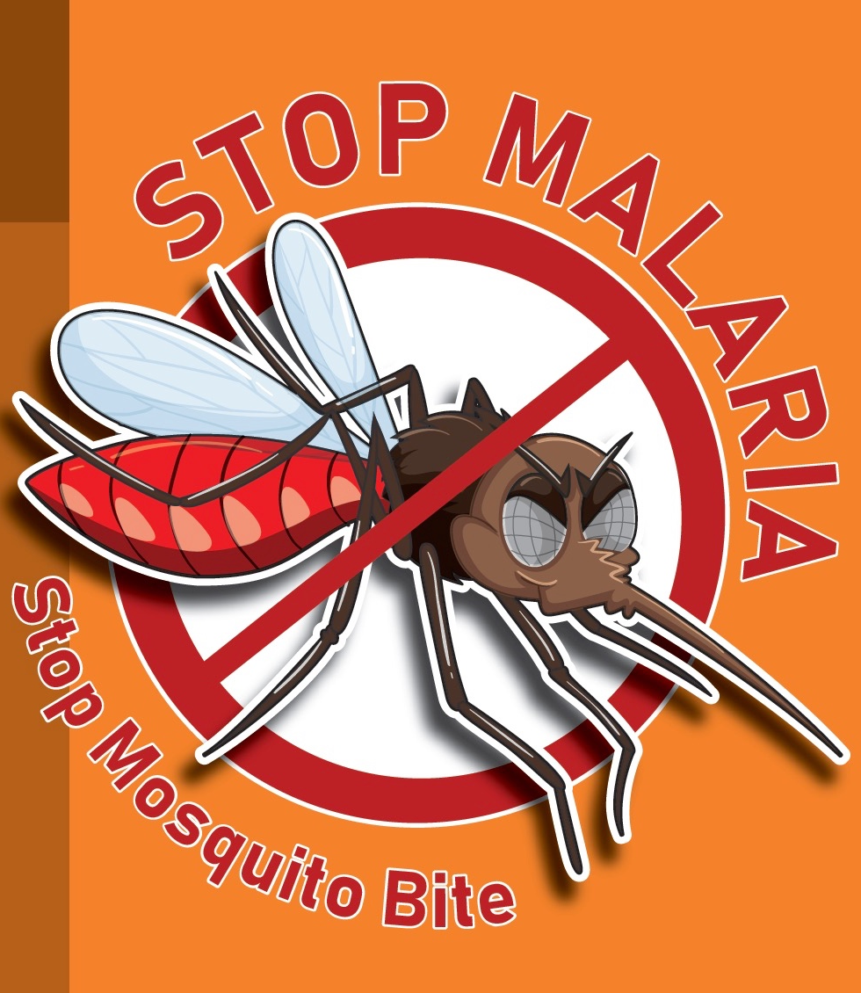
Controls
Stop mosquitoes from biting
Stop mosquitos from breeding
Kill mosquitoes
Take medication to increase immunity
Treat malaria early

Slide 5
Malaria Key Controls
Click below to watch a short video about the key controls
for Malaria.

