Slide 1
Park up / fundamentally stable
Awareness package
Notes:
Welcome to the OK TEDI Fundamentally Stable Awareness training package.
Please amend this presentation to suit your site requirements and your training style.
You may have photos or video links that you may wish to insert to improve your training session.
Welcome course participants. Introduce yourself as the trainer. Outline your experience.
Explain where the facilities are (toilets, coffee room).
Discuss OH&S issues and any ground rules.
Explain the general timing and layout of the course and what will be expected of participants.
Any questions?

Slide 2
OK TEDI’S view
Safe workplace for interaction between:
Light vehicles
Heavy vehicles
Mobile equipment
Pedestrians
Notes:
Discuss the importance of maintaining a safe workplace for all personnel when vehicles and other mobile equipment are around.

Slide 3
Park-up hazards and risks
Park-up hazards and risks include:
Collision with other vehicles
Collision with obstacles
Collision with pedestrians
Uncontrolled movement
Notes:
Discuss the hazards and associated risks with the park-up of vehicles and other mobile equipment.

Slide 4
Pedestrian and passenger safety
Watch for people and objects
Give way to pedestrians
Consider other traffic
Check ground conditions
Other work in the area
Separation requirements
Pedestrians clear of plant
Check blind spots
Keep out of operational areas
Notes:
Discuss the precautions to ensure the safety of pedestrians and passengers.

Slide 5
Designated park-up areas
Designated park-up areas include:
Workshops
Parking bays
Pre-operational inspection areas
Park-up bays incorporate:
V-drains
Humps to prevent uncontrolled movement
Notes:
Discuss the features of designated park-up bays.
Explain the measures to prevent uncontrolled vehicle movement.

Slide 6
General principles for park-up
Follow manufacturer recommendations
Separate light vehicles from heavy equipment
Park in a V-drain, over a hump or turn front wheels
Chock wheels if necessary
Level ground, clear of traffic, and visible to other users
Park so that the vehicle can travel forward when leaving
No passengers to remain alone in vehicle
Lower implements to the ground if applicable
Never leave a running vehicle unattended
Notes:
Discuss the general principles for park-up.

Slide 7
Fundamentally stable
Vehicle/equipment will not move
Transmission in correct gear
Apply park brake
Check vehicle is fundamentally stable
Notes:
Discuss the precautions to ensure that a vehicle/mobile equipment item is fundamentally stable.

Slide 8
Signage
Signage is for your protection and identifies:
Parking bays
General parking areas
Pedestrian movement / crossings
Overhead services
Clearance distances
Notes:
Discuss the purpose of signage when parking up.

Slide 9
Car Parks
Reverse parking only
Park in the parking bay
Passengers alight only when fully parked
Notes:
Discuss the requirements for parking in a car park.

Slide 10
Warning signals
Listen for audible warnings
Horn
Reversing signal
Pedestrians stand clear of equipment and remain visible
Use horn signals to indicate
Start-up
Moving forward
Reversing
Wait 5-10 sec before moving
Notes:
Discuss the audible warnings that indicate the close proximity of vehicles.
Discuss the vehicle horn signals that indicate start-up, moving off and reversing.

Slide 11
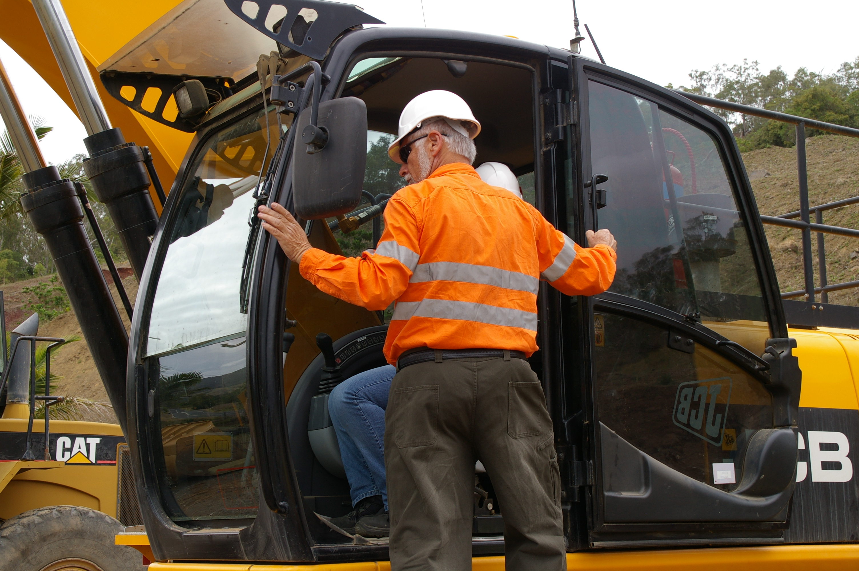
Dismounting from parked equipment
Use ladders, steps, hand holds
Inspect and clean steps
Face the machine
Maintain 3 points of contact
Never dismount moving machine
Never jump off
Do not use controls as hand holds
Keep clear of pinch points
Check for rocks and water
Notes:
Discuss the procedure for mounting and dismounting equipment.

Slide 12
Park-up in operational areas
Keep 50m from equipment
Contact operator
Park on safe, level ground
Turn wheels to berm
Chock wheels
Lower attachments
Apply brake, place in gear
Turn off engine
Leave rotating beacon on
Notes:
Discuss the requirements for stopping or parking in an operational area.

Slide 13
Park-up for refuelling
Coordinate with others
Refuel at designated fuel bay
Approach at low speed
Follow safe driving practices
Transmission in correct gear
Apply park brake, shut down
Dismount correctly
Stay with vehicle
Passengers must exit vehicle
Notes:
Discuss the requirements for refuelling the vehicle.

Slide 14
Emergency park-up
Do not make any situation worse
Do not place yourself in danger
Do not inflict further injuries to casualties
Follow correct emergency procedures
Contact supervisor
Place hazard signs to warn others
Notes:
Discuss the requirements for an emergency park-up.

Slide 15
Equipment runaways
If you lose control while driving:
Apply the service brakes
Apply the emergency brake
Change down gears
Lower any attachments
Ease vehicle to wall or safety barricade
Do not jump from, or attempt to board a moving vehicle
Notes:
Discuss the procedure in the event of an equipment runaway.

Slide 16
Responsibilities
Follow Ok Tedi procedures
Obey instructions / signage
Park in designated areas
Ensure fundamentally stable
Shut down engine
Path clear before moving
Use warning signals
Solve workplace safety issues
Notes:
Discuss the responsibilities of all employees to ensure safe vehicle movement and park-up.

Slide 17
Summary
Any questions?
Notes:
Summarise the main points of this presentation.
Ask for any questions.

