Slide 1
Dropped Objects
Awareness Package
Notes:
Welcome.
Introduce yourself.
Outline your experience.
Explain where the facilities are and any OHS issues if necessary
Timeframe for the course.
Handouts:
- Attendance Sheet - get all trainees to sign
- Reference Book.
Any questions?

Slide 2
Introduction
Dropped objects are one of the biggest workplace killers!
Learning objectives:
Raise awareness of potential dropped objects and industry facts
Recognise and understand:
the top 10 causes of dropped objects
personal responsibilities for the prevention of dropped objects
ways to stop dropped object incidents.
Notes:
Explain that dropped objects are one of the greatest hazards in the workplace and the risks include injury, permanent disability and death.
Discuss some statistics for dropped object related injuries in the work place (share some relevant OTML statistics if available).
The purpose of this training is to raise awareness of potential dropped objects and to recognise and understand:
the top 10 causes of dropped objects
personal responsibilities for the prevention of dropped objects
ways to stop dropped object incidents

Slide 3
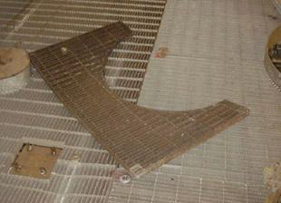
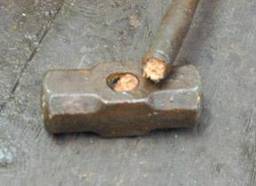
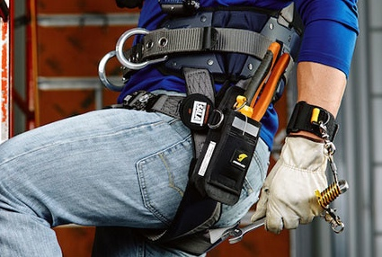
What is a Dropped Object
A dropped object falls from its previous static position under its own weight
The fall can be downwards or sideways
Dropped objects are most commonly associated with work at heights or lifting operations
Notes:
Discuss the definition and examples of dropped objects.

Slide 4
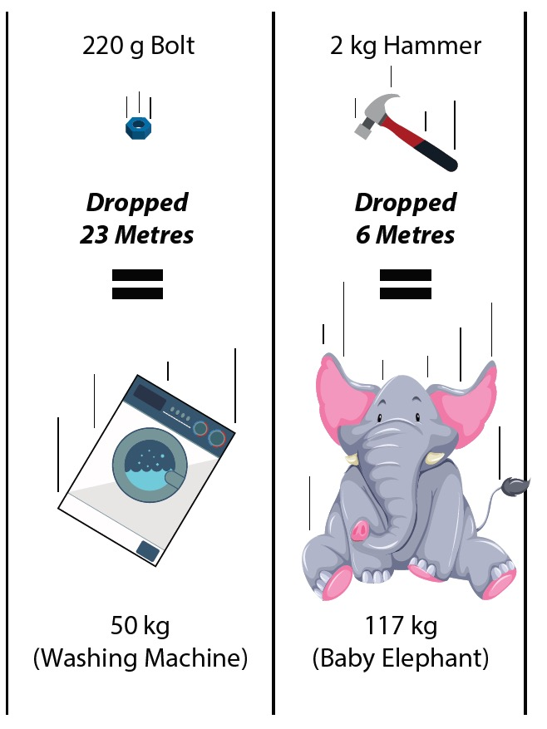
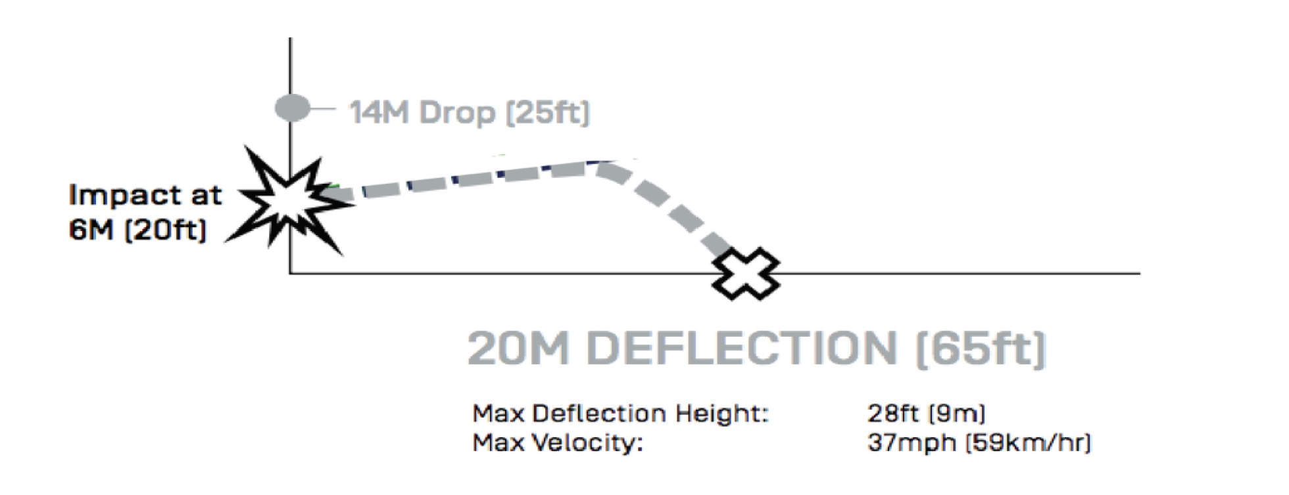
Impact Statistics
The impact is a combination of weight and distance
A 220g bolt dropped 23 meters hits with an impact of 50+ kg
A 2kg hammer dropped 6 metres hits with an impact of 117+ kg
Gravity makes objects fall vertically but objects can be deflected increasing the risk zone
Notes:
Explain that even a small or light object can become deadly when dropped from height.
Explain how the possibility of deflection means that the drop zone will need to extend further out than just under the work zone.
There are a number of videos on the internet that you could choose to show to support this training, for example:
https://www.youtube.com/watch?v=cvuFQgnOCdU
https://www.youtube.com/watch?v=Y_Fk35AEF60&list=PLgCadPtOBl5zp0DKgBCPM-IrK2ha0GWhl

Slide 5
Top 10 Causes of Dropped Objects
Inadequate risk assessment
Lack of planning
Previous jobs
Inadequate repairs and/or inspections
Failed fixtures and fittings
Damaged tools and equipment
Loose objects
Environmental conditions
Collisions and snagging
Human Error
Notes:
Using the reference book as a prompt, lead a discussion about the top 10 identified causes of dropped objects in the work place.
Ask the group if they agree with this list, or do they think there are other causes at their workplace.

Slide 6
Other Hazards
Working near mobile equipment
Working on or near structures
Work area
Notes:
Discuss the ideas of the group in relation to causes of dropped objects.
Discuss the impact of working near mobile equipment, work on or near structures and the work place itself.

Slide 7
Work Safely
Make sure you are trained and authorised
Have required authorisations (permits, etc)
Inspect work site
Use PPE
Inspect equipment
If changes occur, stop and reassess
Notes:
Discuss the actions all workers can take to improve safety in relation to dropped objects.

Slide 8
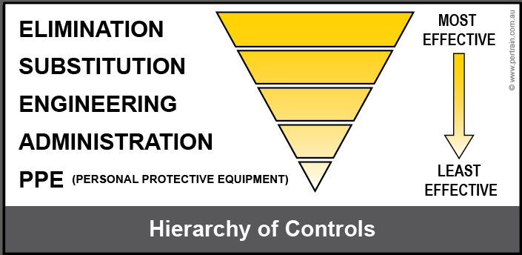
Controls
Key Control Data Sheets
Use and apply the hierarchy of controls
Controls are discussed at shift briefings and listed in:
JSEA/Risk Assessment
Permits
Procedures and work instructions
Notes:
Explain the following points.
That hazards must be identified and controlled to avoid an incident or emergency.
The site hazard analysis tool must be used to identify and control hazards.
Dropped objects is a major hazard so a Key Control Data Sheet has been developed.
Refer to the hierarchy of controls to assist with the implementation of controls.
Controls are listed on JSEA, Permit, Procedures.
Group Discussion : Ask the trainees how they would use the hierarchy of controls for eliminating or reducing the risk of dropped objects:
How would they eliminate the hazards?
What can be used as a substitute?
How can the hazard be engineered out?
What administrative controls are available onsite?
What type of PPE would you need to use?

Slide 9
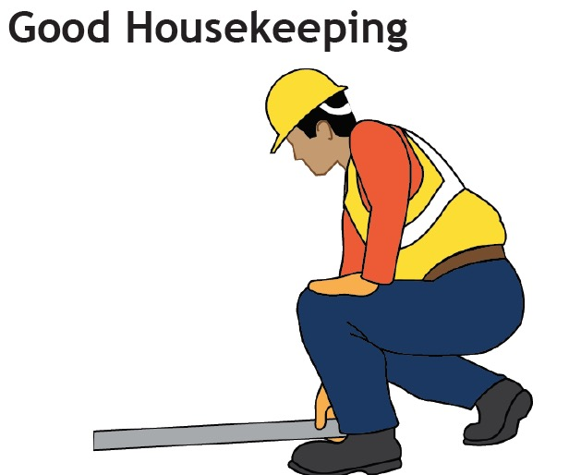
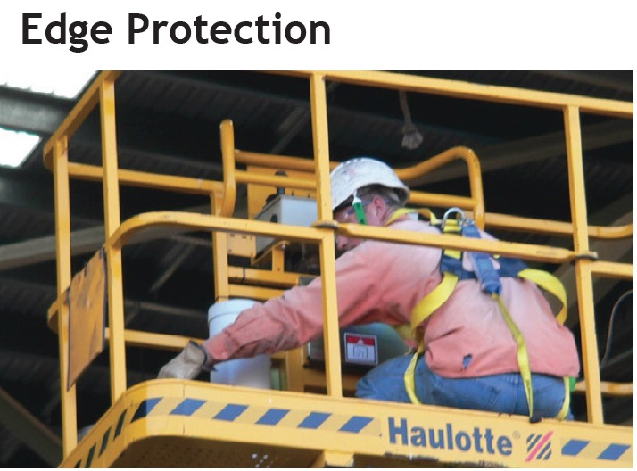
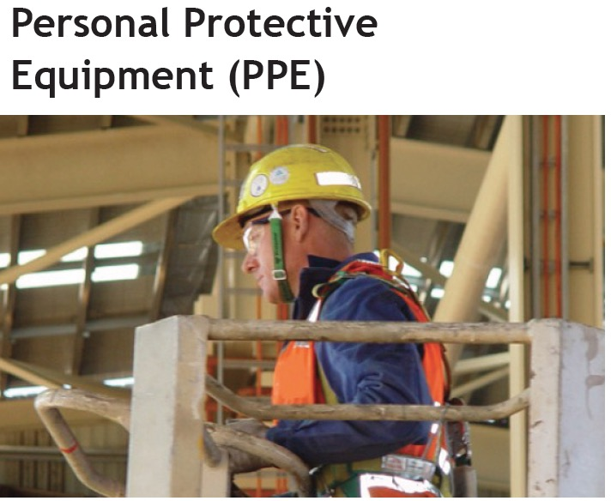
Controls
Notes:
Discuss the controls on the slide (if they weren’t already covered in the discussion with the previous slide).

Slide 10
Challenges
Notes:
Discuss the challenges to eliminating the risk of dropped objects.
Ask the group to identify any other challenges.
Discuss solutions for each challenge.

Slide 11
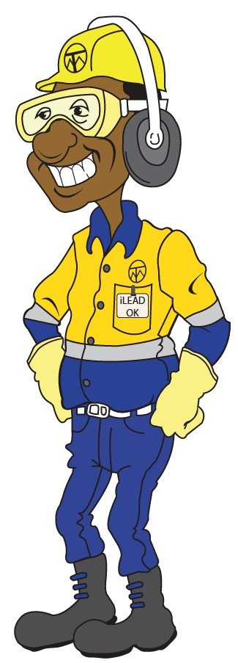
Summary
Remember – Safety is EVERYONE’S responsibility
Protect yourself and others from dropped objects by:
Creating a drop zone and restricting access
Wearing correct PPE
Securing tools and equipment
Having edge protection
Good housekeeping
Following procedures
Being aware of changes to the work area.
Notes:
Summarise the main points from the training session.
Ask the trainees if there are any questions or comments about the training.
Check everyone has signed the attendance sheet (if applicable).

