Slide 1
Driving Demerit Points System
Keeping all road users safe

Slide 2
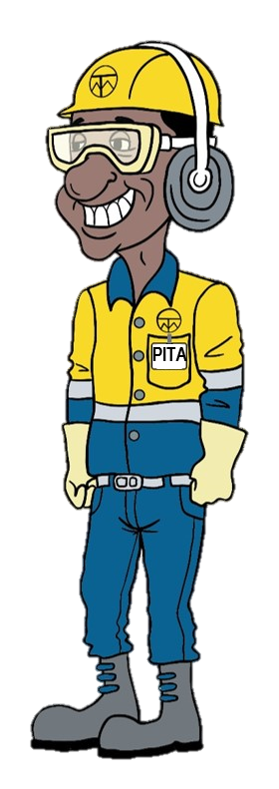
Background
Your previous feedback highlighted that there was a strong punitive nature to the Ok Tedi culture
In order to change that, we recently replaced our Disciplinary Policy with the new Corrective Action Policy to improve our focus on coaching for improvement, rather than punishment
As the next step, we have reviewed our Driver Breach Policy and replaced it with the:
Driving Demerit Point System
Based on the system applied in many countries around the world

Slide 3

Purpose
The Driving Demerit Point System:
Reinforces the need to comply with standards and road rules
Provides a consistent, fair and transparent process by which non-compliances are managed
The rules are pre-determined and not subject to individual supervisors’ decisions
Allows the driver to manage the impact on their Permit by understanding a clear set of pre-determined rules
And most importantly, supports the safety of all road users

Slide 4
How does it work?
A number of Demerit Points have been assigned for each type of non-compliance with the standards or road rules. The table of points is shown later in this presentation.
Should a driver not comply, the number of Demerit Points for that type of non-compliance will be automatically added to their Driver’s Permit.
Should the driver accumulate a total of 12 Demerit Points or more, their Driver’s Permit will be automatically suspended for 3 months.
Demerit Points will expire 12 months after the date on which each incident occurred.

Slide 5
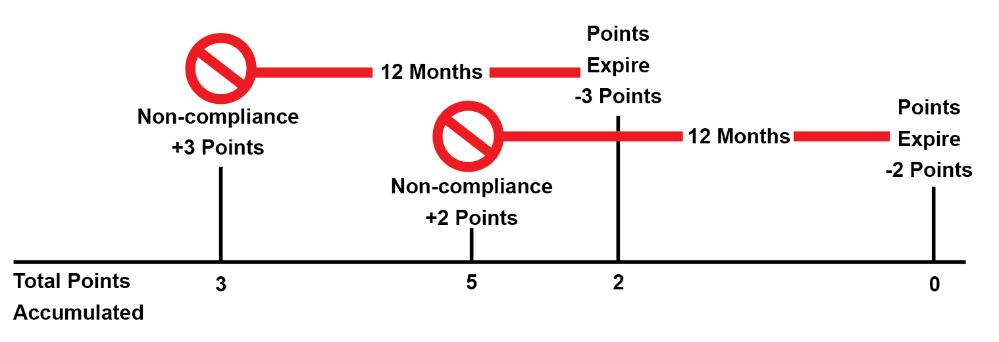
Here’s an example

Slide 6
Some important considerations
Some non-compliances are serious breaches of the Golden Rules and will continue to result in termination of employment. Eg Positive BAC or drug test, driving without a Permit.
Drivers who continuously do not comply with the standards and rules or drivers who commit a serious breach which is not listed in the following table, will be subject to the Corrective Action Policy.
Employees who have their Driver’s Permit suspended and for whom driving is an essential part of their job, may have their employment terminated. However, there is no restriction on them applying for another vacant position which does not require a Driver’s Permit.

Slide 7
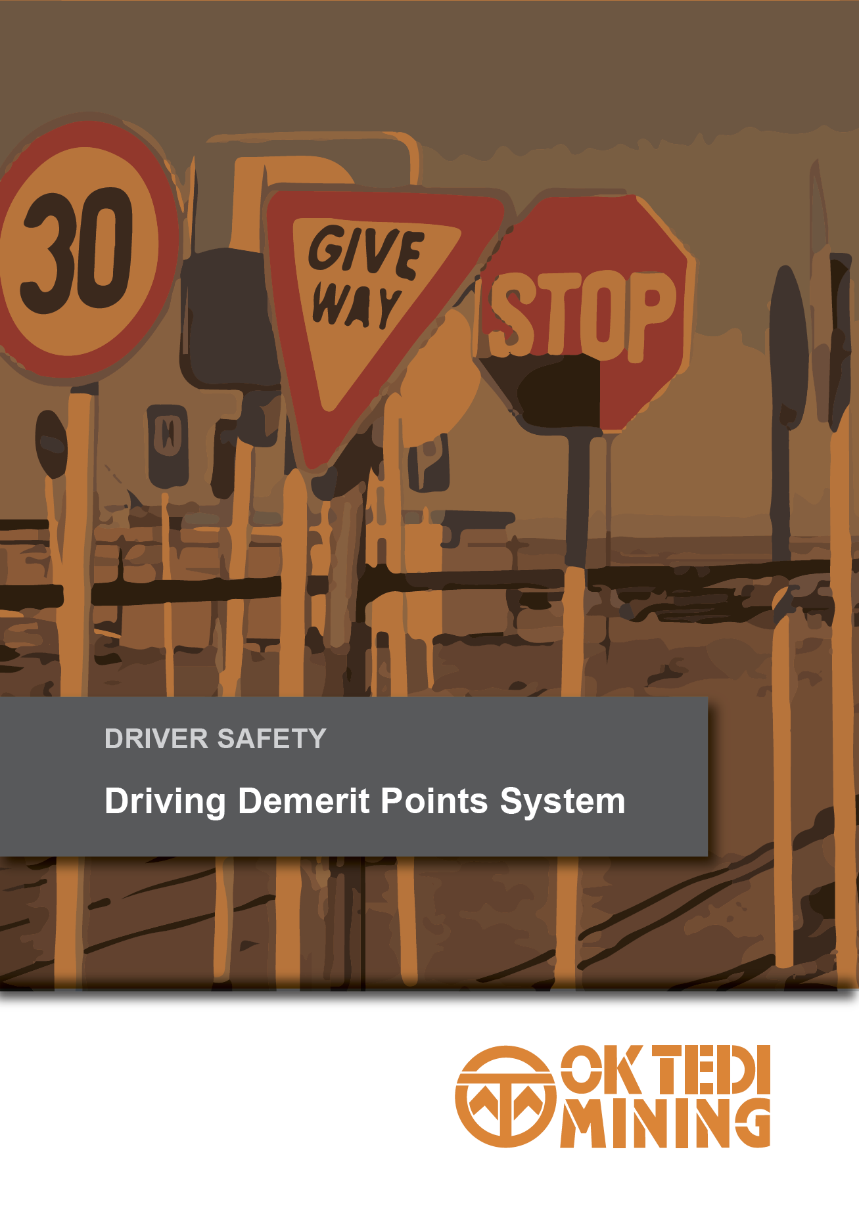
Demerit Points
Nature of Non-Compliance Points
Driving without valid OTML permit for vehicle class | Termination
TrackPro speeding 20kph or more over the speed limit |  | 12
TrackPro Speeding over 10 but under 20kph over speed limit |  | 4
Failure to comply with applicable standards or road rules |  | 3
Use of vehicle for personal business without authority |  | 2

Slide 8
What about Trakpro alerts?
Trakpro speeding alerts are received remotely and identify the vehicle, not the driver.
When a Trakpro speeding alert is received, the details will be sent to the assigned owner of the vehicle.
The vehicle owner is responsible for advising if another person was driving at the time of the alert so the Demerit Points can be re-directed to the correct Driver’s Permit.
The vehicle owner will have 7 days to advise that another person was driving the vehicle. After 7 days, the vehicle owner will require the approval of their next level of management in order to redirect the Demerit Points.
If the vehicle is assigned to a group or company, rather than an individual, and they do not advise who was driving at the time of the speed alert, the Demerit Points will be added to the vehicle and the vehicle will be stood down if 12 points are accumulated.

Slide 9
In summary
The Driving Demerit Point System:
Reinforces the need to comply with standards and road rules
Provides a consistent, fair and transparent process by which non-compliances are managed
The rules are pre-determined and not subject to individual supervisors’ decisions
Allows the driver to manage the impact on their permit by understanding a clear set of pre-determined rules
And most importantly, supports the safety of all road users

Slide 10

Questions

