Slide 1
Vehicle Safety Systems
Awareness Package
Notes:
Welcome.
Introduce yourself.
Outline your experience.
Explain where the facilities are and any OHS issues if necessary
Timeframe for the course.
Handouts:
- Attendance Sheet - get all trainees to sign
- Training Material (Reference book, permits, etc).
Any questions?

Slide 2

Introduction
  Know your vehicle
  Operate within its capability and limitations
  Observe and respond promptly to indicators and warning lights
Notes:
Explain that vehicles accessing and operating on OTML sites must be equipped with appropriate safety features and systems.
Briefly outline the vehicle safety systems in use.

Slide 3
Operator Obligations
  Pre-start inspection
  Report missing and faulty safety equipment
  Tag out and do NOT use vehicle if safety equipment is missing or faulty
  Respond promptly and correctly to safety system alarms
  Ensure planned maintenance of safety equipment is undertaken
Notes:
Discuss the vehicle operators obligations in relation to safety equipment.

Slide 4
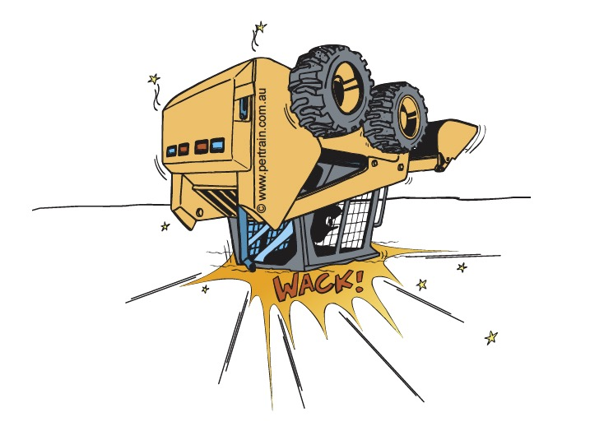

Cabin Safety Systems
  Seatbelts
  ROPS / FOPS
Notes:
Discuss the cabin safety systems that are in place to protect the operator and passengers if applicable.

Slide 5
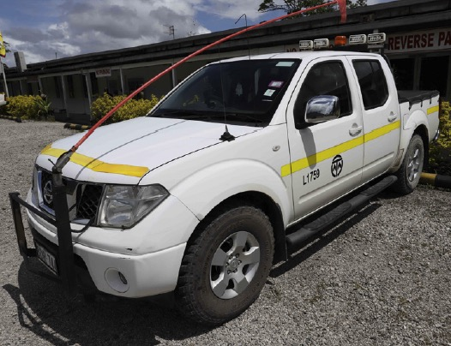
Visibility Safety Systems
  Lights
  Buggy whips
  Horn signals
Notes:
Discuss the visibility safety systems that are in place to ensure vehicles are noticed.

Slide 6
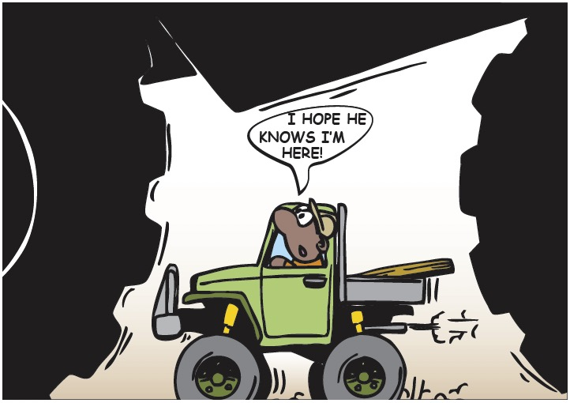
Operational Safety Systems
  Trakpro
  SAFEmine Collision Avoidance System
  ADAS Fatigue Management
Notes:
Discuss the operational safety systems that are in place to ensure vehicles are operated safely.

Slide 7

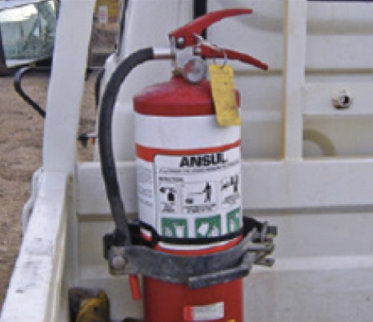
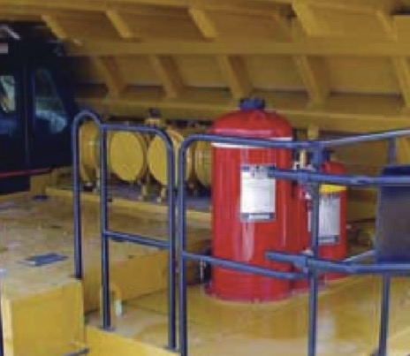
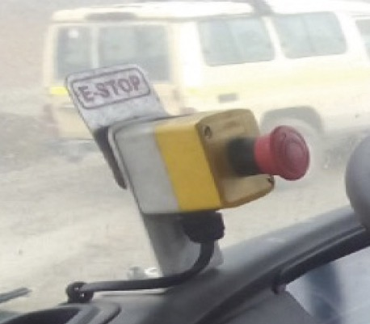
Emergency Safety Systems
  First aid kit
  Fire extinguisher
  Fire suppression system
  Emergency stop button
Notes:
Discuss the emergency safety systems that are in place to respond to an emergency situation.

Slide 8
Other Safety Systems
  Electronic braking systems
  Electronic stability control
  ABS
  Trailer stability control
  Reversing alarms
  Traction and descent control
  Wheel bearing temperature monitors.
Notes:
Discuss the manufacturer standard safety systems that are installed in mobile equipment and heavy vehicles.

Slide 9

Training
  It is your responsibility to ensure that you know how to operate the safety systems in your vehicle
Notes:
Explain that drivers and operators must ensure that they are fully aware of, and know how to operate, the safety systems installed in their vehicle.

Slide 10
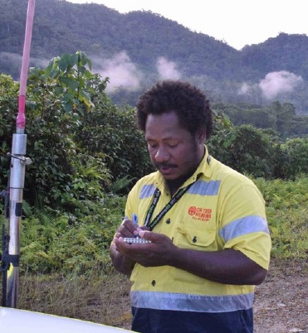
Inspection and Maintenance
Daily pre-start / post start inspection
Audited annually
Operator must:
  check for serviceability before use
  tag out and report faulty equipment
  make sure that planned maintenance is carried out
Notes:
Emphasise that the safety devices and features fitted to vehicles and mobile equipment must be inspected and maintained.
Discuss the operator’s role in making sure safety systems operate as expected.

