Slide 1
Vehicle Safety Systems
Awareness Package
Notes:
Welcome.
Introduce yourself.
Outline your experience.
Explain where the facilities are and any OHS issues if necessary
Timeframe for the course.
Handouts:
- Attendance Sheet - get all trainees to sign
- Training Material (Reference book, permits, etc).
Any questions?

Slide 2
Introduction
Know your vehicle
Operate within its capability and limitations
Observe and respond promptly to indicators and warning lights
Notes:
Explain that vehicles accessing and operating on OTML sites must be equipped with appropriate safety features and systems.
Briefly outline the vehicle safety systems in use.

Slide 3
Operator Obligations
Pre-start inspection
Report missing and faulty safety equipment
Tag out and do NOT use vehicle if safety equipment is missing or faulty
Respond promptly and correctly to safety system alarms
Ensure planned maintenance of safety equipment is undertaken
Notes:
Discuss the vehicle operators obligations in relation to safety equipment.

Slide 4
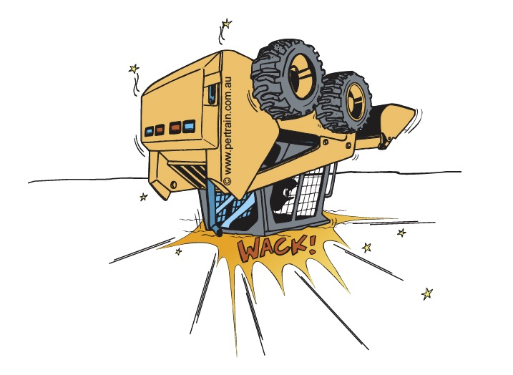
Cabin Safety Systems
Seatbelts
ROPS / FOPS
Notes:
Discuss the cabin safety systems that are in place to protect the operator and passengers if applicable.

Slide 5
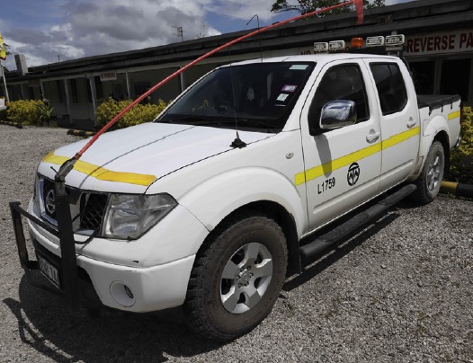
Visibility Safety Systems
Lights
Buggy whips
Horn signals
Notes:
Discuss the visibility safety systems that are in place to ensure vehicles are noticed.

Slide 6
Operational Safety Systems
Trakpro
SAFEmine Collision Avoidance System
ADAS Fatigue Management
Notes:
Discuss the operational safety systems that are in place to ensure vehicles are operated safely.

Slide 7
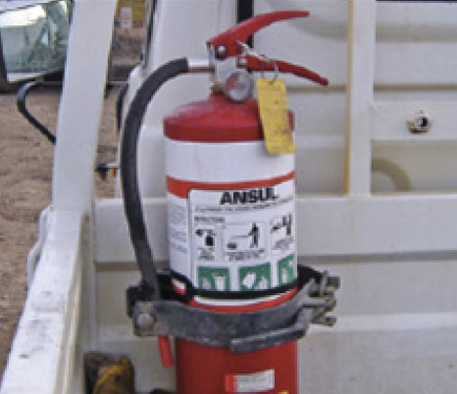
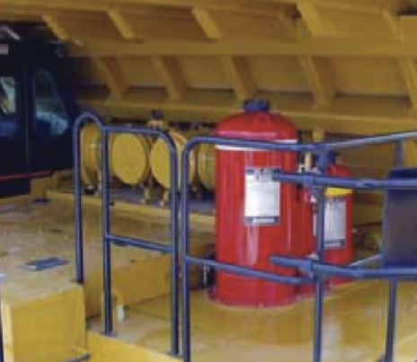
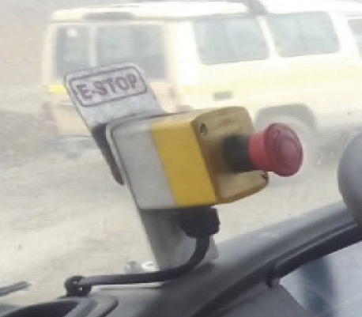
Emergency Safety Systems
First aid kit
Fire extinguisher
Fire suppression system
Emergency stop button
Notes:
Discuss the emergency safety systems that are in place to respond to an emergency situation.

Slide 8
Other Safety Systems
Electronic braking systems
Electronic stability control
ABS
Trailer stability control
Reversing alarms
Traction and descent control
Wheel bearing temperature monitors.
Notes:
Discuss the manufacturer standard safety systems that are installed in mobile equipment and heavy vehicles.

Slide 9
Training
It is your responsibility to ensure that you know how to operate the safety systems in your vehicle
Notes:
Explain that drivers and operators must ensure that they are fully aware of, and know how to operate, the safety systems installed in their vehicle.

Slide 10
Inspection and Maintenance
Daily pre-start / post start inspection
Audited annually
Operator must:
check for serviceability before use
tag out and report faulty equipment
make sure that planned maintenance is carried out
Notes:
Emphasise that the safety devices and features fitted to vehicles and mobile equipment must be inspected and maintained.
Discuss the operator’s role in making sure safety systems operate as expected.

