Slide 1
Driver Fitness for Work
Awareness Package
Notes:
Welcome.
Introduce yourself.
Outline your experience.
Explain where the facilities are and any OHS issues if necessary
Timeframe for the course.
Handouts:
- Attendance Sheet - get all trainees to sign
- Training Material (Reference book, permits, etc).
Any questions?

Slide 2
Introduction
Drivers must:
Be trained and authorised to operate vehicle
Have relevant Permit for vehicle and area
Have current driver’s licence for class of vehicle
Be mentally, emotionally and physically fit for work
Notes:
Discuss the requirements for driving at OTML.

Slide 3
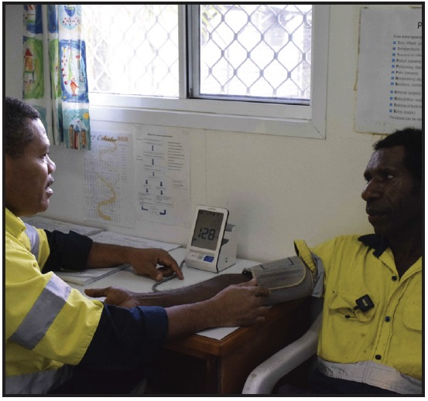
Fit for Work
Physically, mentally and emotionally able to perform your work safely and to required standard
Fitness for work can be affected by
fatigue
alcohol and drugs, including buai / betel nut
stress
physical difficulties
Fitness assessments may be conducted
If you are unfit for work
you cannot drive a vehicle / operate equipment
you may be removed from site
you will get a letter outlining the breach
you cannot return to work until you have met with Manger/Supervisor
Notes:
Explain what is meant by fit for work and what can affect your work fitness.
Discuss the requirements for fitness assessments
Describe the actions that will take place if a worker is found to be unfit for work.

Slide 4
Signs of Fatigue
Notes:
Explain what is meant by fatigue and the risks of being fatigued at work.
Discuss the signs of fatigue.

Slide 5
Controlling Fatigue
Get 7-8 hours of sleep
Have afternoon nap before night shift
Take care at roster change
Discuss fatigue issues with Supervisor and make changes if required
Get professional help if necessary
Notes:
Explain that fatigue is often caused by lack of sleep.
Discuss the actions to take to control fatigue.

Slide 6
OK Tedi Fatigue Management Guidelines
Notes:
Discuss the OTML fatigue management guidelines.
Emphasise that regardless of the length of shift, if a worker, Superintendent, or Supervisor assesses a worker as suffering fatigue, or being at risk from fatigue, the Superintendent or Supervisor will arrange a means of alternative travel home.

Slide 7
Alcohol and Drugs
ZERO TOLERANCE for alcohol and illicit drugs at work
Must have 0.000 BAC and negative drug test result
Alcohol and drugs can affect a person’s ability to:
stay awake and alert
react promptly
make good decisions
function normally physically
Symptoms of alcohol or drug use include:
unusual behaviour
increased near misses and incidents
deteriorating work performance
You must:
notify supervisor if taking medication
use medication as directed by doctor or manufacturer
cooperate and participate in alcohol and drug testing
Notes:
Emphasise that OTML has a zero tolerance for alcohol and illicit drugs at the work place.
Discuss the symptoms and risks of alcohol and drugs.
Empasise that this applies to all substances containing alcohol, drugs including amphetamines, barbiturates, benzodiazepines, cannabinoids, cocaine, LSD, methadone, and opiates, over-the-counter and prescription medication and betel nut.

Slide 8
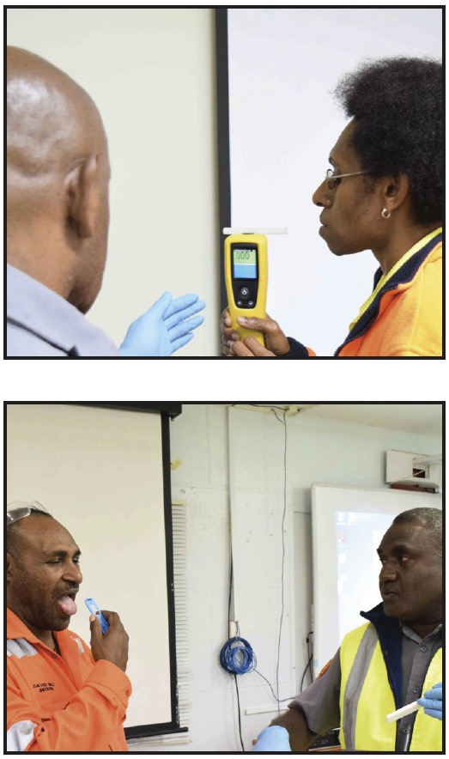
Alcohol and Drug Testing
Breath test for alcohol
Saliva test for drugs
Self-test kits
Do not tamper with test samples or results
Notes:
Discuss the process for alcohol and drug testing at OTML.

Slide 9
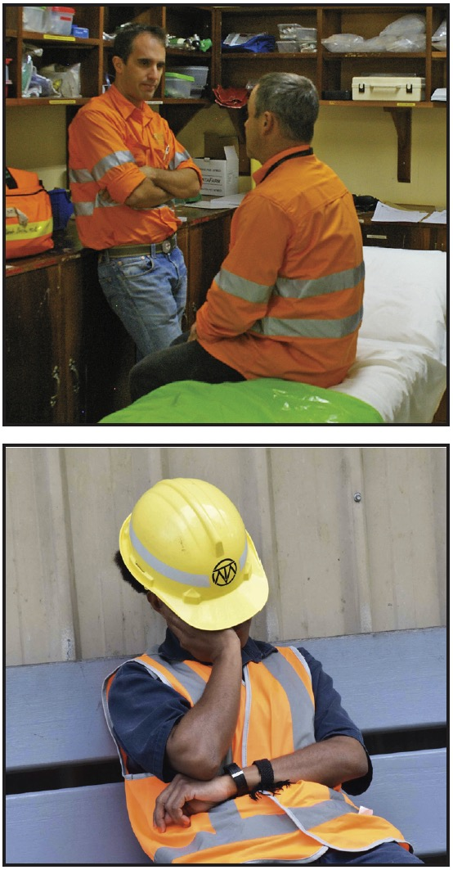
Other Causes of Fatigue
Physical illness or injury
Emotional issues and stress
Notes:
Discuss the other causes of fatigue.

