Slide 1
Vehicle Accident Prevention
Awareness Package
Notes:
Welcome.
Introduce yourself.
Outline your experience.
Explain where the facilities are and any OHS issues if necessary
Timeframe for the course.
Handouts:
- Attendance Sheet - get all trainees to sign
- Training Material (Reference book, permits, etc).
Any questions?

Slide 2

Introduction
  Driving is something we do every day
  Follow PNG Motor Act
  Adhere to Traffic Management Plans, including rules for:
  Speed limits
  Give way
  Overtaking
  U-turns
  Horn signals
  Separation requirements
  Minimum approach distances
  Park up
Notes:
Discuss the dangers of driving, and in particular the risks relating to driving at OTML.
Explain drivers must adhere to PNG Motor Act and Traffic Management Plans.

Slide 3


Safety
  You must comply with:
  Safety rules
  Regulations
  Policies
  Procedures
  You must be fit for work
  Follow general site rules
  Wear your seatbelt
Notes:
Discuss the safety requirements for operating vehicles on site.

Slide 4

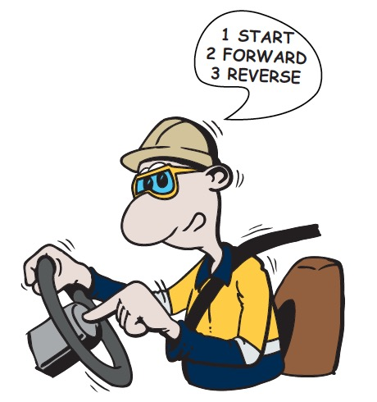
Communication
  When using the radio:
  Identify yourself and wait for confirmation
  Know site and emergency radio channels
  Inspect equipment before use
  Have spare power source
  Have more than one communication method
  Acknowledge communication directed at you
  No swearing or offensive language
  Do not use hand held mobile phone
  Obey signs
  Use horn signal
Notes:
Discuss the communication requirements when operating vehicles.

Slide 5
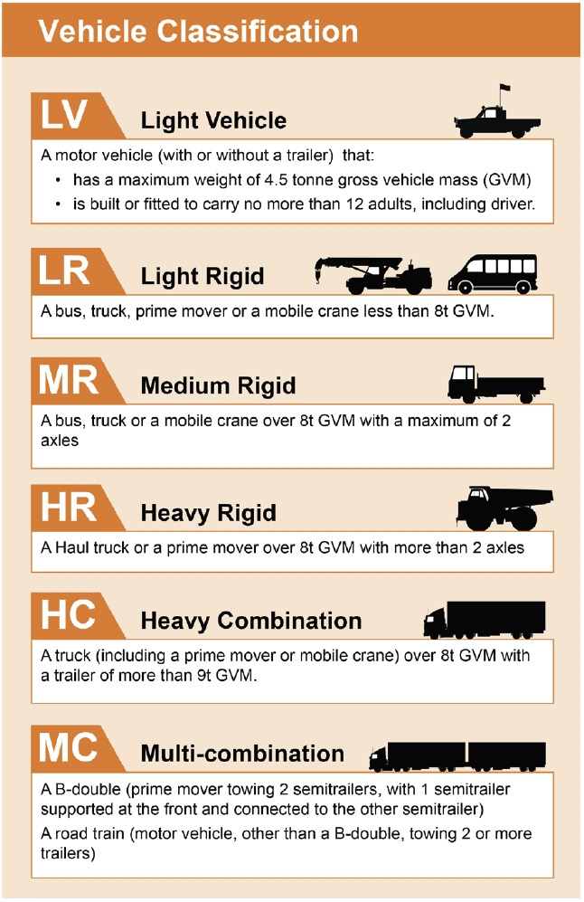
Operating Vehicles
  Right vehicle for task
  Check vehicle, tools and equipment before use
  Tag out faulty or damaged equipment
  Use indicators
  Know your vehicle and operate within capacity
  Respond to warnings
  Drive to conditions
Notes:
Discuss the considerations for operating vehicles.

Slide 6

Journey Management Plan
Details of driver and passengers
Destination
Day, date, time of departure and arrival
Route
Hazards
Resources and supplies
Agreed call in times
Notes:
Discuss the requirements for a Journey Management Plan.

Slide 7
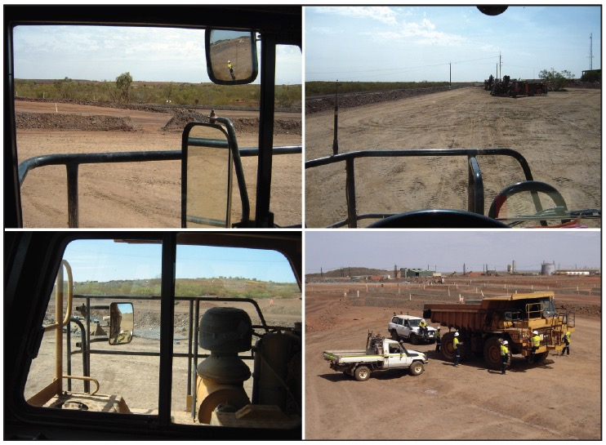
Blind Spots
Notes:
Discuss the blind spots that are around all vehicles and the guidelines you can follow to minimise the risks associated with blind spots.
Emphasise that the bigger the vehicle, the bigger the blind spots.

Slide 8
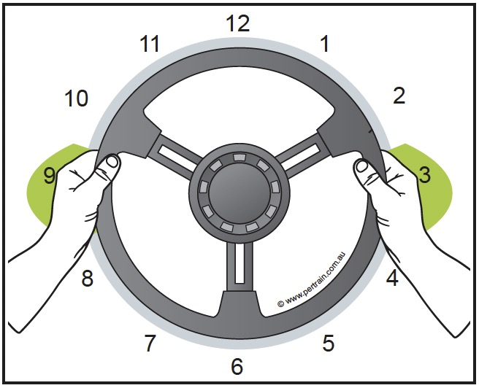
Driving Techniques
Adjust seat, mirror, steering wheel
Hands on opposite sides of steering wheel for greater control
Use hand over hand for turning
Do not let wheel slip through fingers
Do not put hand through steering wheel
Notes:
Discuss the general driving techniques.

Slide 9
Cornering
Slow down
Decelerate into the corner and accelerate out
Position the vehicle as far to the outside of the lane before turning to maximise vision
Maintain constant radius around the corner
Return steering to straight position on exit
Notes:
Discuss the procedure for safe cornering.

Slide 10
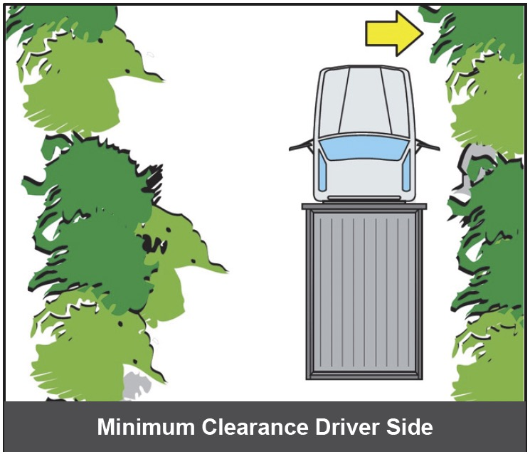
Reversing
Use mirrors, camera and your eyes
Some vehicles have audible proximity detectors
Maintain clearance on the driver side
Use a spotter
Notes:
Discuss the precautions to take when reversing.

Slide 11

Slowing and Braking
Use a combination of throttle, downshifting and brakes to slow
Stopping distance is affected by
  Driver reaction time
    The time it takes from recognising a hazard to applying the brake
    Usually about ¾ of a second
  Braking distance
    The distance the vehicle travels after the brake is applied
    Depends on brake construction and condition, weight of vehicle (loaded/unloaded)
    Speed
Notes:
Discuss the conditions that can affect stopping distance and the key considerations when braking.

Slide 12
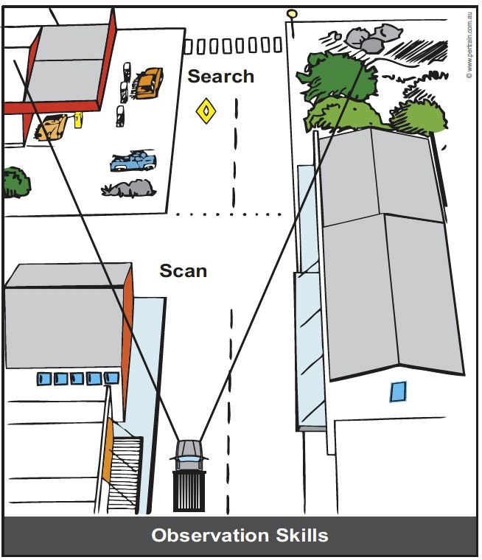
Observation Skills
12 seconds ahead
Frequently check mirrors
Scan
  Aim high
  Get the big picture
  Keep your eyes moving
  Have a way out
  Ensure you can be seen
Notes:
Discuss good observation skills.

Slide 13
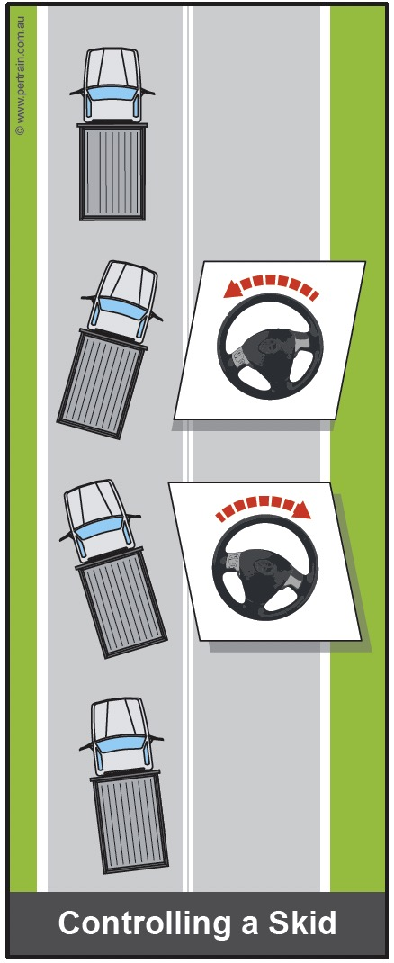
Dealing with Skids
No brake until vehicle slows
Turn steering wheel in direction you want to go
Turn steering wheel back the other way
Continue to correct steering
Notes:
Discuss the response to a skid.

Slide 14
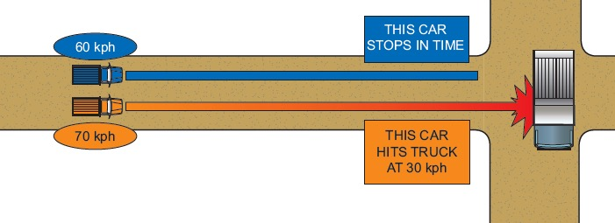
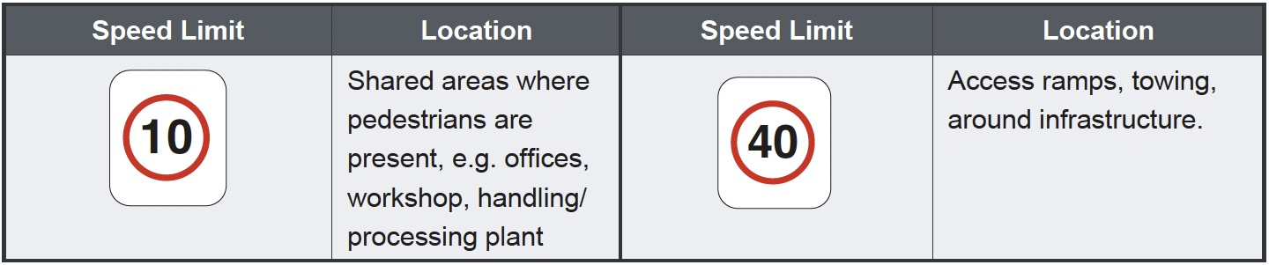
Speed Limits
Notes:
Discuss the effect of speed on braking distance and the consequences of a collision.
Discuss typical speed limits on site.

Slide 15
Traffic Flow
50 metres from travelling vehicle
Sound horn when approaching corner
In one-way traffic flow, observe traffic control lights
Approach intersections with caution
Drive around corners with care
Use a spotter
Notes:
Discuss the requirements for traffic flow safety.

Slide 16

U-Turns
Check if U-turns are permitted
Notes:
Discuss the requirements for doing a U-turn on site and on a public road.
Emphasise that U-turns are not permitted on ramps in open cut operations.

Slide 17
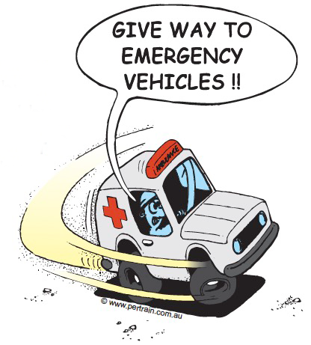
Right of Way
These vehicles have right of way
  Emergency vehicles with flashing lights
  Road maintenance plant working on the road
  Operating production vehicles
Notes:
Discuss which vehicles have right of way.

Slide 18
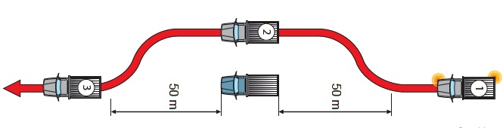
Overtaking / Passing
Use the MLBMLC method when changing lanes:
Mirror - Look - Blinker - Mirror - Look - Change
Notes:
Discuss the requirements for overtaking or passing another vehicle.
Explain the MLBMLC medthod.

Slide 19

Parking
  Site parking regulations
  Park in designated area
  Separate parking areas
  Away from operating equipment and highwalls
  Level ground
  Clear of traffic
  Park in a v-drain or over a hump or chock wheels
  Keep rotating beacon on in operational area
  Reverse park if possible
  Manufacturer recommendation
  Fundamentally stable (Neutral or park gear, park brake applied)
  Lower implements
  Do not leave load suspended
  If leaving vehicle, turn ignition off and remove keys
Notes:
Discuss the guidelines for parking vehicles on site

Slide 20
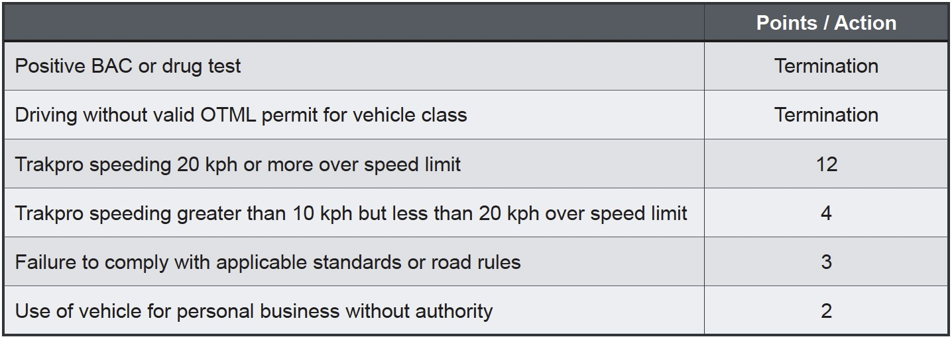
Non-Compliance
Notes:
Discuss the consequences of non-compliance.

