Slide 1
Vehicle Accident Prevention
Awareness Package
Notes:
Welcome.
Introduce yourself.
Outline your experience.
Explain where the facilities are and any OHS issues if necessary
Timeframe for the course.
Handouts:
- Attendance Sheet - get all trainees to sign
- Training Material (Reference book, permits, etc).
Any questions?

Slide 2
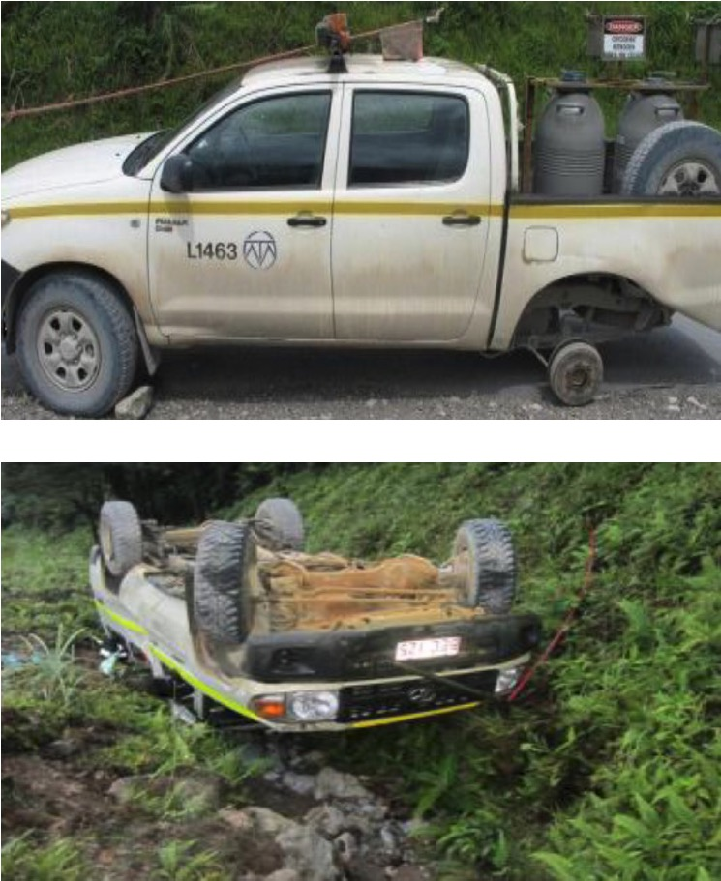
Introduction
  Driving is something we do every day
  It can be the most dangerous thing we do
  The consequences of vehicle accidents can include injury and death
  Low risk driving behaviours help to prevent vehicle accidents
  Plan the trip
  Be fit and competent
  Take rest breaks
  Drive to conditions
  Be respectful of others
Notes:
Discuss the dangers of driving, and in particular the risks relating to driving at OTML.
Globally: Nearly 1.3 million people die in road crashes each year (That is more than twice the number of workers at OTML each day!)m and an additional 20-50 million are injured or disabled.Global statistics from Association for Safe International Road Travel (ASIRT), http://asirt.org/initiatives/informing-road-users/road-safety-facts/road-crash-statistics.
Briefly outline the low risk driving behaviours that can help to prevent accidents. These will be discussed in more detail throughout this awareness training.

Slide 3
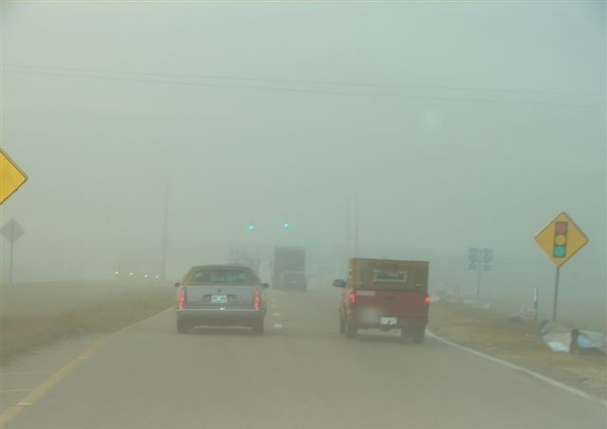
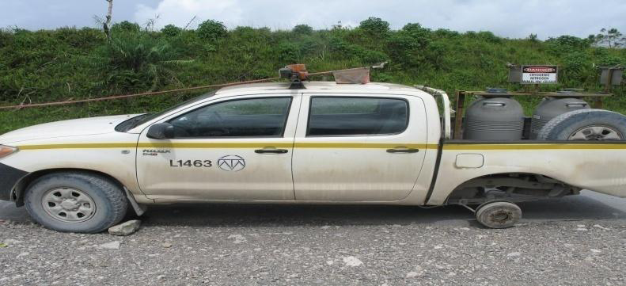
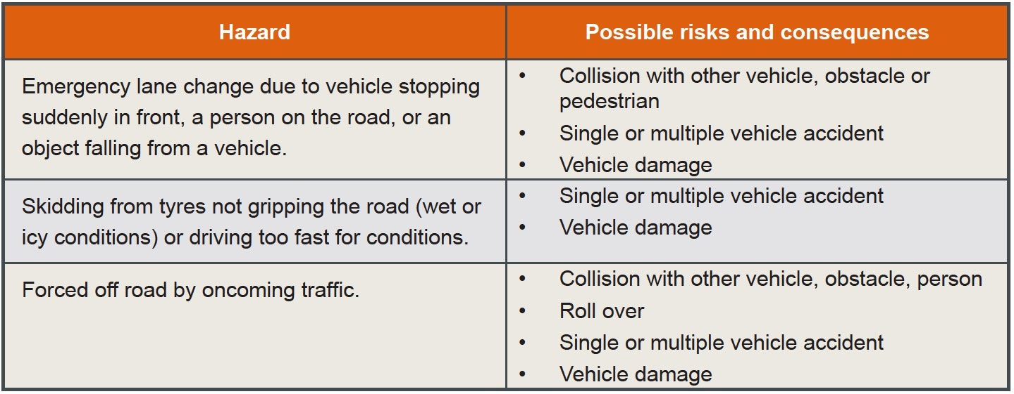

Driving Hazards
  Environment
  Vehicle
  People
Notes:
Driving hazards basically fall into 3 categories:
the environment (including weather, road and ground conditions, road design, slopes)
the vehicle (improper maintenance, tyre tread/wear/pressure, system failure, breakdown)
people – drivers and pedestrians (inattention, inexperience, stress/emotions, over confident, under the influence of alcohol or drugs)

Slide 4

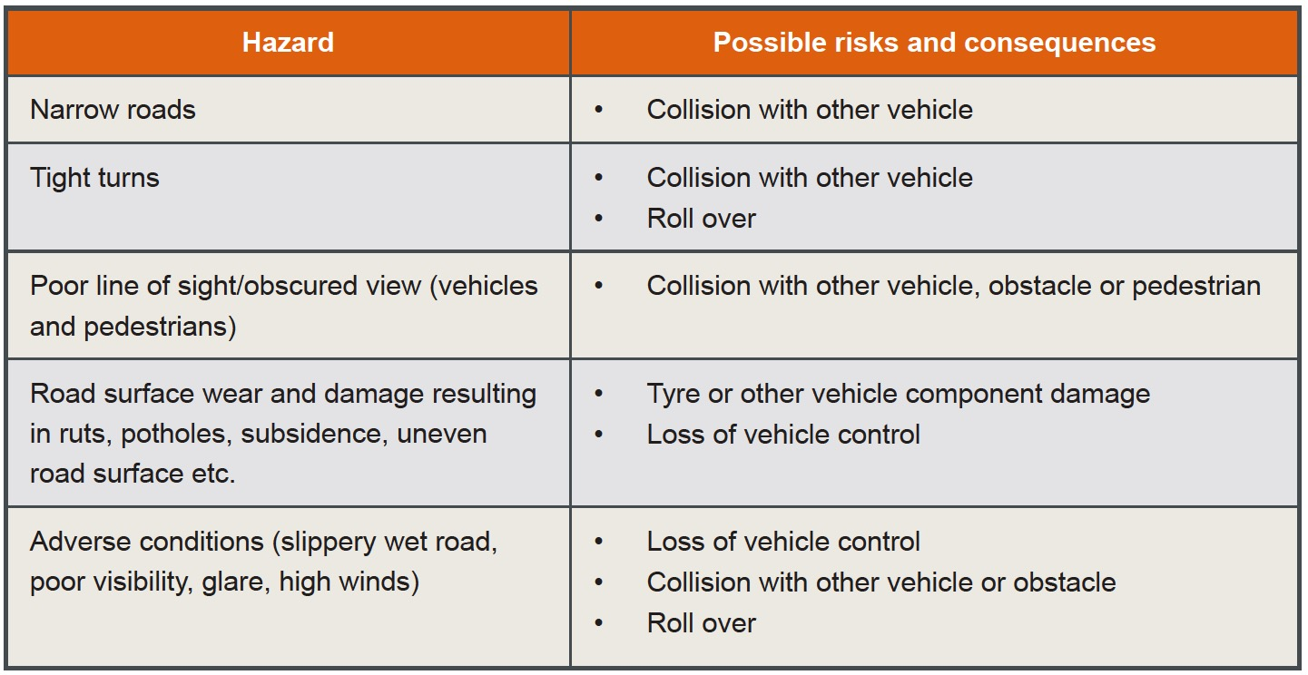
Road Design and Maintenance Hazards
Notes:
Discuss common road design and maintenance hazards and the controls that can minimise the risks related to these hazards.
Designated areas
Construction standards
Access control
Traffic flow, speed, etc
Signs.

Slide 5
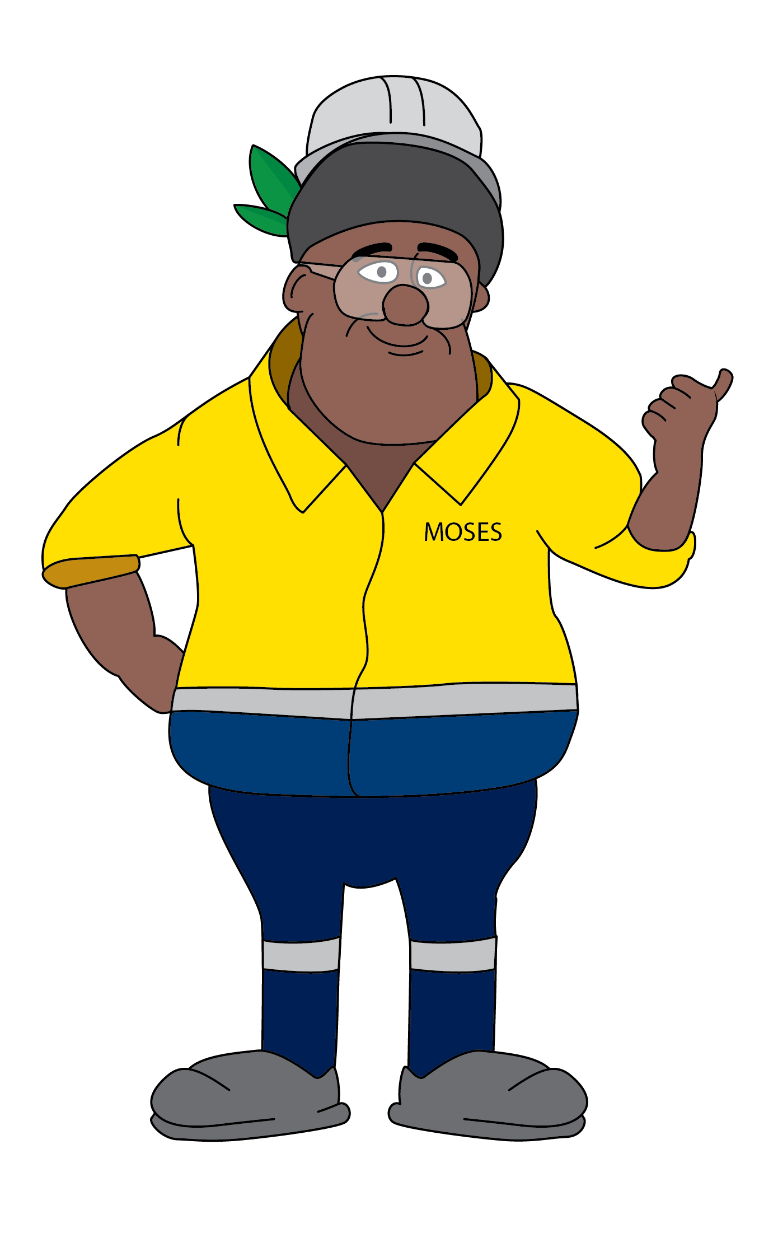
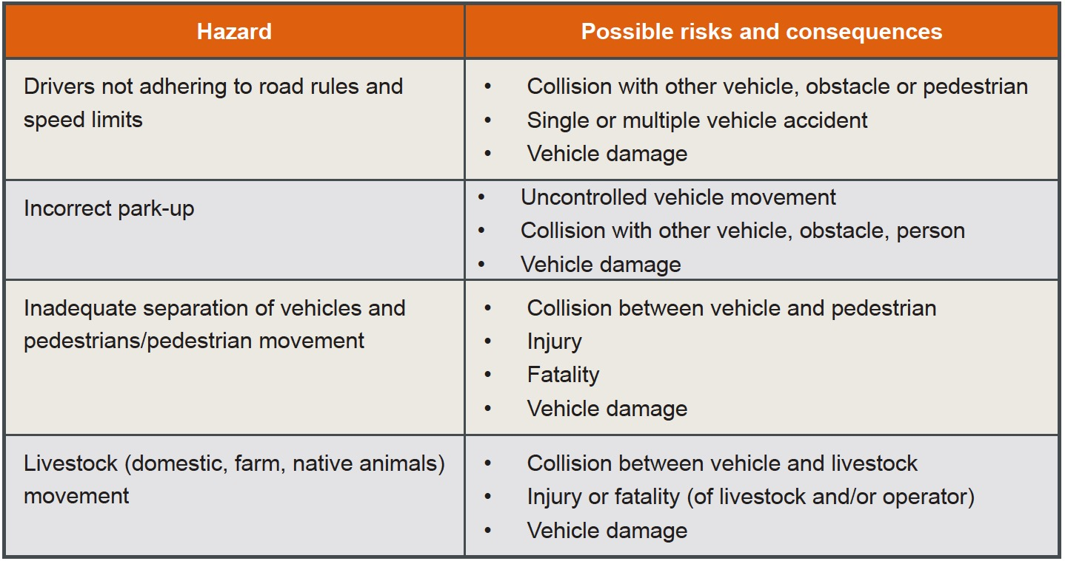
Traffic Management Hazards
Notes:
Discuss common traffic management hazards and the controls that can minimise the risks related to these hazards.
Signs and signals
Surface marking
Lighting
Barriers
Detours
Traffic Management Plans.

Slide 6
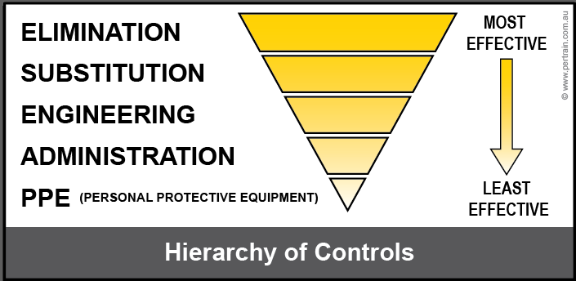
Controls
  Use and apply the hierarchy of controls
Notes:
Revise the hierarchy of controls and the importance of choosing controls from the most effective to the lease effective.
Group Discussion: Ask the trainees how they would use the hierarchy of controls for preventing vehicle accidents (Note there are suggestions in the resource book, so have the participants close their books for this part of the discussion):
How would they eliminate the hazards?
What could be substituted?
How can the hazard be engineered out or isolated from personnel?
What administrative controls are available onsite?
What type of PPE would minimise the likelihood and consequences of vehicle accidents?
Explain that from an operator’s point of view the best way to operate a vehicle safely is for the operator to:
know the vehicle
be authorised/licenced and competent to use it
be fit for work
comply with road rules and safety requirements
recognised changing conditions and adjust the driving technique to suit.

Slide 7
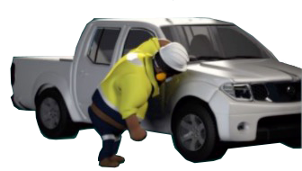
Check the Vehicle
Vehicles on site must be:
Registered
Insured
Serviced regularly
Used for purpose within the equipment’s limits and capability as per manufacturer’s manual
Notes:
Discuss the requirements for vehicles on site.

Slide 8
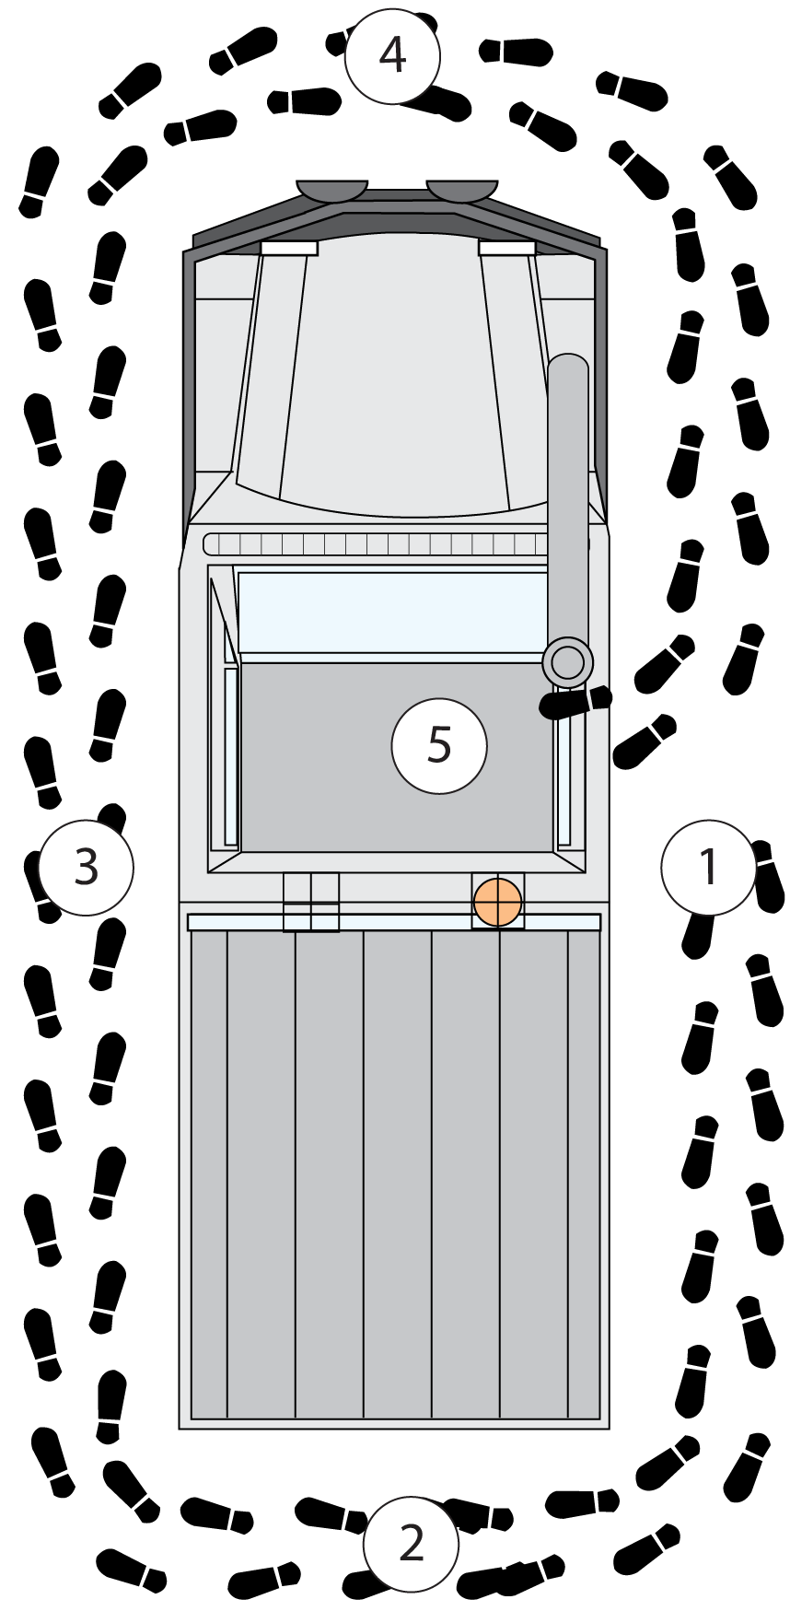
Always Start with a Pre-Start
  Start at the drivers door and walk completely around the vehicle.
  Complete the checklist as you go:
  No damage to body, clean tray
  Lights / signals clean and undamaged
  Tyres (including spare) properly
  inflated / good tread / no cracks or deformation
  Wheel nuts, wheel studs and mounts are
  secure / none missing or damaged
  No fluid leaks under /around vehicle
  No obvious damage to chassis, suspension
  Windows clean / no cracks
  Security of bullbar, winch, whip, snorkel,
  spotter lights, flashing beacon, etc
  Check fluid levels as per manual
Notes:
Take the learners on a walk around a light vehicle.
Using the prestart checklist booklet, discuss and demonstrate the checks that must be performed on the outside of the vehicle.
Fluid levels may include engine oil, radiator and coolant, brake oil, transmission fluid, power steering fluid, battery water level, windscreen washer water.

Slide 9
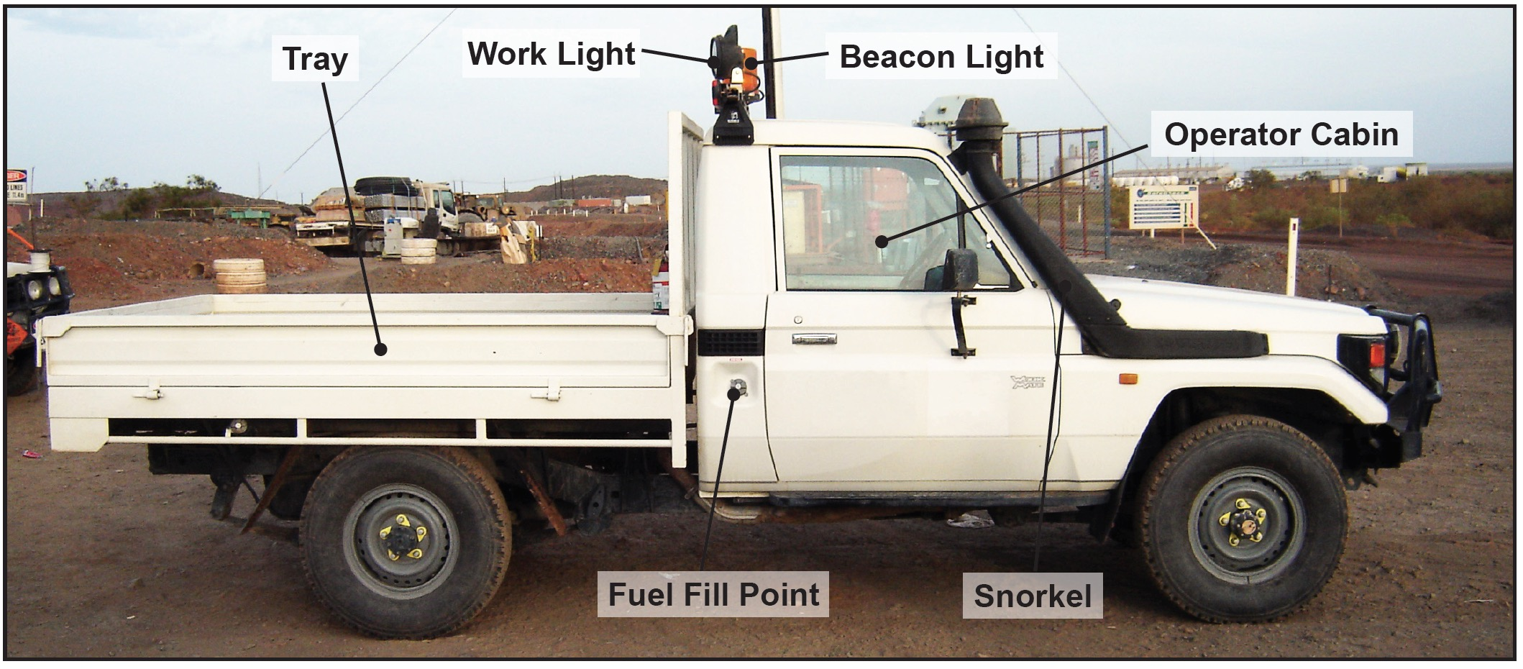
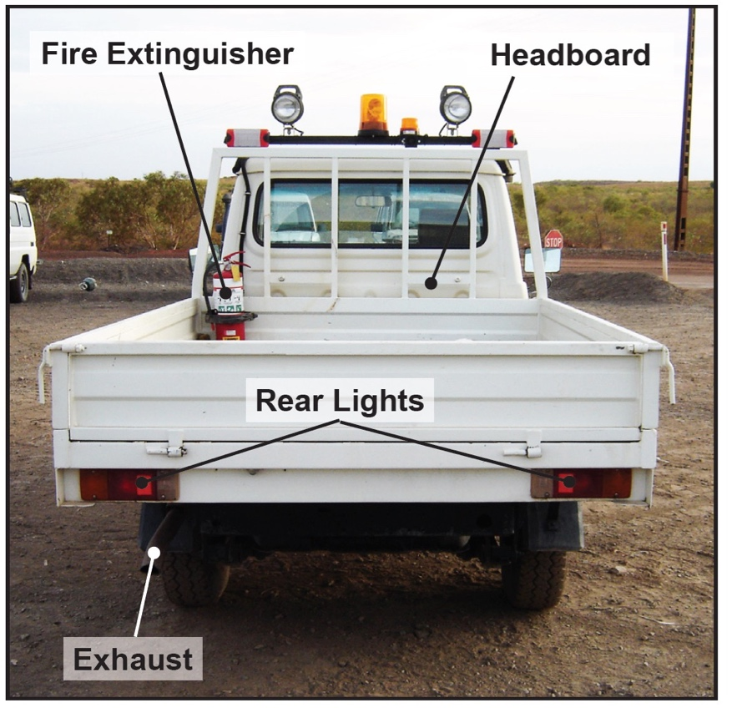
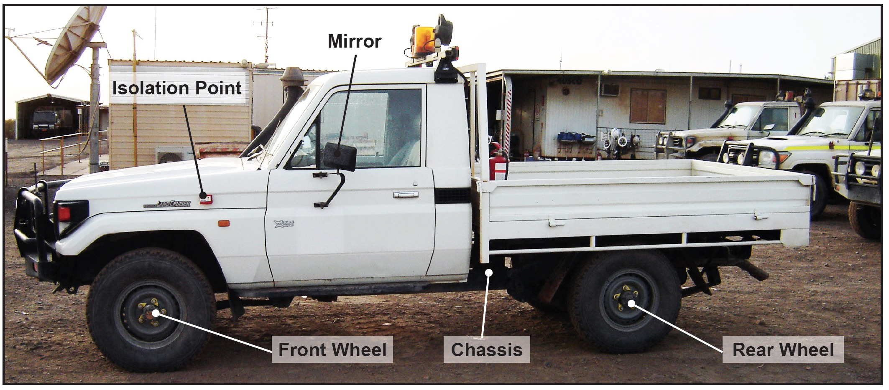
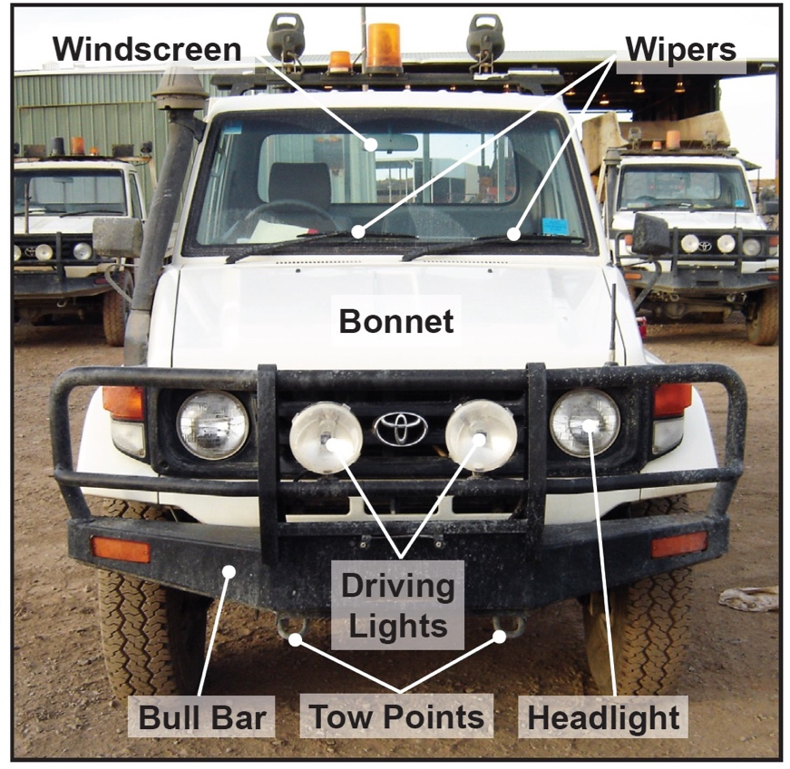
Typical Light Vehicle
Notes:
If it is not practicable to do a walk around inspection of a real vehicle, use these photos to discuss the various inspection points.
Emphasise that all vehicles differ and inspection points should be as per the vehicle manufacturer manual (which should be kept in the glove box).

Slide 10
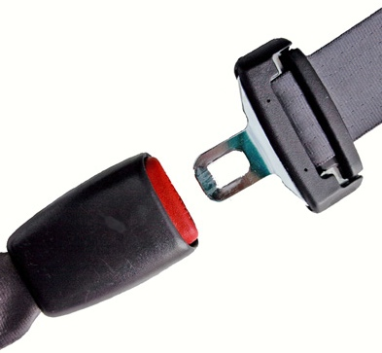
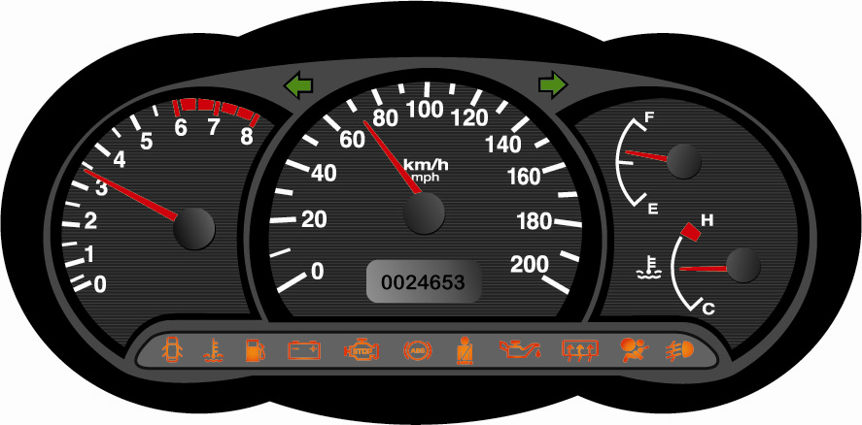
Pre-start Inspections
  Enter the vehicle cabin and check:
  Vehicle authorised for site
  No Out of Service, Danger or Information Tags
  Cabin clean and free of debris
  Seatbelt undamaged
  Mirrors clean and undamaged
  Check vehicle is in park and brake is applied
  Start engine and check:
  Instrument gauges
  Warning lights
  Operation of lights, washer/wipers,
  brakes and steering
  Two-way radio
Notes:
Discuss and demonstrate the checks that must be performed inside the vehicle, before and after starting the engine.
Remind participants that if the engine is cold, allow it to warm up at idle speed for 1-3 minutes before checking gauges and warning lights.

Slide 11
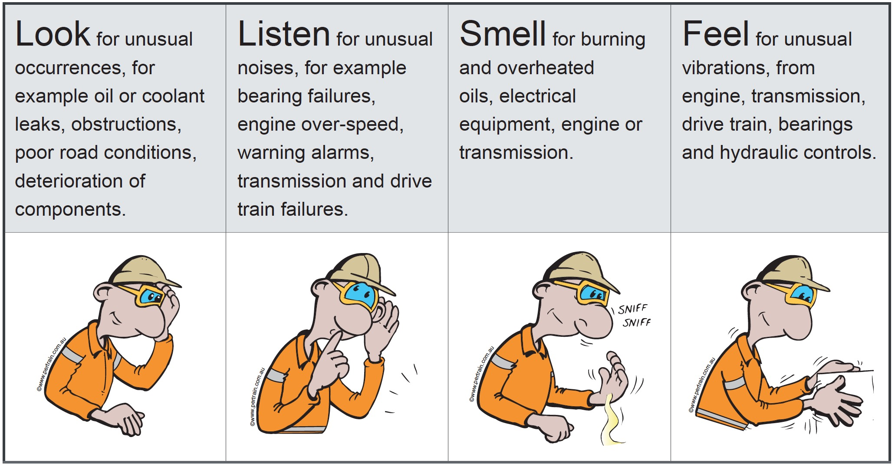
Use all Your Senses at Startup and During Operations
Notes:
Emphasise that if something is wrong there is usually some sort of warning - a strange sound, vibration, smell, etc.
Use all your senses during start-up and operation.

Slide 12

What to do with Damaged or Faulty Vehicle
  Do not use damaged or faulty equipment.
  Remove the key.
  Put an Out of Service tag on the steering wheel.
  Report the fault/damage to your supervisor or maintenance.
  If you are driving:
  Pull over safely
  Apply brake and stop engine
  Contact supervisor or maintenance.
  If stopped on a road stay visible:
  Rotating beacon and hazard lights.
  Witches hats
  Radio other road users.
Notes:
If something doesn’t seem right, it probably isn’t.
Do not operate faulty or damaged equipment.
Tag it out of service and report it for maintenance.

Slide 13

Other Operator Controls
  Only operate vehicles that you are trained, licenced and authorised to operate
  Advise your supervisor if you lose your licence
  Be fit for work:
  No alcohol or drugs
  Not fatigued or stressed
  Take rest breaks every 2 hours when driving
  Stop and rest if tired
  Comply with road rules
  Wear seatbelt
  Follow speed limits
  No mobile phones (unless hands free)
  Drive to conditions
Notes:
Discuss the other operator controls:
Training and authorisation
Fit for work
Comply with road rules
Do not use mobile phone when driving
Drive to conditions, e.g. slow down in wet conditions.

Slide 14
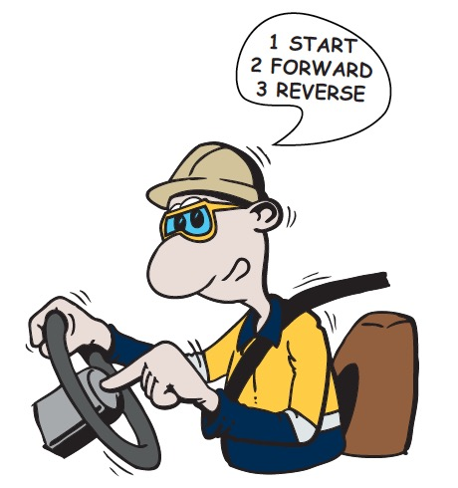
Driving Techniques
Operate vehicle in a safe manner
Monitor vehicle indicators and gauges
Respond to alarms and indicators
Use vehicle within the limits and capability set by the manufacturer
Use horn signals to indicate your intention
Wait 5-10 seconds to allow others to respond before moving
Ensure smooth gear changes
Do not ‘ride’ the clutch (if applicable)
You have less control at high speed in a high gear
Hands should be on opposite sides of the steering wheel
Notes:
Discuss the driving techniques that can help to prevent vehicle accidents.

Slide 15
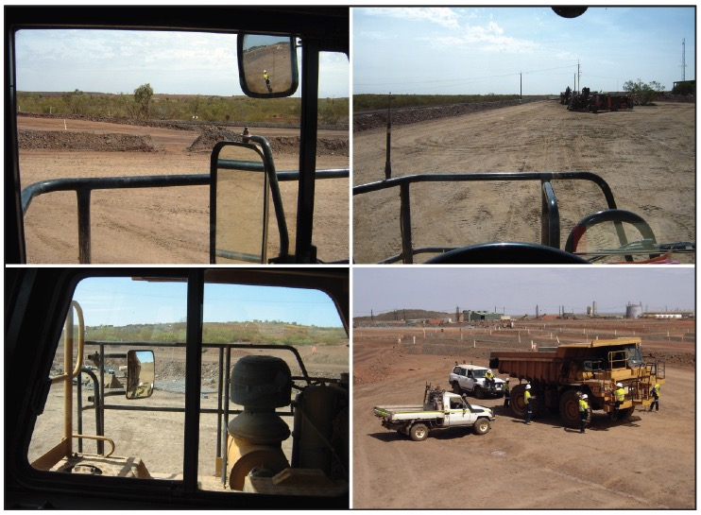
Blind Spots
Notes:
Using the photo, discuss the blind spots that are around all vehicles and the guidelines you can follow to minimise the risks associated with blind spots.
Discuss the controls that a pedestrian must apply to minimise the risks associated with vehicle blind spots
Separation/safe distance
Assume you cannot be seen (this is much safer than assuming you can be/have been seen)
Do not position yourself between vehicles
Stay on designated walkways
Wear hi-vis clothes.

Slide 16
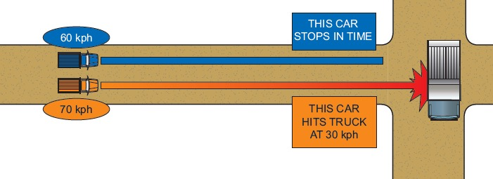
Speed
Notes:
Discuss the effect of speed on breaking distance and the consequences of a collision.

Slide 17
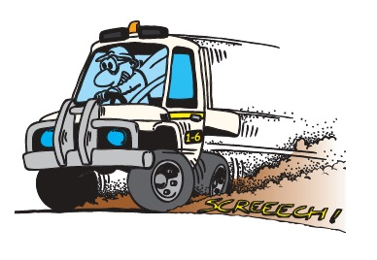
Slowing and Braking
Use a combination of throttle, downshifting and brakes to slow
Stopping distance is affected by
  Driver reaction time
    The time it takes from recognising a hazard to applying the brake
    Usually about ¾ of a second
  Braking distance
    The distance the vehicle travels after the brake is applied
    Depends on brake construction and condition, weight of vehicle (loaded/unloaded)
    Speed.
Notes:
Discuss the conditions that can affect stopping distance and the key considerations when braking.

Slide 18

U-Turns
Check if U-turns are permitted
Ensure there is no traffic for at least 200m
Do not enter a U-turn at speed and under power
No U-turns at traffic lights unless signed
Notes:
Discuss the requirements for doing a U-turn on site and on a public road.

Slide 19
Cornering
Slow down
Decelerate into the corner and accelerate out
Position the vehicle as far to the outside of the lane before turning to maximise vision
Maintain constant radius around the corner
Return steering to straight
position on exit
Notes:
Discuss the procedure for safe cornering.

Slide 20
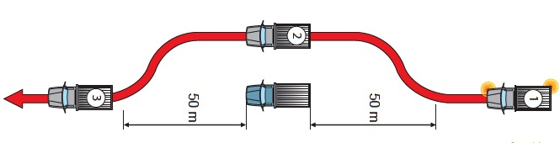
Overtaking / Passing
Use the MLBMLC method when changing lanes:
Mirror - Look - Blinker - Mirror - Look - Change
Notes:
Discuss the requirements for overtaking or passing another vehicle.
Explain the MLBMLC medthod.

Slide 21
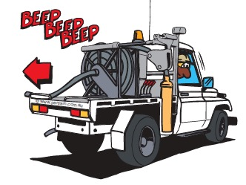
Reversing
Use mirrors, camera and your eyes
Some vehicles have audible proximity detectors
Maintain clearance on the driver side
Use a spotter
Notes:
Discuss the precautions to take when reversing.

Slide 22
10 Commandments of Driving
Look up and read ahead
Trust no one
Leave a safety cushion when stationary
Leave a safety cushion when moving off
Leave a safety cushion when mobile
Change lanes using the MLBMLC system
Use your mirrors when driving
Use your mirrors before braking
Know your road rules
Concentrate
Notes:
Discuss the ten commandments of driving.

Slide 23
Parking
  Park in designated area
  Make sure vehicle is fundamentally stable (will not move when transmission is in neutral and park brake is not applied)
  When the vehicle is stable
  shift transmission into park
  apply park brake
  turn engine off
  secure vehicle
  Other parking guidelines
  Park up vehicle according to manufacturer’s guidelines
  park on level ground, clear of other traffic
  Park in a v-dran or over a hump or chock wheels
  Park so you can drive forward when leaving unless otherwise signed
  Do not leave vehicle
    if there are passengers in it
    If the engine is running
Notes:
Discuss the guidelines for parking vehicles on site

Slide 24
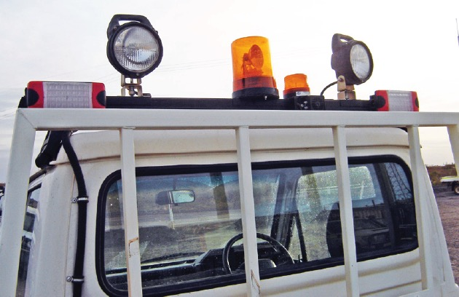
Parking in Operational Areas
Do not park within 50m of operating equipment
Make positive contact with equipment operators
Park on safe, level ground
Stay visible:
  Keep rotating beacon on
  Do not park:
    Where you will create a
    hazard for other traffic
    behind other equipment
    near a corner
Notes:
Discuss the additional requirements when parking in an operational area.

Slide 25
Park-up for Refuelling
No smoking, naked flames or mobile phone use in refuelling area
Coordinate with personnel in the work/refuelling area
Refuel at a designated fuel bay
Approach at low speed
When in position:
  transmission in park
  apply brake
  shut down engine
  exit vehicle
  stay within refueller’s line of sight
  Passengers must also exit the vehicle before refuelling
Notes:
Discuss the additional requirements when parking to refuel.

Slide 26
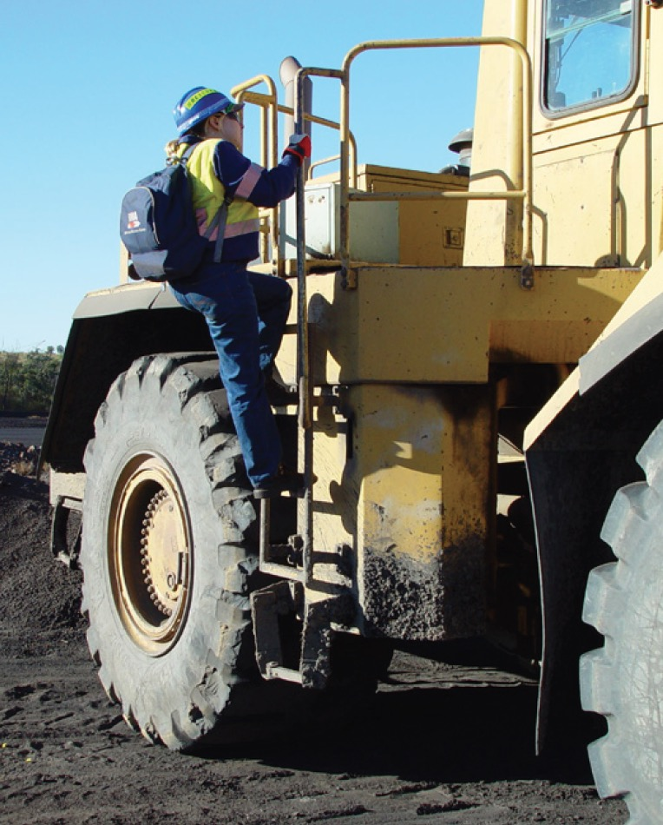
Dismounting
Use ladders, non-slip steps and hand holds
Ensure steps and hand holds are clean and undamaged
Face towards the machine when using steps
3 points of contact
Never dismount when machine is moving
Do not use controls as hand holds
Keep body and clothes away from pinch points
Before stepping off, check ground
Notes:
Discuss the safe way to dismount a vehicle (especially a heavy vehicle)

Slide 27
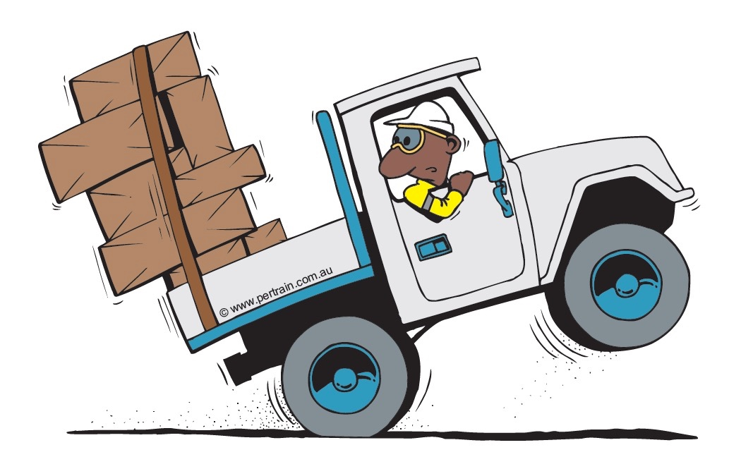
Loads
You are legally responsible for your load
Separate cargo and driver / operator
Stay within legal and vehicle limits
Spread load across axles
Keep centre of gravity low
Check dimensions do not exceed clearances along the route
Make overhangs conspicuous
Be trained in, inspect and use suitable load restraint method:
  Tie down
  Direct restraint
Check restraints
When unloading passengers or cargo,
consider:
  Other traffic in the area
  Ground conditions
  Other work happening in the area
Notes:
Discuss the requirements for loading, restraining the load and unloading a vehicle.

Slide 28
Incidents Involving Vehicles
Any action you take in responding to an incident must not make the situation worse. You must:
NOT place yourself in unnecessary danger
NOT inflict further injuries when moving an already injured person
Understand, memorise and use the correct emergency procedures
Contact your supervisor
Place hazard signs to warn others of an immediate hazard.
Notes:
Briefly outline the requirements for responding to an incident involving vehicles.
These points will be discussed in more detail with the next few slides.

Slide 29
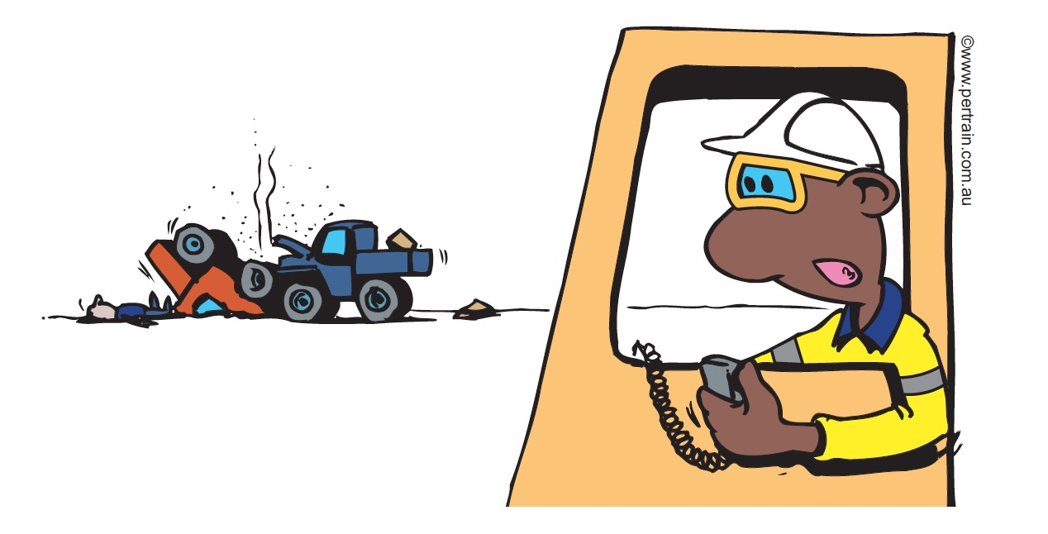
Witnessing a Vehicle Incident
Do not disturb the scene except to save a life or prevent further injury
Activate hazard lights, place safety cones to warn other vehicles
Administer first aid
Report the incident and provide directions to the site
If the incident happens off site, make a full and detailed record, including:
  time and place
  drivers name and address
  licence number/s
  registration and insurance details
If the incident happens on site,
follow the incident reporting
process
Notes:
Discuss the actions to take if you are first onto the scene of a vehicle accident.

Slide 30
Equipment Runaway
  If you lose control of a vehicle while driving:
  Apply the brakes
  Change down gears
  Ease vehicle into a safety barricade
  Do NOT:
  Attempt to jump into or out of a moving vehicle
  Put the transmission in the opposite direction to the vehicle movement
Notes:
Discuss the actions to take if you lose control of the vehicle while driving.
Emphasise that personnel must NEVER try to jump into or out of a moving vehicle as the risk of being run over is extreme.

Slide 31
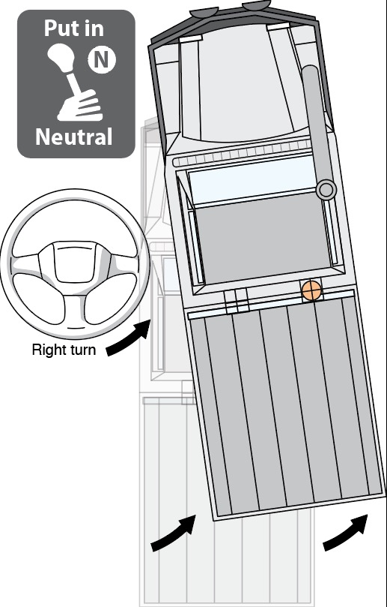
What to do if a Wheel Comes Off
  If a wheel comes off while you are driving:
  Don't panic! stay calm
  Keep your hands on the wheel
  Keep your eyes open
  Shift into Neutral, to stop power to the wheels.
  Steer into the skid
  Don't slam on the brake
  Drive out of danger before stopping
  the vehicle and getting out
  Contact supervisor or maintenance
  Report the incident
  Ensure the vehicle goes to the workshop to have tyre, rim, nuts etc checked
Notes:
Discuss the actions to take if a wheel comes off while you are operating the vehicle.

Slide 32
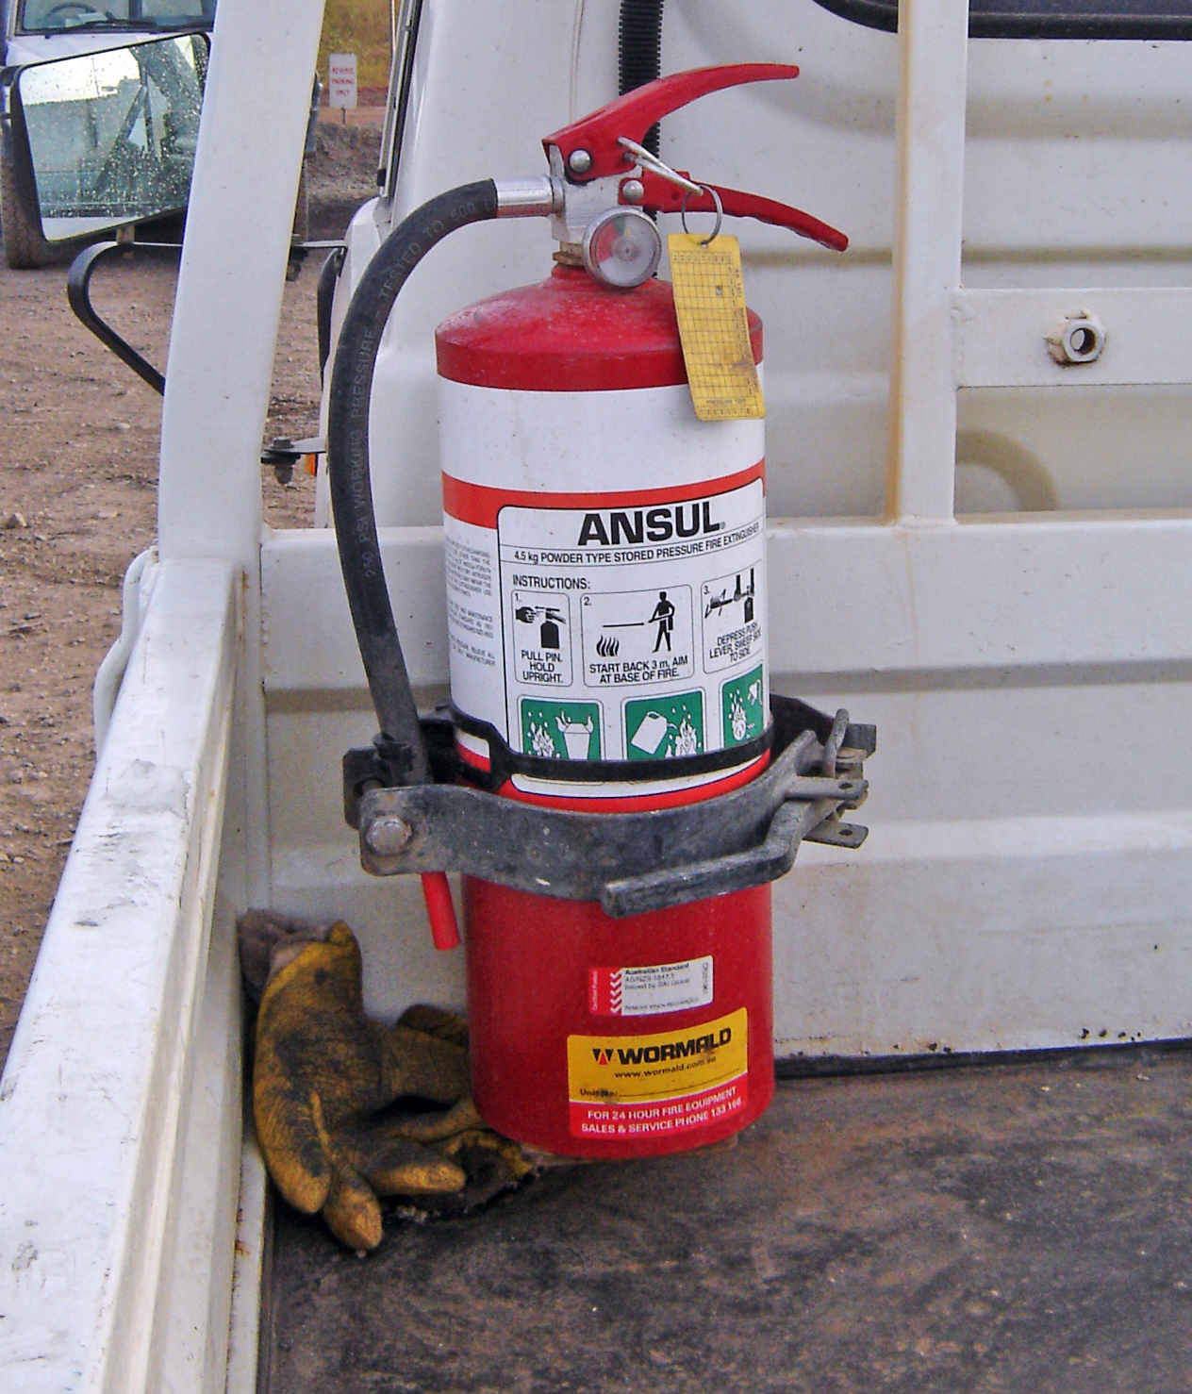
Fire
  Stop safely
  Lower load/attachments (if applicable)
  Put vehicle in neutral and apply brake
  Shut down engine
  Activate fire suppression (if needed)
  Use the radio to call an emergency
  Evacuate the cabin
  Take and use the fire extinguisher (if safe)
  Withdraw to a safe distance
  Set up an exclusion zone and wait for emergency personnel
  Do not put yourself in danger!
Notes:
Discuss the actions to take if a fire breaks out on the vehicle you are operating.

Slide 33
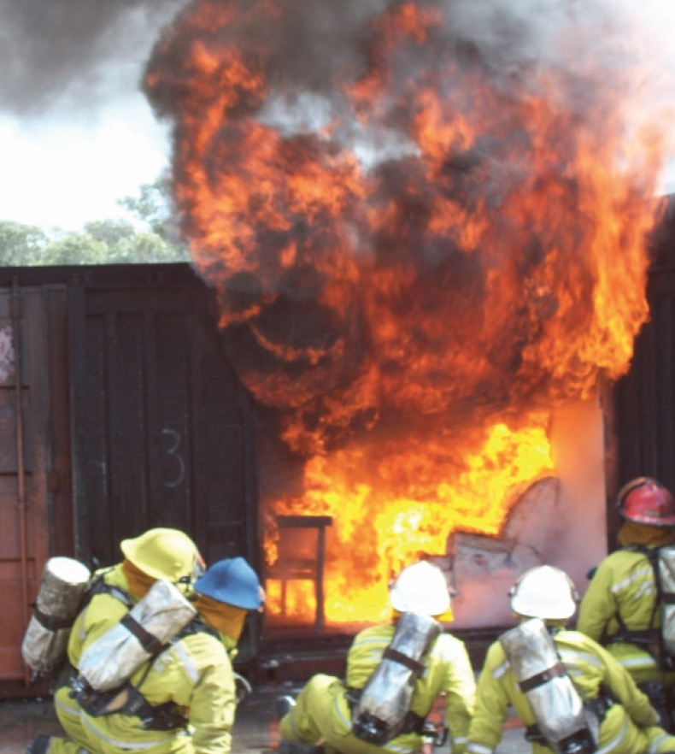
Emergency Response Personnel
  Trained and authorised
  Respond in line with OTML Emergency Response Plan
  Use emergency equipment
Notes:
Discuss the role of emergency response personnel.

Slide 34

Summary
  Personnel, contractors and visitors are responsible for operating vehicles safely and efficiently by:
  Obeying road rules
  No drugs or alcohol when operating a vehicle
  Driving vehicles that are inspected regularly and roadworthy
  Being considerate of other road users
  Driving to conditions
  Parking in designated parking areas
  Making sure that the vehicle is fundamentally stable
  Reporting all incidents.
Notes:
Summarise the main points from the training session.
Ask the trainees if there are any questions or comments about the training.
Ask trainees to complete evaluation form (if applicable).
Check everyone has signed the attendance sheet.

