Slide 1
Health for Life
Awareness Package

Slide 2

Introduction
What would happen if you got sick and could no longer work? How would your family cope without you?
The health and well being of our people is a priority at Ok Tedi.
Ok Tedi’s Employee Health and Wellness Program has been designed to help you:
Assess your own health
Access professional help when needed
Make healthy choices that can lead to better health for life.

Slide 3
What are the Major Health Hazards facing OTML?
Major health hazards facing OTML workers include:
Malaria
Tuberculosis (TB)
Diarrheal diseases (spread by poor hygiene)
Acute respiratory disease (Flu, Pneumonia, etc.)
Lifestyle illnesses such as:
  High blood pressure
  Coronary artery (heart) disease
  Diabetes
  Obesity
Fatigue
HIV / Aids
Alcohol and drugs, including smoking and betel nut.

Slide 4
The Life-long Health Journey
  Think of life-long health as a journey.
  You need a map (The Health for Life Book)
  You might need a tune up (See your Doctor for a health assessment)
  You need the right fuel (Plenty of fresh fruit and vegetables and water)
  You must choose the right path for you (Everyone is different, do what is right for you)
  You should enjoy the ride (It is not a race to get somewhere, it is about making healthy choices and changes for life)

Slide 5
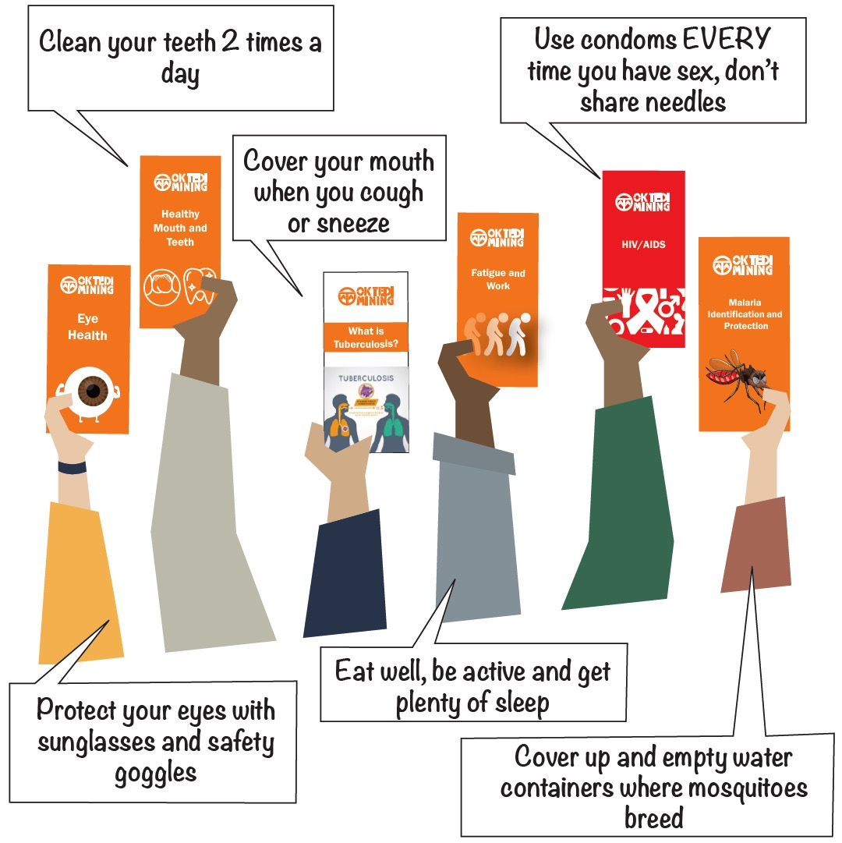
Controls
Your health is in your hands:
  Eat well
  Move more
  Quit drugs (including alcohol,
  smoking, betel nut)
  Be happy.
  Refer to the OTML Intranet for
  resources and information on
  how to be healthy for life.

