Slide 1
Confined Space
Awareness Package

Slide 2
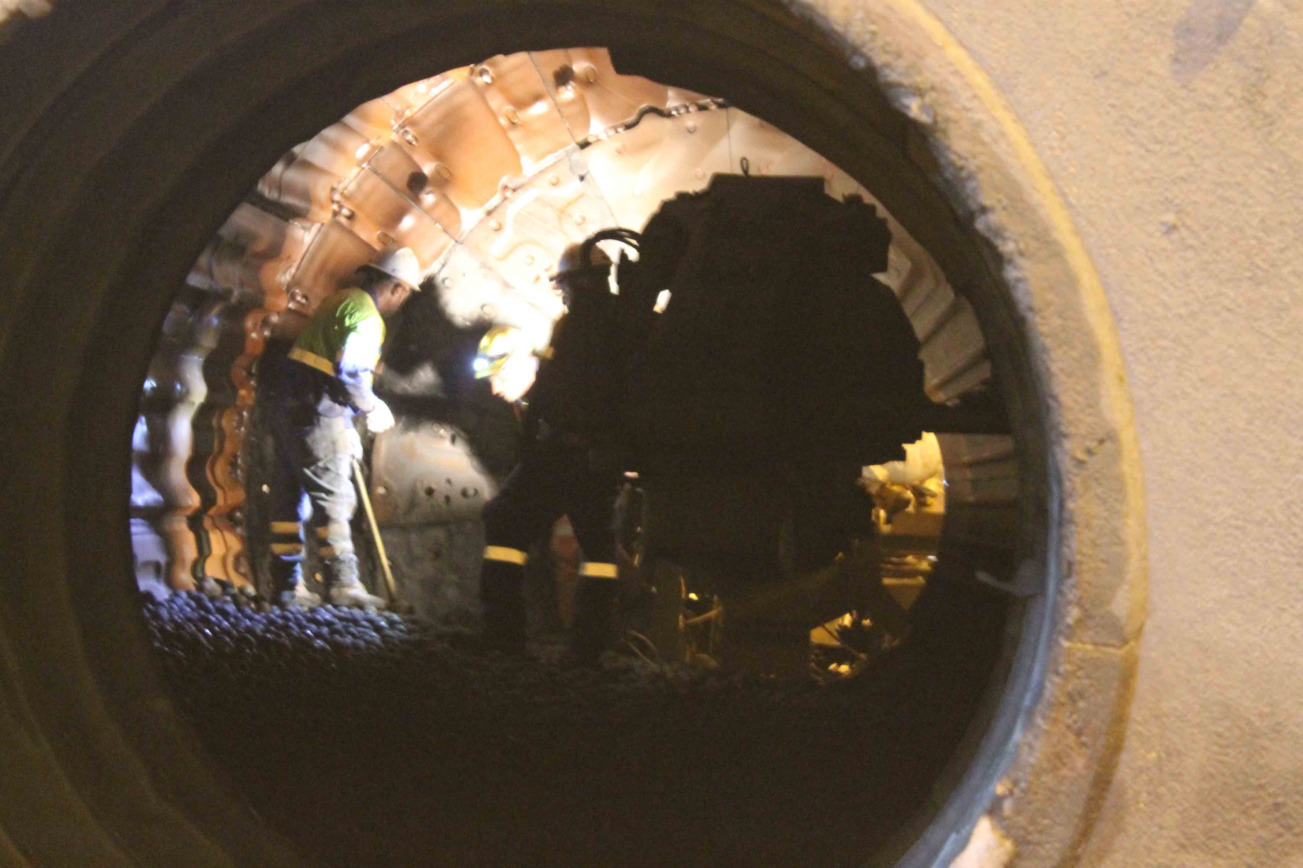
Introduction
A confined space is an enclosed space that is not designed for human occupancy, and has:
an oxygen concentration outside the safe oxygen range
a concentration of toxic or flammable airborne contaminants
the potential for engulfment that can cause suffocation or drowning

Slide 3
Confined Space Risks
One of the greatest risks when working in a confined space is that the atmosphere may be:
Toxic (containing gases such as carbon monoxide or particles such as dust or silica, that can cause illness and death)
Unbreathable (Oxygen is less than 19.5% or more than 23.5%)
Flammable or explosive.
Other risks include:
Engulfment
Heat related illness
Musculosketal injury
Contact with mechanical or electrical energy
Dust, noise, poor light
Vermin.

Slide 4
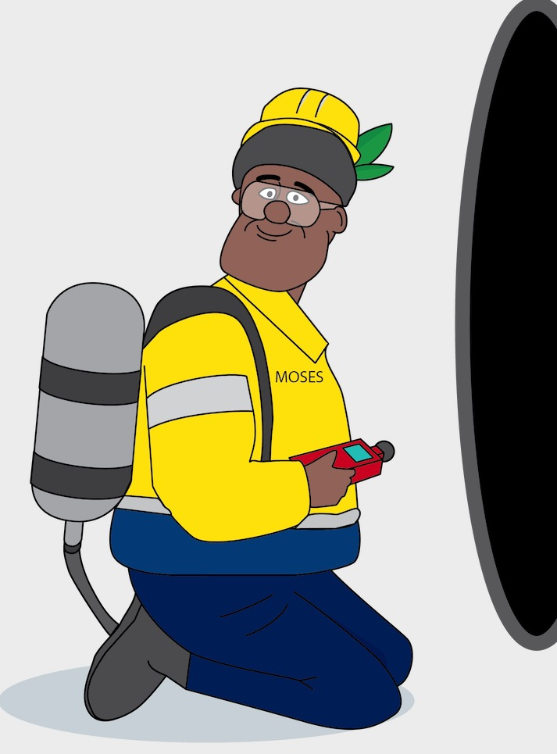
Controls
Be competent and authorised to work in a confined space
An authority to work and all listed controls must be in place before the task begins
Gas testing must be undertaken before anyone enters the confined space
Breathing apparatus may be required
A Standby person must remain outside the space at all times while personnel are inside the confined space
Follow procedures

Slide 5
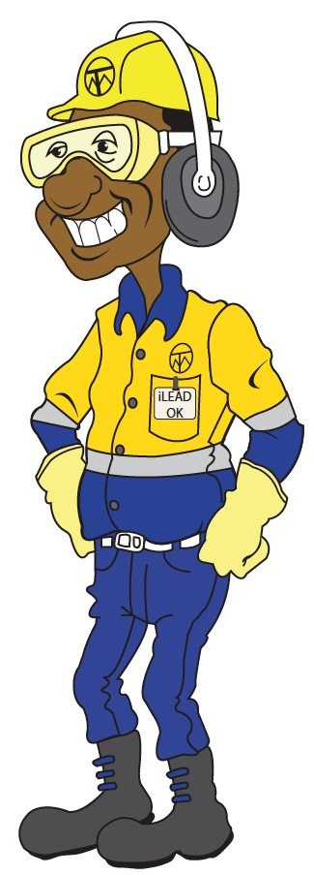
Confined Space Key Controls
Click below to watch a short video about the key controls
for confined space hazards.

